Slide 1
DATABASE 2
RDF Group Project
Team Protegers
Muhammad Ali
Abdur Rehman
Muhammad Hashsham Ullah

Slide 2
Dataset Graph Ontology Notebook RDF Data Queries
OUTLINE

Slide 3
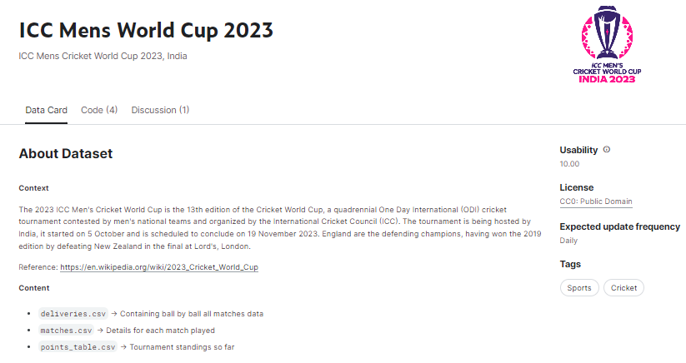
Dataset
Get The Data Here
https://www.kaggle.com/datasets/pardeep19singh/icc-mens-world-cup-2023

Slide 4
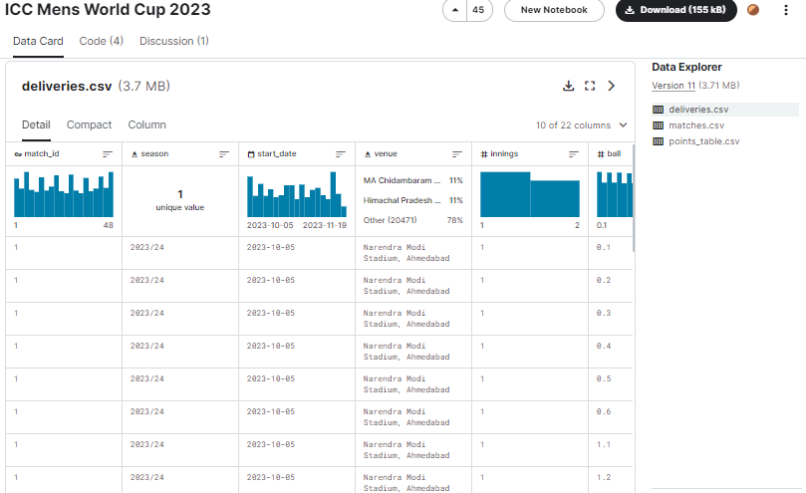
Dataset
Get The Data Here
https://www.kaggle.com/datasets/pardeep19singh/icc-mens-world-cup-2023

Slide 5
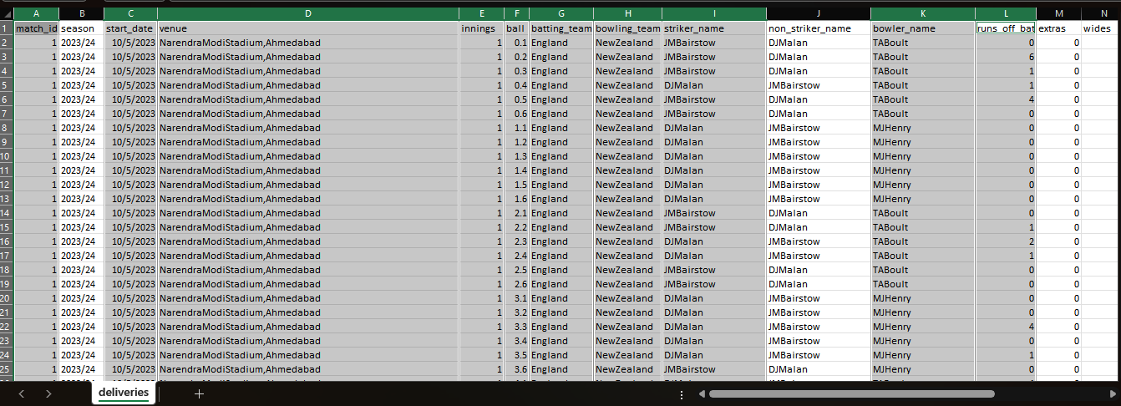
Dataset
deliveries.csv

Slide 6
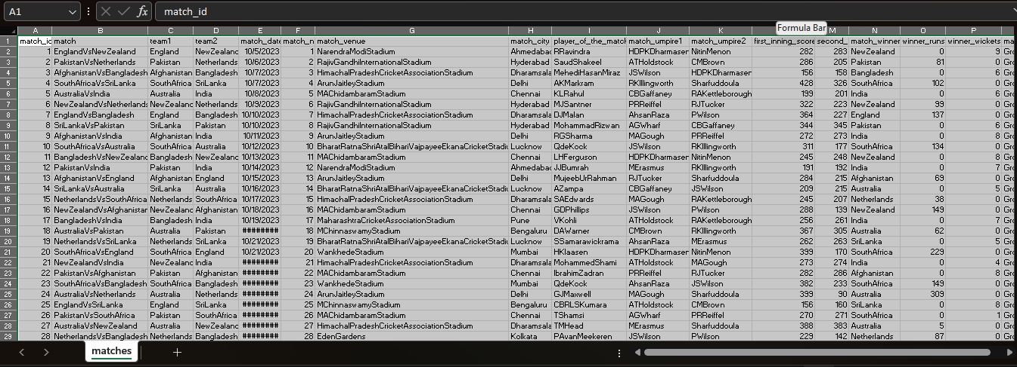
Dataset
matches.csv

Slide 7
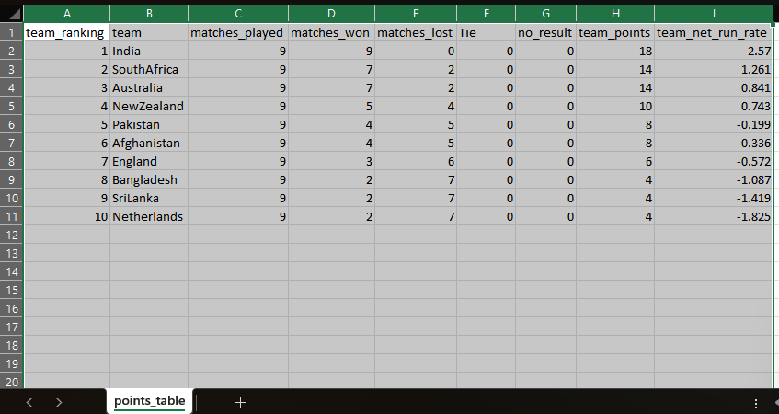
Dataset
points_table.csv

Slide 8
Dataset Graph Ontology Notebook RDF Data Queries
OUTLINE

Slide 9
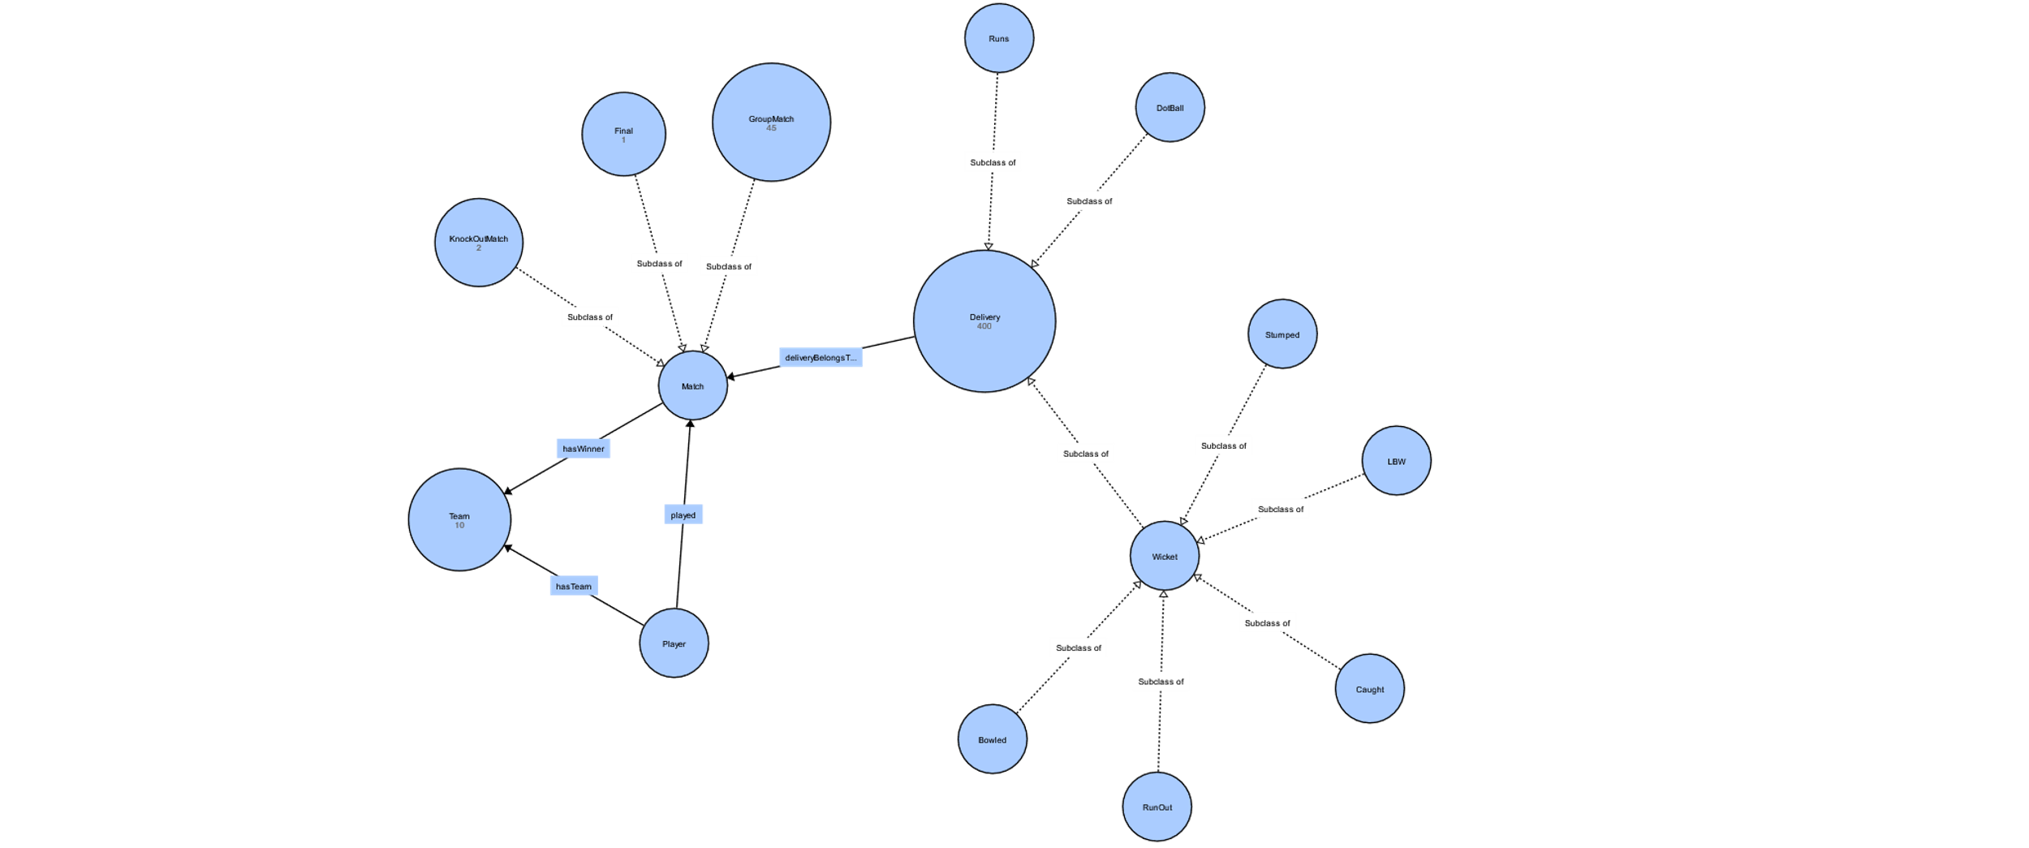
Graph
/

Slide 10
Dataset Graph Ontology Notebook RDF Data Queries
OUTLINE

Slide 11
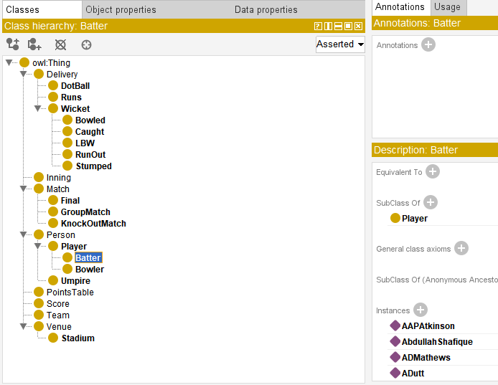
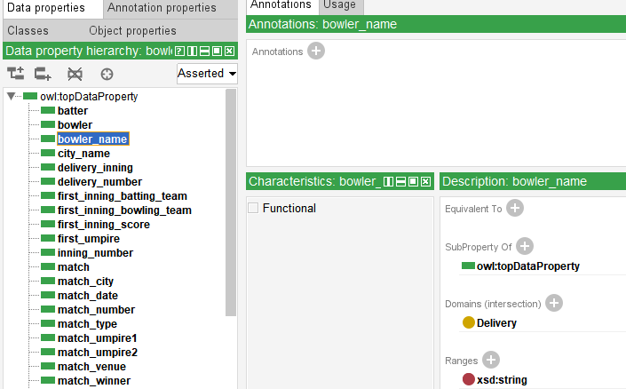
Ontology (Classes & Data Properties)

Slide 12
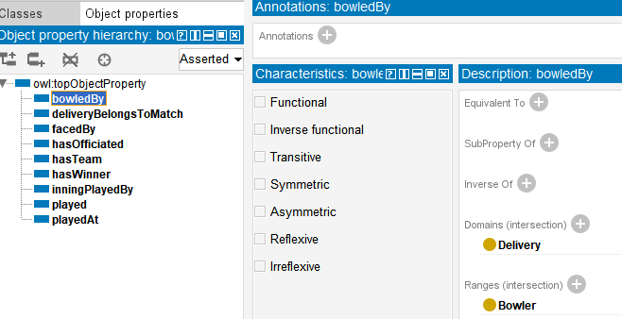
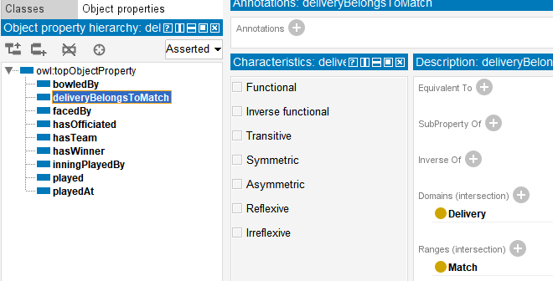
Ontology (Object Properties)

Slide 13
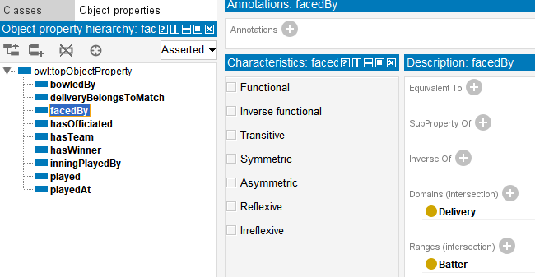
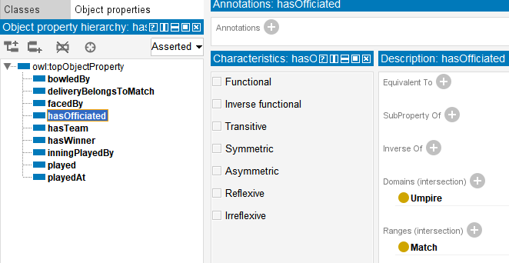
Ontology (Object Properties)

Slide 14
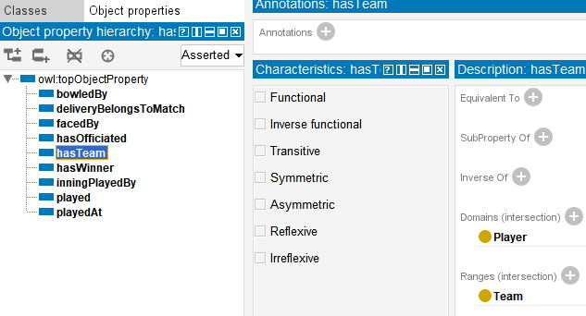
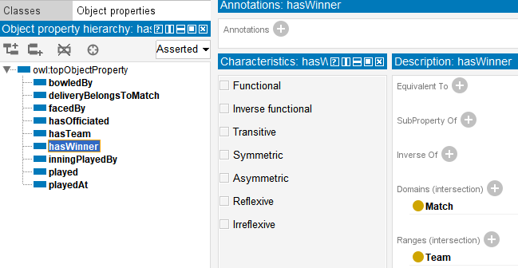
Ontology (Object Properties)

Slide 15
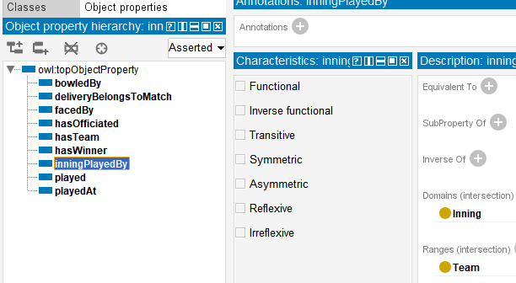
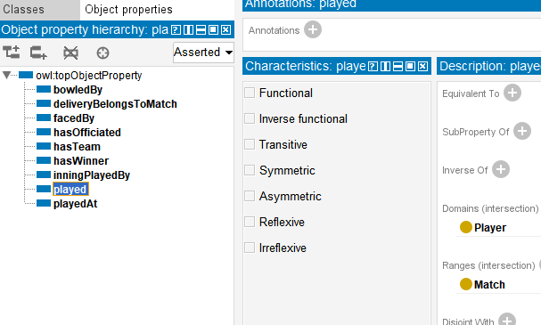
Ontology (Object Properties)

Slide 16
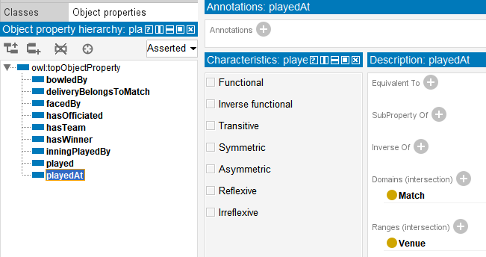
Ontology (Object Properties)

Slide 17
Dataset Graph Ontology Notebook RDF Data Queries
OUTLINE

Slide 18
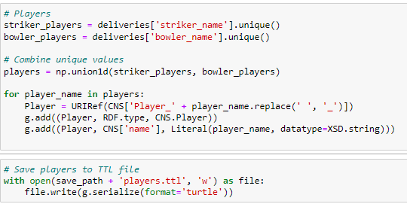
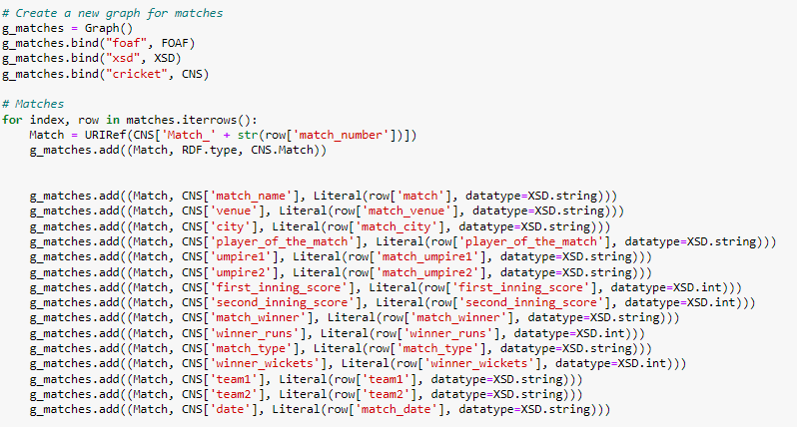
Notebook

Slide 19
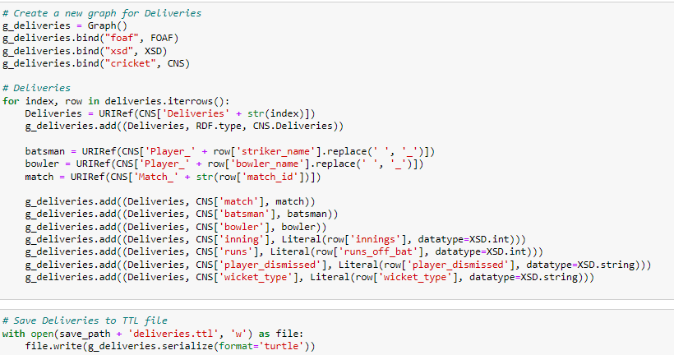
Notebook

Slide 20
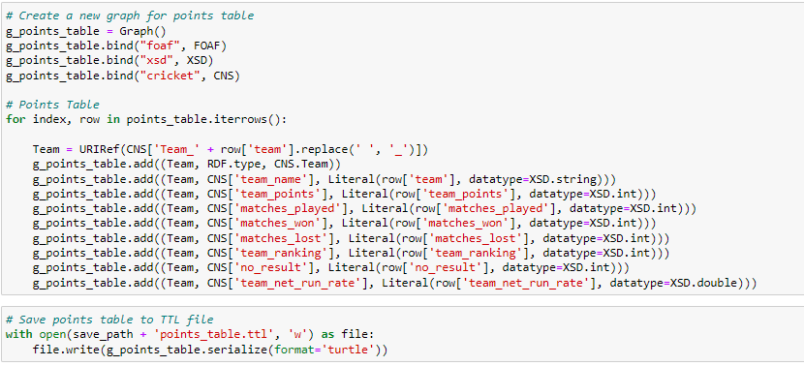
Notebook

Slide 21
Dataset Graph Ontology Notebook RDF Data Queries
OUTLINE

Slide 22
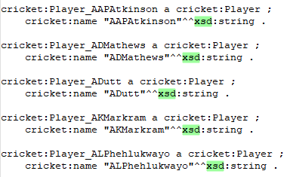
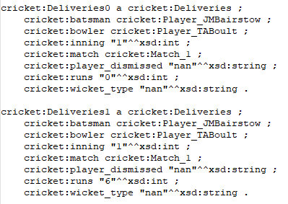
RDF Data
Players
Deliveries

Slide 23
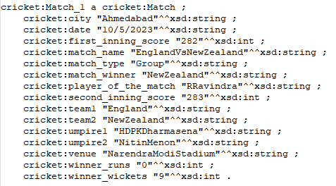
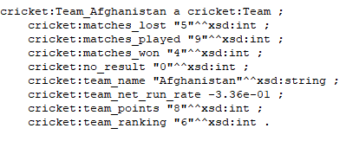
RDF Data
Matches
Points Table

Slide 24
Dataset Graph Ontology Notebook RDF Data Queries
OUTLINE

Slide 25
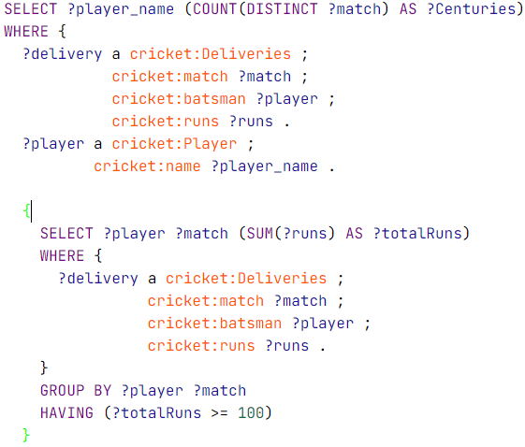
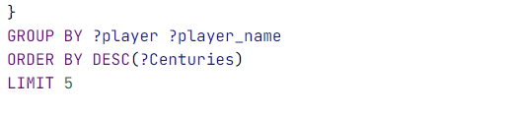
Queries #1: Top 5 Players who have scored a century in the most number of matches:

Slide 26
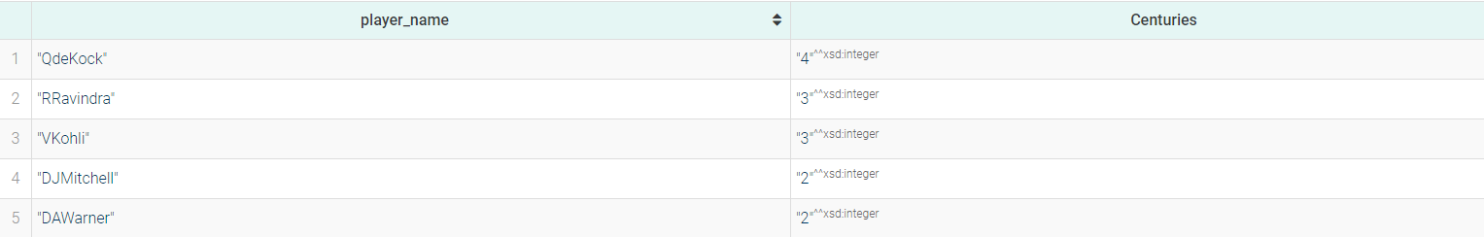
Queries #1: Top 5 Players who have scored a century in the most number of matches:

Slide 27
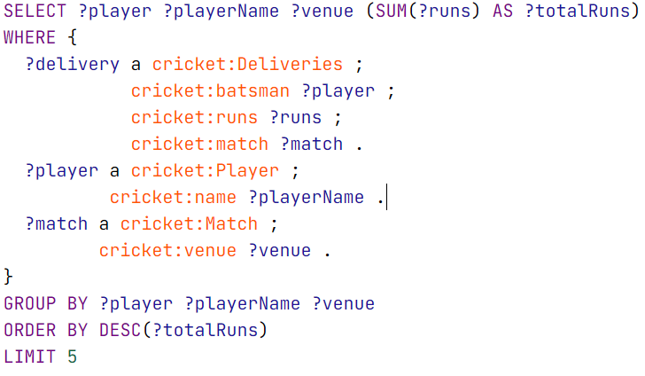
Queries #2: Players who have scored the most runs in matches played at a specific venue:

Slide 28
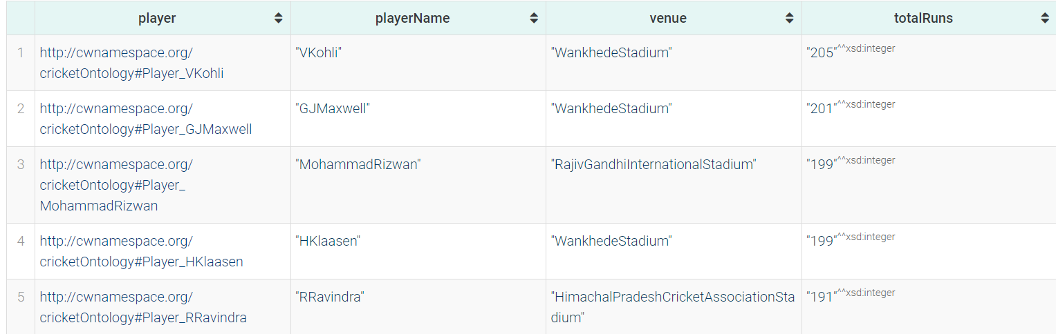
Queries #2: Players who have scored the most runs in matches played at a specific venue:

Slide 29
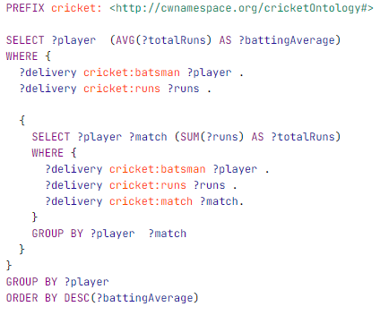
Queries #3: Top 5 Batsmen with respect to their Average Runs Scored:

Slide 30
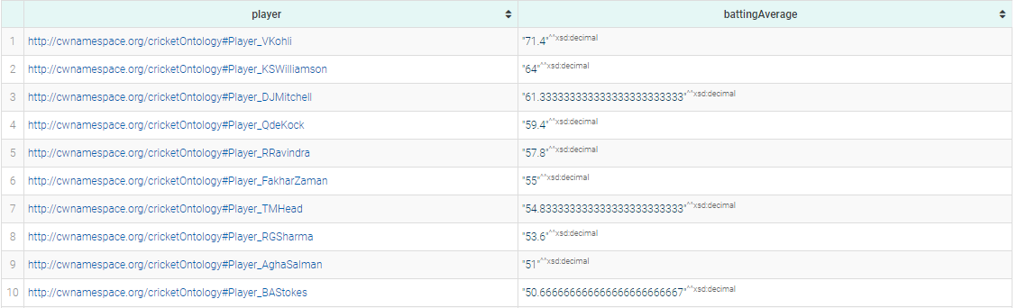
Queries #3: Top 5 Batsmen with respect to their Average Runs Scored:

Slide 31
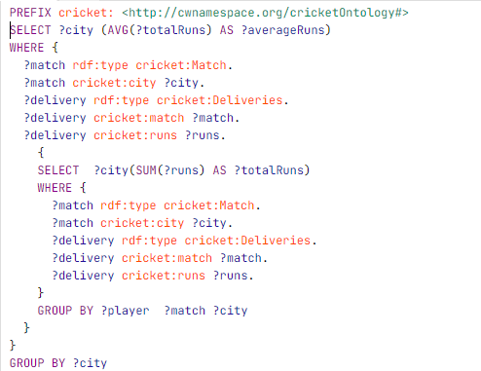
Queries #4: Average number of runs scored in a single match in each city:

Slide 32
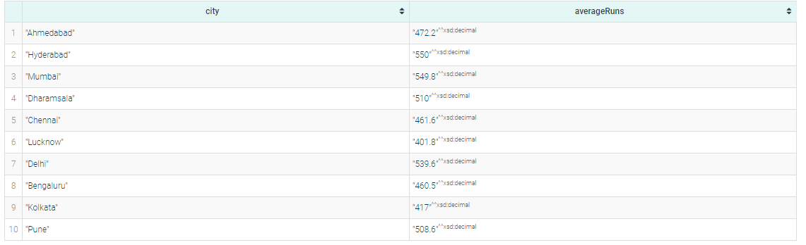
Queries #4: Average number of runs scored in a single match in each city:

Slide 33
Thank You!

