Slide 1
Project Title
Group Member (Registration No.)

Slide 2
Problem Statement/Type of Work

Slide 3
Literature Review/Background

Slide 4
Business Scope

Slide 5
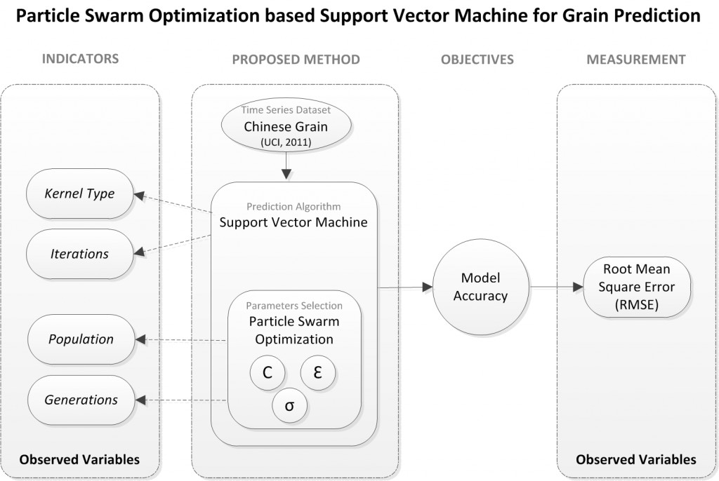
Methodology/Framework
Framework is a diagram that describes in outline the logic flow goes to a study

Slide 6
Tools and Languages

Slide 7
Constraints and Limitation

Slide 8
Work breakdown with timelines

Slide 9
Conclusion

Slide 10
References

Slide 12
Q/A

