Slide 1
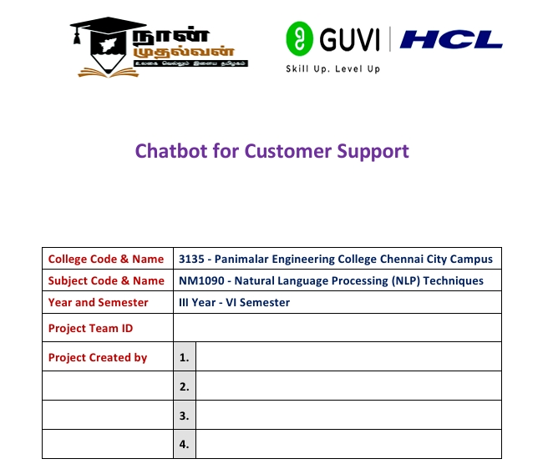
NM2024TMID104028
MOHAMMAD AQUIB MATEEN
MOHAN KUMAR G N
MOULI CHANDRAN R
MUHAMMAD IBRAHIM

Slide 2
INTRODUCTION
Growing demand for 24/7 customer support makes traditional methods hard to scale.
Chatbots offer fast, automated help via text or voice.
Powered by AI, NLP, and machine learning to understand and respond like humans.
Benefits: instant replies, cost savings, scalability, better customer service.
Challenges: understanding diverse queries, personalizing responses, smooth handover to humans.

Slide 3
TECHNOLOGIES USED
NLP – Helps chatbots understand natural human language.
ML & DL – Lets chatbots learn and improve over time.
Speech Recognition – Converts voice to text for voice-based bots.
Sentiment Analysis – Detects customer emotion and adjusts responses.
Knowledge Base – Stores and retrieves relevant info for queries.
Dialog Management – Keeps conversations smooth and context-aware.
Cloud & APIs – Scales bots and connects to other systems.
Rule-Based Systems – Handles basic tasks using predefined rules.
Human Escalation – Hands off complex issues to live agents.
Analytics Tools – Tracks performance and identifies improvements.

Slide 4
PROJECT IMPLEMENTATION
Define Goals – Know what the bot should do and who it serves.
Choose Tech – Pick tools like Dialogflow, Rasa, or cloud platforms.
Design Conversations – Map out scenarios and plan responses.
Develop Bot – Build, train NLP, add features, and connect systems.
Test Thoroughly – Check performance, accuracy, and user experience.
Deploy – Launch on web, apps, or social platforms with monitoring.
Monitor & Optimize – Track feedback and performance; improve regularly.
Iterate – Update features, retrain models, and expand capabilities.

Slide 5
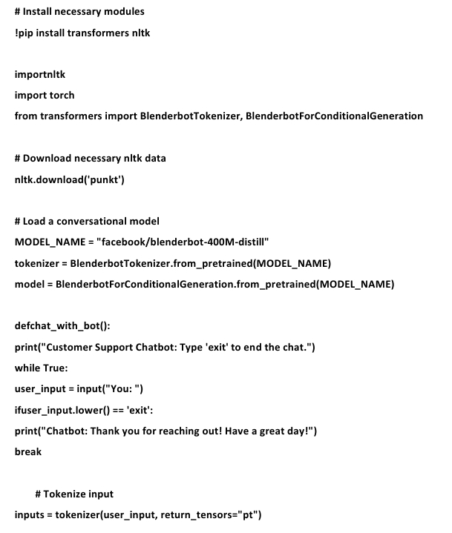
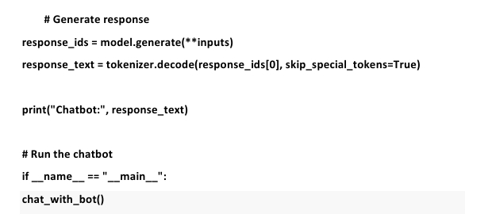
CODING

Slide 6
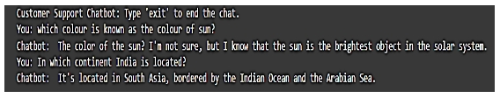
SAMPLE OUTPUT

Slide 7
CONCLUSION
Chatbots offer fast, 24/7 customer support.
They handle routine queries, saving time for human agents.
AI and NLP make chatbots smarter and more personalized.
Businesses benefit from better service, higher customer loyalty, and lower costs.

