Slide 1
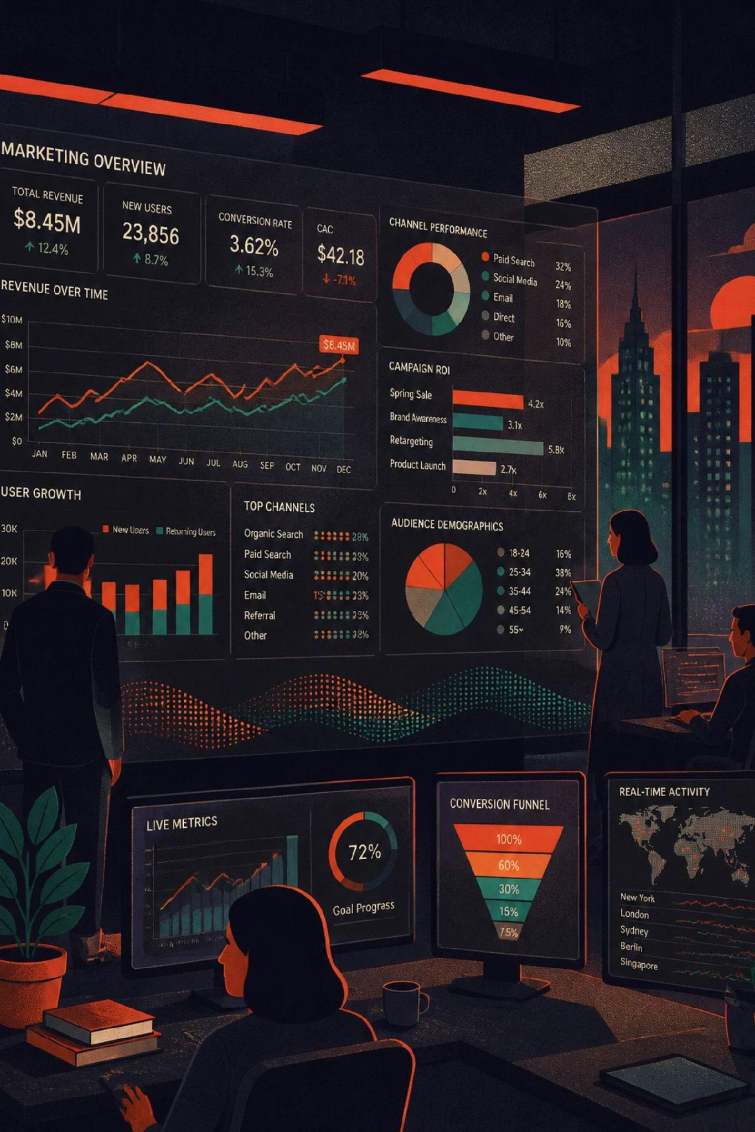
Performance Marketing Case Study
Direct-Response Acquisition at Scale
7-Month Confidential Engagement
Muhammad Ibrahim Bin Zahid | LinkedIn
Anonymized case study. Figures are historical snapshots, not complete results.

Slide 2

At a Glance
7mo
Full Engagement
End-to-end campaign cycle
$20K
Peak Daily Spend
Peak advertising spend per day
2
Verticals
Fatty Acids + Vitamins
24/7
Operating Cycle
Continuous campaign management
Peak spend is a combined daily figure across multiple ad accounts, not a single campaign or account.

Slide 3






What I Owned
The complete acquisition loop across six functions:
Research
Creative
Ad spying, competitor analysis, market intelligence
UGC concepts, script development, winner iteration
Traffic
Funnel
Meta Ads management, campaign launches, budget allocation
Landing page optimization, conversion testing, backend architecture
Tracking
Optimization
ClickMagick reporting, KPI monitoring, performance analysis
Daily performance reviews, creative fatigue management, scaling decisions

Slide 4
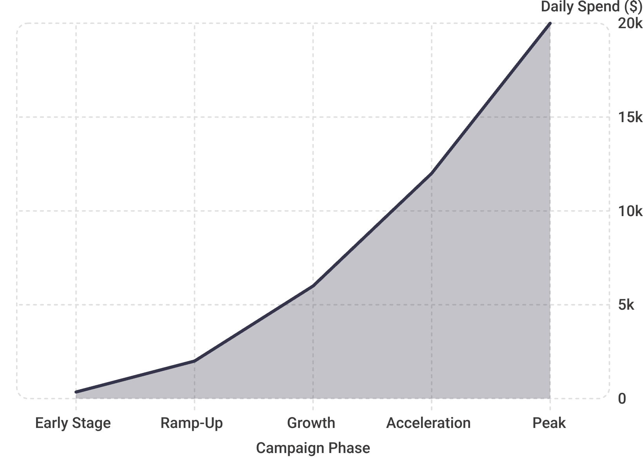

The Scale Story
From $300 to $20,000/Day
Campaign spend scaled dramatically over the 7-month engagement — from early-stage budgets of ~$300–400/day to peak periods exceeding $20,000/day.
This trajectory required constant operational sophistication: managing creative fatigue, audience saturation, and budget efficiency simultaneously at every stage of growth.
The peak is supported by the Ads Manager snapshot on the next slide. Earlier spend levels are from my operating records and recollection; complete historical financials were not available.

Slide 5
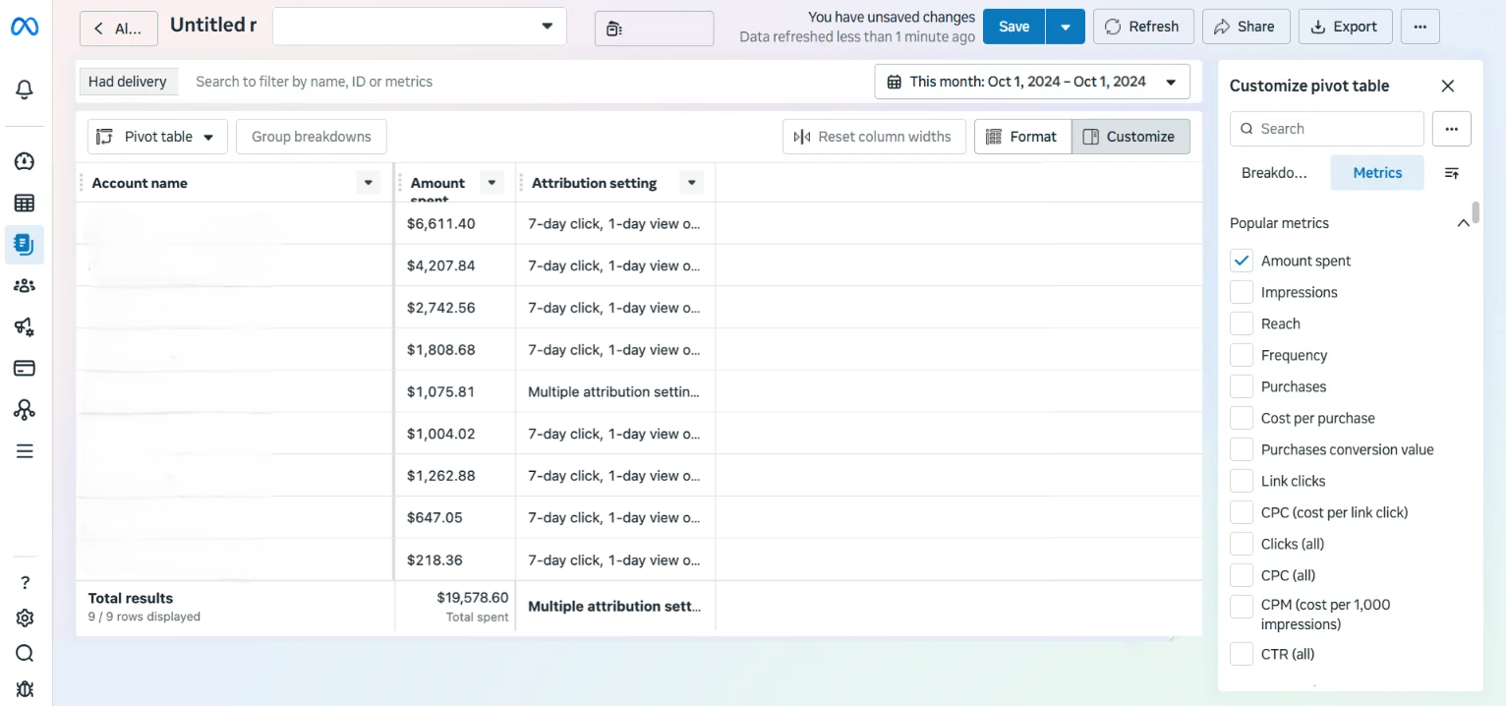
Meta Ads: Proof of Scale
Note: Statistics are reported on a per-day basis. Account names have been redacted to maintain confidentiality.

Slide 6
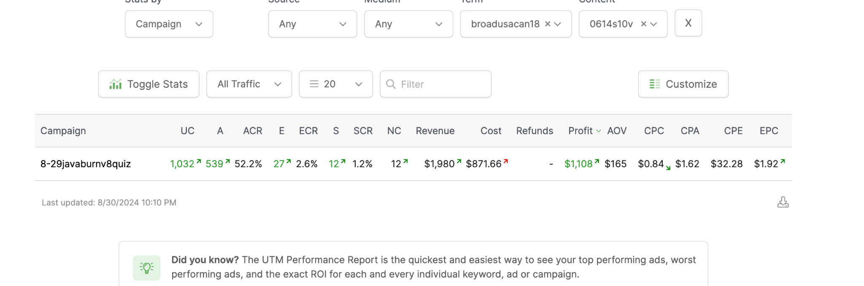
Fatty Acids Performance Snapshots
Daily Stats Per Account — Tracked and reported through ClickMagick
Fatty Acid Vertical
Spend
$871
Profit
$1,980
AOV
$165
CPC
$0.84
CPA
$1.62
EPC
$1.92
ECR
2.6%
ACR
52.2%

Slide 7
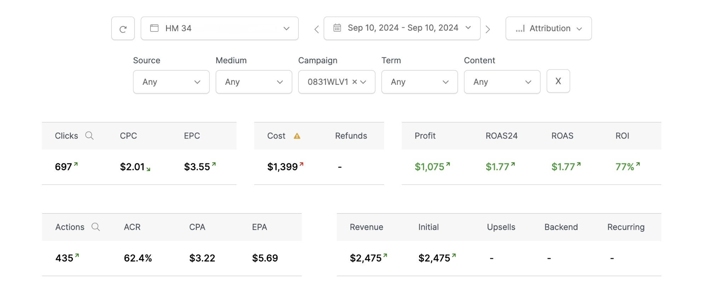
Vitamins Performance Snapshots
Daily Stats Per Account — Tracked and reported through ClickMagick

Slide 8
Creative Engine
The acquisition strategy relied on continuous creative iteration and competitor intelligence:
01
02
Spy & Analyze
Script Development
Monitor competitor ads, identify winning hooks and messaging angles
Create UGC concepts aligned with successful patterns
03
04
Production
Test & Measure
Coordinate video editors, creators, and asset production
Launch multiple creative variations, track performance
05
06
Iterate Winners
Scale
Remake and refine top-performing concepts
Increase budget on proven creative while maintaining efficiency
This continuous feedback loop maintained creative freshness and supported campaign growth across both verticals.

Slide 9
Creative Fatigue at $10,000+/day
Managing creative decay during aggressive Meta Ads scaling across US & Canada (Vitamins & Fatty Acids)
01
02
03
Situation
Winning UGC ad CPA & ECR started declining rapidly as spend reached $10,000/day on Meta Ads.
The actual Cost Per Purchase (CPS) ballooned from a highly profitable baseline of $110.00 up to a devastating $150.00 (+36.4%) as audience fatigue set in.
TOF efficiency crumbled, dropping the overall Sales Conversion Rate (SCR) by 20% (falling from a stable 1.5% down to 1.2%).
Frequency reached 3.8x in primary target demographics (US & CA)
Action
Executed rapid creative iteration and hook variation refresh within 48 hours.
Deployed a comprehensive creative turnaround and variation cycle within a tight 48-hour window to combat ad fatigue.
Re-shot and remade the top-performing visual hooks utilizing 2 fresh UGC creators to completely reset demographic blind spots.
Developed and tested 8 hook variations, optimizing the first 5 seconds’ visuals and psychological audio.
Result
Full ad account and funnel stabilization achieved within 10 days post-launch of the fresh creative assets.
Slashed the bloated Cost Per Purchase back down from $150.00 to an optimized $72.00 (-34.5%).
Successfully rebuilt the Sales Conversion Rate (SCR) from 1.2% to a highly efficient 1.8% (+50.0% lift).
Sustained aggressive daily budgets of $10,000+ while locking back in a highly secure, stable 1.5X ROAS mirroring our best operational days.
Continuous hook testing, top demographic testing and top products scaling prevents creative fatigue and protects unit economics while scaling paid acquisition.

Slide 10
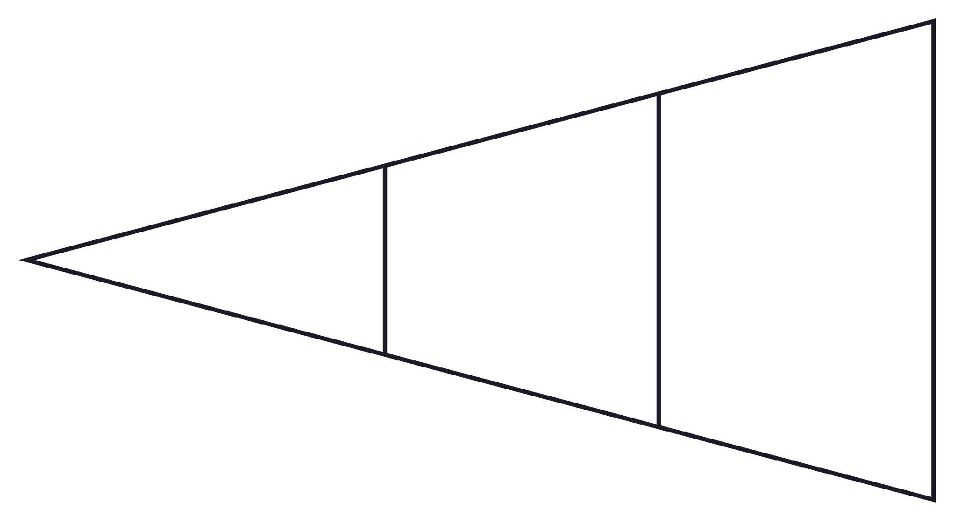
Funnel & Conversion Architecture
Every Stage Was a Lever
Each layer of the funnel was continuously tested and optimized for conversion efficiency — not just the ad creative at the top.
Pre-sell / Advertorial — Warmed cold traffic and established credibility before the offer
Sales Page — Tested headline variants, proof elements, and offer framing
Checkout — Reduced friction and abandoned cart rate
Upsell / Backend — Maximized AOV and customer lifetime value
Meta Ad
Sales Page
Pre-sell / Advertorial
Generic representation of the acquisition architecture; actual client funnel architecture is not disclosed.

Slide 11





Daily Optimization Loop
Campaigns were reviewed 4–5× daily to maintain performance and identify scaling opportunities:
Diagnose
Evaluate
Decide
Monitor spend, CPC, CPA, EPC across all active campaigns
Assess creative performance, funnel conversion, cost trends
Kill underperformers, iterate mid-performers, scale winners
Execute
Recheck
Adjust budgets, launch new creatives, test funnel changes
Verify impact, repeat throughout 24-hour operating cycle
This operational cadence enabled rapid scaling while maintaining acquisition efficiency.

Slide 12
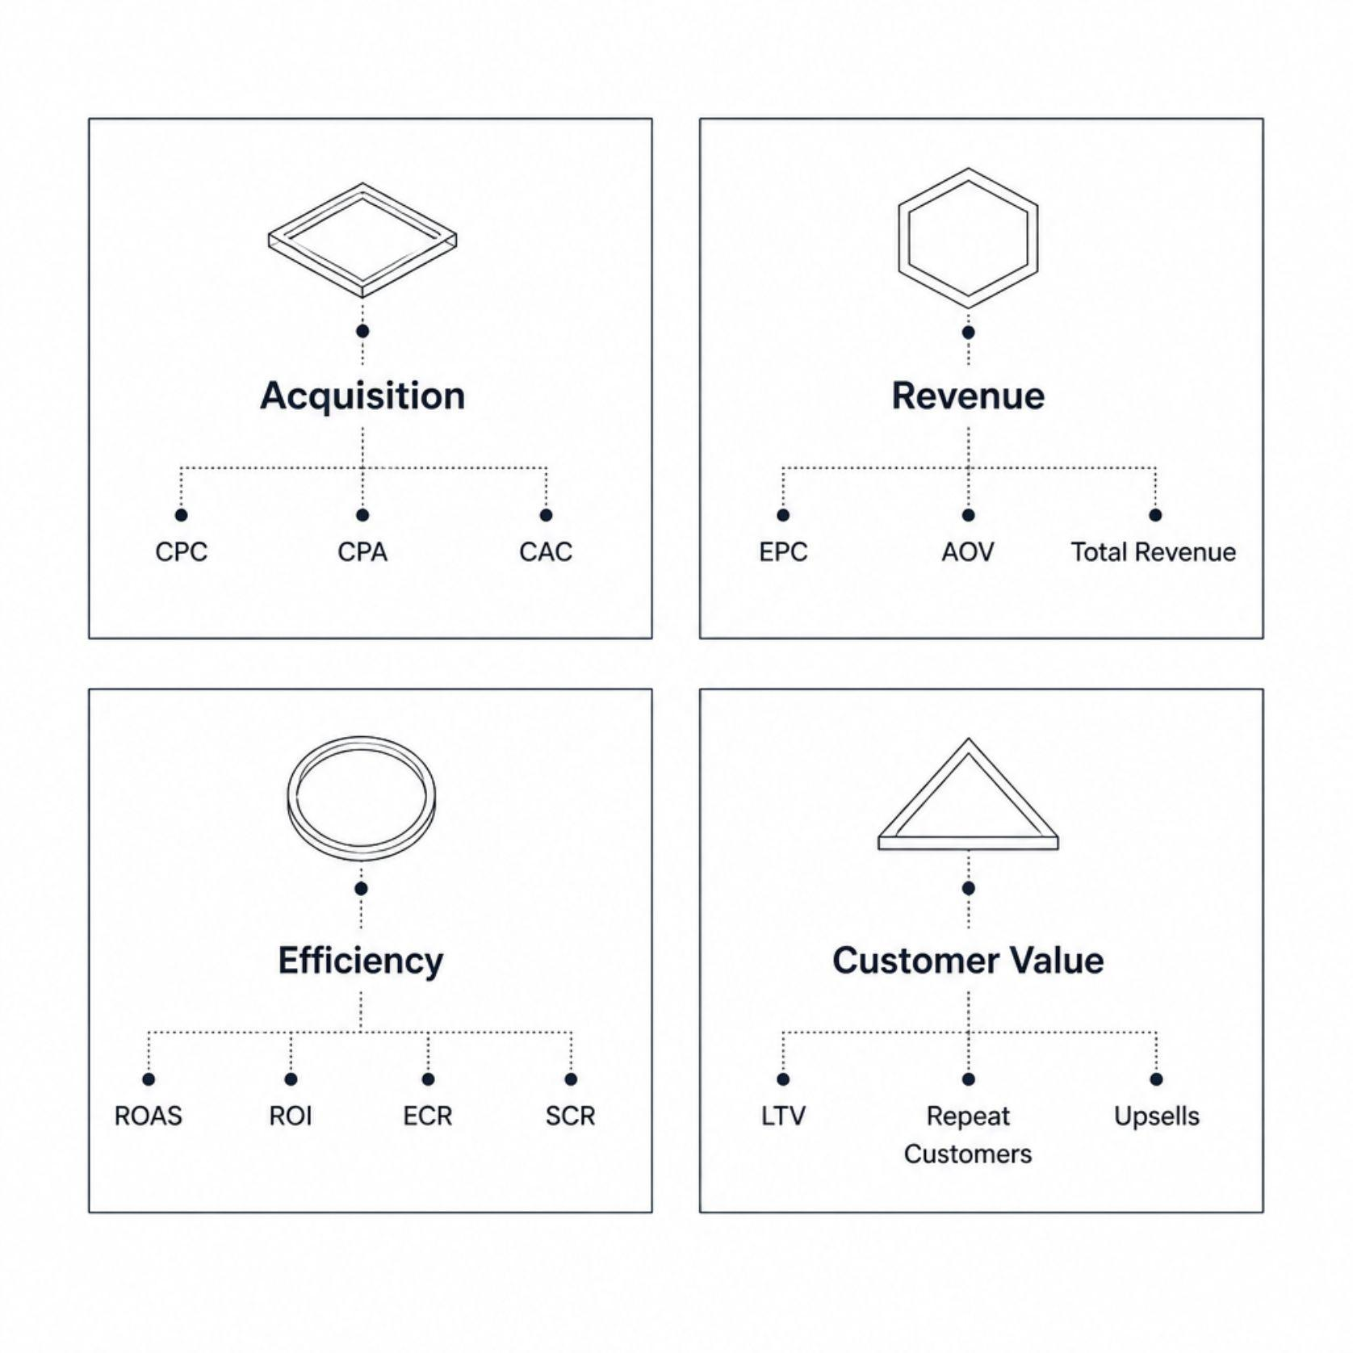

KPI Framework
Beyond Cheap Clicks
Performance was tracked across four dimensions — the objective was never simply to drive cheap clicks. The goal was to understand acquisition efficiency through the full revenue and backend economics of each offer.
KPI Definition:
ECR = E-commerce Conversion Rate
ACR = Abandoned Cart Rate
SCR = Shopping Cart Recovery Rate
AOV = Average Order Value
LTV = Lifetime Value
Acquisition
Revenue
Efficiency
Customer Value
CPC, CPA, CAC — cost per action
EPC, AOV, Revenue — per-customer economics
ROAS, ROI, ECR, SCR — return on ad spend
LTV, Repeat Customers, Upsells — backend economics

Slide 13

What This Demonstrates
Seven months of direct-response acquisition built a repeatable, scalable performance marketing operation — not just ad management.
Full-Funnel Ownership
From creative strategy through backend optimization — managed every lever in the acquisition loop
Operational Discipline
4–5× daily reviews, systematic KPI tracking, and rapid decision cycles at ~$20K/day combined peak spend.
Creative Intelligence
Competitor intelligence, UGC scripting, and continuous iteration to maintain creative freshness at scale
Transferable Expertise
Methodology, systems, and analytical rigor that translate across verticals, platforms, and offer types

Slide 14
Key Challenges
Creative Fatigue
Scaling Efficiency
Continuously identify and iterate winning concepts to maintain ad performance
Impact Metrics: +36.4% CPA Surge | -20.0% Sales Conversion Drop
Increase spend without allowing acquisition costs to deteriorate
Impact Metrics: $10,000+/day Ad Spend | Target 1.5x ROAS
Competitive Markets
Operational Speed
Compete in saturated Fatty Acids and Vitamins Market
Impact Metrics: +50.0% Funnel Efficiency Lift (Post-Refresh)
Coordinate media buying, creative production, and funnel optimization on a daily cycle
Impact Metrics: 48-Hour Creative Refresh Cycle

Slide 15
What I Can Do
From launching campaigns to operating the entire acquisition loop.
Media Buying & Campaign Management
Creative Strategy & UGC Direction
Funnel Optimization & Testing
Performance Analytics & Reporting
Direct-Response Marketing
Campaign Scaling & Budget Allocation
Open to media buying and performance marketing roles / contracts
LinkedIn - Let's Connect

Slide 16
Confidentiality Notice
This case study has been intentionally anonymized. Client identities, proprietary creative assets, internal documents, account credentials, domains, complete financial records, and other confidential materials have been excluded.
Performance figures shown are limited to historical snapshots that I am permitted to reference and should not be interpreted as complete seven-month financial results.

