Slide 1
$4.41M Qualified-Call Revenue
U.S. ACA Lead Generation | 2023 · Google Ads + Meta · 20 Accounts · 100 CCs Peak
MEDIA BUYER CASE STUDY

Slide 2
A year of performance at scale
$4.41M
$3.3M
Ringba Revenue
Paid Media Spend
470K
147K
Incoming Calls
Paid Calls
64K
~35%
Converted Calls
Reported ROI
100+ Accounts | United States | ACA | Google + Meta

Slide 3
From $220 CPA to < $90
BEFORE
AFTER
CPA
$220
< $90
Monthly Spend
~$7K
$30K–$60K
Monthly Calls
~2K
50K–70K
Monthly Revenue
~$8K
>$500K
Conversion
<10%
~30%
ROI
0–10%
~35%
Lower CPA. Higher volume. Higher conversion. Meaningful scale.

Slide 4
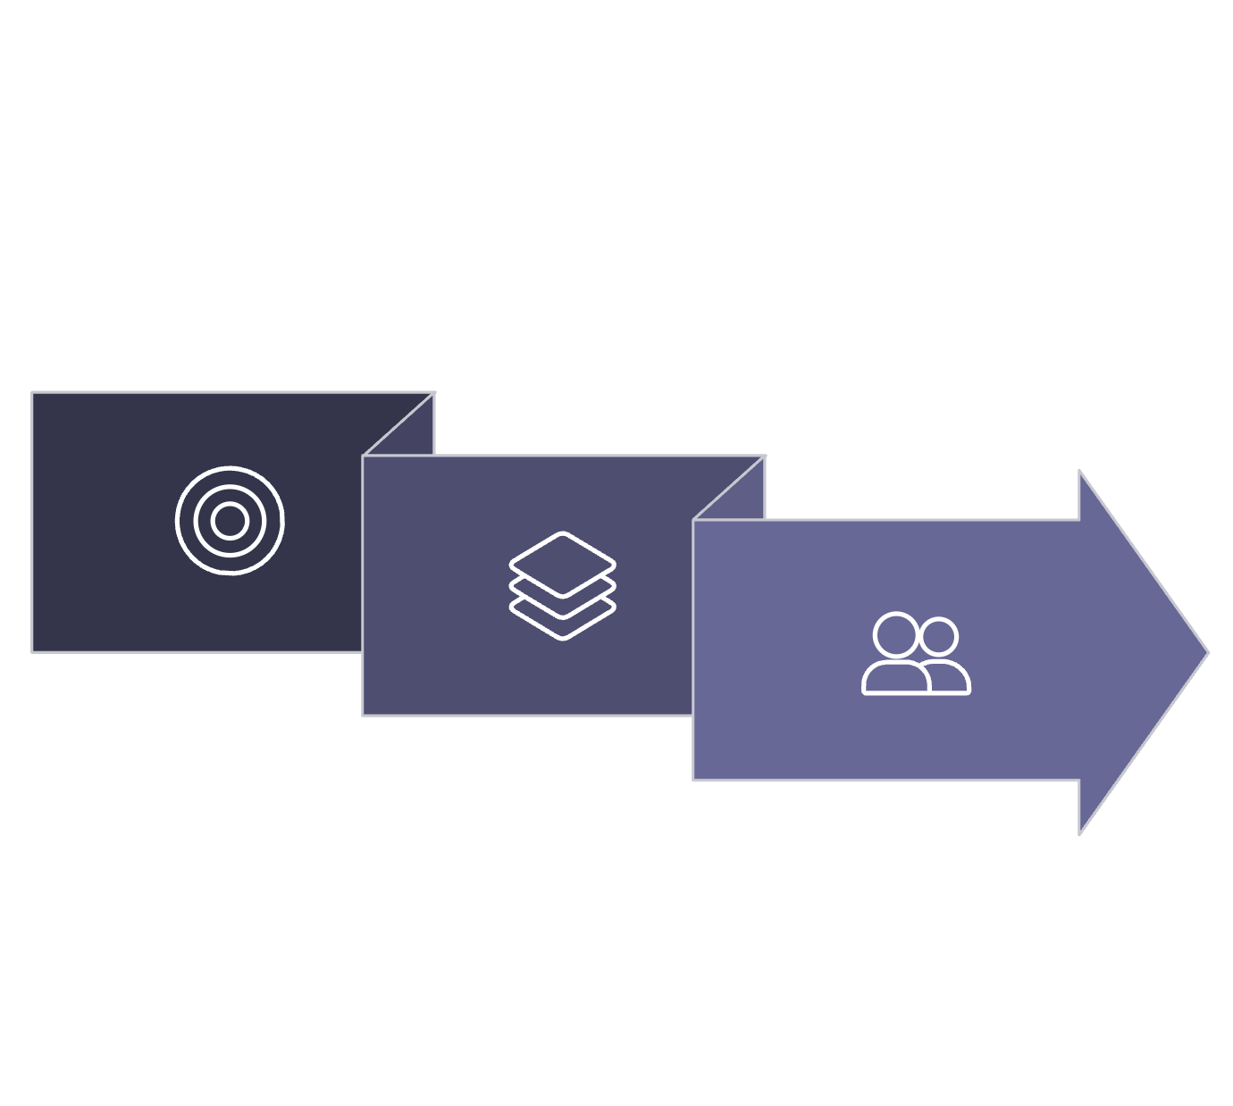

The testing system
WINNING AD
NEW AD
Campaign
Analyze Results
Campaign A
Age & Landing
Find highest economic performance
Test in Environment 1
Identify Strongest Environment
Campaign C
Campaign B
Test in Environment 3
Test in Environment 2
5 Ad Groups
Parallel test new creatives across multiple campaign environments simultaneously.
Keep the creative constant. Find the environment where the economics are strongest.

Slide 5

Optimize the audience and the path to conversion
TARGETING
FUNNEL
Age-group testing
Audience comparison
Test different endpoints
Remove low-value questions
Account-level performance
CPA + revenue validation
Avoid unnecessary friction
Intervene when CPA deteriorates
Audience × Funnel × Economics

Slide 6


Creative that adapts to how people consume content
UGC
TRENDING FORMATS
B-ROLL + VO
INFLUENCER
Native-feeling direct response
Trending ideas transformed into business solutions
Visual storytelling + direct-response messaging
Creator-led credibility and native distribution
The creative wasn't judged by engagement alone. It had to produce calls that made economic sense.

Slide 7
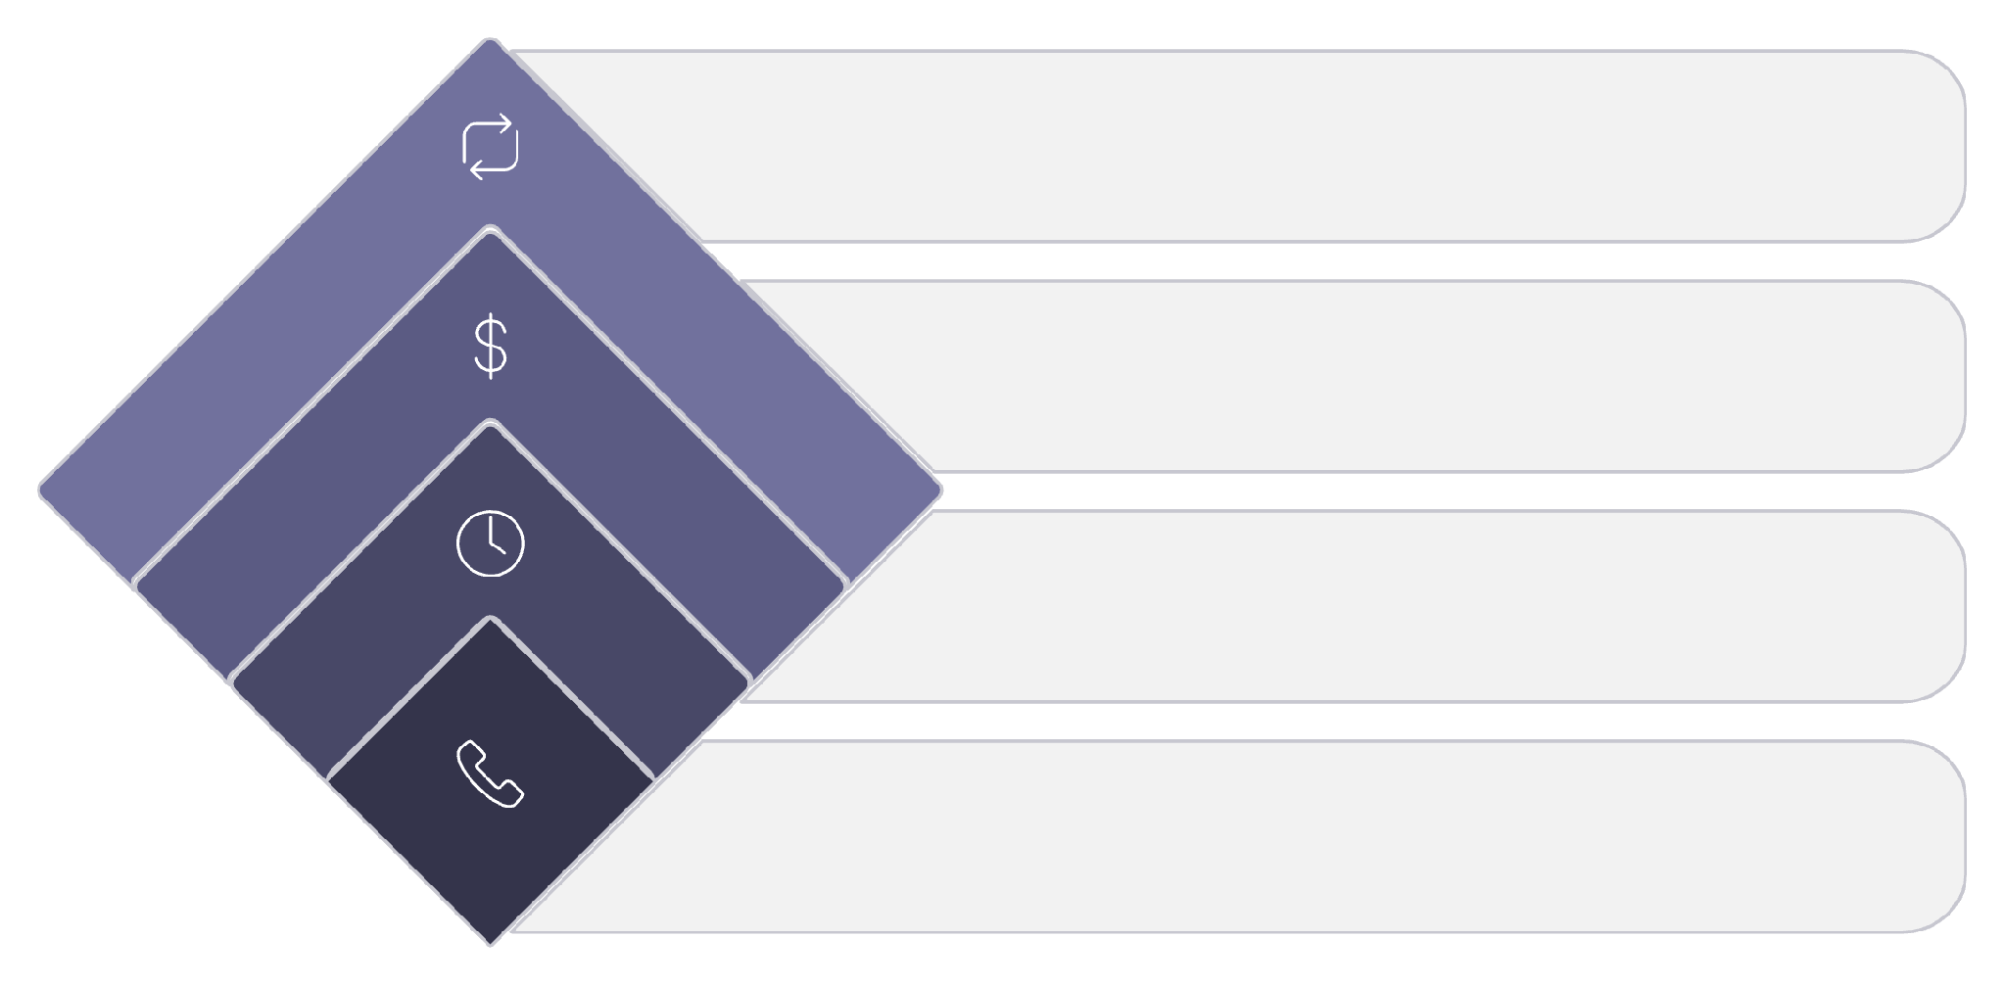
Don't rush to kill your killers
2 consecutive negative days
Performance Repeat?
Repeat positive or negative?
→ KILL
Day 2 Calls & Revenue?
Calls and revenue seen?
Promising winner
Give Another Day
→ PROTECT
Wait and monitor
Day 1 Calls?
Patience is a competitive advantage. Most buyers kill campaigns before the data is conclusive.
Any calls observed?

Slide 8
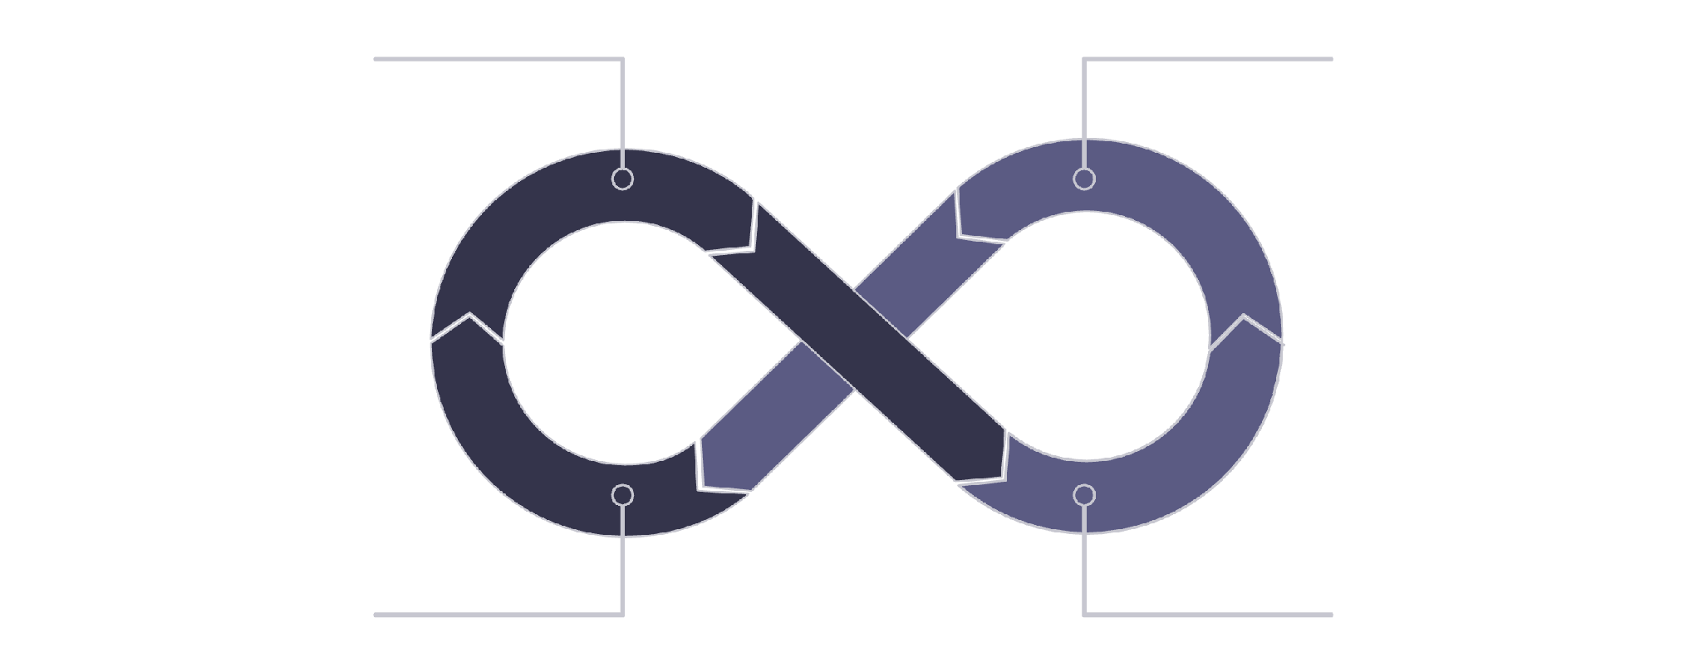
Scale the economics—not just the budget
Profitable
+35–40% Spend
Evaluate & Repeat
3 Days
Controlled budget expansion allowed profitable campaigns to absorb more spend without relying on reckless jumps.
+35%
100
Spend Increase
Peak CCs
Approximately every 3 days
Simultaneously active

Slide 9
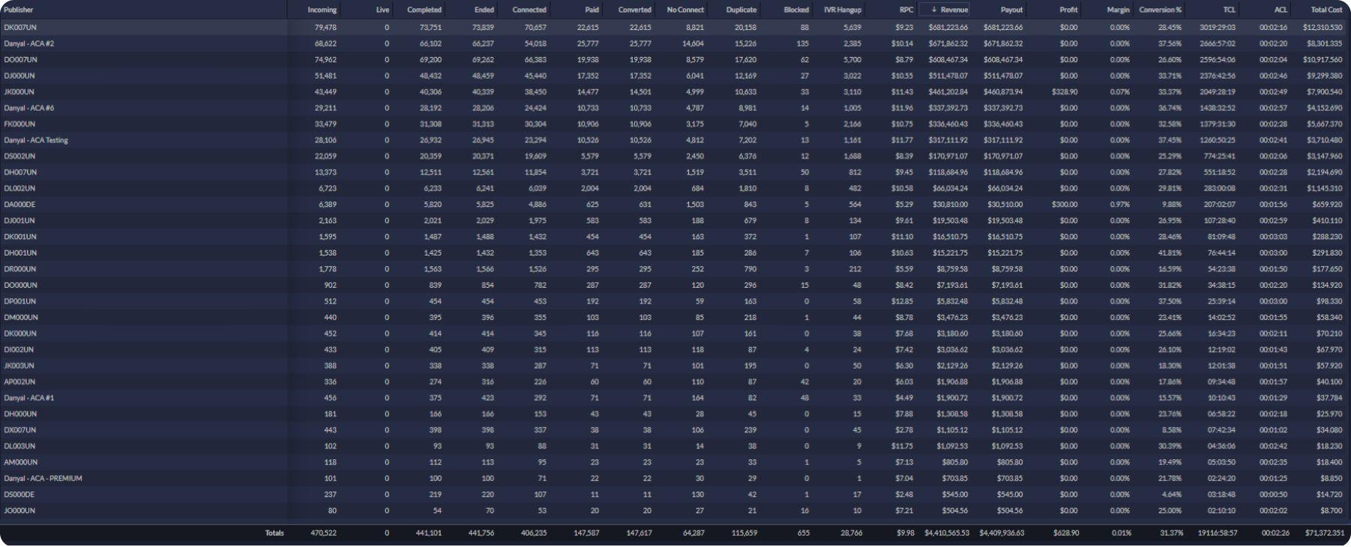
The numbers behind the operation
Revenue shown is Ringba-reported buyer revenue. Media spend is reported separately from Ringba's Total Cost metric.
470,522
147,617
64,287
$4.41M
Incoming Calls
Paid Calls
Converted Calls
Revenue
31.37%
2:26
Conversion Rate
Avg. Call Length

Slide 10
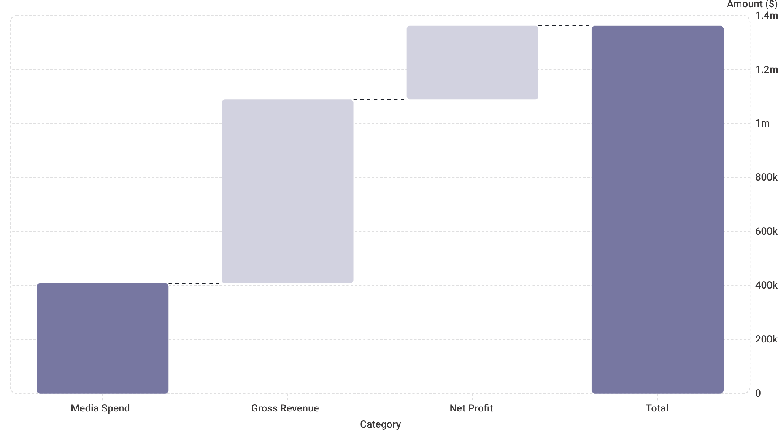
$681K+ from the top account
$681K
$408K
~1.67×
Top Account Revenue
Media Spend
Revenue / Spend
The strongest account demonstrated that the testing and scaling framework could support substantial spend while maintaining positive campaign economics.

Slide 11
A repeatable acquisition operating system
1
TEST
2
VALIDATE
3
QUALIFY
4
CUT
5
PROTECT
6
SCALE
7
REPEAT
CPA < $90
2+ Min Call Qualification
35% Reported ROI
Built around real buyer economics—not vanity metrics.

Slide 12
Ready to scale qualified-call acquisition?
I manage paid acquisition around the metrics that actually matter:
CPA
Call Quality
Conversion
Revenue
ROI
REQUEST CAMPAIGN MANAGEMENT
Paid Media • Lead Generation • Google Ads • Meta • Qualified Calls

