Slide 1

Google Search Acquisition at Scale
Performance Marketing • Search Acquisition • Multi-Account Scaling
Insurance Vertical | January 2026 – Present

Slide 2
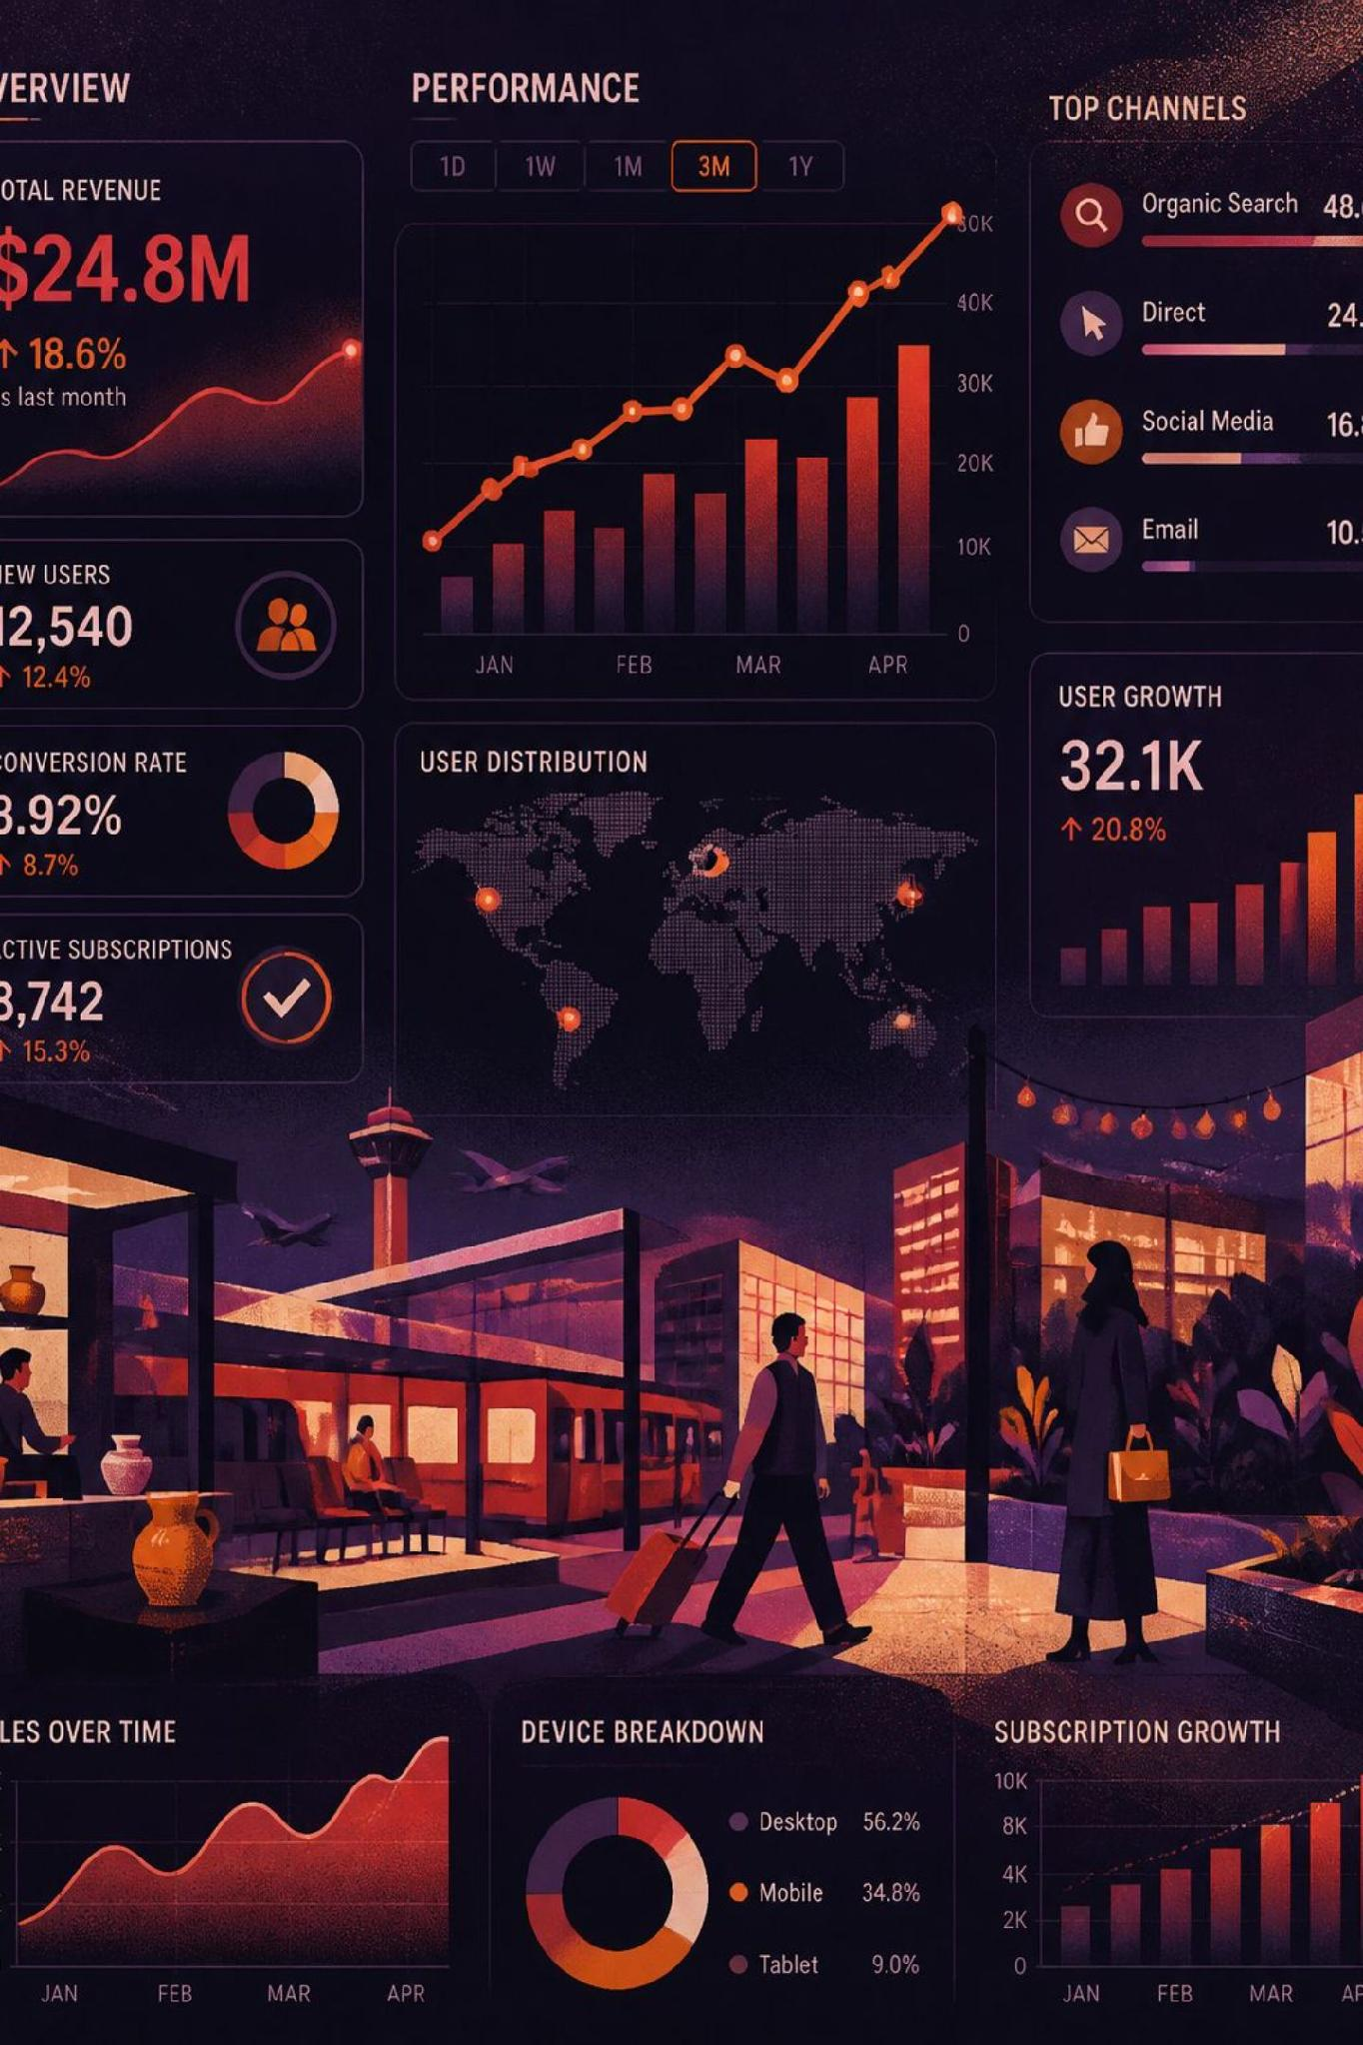

Scale at a Glance
$800K+
Estimated Cumulative Spend
Approximate operational figure across the full engagement
$489.5K
Documented Spend
Available account-level historical snapshots
20×
Daily Spend Scaled
From $300/day to $6,000+/day on a winning campaign
6
Months Running
Ongoing engagement, January 2026 – Present
Cumulative spend is an approximate operational figure; documented spend represents available account-level historical snapshots.

Slide 3





What I Owned
End-to-end Search acquisition ownership — not a single slice of the funnel.
Research
Competitive search intelligence, keyword testing, market research
Build
Campaign launches, structure, keywords & ads
Operate
Multi-account management, hourly monitoring, budget management
Optimize
Search-term analysis, bid strategy, conversion performance, landing-page relevance
Scale
Winning campaign expansion, budget increases, multi-account scaling

Slide 4
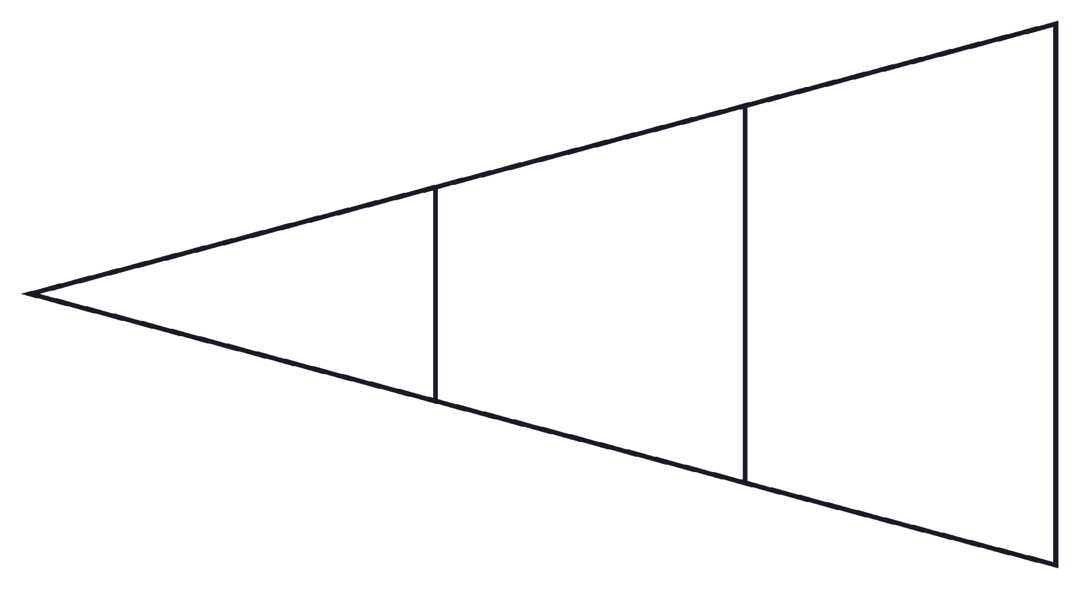
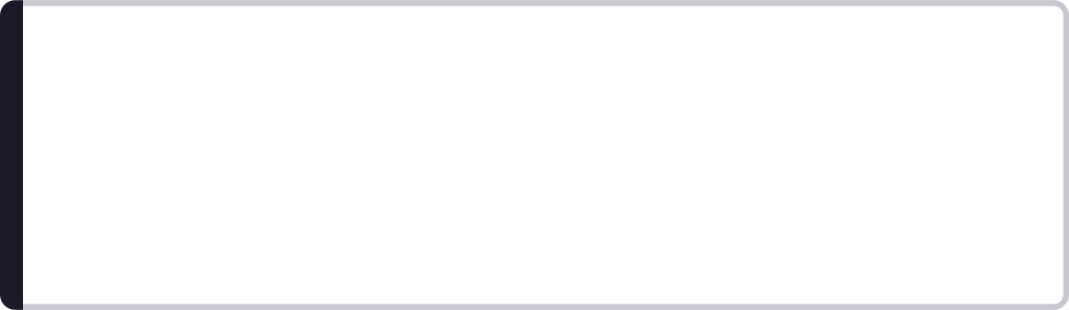
Search Acquisition Architecture
Optimization Objective
Search Traffic
Conversions
Landing Page
Maximize qualified acquisition while maintaining sustainable cost efficiency across every stage of the funnel.
Top of Funnel
Mid Funnel
Bottom of Funnel
Search intent capture — keywords, match types, ad relevance
Landing page alignment, form completion, call connection
Qualified lead delivery and downstream sale conversion

Slide 5
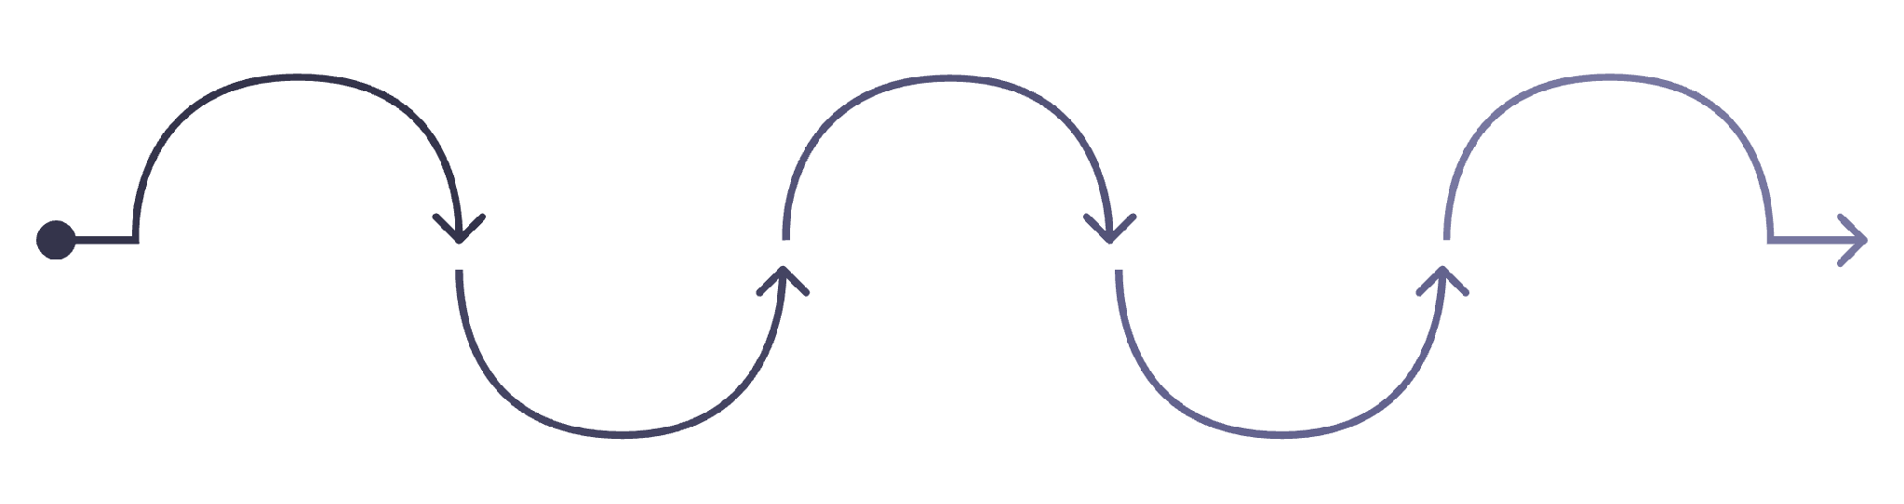
Search Intelligence → Campaign Build
Structural Decisions at Every Stage
Brand / non-brand segmentation — isolate intent signals and control budget allocation
Keyword themes & match types — balance reach with precision
Competitive Intelligence
Keyword Opportunities
Search Tests
Campaign Structure
RSA + Landing Page
Negative keywords — protect spend from irrelevant traffic
Identify themes and match types
Validate intent and ad triggers
Segment brand vs non‑brand budgets
Map competitor tactics and gaps
Align messaging and experience
Location segmentation — align geo targeting with market opportunity
Device considerations — optimize bids and creative by device behavior
Search-term analysis — continuous refinement based on real query data

Slide 6
Optimization & Bidding Framework
Launch
1
Maximize Conversions — gather conversion data while maximizing volume within budget
2
Gather Data
Conversion volume, CPA & CPC, search terms & conversion rate
Stabilize
3
Target CPA — provide greater control over acquisition efficiency
4
Optimize
Budget allocation, search terms & keywords, ads & landing-page relevance
Scale
5
Increase volume while maintaining acceptable acquisition economics
This phased bidding approach ensures campaigns are data-informed before scaling — protecting spend efficiency at every stage of growth.

Slide 7
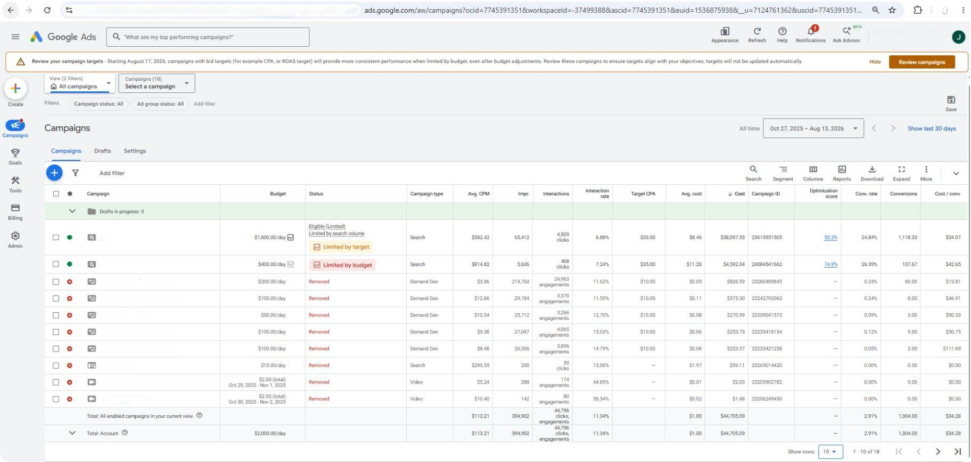
The Scaling Story
20×
Daily Spend Scaled
$300/day → $6,000+/day
Winning campaign identified through rigorous testing
Applied Search best practices at every layer
Continued search term testing throughout scale
Monitored performance closely — hourly
Optimized account structure in parallel
Increased budget progressively as efficiency held
Scaled daily spend by ~20× while continuing to optimize for qualified acquisition.

Slide 8
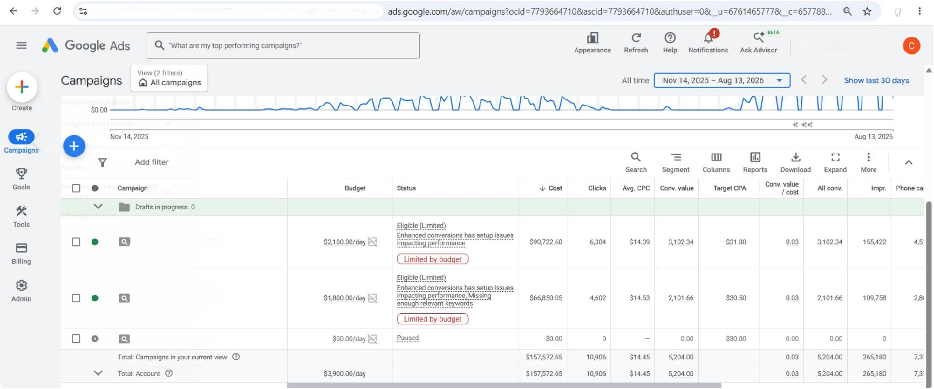

Multi-Account Scaling
One acquisition engine → multiple accounts
Why Multi-Account?
Managed Search acquisition across multiple Google Ads accounts to support continued growth and reduce dependency on a single acquisition account.
~$489.5K documented spend across available account snapshots
Redundancy
Scale
Testing
Reduce single-account risk and policy exposure
Expand volume beyond single-account budget ceilings
Run parallel experiments without disrupting primary performance

Slide 9
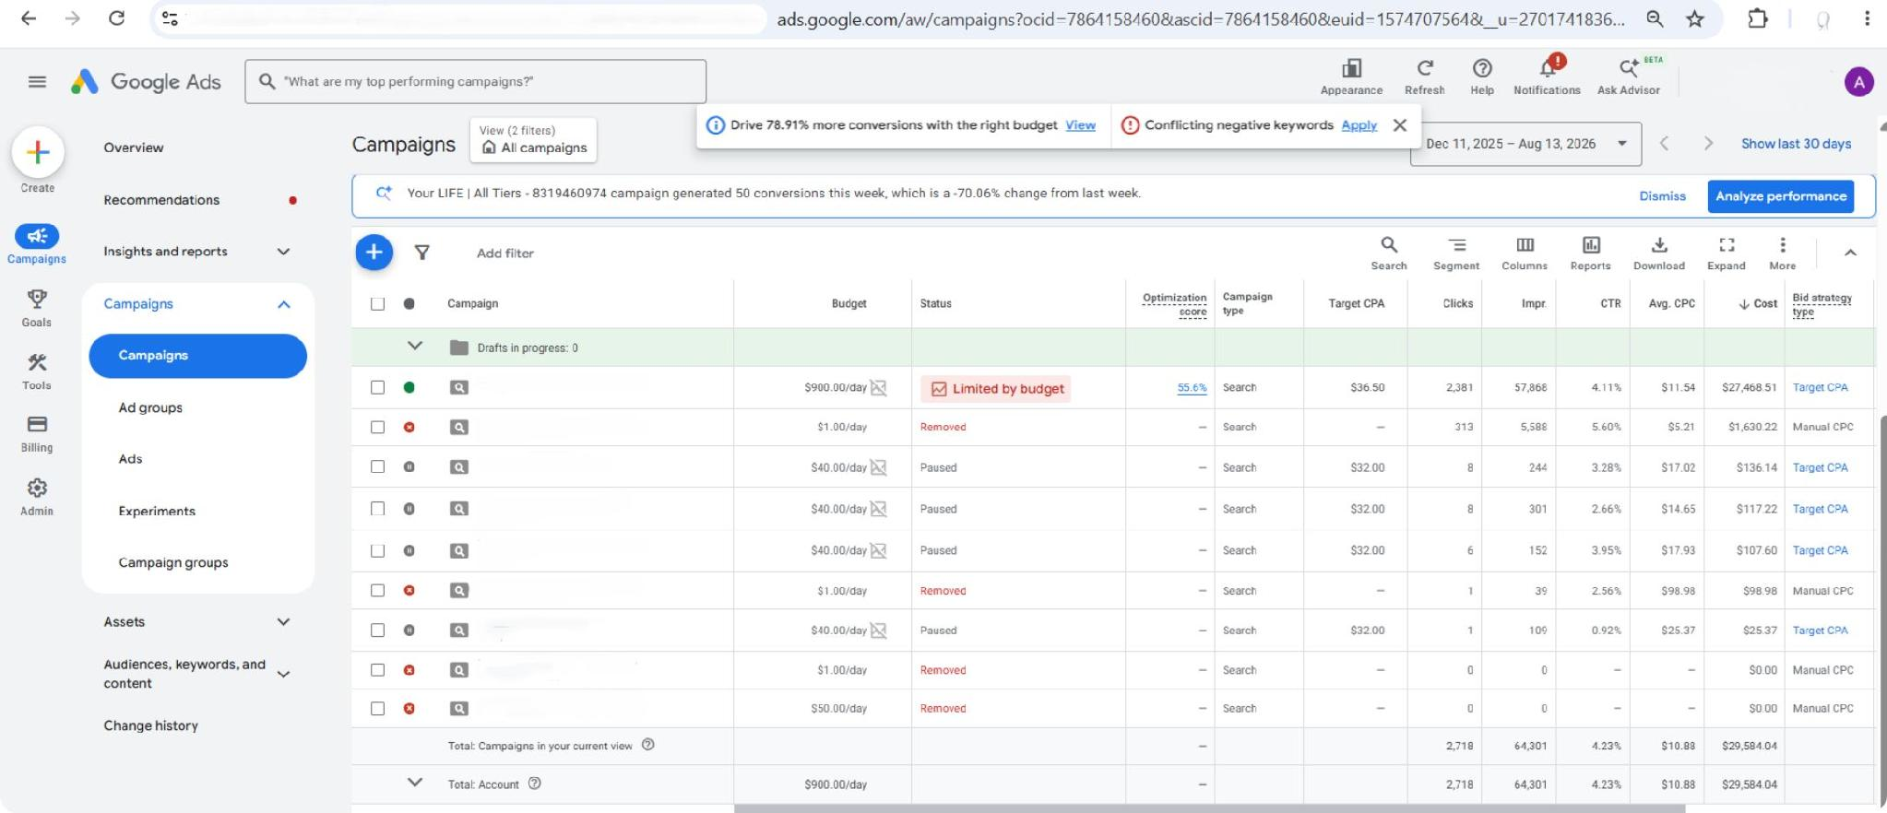
Performance & Monitoring System
Hourly Cadence
Spend → Clicks → CPC → Conversions → CPA → Search Terms → Account Decision
Daily Cadence
Reporting → Team Meeting → Performance Review → Testing Plan → Next-Day Strategy
Primary Metrics Tracked
Spend
CTR
CPC
CVR
CPA
tCPA

Slide 10
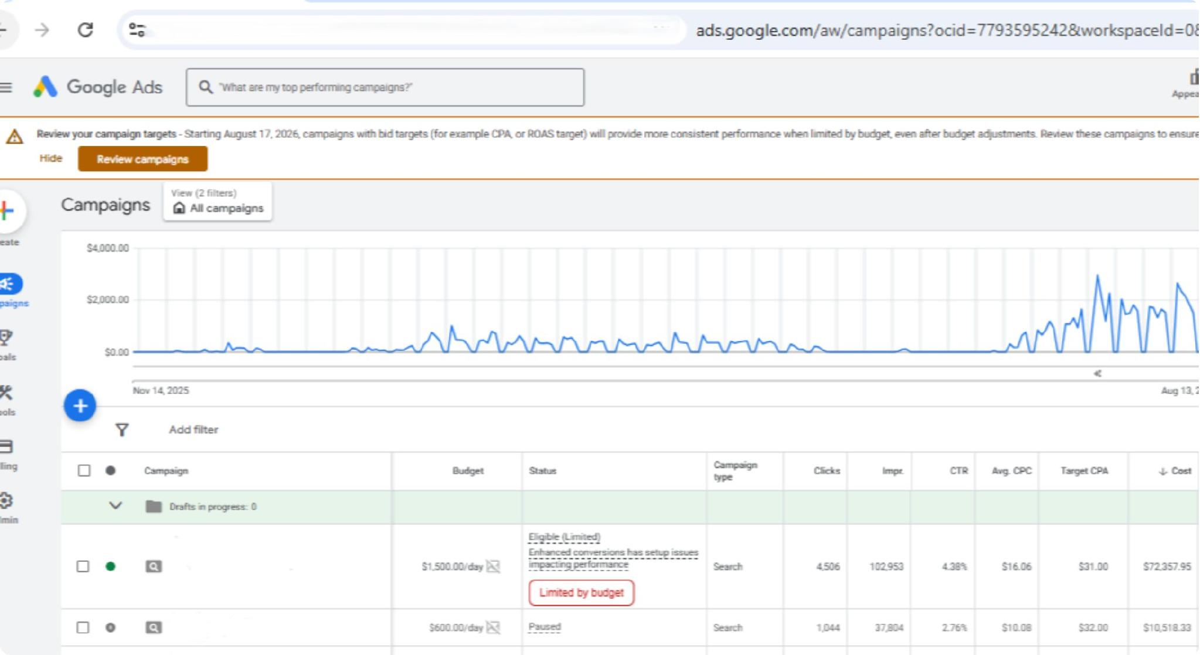
Documented Campaign Performance
Account-Level Snapshots
Account
Conversions
Spend
Cost / Conv.
Account P
$85.2K
3,066
$27.77
Account M
$82.0K
3,038
$26.99
Account C
$157.6K
5,204
—
Conversion definitions may vary across accounts; figures are presented as reported within the respective Google Ads accounts.

Slide 11

Results + My Role
Performance Marketing at Scale
What I Personally Own
Client identities, account identifiers, proprietary tools, and confidential business information have been omitted. Spend figures are labeled according to whether they are documented or approximate.
~$800K+ Estimated Cumulative Spend
~$489.5K Documented Spend
Approximate operational figure across the full engagement
Available account-level historical snapshots
$300 → $6K+ Daily Spend Scaled
6 Months — January 2026 – Present
~20× increase on a single winning campaign
Ongoing, full-funnel Search acquisition ownership
Google Search campaign management
Campaign launches & structure
Search intelligence & optimization
Scaling & multi-account management
Hourly reporting & daily strategy

Slide 12
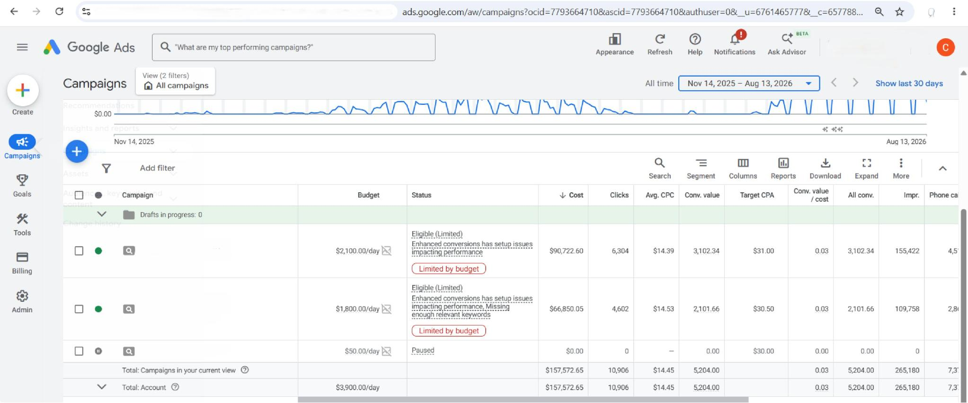
Sources
These account-level performance snapshots provide visual evidence from the Google Ads accounts referenced in this presentation.
Note: These screenshots represent documented campaign performance across the accounts referenced in the presentation.

Slide 13
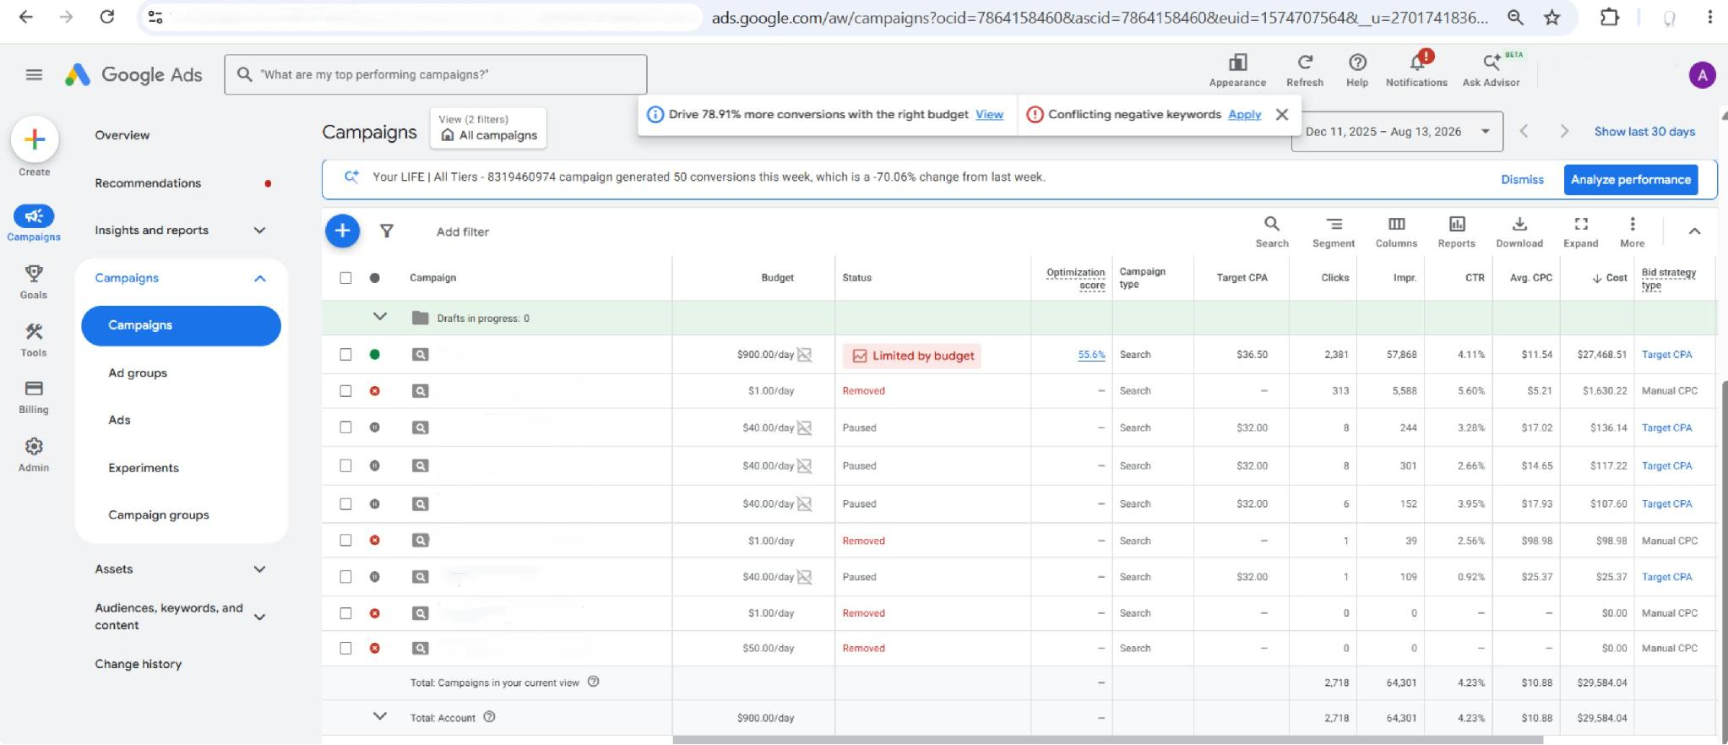
Sources
These account-level performance snapshots provide visual evidence from the Google Ads accounts referenced in this presentation.
Note: These screenshots represent documented campaign performance across the accounts referenced in the presentation.

Slide 14
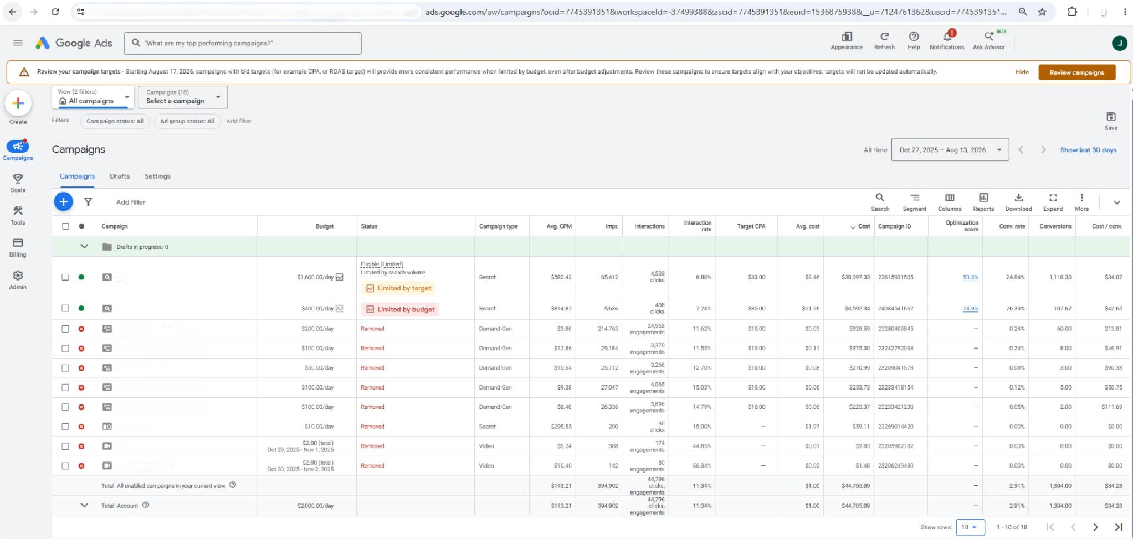
Sources
These account-level performance snapshots provide visual evidence from the Google Ads accounts referenced in this presentation.
Note: These screenshots represent documented campaign performance across the accounts referenced in the presentation.

Slide 15

Sources
These account-level performance snapshots provide visual evidence from the Google Ads accounts referenced in this presentation.
Note: These screenshots represent documented campaign performance across the accounts referenced in the presentation.

