Slide 1
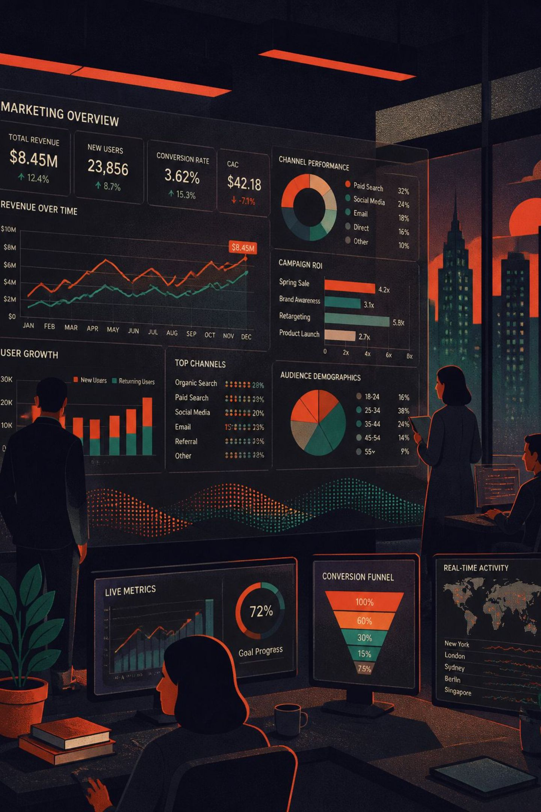
Performance Marketing Case Study
Direct-Response Acquisition at Scale
7-Month Confidential Engagement

Slide 2

At a Glance
7mo
Full Engagement
End-to-end campaign cycle
$20K
Peak Daily Spend
Peak advertising spend per day
2
Verticals
Weight Loss + Manifestation
24/7
Operating Cycle
Continuous campaign management

Slide 3






What I Owned
The complete acquisition loop across seven functions:
Research
Creative
Ad spying, competitor analysis, market intelligence
UGC concepts, script development, winner iteration
Traffic
Funnel
Meta Ads management, campaign launches, budget allocation
Landing page optimization, conversion testing, backend architecture
Tracking
Optimization
ClickMagick reporting, KPI monitoring, performance analysis
Daily performance reviews, creative fatigue management, scaling decisions

Slide 4
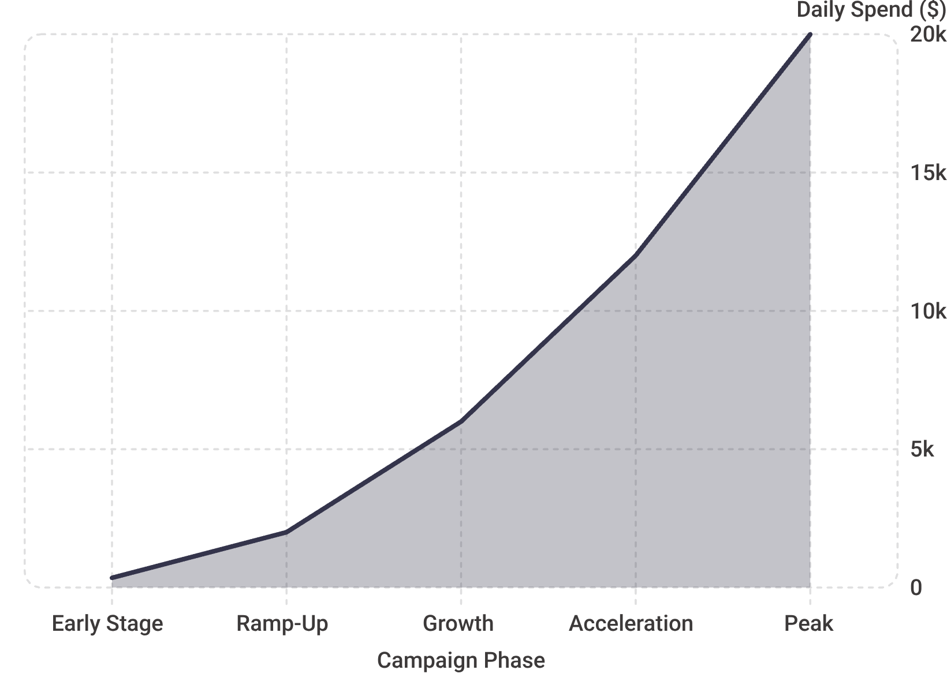

The Scale Story
From $300 to $20,000/Day
Campaign spend scaled dramatically over the 7-month engagement — from early-stage budgets of ~$300–400/day to peak periods exceeding $20,000/day.
This trajectory required constant operational sophistication: managing creative fatigue, audience saturation, and budget efficiency simultaneously at every stage of growth.
Spend figures represent available campaign snapshots and recalled operating ranges; complete historical financial data was not available.

Slide 5
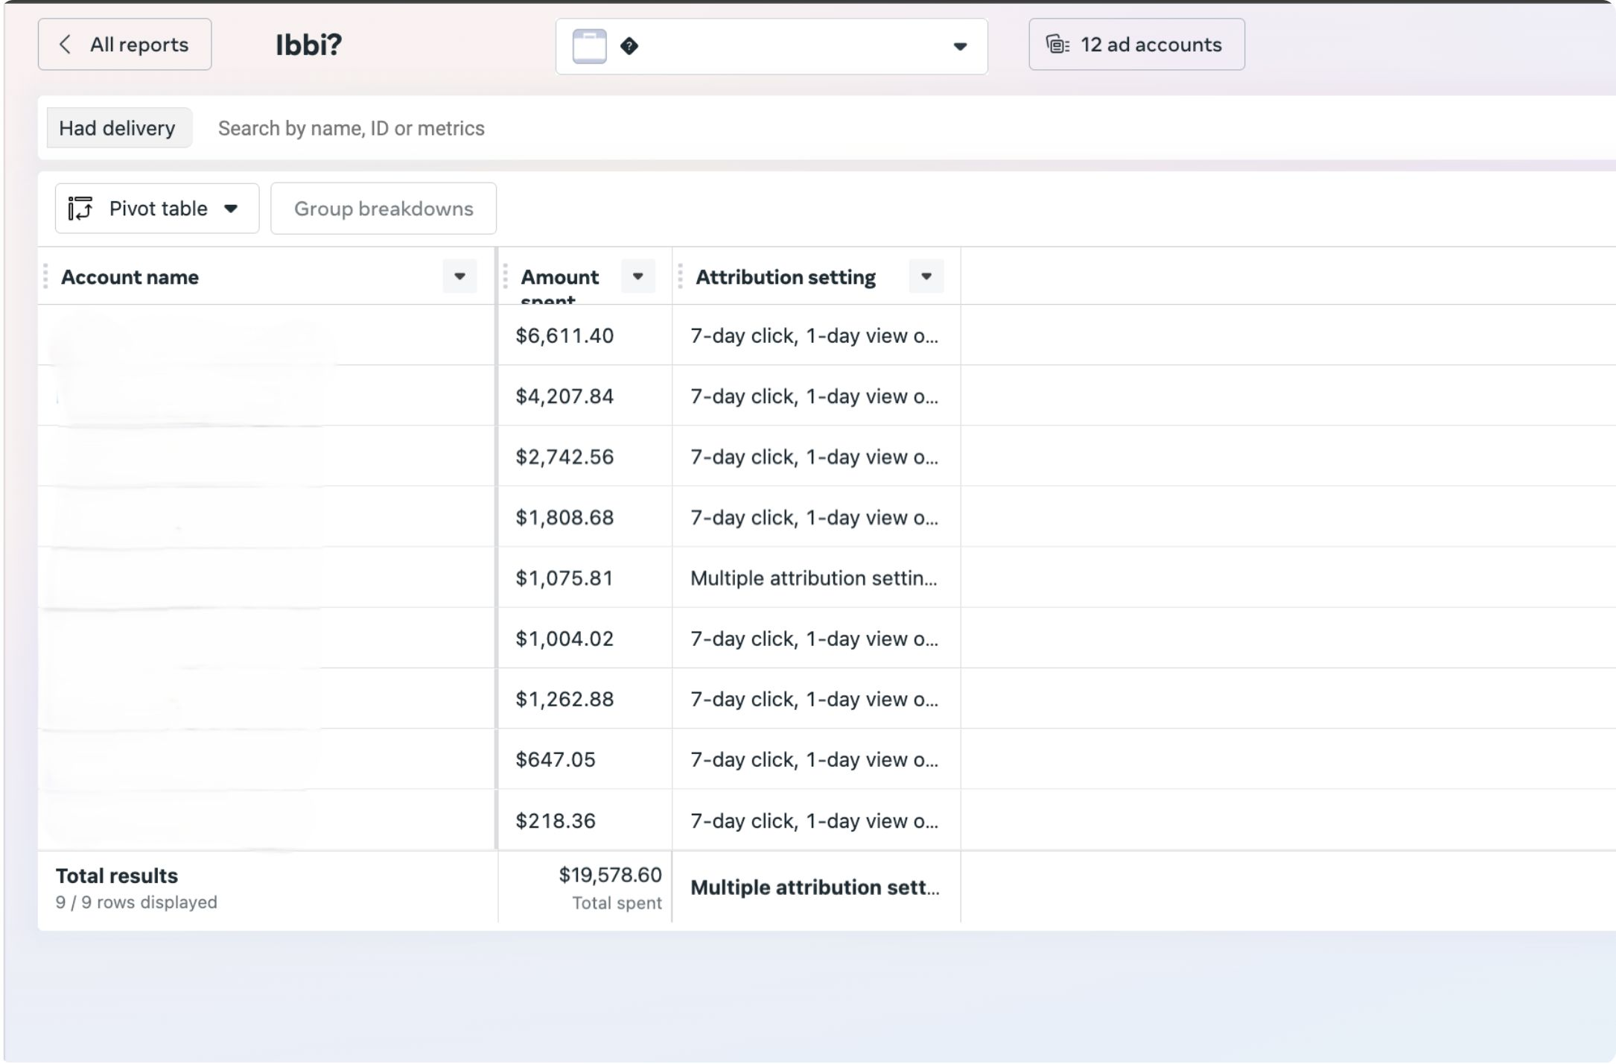
Meta Ads: Proof of Scale
Example account-level spend snapshot across multiple campaigns

Slide 6
Performance Snapshots
Captured from available historical reporting across both verticals
Manifestation Vertical
Weight Loss Vertical
Spend
$871
Spend
$1,399
Profit
$1,980
Revenue
$2,475
AOV
$165
ROAS
1.77×
CPC
$0.84
ROI
77%
CPA
$1.62
CPA
$3.22
EPC
$1.92
ACR
64%
ECR
2.6%
ACR
52.2%

Slide 7
Creative Engine
The acquisition strategy relied on continuous creative iteration and competitor intelligence:
01
02
Spy & Analyze
Script Development
Monitor competitor ads, identify winning hooks and messaging angles
Create UGC concepts aligned with successful patterns
03
04
Production
Test & Measure
Coordinate video editors, creators, and asset production
Launch multiple creative variations, track performance
05
06
Iterate Winners
Scale
Remake and refine top-performing concepts
Increase budget on proven creative while maintaining efficiency
This continuous feedback loop maintained creative freshness and supported campaign growth across both verticals.

Slide 8
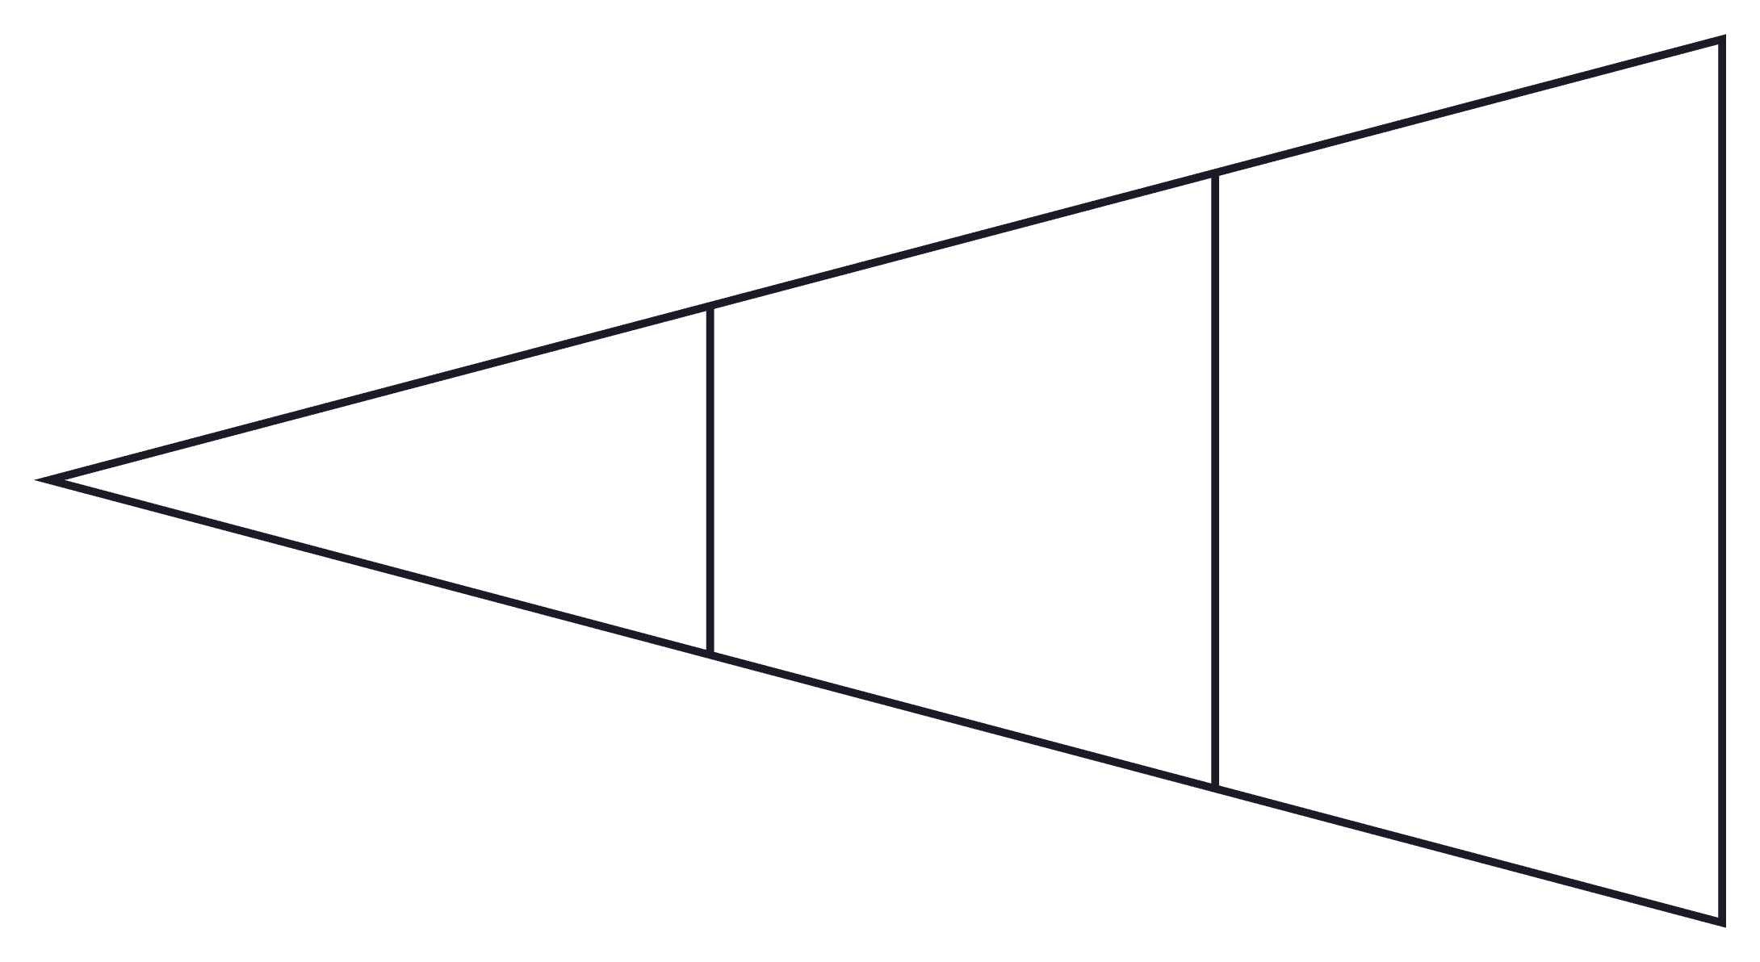
Funnel & Conversion Architecture
Every Stage Was a Lever
Each layer of the funnel was continuously tested and optimized for conversion efficiency — not just the ad creative at the top.
Pre-sell / Advertorial — Warmed cold traffic and established credibility before the offer
Sales Page — Tested headline variants, proof elements, and offer framing
Checkout — Reduced friction and abandoned cart rate
Upsell / Backend — Maximized AOV and customer lifetime value
Meta Ad
Sales Page
Pre-sell / Advertorial
Generic representation of the acquisition architecture; actual client funnel architecture is not disclosed.

Slide 9





Daily Optimization Loop
Campaigns were reviewed 4–5× daily to maintain performance and identify scaling opportunities:
Diagnose
Evaluate
Decide
Monitor spend, CPC, CPA, EPC across all active campaigns
Assess creative performance, funnel conversion, cost trends
Kill underperformers, iterate mid-performers, scale winners
Execute
Recheck
Adjust budgets, launch new creatives, test funnel changes
Verify impact, repeat throughout 24-hour operating cycle
This operational cadence enabled rapid scaling while maintaining acquisition efficiency.

Slide 10
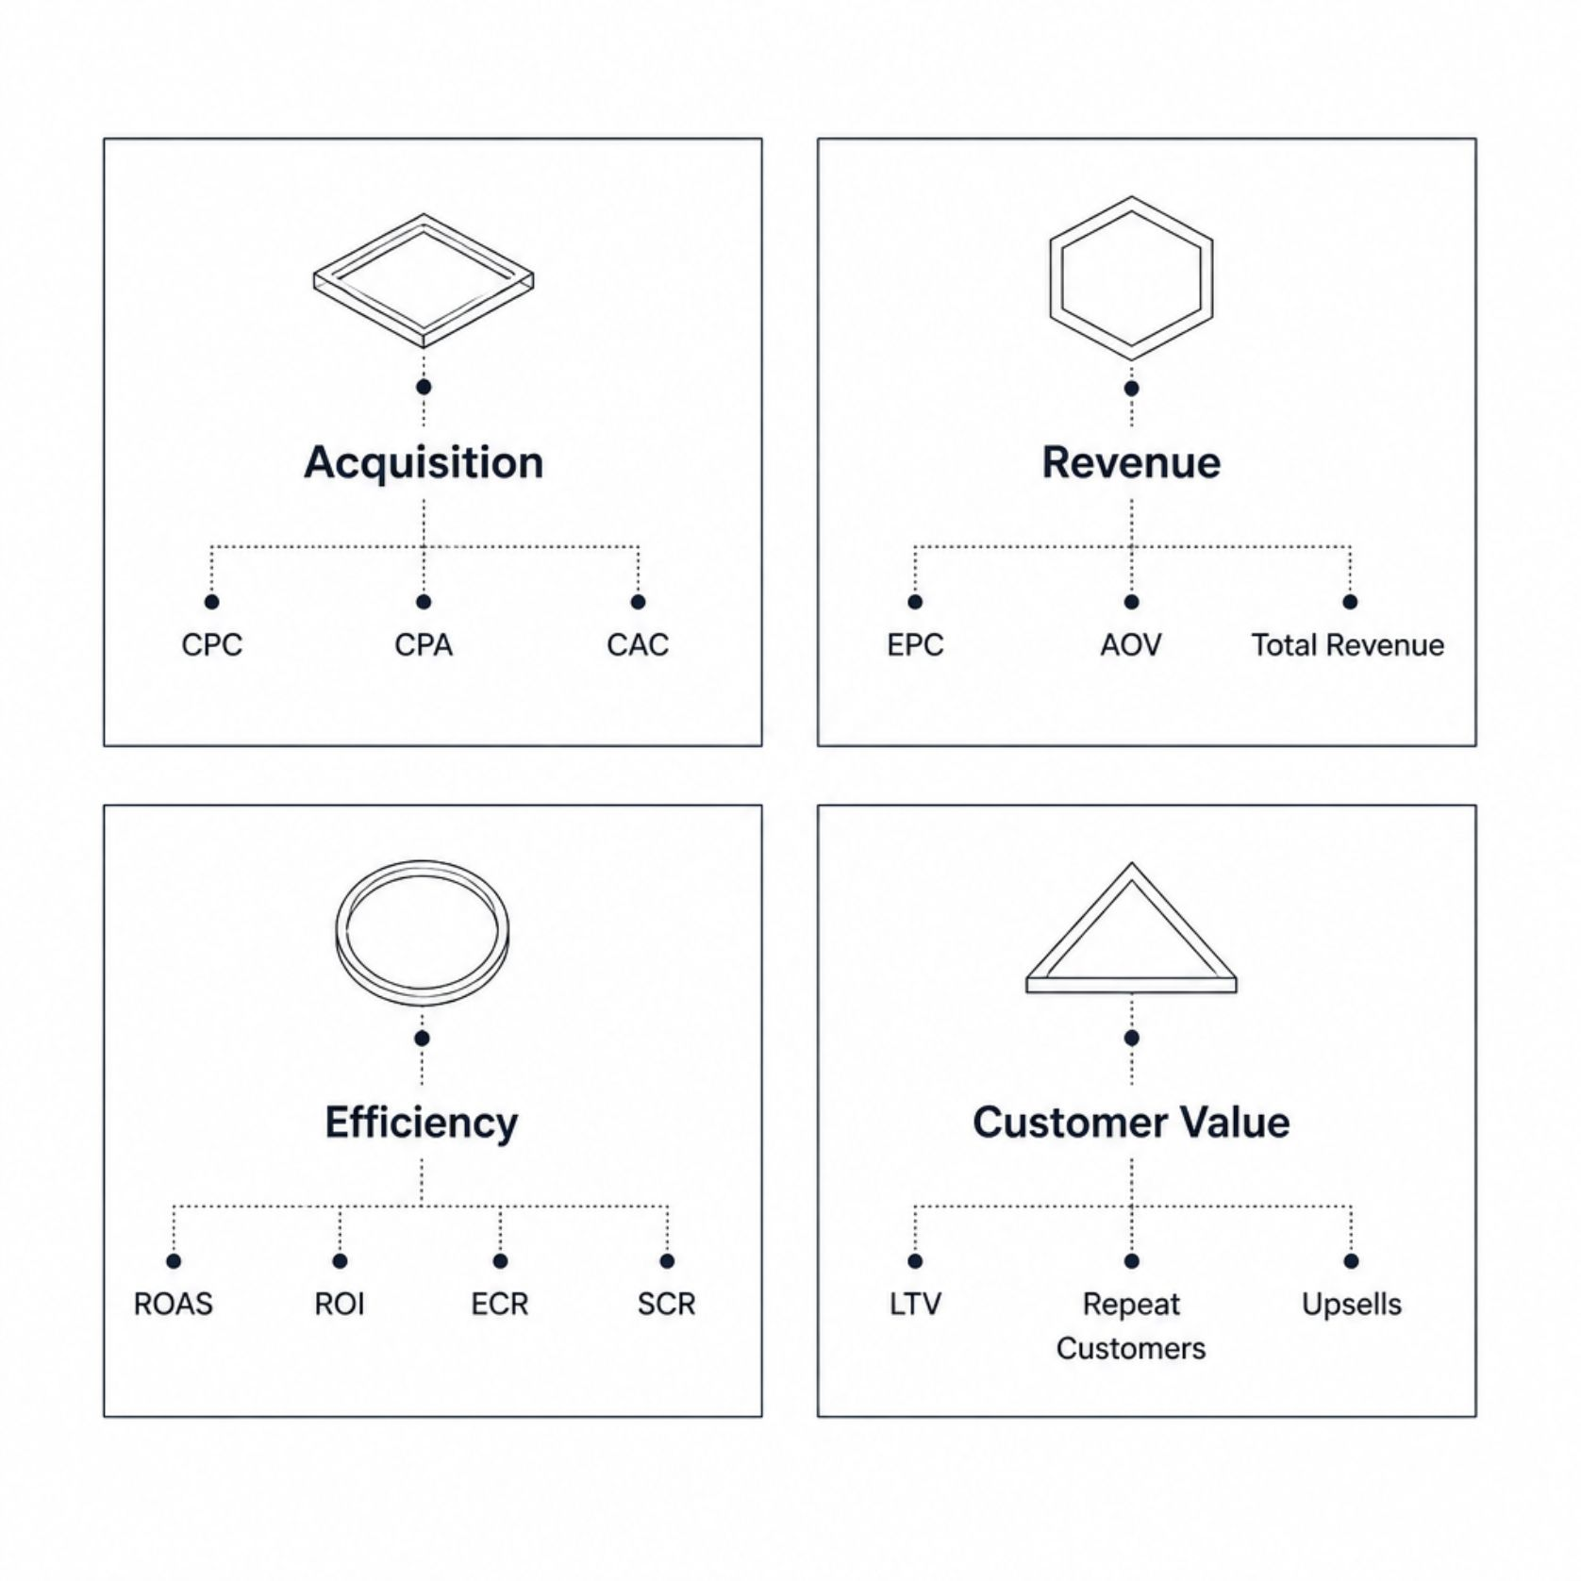

KPI Framework
Beyond Cheap Clicks
Performance was tracked across four dimensions — the objective was never simply to drive cheap clicks. The goal was to understand acquisition efficiency through the full revenue and backend economics of each offer.
Acquisition
Revenue
Efficiency
Customer Value
CPC, CPA, CAC — cost per action
EPC, AOV, Revenue — per-customer economics
ROAS, ROI, ECR, SCR — return on ad spend
LTV, Repeat Customers, Upsells — backend economics

Slide 11

What This Demonstrates
Seven months of direct-response acquisition built a repeatable, scalable performance marketing operation — not just ad management.
Full-Funnel Ownership
From creative strategy through backend optimization — managed every lever in the acquisition loop
Operational Discipline
4–5× daily reviews, systematic KPI tracking, and rapid decision cycles at $20K/day peak spend
Creative Intelligence
Competitor intelligence, UGC scripting, and continuous iteration to maintain creative freshness at scale
Transferable Expertise
Methodology, systems, and analytical rigor that translate across verticals, platforms, and offer types

Slide 12
Key Challenges
Creative Fatigue
Scaling Efficiency
Continuously identify and iterate winning concepts to maintain ad performance
Increase spend without allowing acquisition costs to deteriorate
Competitive Markets
Operational Speed
Compete in saturated Weight Loss and Manifestation verticals
Coordinate media buying, creative production, and funnel optimization on a daily cycle

Slide 13
What I Can Do
From launching campaigns to operating the entire acquisition loop.
Media Buying & Campaign Management
Creative Strategy & UGC Direction
Funnel Optimization & Testing
Performance Analytics & Reporting
Direct-Response Marketing
Campaign Scaling & Budget Allocation

Slide 14
Confidentiality Notice
This case study has been intentionally anonymized. Client identities, proprietary creative assets, internal documents, account credentials, domains, complete financial records, and other confidential materials have been excluded.
Performance figures shown are limited to historical snapshots that I am permitted to reference and should not be interpreted as complete seven-month financial results.

