Slide 1

Lead Generation Media Buying Case Study
Spanish & English Debt Relief
From $2K/day acquisition to $10K+/day scale

Slide 2
2-Year Acquisition Performance
$5.4M+
$3.7M+
Revenue Generated
Media Spend
935K+
272K+
Calls Generated
Monetized Qualified Calls
Platforms
Market
Vertical
Google · Meta · TikTok
United States · Nationwide
Debt Relief / Debt Settlement / Debt Consolidation
Confidential case study. Selected metrics are presented in rounded or range-based form to protect client, buyer and proprietary business information.

Slide 3


A Different Kind of Lead Generation Model
This was not a traditional form-lead campaign. The objective was to generate high-intent consumer demand, route qualified leads into the buyer's call-center operation, and monetize standard calls that met the agreed 8+ minute qualification threshold.
Paid Traffic
Qualification
Buyer Call Center
8+ Min Call
Monetization
The optimization target was not simply "Get the cheapest lead." It was: Generate buyer-valuable calls at a sustainable CPA while maintaining call quality. The standard qualification threshold was approximately 8+ minutes, while many high-quality calls extended substantially longer.

Slide 4



The Problem Wasn't Traffic. It Was Scale + Quality.
When I took over, the advertising platform was already operational. The real challenge was creating a repeatable acquisition system capable of scaling without destroying lead quality or economics.
Starting Conditions
Key Realization
The same audience was producing dramatically different outcomes depending on the call-center operation.The buyer's call-center operation was performing approximately 3–4× better than the original low-performing agent environment.
Acquisition CPA
ACL
$2,000+
~5 minutes
Monetized Calls
Daily Spend
Media quality could not be evaluated independently from downstream call quality. The acquisition strategy had to optimize for the entire funnel—not just clicks or form submissions.
~2000 per month
~$2K
Monthly Revenue
~$100K / breakeven territory

Slide 5
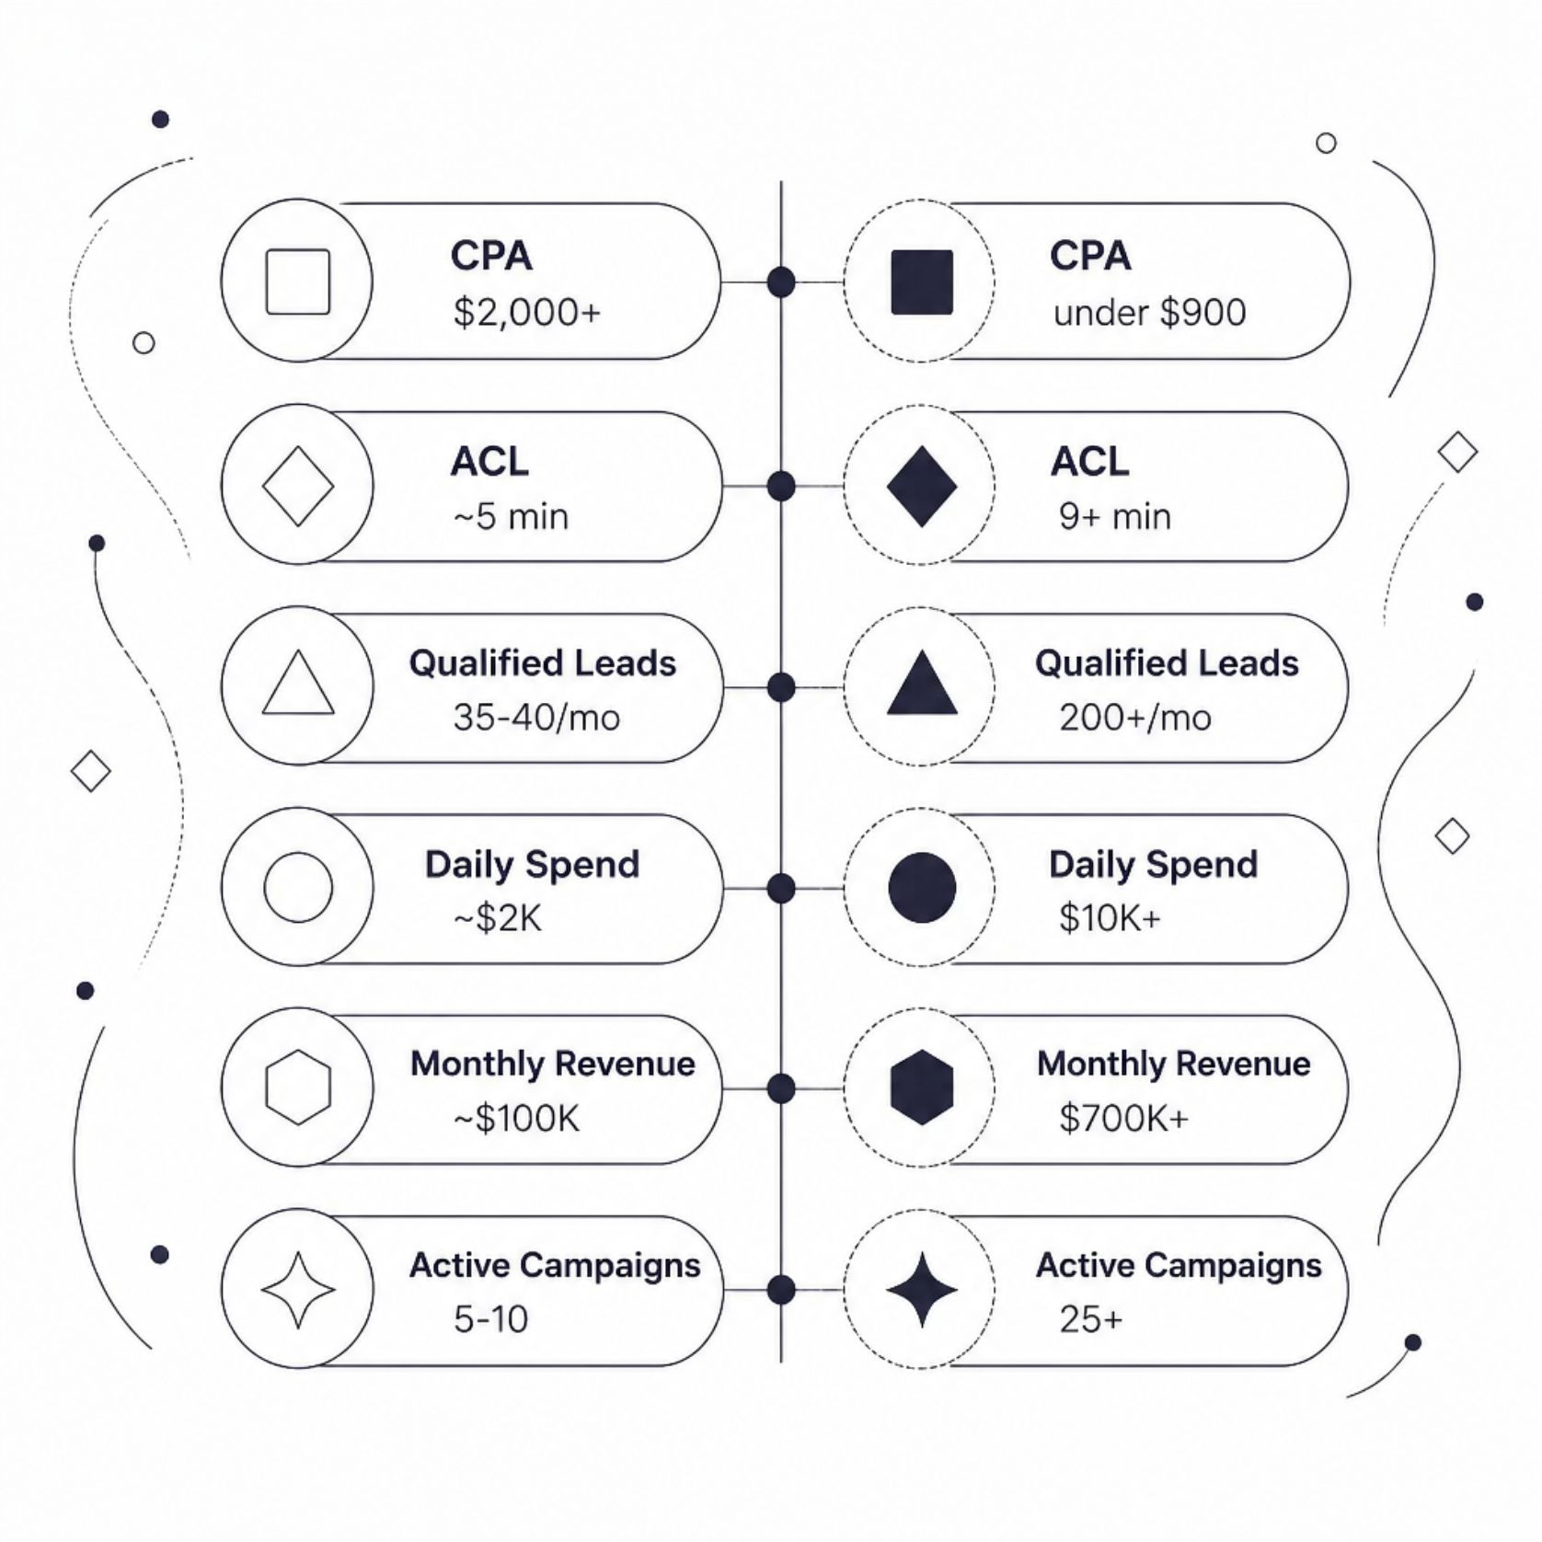
The Transformation: Before vs. After
Scale Achieved in ~4 Months
~5×
~5×
Lead-volume increase
Daily spend increase
~7×
Monthly revenue increase
Figures are approximate/rounded where required for confidentiality.

Slide 6





The Breakthrough: Creative as a Qualification Layer
The biggest breakthrough was not simply finding cheaper traffic. It was understanding that the ad itself could help pre-qualify the audience.
The buyer had a clear demand for consumers carrying $15K+ in debt. Instead of optimizing exclusively for maximum call volume, we developed a proprietary creative framework designed to attract the buyer's preferred audience.
Buyer Demand
$15K+ debt consumers
Audience Definition
Buyer-defined audience criteria
Creative Messaging
Pre-qualification built in
LP Qualification
Filter before the call
Higher-Intent Calls
Monetizable at scale
We stopped treating creative as merely a CTR mechanism. Creative became part of the qualification system. The actual scripts and creative assets remain confidential.

Slide 7
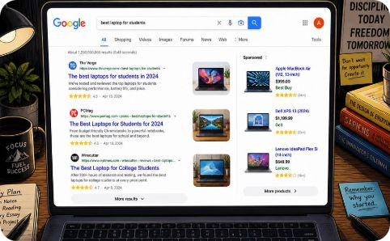
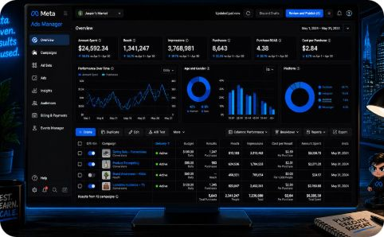
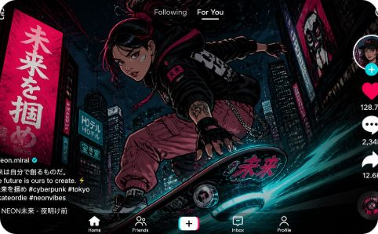

Multi-Platform Acquisition Strategy
Google: Search + Video
Meta: Broad Targeting
TikTok: Video-First
Search Terms & Keyword Planner
SEMrush & YouTube research
Competitive advertising research
Bidding: Max Conversions / tCPA
Winner: 1 Campaign → 1 Ad Set → 5 Ads
New-test: 1 Campaign → 1 Ad Set → 3 Ads
Optimization: cost per result + downstream quality
Creative testing & scalable audience acquisition
Cost Cap bidding for economic control
Common denominator: Every platform had to answer: Can this traffic produce qualified, monetizable calls at an acceptable CPA?

Slide 8



Creative Testing Engine
Research Sources
Creative Development Process
Ad Libraries
Key principle: A creative was not considered successful simply because it generated cheap clicks. It had to contribute to: CPA + qualification + ACL + monetization.
Meta Ad Library, TikTok Creative Center, Google/YouTube
Competitor Intelligence
Competitor advertising patterns & industry trends
Social Trends
Social media trends & industry advertising patterns
01
02
Identify proven hook
Reframe for debt vertical
03
04
Adapt to target audience
Launch controlled test
05
06
Measure downstream quality
Scale / iterate / kill

Slide 9


Campaign Architecture & Testing
The account structure was designed to separate testing from scaling.
New Campaigns
Deteriorating Winners
~2 days of consistent negative performance before shutdown consideration, depending on spend and data quality.
−20% budget adjustment. If negative performance persisted: Descale → reassess → eventually kill.
Scaling Winners
+30–40% budget increase approximately every 3 days once consistent profitable performance was demonstrated.
Why this worked: Scale came from finding more repeatable winners, not simply forcing more budget into one campaign.

Slide 10
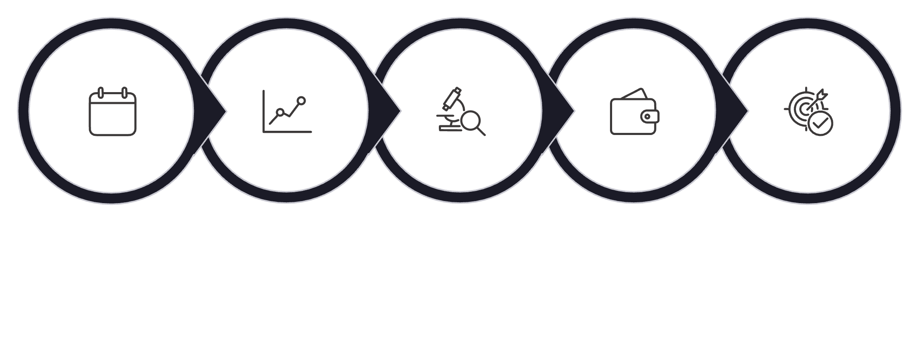

The Buyer Feedback Loop
We did not optimize inside an advertising platform in isolation. The buyer supplied weekly downstream CPA and call-quality performance reports, creating a downstream feedback loop.
What This Changed
Result: The optimization system increasingly selected for traffic that was valuable after the click, rather than traffic that merely looked good inside the ad platform.
Weekly Data
Identify Patterns
Analyze Drivers
Reallocate Budget
Adjust Targeting
Before
After
Optimizing for metrics that looked good inside the ad platform
Selecting for traffic that was valuable after the click

Slide 11

Systems Thinking, Not Single-Campaign Wins
This case study represents a 2-year, full-funnel performance operation — not a single campaign or a lucky month. The results were produced by building repeatable systems across creative, targeting, qualification, and optimization.
$5.4M+ Revenue
<$800 Buyer-side CPA
Across 2 years of sustained operation
For guaranteed qualified leads
272K+ Monetized Calls
Qualified, buyer-valuable inbound calls
All data presented in this case study has been rounded, aggregated, or presented in range-based form. No client identity, proprietary scripts, payout percentages, account names, or screenshots are disclosed. This case study is presented for portfolio evaluation purposes and does not disclose proprietary client or buyer information. Consumer-facing advertising claims should be independently reviewed for applicable legal and platform requirements before reuse.

