Slide 1
Natural Language Processing

Slide 2




introduction
www.tuf.edu.pk
unioffaisalabad
NLP stands for Natural Language Processing. It is a subfield of artificial intelligence (AI) and linguistics that focuses on the interaction between computers and human language. NLP is concerned with enabling machines to understand, interpret, and generate human language in a valuable way. This field is at the intersection of computer science, artificial intelligence, and linguistics.

Slide 3
Tasks
www.tuf.edu.pk
unioffaisalabad
NLP involves a wide range of tasks and applications, including but not limited to:
Text Classification: Categorizing text into predefined categories or labels (e.g., spam detection, sentiment analysis).
Named Entity Recognition (NER): Identifying and categorizing entities like names of people, places, organizations, and dates in text.
Part-of-Speech Tagging (POS): Labeling words in a sentence with their grammatical parts of speech (e.g., nouns, verbs, adjectives).

Slide 4
Tasks
www.tuf.edu.pk
unioffaisalabad
Machine Translation: Translating text from one language to another (e.g., Google Translate).
Text Generation: Creating human-like text, which can be used for chatbots, content generation, and more.
Question Answering: Building systems that can answer questions posed in natural language based on a given text or dataset.
Speech Recognition and Synthesis: Converting spoken language into written text (Speech-to-Text) and vice versa (Text-to-Speech).

Slide 5
Tasks
www.tuf.edu.pk
unioffaisalabad
Text Summarization: Creating concise and coherent summaries of longer texts or documents.
Language Modeling: Building models that can predict the next word or phrase in a sentence.
Chatbots and Virtual Assistants: Developing conversational agents that can interact with users in natural language, like Siri, Alexa, or chatbots for customer service.
Information Retrieval: Finding relevant documents or information from a large corpus in response to a user's query, which underlies search engines.

Slide 6
Tasks
www.tuf.edu.pk
unioffaisalabad
NLP relies on a combination of linguistics, machine learning, and deep learning techniques to process, analyze, and generate human language. In recent years, the field has seen significant advancements, particularly with the advent of large pre-trained language models like GPT-3 and BERT, which have substantially improved the performance of various NLP tasks.

Slide 7
Tasks
www.tuf.edu.pk
unioffaisalabad
NLP has a wide range of applications across industries, including healthcare, finance, customer service, e-commerce, content generation, and more. It plays a crucial role in making human-computer interactions more natural and accessible.

Slide 8
Supervised and Unsupervised learning
www.tuf.edu.pk
unioffaisalabad
Supervised learning
Supervised learning is a type of machine learning algorithm that learns from labeled data. Labeled data is data that has been tagged with a correct answer or classification.
Supervised learning, as the name indicates, has the presence of a supervisor as a teacher. Supervised learning is when we teach or train the machine using data that is well-labelled. Which means some data is already tagged with the correct answer.

Slide 9
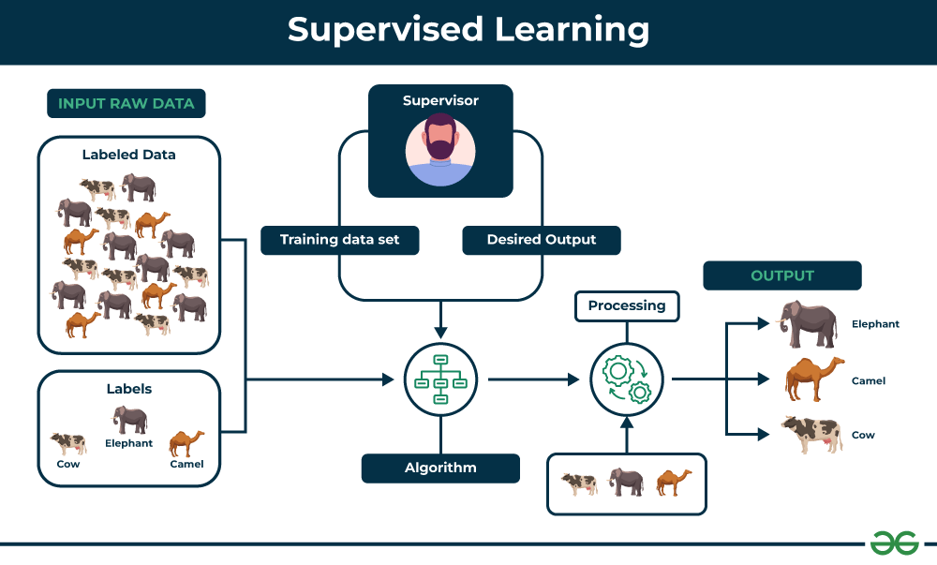

Slide 10
Key Points
www.tuf.edu.pk
unioffaisalabad
Supervised learning involves training a machine from labeled data.
Labeled data consists of examples with the correct answer or classification.
The machine learns the relationship between inputs (fruit images) and outputs (fruit labels).
The trained machine can then make predictions on new, unlabeled data.

Slide 11
Types of Supervised Learning
www.tuf.edu.pk
unioffaisalabad
1- Regression
Regression is a type of supervised learning that is used to predict continuous values, such as house prices, stock prices, or customer churn. Regression algorithms learn a function that maps from the input features to the output value.
Some common regression algorithms include:
Linear Regression
Polynomial Regression
Support Vector Machine Regression
Decision Tree Regression
Random Forest Regression

Slide 12
Types of Supervised Learning
www.tuf.edu.pk
unioffaisalabad
2- Classification
Classification is a type of supervised learning that is used to predict categorical values, such as whether a customer will churn or not, whether an email is spam or not, or whether a medical image shows a tumor or not. Classification algorithms learn a function that maps from the input features to a probability distribution over the output classes.
Some common classification algorithms include:
Logistic Regression
Support Vector Machines
Decision Trees
Random Forests
Naive Baye

Slide 13
Applications of Supervised Learning
www.tuf.edu.pk
unioffaisalabad
Spam filtering: Supervised learning algorithms can be trained to identify and classify spam emails based on their content, helping users avoid unwanted messages.
Image classification: Supervised learning can automatically classify images into different categories, such as animals, objects, or scenes, facilitating tasks like image search, content moderation, and image-based product recommendations.
Medical diagnosis: Supervised learning can assist in medical diagnosis by analyzing patient data, such as medical images, test results, and patient history, to identify patterns that suggest specific diseases or conditions.
Fraud detection: Supervised learning models can analyze financial transactions and identify patterns that indicate fraudulent activity, helping financial institutions prevent fraud and protect their customers.
Natural language processing (NLP): Supervised learning plays a crucial role in NLP tasks, including sentiment analysis, machine translation, and text summarization, enabling machines to understand and process human language effectively

Slide 14
Unsupervised Learning
www.tuf.edu.pk
unioffaisalabad
Unsupervised learning is a type of machine learning that learns from unlabeled data. This means that the data does not have any pre-existing labels or categories. The goal of unsupervised learning is to discover patterns and relationships in the data without any explicit guidance.
Unsupervised learning is the training of a machine using information that is neither classified nor labeled and allowing the algorithm to act on that information without guidance. Here the task of the machine is to group unsorted information according to similarities, patterns, and differences without any prior training of data.

Slide 15
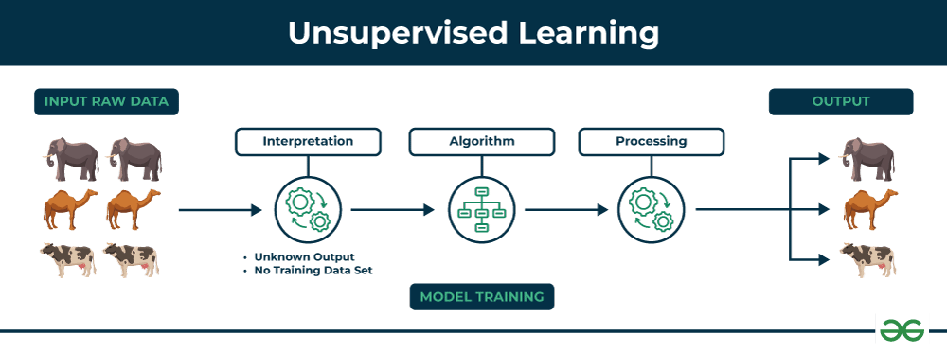

Slide 16
Key Points
www.tuf.edu.pk
unioffaisalabad
Unsupervised learning allows the model to discover patterns and relationships in unlabeled data.
Clustering algorithms group similar data points together based on their inherent characteristics.
Feature extraction captures essential information from the data, enabling the model to make meaningful distinctions.

Slide 17
Types of Unsupervised Learning
www.tuf.edu.pk
unioffaisalabad
Clustering
Clustering is a type of unsupervised learning that is used to group similar data points together. Clustering algorithms work by iteratively moving data points closer to their cluster centers and further away from data points in other clusters.
Exclusive (partitioning)
Agglomerative
Overlapping
Probabilistic

Slide 18
Types of Unsupervised Learning
www.tuf.edu.pk
unioffaisalabad
Association rule learning
Association rule learning is a type of unsupervised learning that is used to identify patterns in a data. Association rule learning algorithms work by finding relationships between different items in a dataset.
Some common association rule learning algorithms include:
Apriori Algorithm
Eclat Algorithm
FP-Growth Algorithm

Slide 19
Applications of Unsupervised Learning
www.tuf.edu.pk
unioffaisalabad
Anomaly detection: Unsupervised learning can identify unusual patterns or deviations from normal behavior in data, enabling the detection of fraud, intrusion, or system failures.
Scientific discovery: Unsupervised learning can uncover hidden relationships and patterns in scientific data, leading to new hypotheses and insights in various scientific fields.
Recommendation systems: Unsupervised learning can identify patterns and similarities in user behavior and preferences to recommend products, movies, or music that align with their interests.
Customer segmentation: Unsupervised learning can identify groups of customers with similar characteristics, allowing businesses to target marketing campaigns and improve customer service more effectively.
Image analysis: Unsupervised learning can group images based on their content, facilitating tasks such as image classification, object detection, and image retrieval.

Slide 20
