Slide 1
NLP Pipeline

Slide 2




NLP Pipeline
www.tuf.edu.pk
unioffaisalabad
In NLP we need to perform some extra processing steps. The region is very simple that machines don’t understand the text. Here our biggest problem is How to make the text understandable for machines. Some of the most common problems we face while performing NLP tasks are mentioned below.
Data Acquisition
Text Cleaning
Text Preprocessing
Feature Engineering
Model Building
Evaluation
Deployment

Slide 3
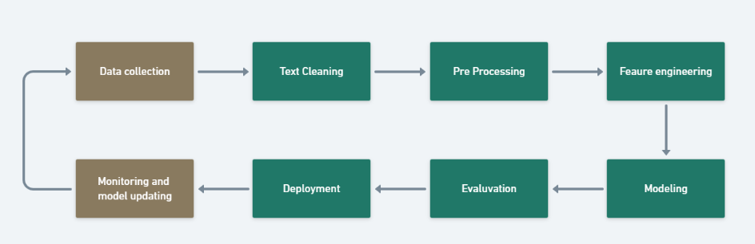
NLP Pipeline
www.tuf.edu.pk
unioffaisalabad

Slide 4
1. Data Acquisition
www.tuf.edu.pk
unioffaisalabad
For building the machine learning model we need data related to our problem statements, Sometimes we have our data and Sometimes we have to find it. Text data is available on websites, in emails, in social media, in form of pdf, and many more. But the challenge is. Is it in a machine-readable format? if in the machine-readable format then will it be relevant to our problem? So, First thing we need to understand our problem or task then we should search for data. Here we will see some of the ways of collecting data if it is not available in our local machine or database.

Slide 5
1. Data Acquisition
www.tuf.edu.pk
unioffaisalabad
Public Dataset: We can search for publicly available data as per our problem statement.
Web Scrapping: Web Scrapping is a technique to scrap data from a website. For this, we can use Beautiful Soup to scrape the text data from the web page.
Image to Text: We can also scrap the data from the image files with the help of Optical character recognition (OCR). There is a library Tesseract that uses OCR to convert image to text data.
pdf to Text: We have multiple Python packages to convert the data into text. With the PyPDF2 library, pdf data can be extracted in the .text file.

Slide 6
2. Text Cleaning
www.tuf.edu.pk
unioffaisalabad
Unicode Normalization: if text data may contain symbols, emojis, graphic characters, or special characters. Either we can remove these characters or we can convert this to machine-readable text.
Regex or Regular Expression: Regular Expression is the tool that is used for searching the string of specific patterns. Suppose our data contain phone number, email-Id, and URL. we can find such text using the regular expression. After that either we can keep or remove such text patterns as per requirements.
Spelling corrections: When our data is extracted from social media. Spelling mistakes are very common in that case. To overcome this problem we can create a corpus or dictionary of the most common mistype words and replace these common mistakes with the correct word.

Slide 7
3. Text Preprocessing
www.tuf.edu.pk
unioffaisalabad
Text preprocessing refers to a series of techniques used to clean, transform and prepare raw textual data into a format that is suitable for NLP or ML tasks. The goal of text preprocessing is to enhance the quality and usability of the text data for subsequent analysis or modeling.
Tokenization: Tokenization is the process of segmenting the text into a list of tokens. In the case of sentence tokenization, the token will be sentenced and in the case of word tokenization, it will be the word. It is a good idea to first complete sentence tokenization and then word tokenization, here output will be the list of lists. Tokenization is performed in each & every NLP pipeline.

Slide 8
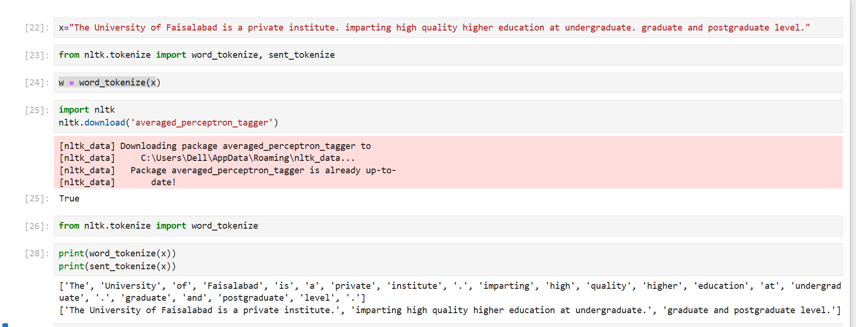
3. Text Preprocessing
www.tuf.edu.pk
unioffaisalabad

Slide 9
3. Text Preprocessing
www.tuf.edu.pk
unioffaisalabad
Lowercasing: This step is used to convert all the text to lowercase letters. This is useful in various NLP tasks such as text classification, information retrieval, and sentiment analysis.
Stop word removal: Stop words are commonly occurring words in a language such as “the”, “and”, “a”, etc. They are usually removed from the text during preprocessing because they do not carry much meaning and can cause noise in the data. This step is used in various NLP tasks such as text classification, information retrieval, and topic modeling.

Slide 10
3. Text Preprocessing
www.tuf.edu.pk
unioffaisalabad
Stemming or lemmatization: Stemming and lemmatization are used to reduce words to their base form, which can help reduce the vocabulary size and simplify the text. Stemming involves stripping the suffixes from words to get their stem, whereas lemmatization involves reducing words to their base form based on their part of speech. This step is commonly used in various NLP tasks such as text classification, information retrieval, and topic modeling.
Removing digit/punctuation: This step is used to remove digits and punctuation from the text. This is useful in various NLP tasks such as text classification, sentiment analysis, and topic modeling.

Slide 11
3. Text Preprocessing
www.tuf.edu.pk
unioffaisalabad
POS tagging: POS tagging involves assigning a part of speech tag to each word in a text. This step is commonly used in various NLP tasks such as named entity recognition, sentiment analysis, and machine translation.
Named Entity Recognition (NER): NER involves identifying and classifying named entities in text, such as people, organizations, and locations. This step is commonly used in various NLP tasks such as information extraction, machine translation, and question-answering

Slide 12
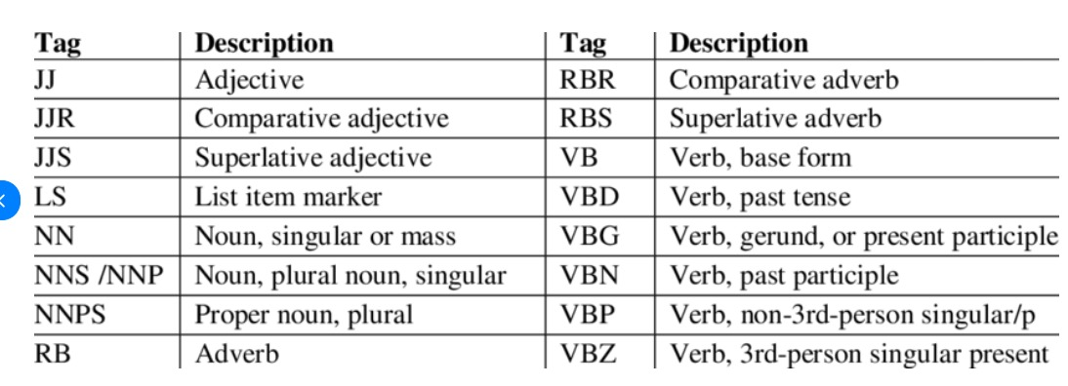
3. Text Preprocessing
www.tuf.edu.pk
unioffaisalabad

Slide 13
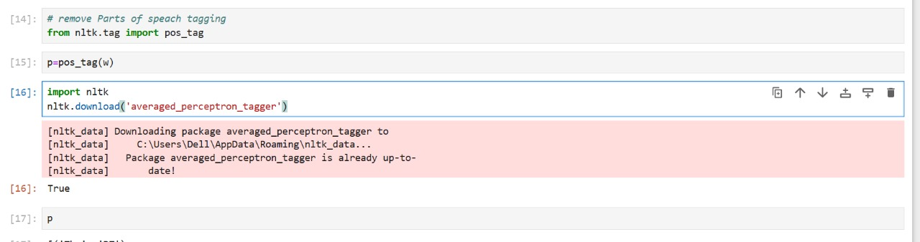
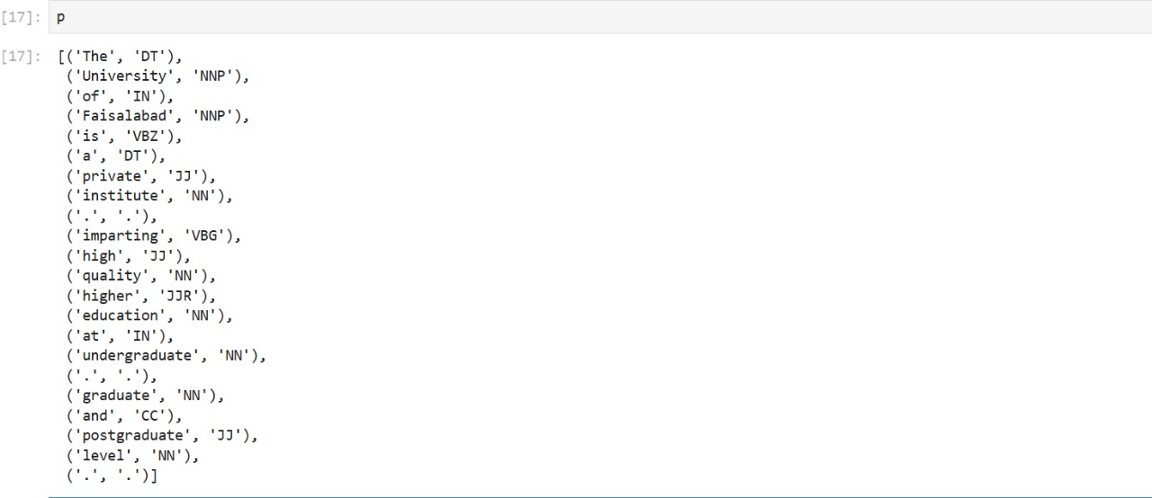
3. Text Preprocessing
www.tuf.edu.pk
unioffaisalabad

Slide 14
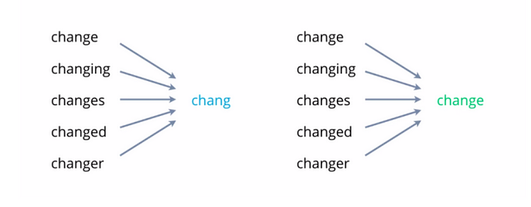
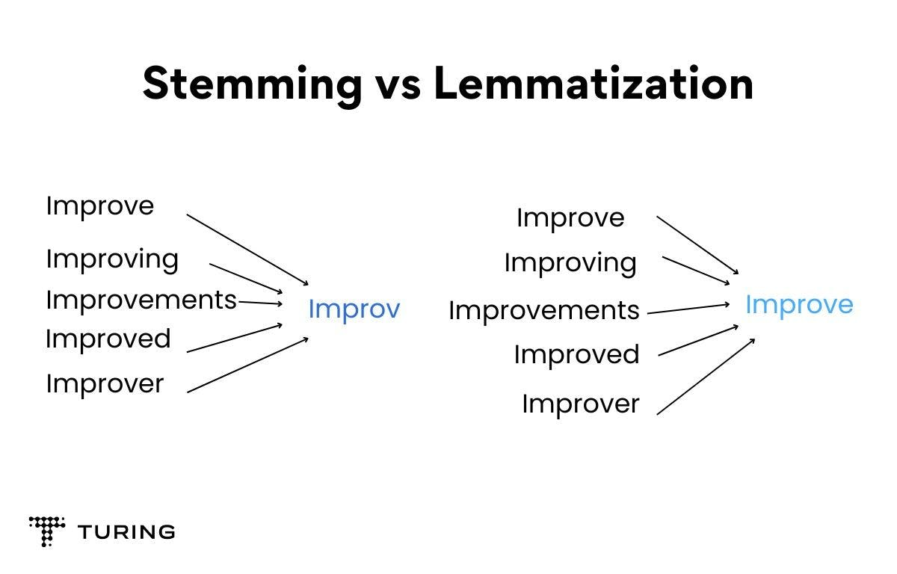
3. Text Preprocessing
www.tuf.edu.pk
unioffaisalabad

