Slide 1
Text classification

Slide 2
Text classification
Text classification in natural language processing (NLP) is the process of assigning predefined categories or labels to a given piece of text. It is a fundamental NLP task used in various applications, including spam detection, sentiment analysis, topic categorization, and more. Text classification models learn to make predictions about the category or label of a text based on the patterns and features present in the text.
Text classification is a Machine Learning approach for automatically categorizing open-ended text into a number of predetermined categories. Text classifiers can structure, arrange, and classify almost any type of text, including articles, medical research, and customer tickets, as well as text found on the internet.

Slide 3
Why text classification is important.
With text classification, businesses can make the most out of unstructured data. Text classification tools allow organizations to efficiently and cost-effectively arrange all types of texts, e-mails, legal papers, ads, databases, and other documents. This enables them to save time and make informed decisions based on relevant data.
For example, you could collect app crash reports and categorize them based on the problem. Categories for this could be:
Loading time
App not responsive
Screen freezes

Slide 4
Reasons to consider text classification
Identifying problems users have with your product
Most customer service requests end up in a backlog, while the product team is prioritizing new features. With a structured system to categorize requests, you’ll have a better overview of the problems users are facing.
Recognizing user segments to improve your targeting
You may segment your audience depending on the words and phrases they use, allowing you to develop more focused campaigns.
Getting ideas for new features
One of your users could tweet “If this product would have a logo generation feature, it would be perfect for me.” This is valuable feedback and you can leverage it to make your product more useful.
Analyzing data in real-time
Automated text classification can track your brand mentions in real time, allowing you to see timely posts and take immediate action.

Slide 5
Here are the key steps involved in training a text classification model:
1.Data Collection and Preprocessing:
Gather a dataset of text documents, where each document is associated with a predefined category or label.
Preprocess the text data, which includes tasks like tokenization (breaking text into words or phrases), removing stop words, stemming or lemmatization (reducing words to their base form), and handling other text-specific cleaning tasks.

Slide 6
2.Feature Extraction:
Convert the text data into a numerical format that can be used as input for machine learning algorithms. Common techniques include:
Bag of Words (BoW): Represent each document as a vector where each element corresponds to the frequency of a word in the document.
TF-IDF (Term Frequency-Inverse Document Frequency): Weigh words based on their importance in the document and the corpus.
Word Embeddings: Represent words as dense, continuous-valued vectors. Techniques like Word2Vec, GloVe, or pre-trained embeddings like Word2Vec, FastText, or BERT embeddings are used.

Slide 7
3. Data Splitting:
Divide the dataset into training, validation, and test sets. The training set is used to train the model, the validation set is used for hyper parameter tuning, and the test set is used to evaluate the model's performance.

Slide 8
4.Model Selection:
Choose an appropriate text classification model. Common choices include:
Naive Bayes: A simple probabilistic model often used for text classification.
Support Vector Machines (SVM): Effective for text classification when combined with appropriate feature representations.
Deep Learning Models: Neural networks, including Convolutional Neural Networks (CNNs) and Recurrent Neural Networks (RNNs), can be used for more complex text classification tasks.
Pre-trained Language Models: Models like BERT, GPT-3, and their variants have shown remarkable performance on a wide range of text classification tasks

Slide 9
5.Model Training:
Train the chosen model on the training data. This involves feeding the feature vectors from the training text data to the model and optimizing its parameters using a loss function and an optimization algorithm.

Slide 10
6.Model Evaluation:
Evaluate the trained model's performance on the test dataset using appropriate evaluation metrics like accuracy, precision, recall, F1 score, or others depending on the nature of the classification task

Slide 11
Deployment:
Deploy the trained model into production for real-world text classification tasks. This may involve integrating it into a web application, chatbot, or any other relevant system

Slide 12
Why is the Bag-of-Words algorithm used?
So, why bag-of-words, what is wrong with the simple and easy text?
One of the biggest problems with text is that it is messy and unstructured, and machine learning algorithms prefer structured, well defined fixed-length inputs and by using the Bag-of-Words technique we can convert variable-length texts into a fixed-length vector.
Also, at a much granular level, the machine learning models work with numerical data rather than textual data. So to be more specific, by using the bag-of-words (BoW) technique, we convert a text into its equivalent vector of numbers.
Notes:
Level of Granularity refers to the extent or level of detail at which data is collected and analyzed.
It can influence the accuracy and efficiency of data analysis, machine learning, and artificial intelligence.

Slide 13
Understanding Bag of Words with an example Example With preprocessing:
Sentence 1: ”Welcome to Great Learning, Now start learning”
Sentence 2: “Learning is a good practice”
Step 1: Convert the above sentences in lower case as the case of the word does not hold any information.
Step 2: Remove special characters and stopwords from the text. Stopwords are the words that do not contain much information about text like ‘is’, ‘a’,’the and many more’.
After applying the above steps, the sentences are changed to
Sentence 1: ”welcome great learning now start learning”
Sentence 2: “learning good practice”
Although the above sentences do not make much sense the maximum information is contained in these words only.

Slide 14
Step 3: Go through all the words in the above text and make a list of all of the words in our model vocabulary.
welcome
great
learning
now
start
good
practice
Now as the vocabulary has only 7 words, we can use a fixed-length document-representation of 7, with one position in the vector to score each word.
The scoring method we use here is the same as used in the previous example. For sentence 1, the count of words is as follow:

Slide 15
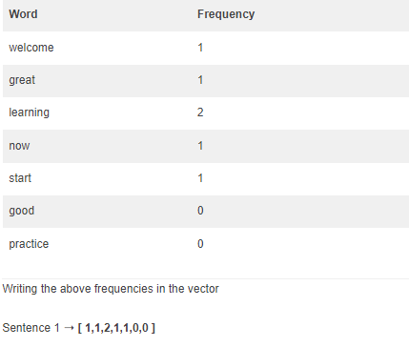
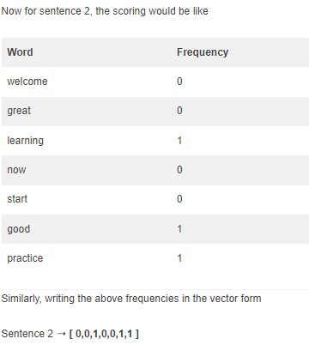
Sentence 1: ”Welcome to Great Learning, Now start learning” Sentence 2: “Learning is a good practice”

Slide 16
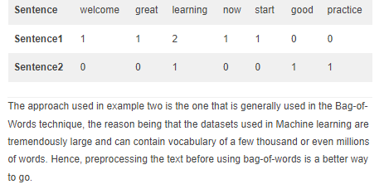

Slide 17
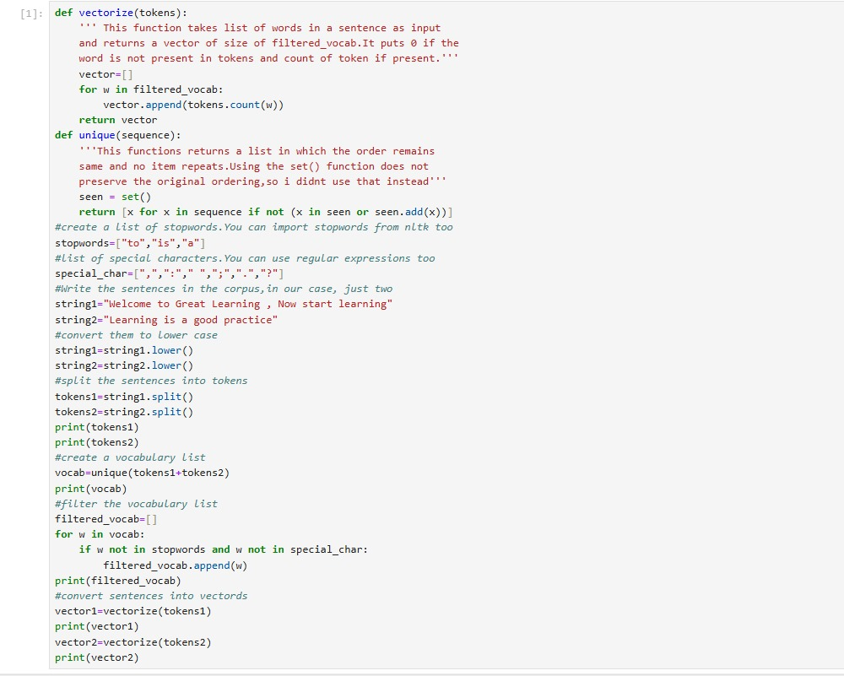

Slide 18
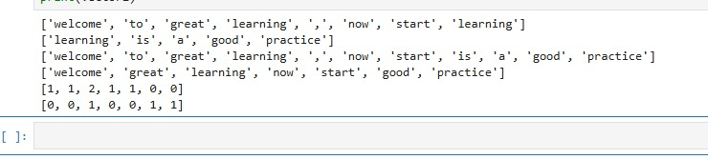
Output

Slide 19
Limitations:
Ignores word order: It does not capture the relationship between words or their sequence
(i.e., it treats "dog bites man" and "man bites dog" the same).
Sparse representation: For large vocabularies, the resulting vectors can be very sparse (mostly zeros).
No semantic meaning: The model doesn't capture the meaning of words or their context (e.g.,
synonyms are treated as different words).

Slide 20
What is TF-IDF?
TF-IDF is a numerical statistic that reflects the significance of a word within a document relative to a collection of documents, known as a corpus. The idea behind TF-IDF is to quantify the importance of a term in a document with respect to its frequency in the document and its rarity across multiple documents

Slide 21

Term Frequency (TF)
TF measures the frequency of a term within a document. It is calculated as the ratio of the number of times a term occurs in a document to the total number of terms in that document. The goal is to emphasize words that are frequent within a document.

Slide 22

​Inverse Document Frequency (IDF)
IDF measures the rarity of a term across a collection of documents. It is calculated as the logarithm of the ratio of the total number of documents to the number of documents containing the term. The goal is to penalize words that are common across all documents.

Slide 23
Combining TF and IDF: TF-IDF
The TF-IDF score for a term in a document is obtained by multiplying its TF and IDF scores
TF-IDF(t,d,D)=TF(t,d)×IDF(t,D

Slide 24
Benefits of TF-IDF:
Reduces the impact of common words: TF-IDF effectively reduces the weight of very common words that don't provide useful information, like "is," "the," or "and."
Improves relevance of rare words: Words that appear in only a few documents get higher scores, making them more important for identifying the document's topic or classification.
Simple and effective: Despite its simplicity, TF-IDF often works well in practice for tasks like document retrieval and classification.

Slide 25
TF-IDF in Practice:
Information Retrieval: Search engines use TF-IDF to rank documents by their relevance to a query. For example, a search query that contains a rare term will result in documents with high TF-IDF scores for that term being ranked higher.
Text Classification: TF-IDF is used to generate features for machine learning models in tasks like spam detection, sentiment analysis, and topic classification.
Document Similarity: TF-IDF vectors of documents can be compared using cosine similarity or other distance metrics to determine how similar the documents are.
Keyword Extraction: TF-IDF helps in extracting important keywords from documents by identifying words with high scores.

Slide 26
Limitations of TF-IDF:
Ignores word order and context: TF-IDF doesn't capture the relationships between words or the order in which they appear.
Bag-of-Words assumption: It treats documents as bags of words, ignoring syntax and structure.
Not ideal for very large corpora: For very large datasets, the computational cost of calculating IDF for every term across all documents can be high.
Inability to capture semantic meaning: TF-IDF treats different forms of a word (e.g., "run" and "running") as distinct, and it doesn't understand synonyms or word meanings. Word embeddings like Word2Vec, GloVe, and BERT provide more advanced ways to capture semantic relationships.

