Slide 1
Homogeneity of Variance–Covariance Matrices
Applied Multivariate Statistics
Muhammad Jawad Khan

Slide 2
Introduction
In multivariate statistics, we often analyze multiple dependent variables simultaneously.
Many multivariate techniques rely on certain assumptions.
One of the most important assumptions is homogeneity of variance–covariance matrices.

Slide 3
Variance and Covariance
Variance measures how much the values of a single variable deviate from their mean.
In simple words:
Variance tells us how spread out the data is
If variance is:
Small → values are close to the mean
Large → values are widely spread

Slide 4
Why variance is important
Variance helps us understand:
Data consistency
Risk and uncertainty
Reliability of measurements
Two groups may have the same mean but very different variances — which changes interpretation.

Slide 5
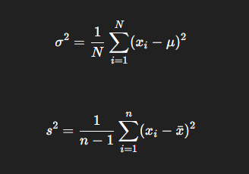
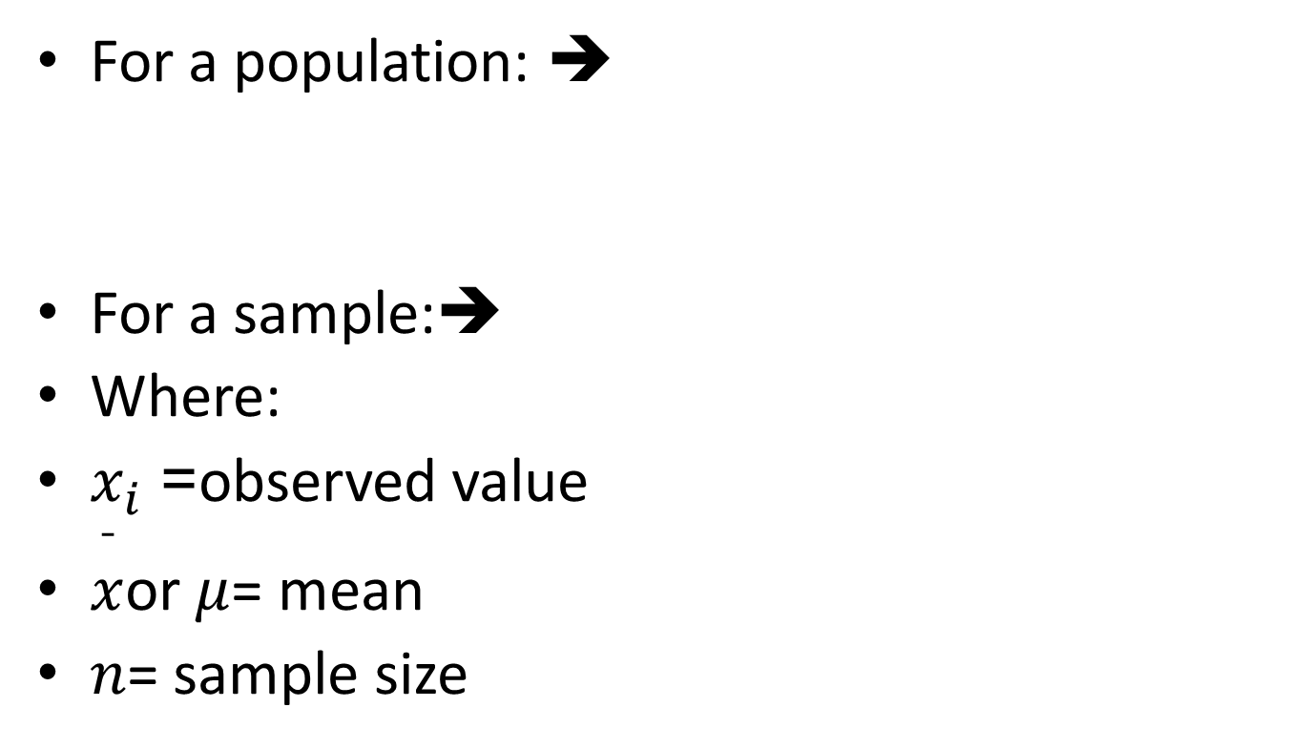
Mathematical formula
For a population: ➔
For a sample:➔
Where:
$x_{i}$= observed value
$\overset{ˉ}{x}$or $μ$= mean
$n$= sample size

Slide 6
Example
Suppose exam scores of two classes:
Class A: 60, 61, 59, 60
Class B: 40, 60, 80, 100
Both have almost the same mean, but:
Class A → low variance
Class B → high variance
➡️ This shows why variance matters beyond averages.
Key point
Variance measures variability within a single variable, not relationships between variables.

Slide 7
Covariance
Covariance measures how two variables change together.
In simple words:
Covariance tells us whether two variables move in the same direction or in opposite directions.

Slide 8
Why covariance is important
Covariance helps us:
Understand relationships between variables
Form the basis for correlation
Build multivariate models (MANOVA, PCA, regression)

Slide 9
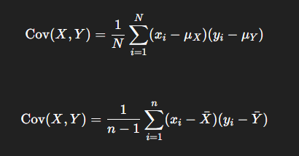

Mathematical formula
For a population:➔
For a sample:➔
$x_{i}$= observed value
$\overset{ˉ}{x}$or $μ$= mean
$n$= sample size

Slide 10
Interpretation of covariance
Covariance value | Meaning
Positive | Both variables increase or decrease together
Negative | One increases while the other decreases
Zero | No linear relationship
Important limitation
The magnitude of covariance is difficult to interpret because it depends on measurement units.
This is why we often use correlation, which is standardized.
Example
Height and weight → positive covariance
Price and demand → negative covariance
Shoe size and IQ → near zero covariance

Slide 11
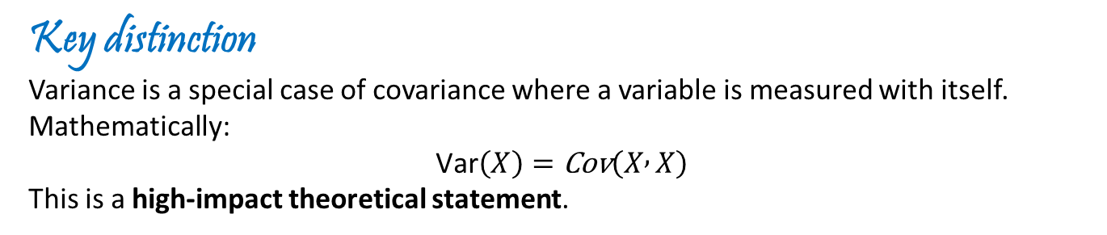
Variance vs Covariance
Aspect | Variance | Covariance
Number of variables | One | Two
Measures | Spread | Joint movement
Can be negative | No | Yes
Role in multivariate analysis | Diagonal elements | Off-diagonal elements
Key distinction
Variance is a special case of covariance where a variable is measured with itself.
Mathematically:
$$\text{Var}\left(X\right)=\text{Cov}\left(X , X\right)$$
This is a high-impact theoretical statement.

Slide 12
Variance–Covariance Matrix
A matrix that summarizes variances and covariances of multiple variables.
Diagonal elements: variances of individual variables.
Off-diagonal elements: covariances between variables.

Slide 13
What is Homogeneity of Variance–Covariance Matrices?
Homogeneity of variance–covariance matrices is the assumption that all groups being compared have the same variance and covariance structure for the dependent variables.
In simple words:
Homogeneity of variance–covariance matrices is the assumption, and Box’s M test is the tool used to check whether that assumption holds.
Not only should the spread of each variable be similar across groups, but also the relationship between variables should be similar.

Slide 14
Definition
Homogeneity of variance–covariance matrices means that:
All groups have the same variance–covariance structure.
Mathematically: Σ₁ = Σ₂ = Σ₃ = ... = Σg
This is a multivariate extension of homogeneity of variance.

Slide 15
Why This Assumption Matters
Required for MANOVA, discriminant analysis, and multivariate ANOVA.
Ensures validity of test statistics.
Violation may lead to incorrect conclusions and inflated Type I error.

Slide 16
Difference from Homogeneity of Variance
Aspect | Homogeneity of Variance | Homogeneity of Variance–Covariance
Number of variables | One | Two or more
What is compared | Variance only | Variance + covariance
Used in | ANOVA | MANOVA

Slide 17
Practical Example
Suppose we compare three age groups using blood pressure and cholesterol.
Homogeneity implies:
- Similar variability of blood pressure across groups
- Similar variability of cholesterol across groups
- Similar relationship between blood pressure and cholesterol across groups

Slide 18
Testing Homogeneity
Box’s M Test is commonly used.
Null hypothesis: covariance matrices are equal.
p > 0.05 → assumption satisfied
p ≤ 0.05 → assumption violated
Box’s M is sensitive to non-normality.

Slide 19
Box’s M Test
Purpose:
To test whether the covariance matrices of your groups are equal (homogeneous).
Covariance matrix:
Shows how variables vary together within a group.
Homogeneity assumption:
Many multivariate tests assume all groups have similar patterns of variability.

Slide 20
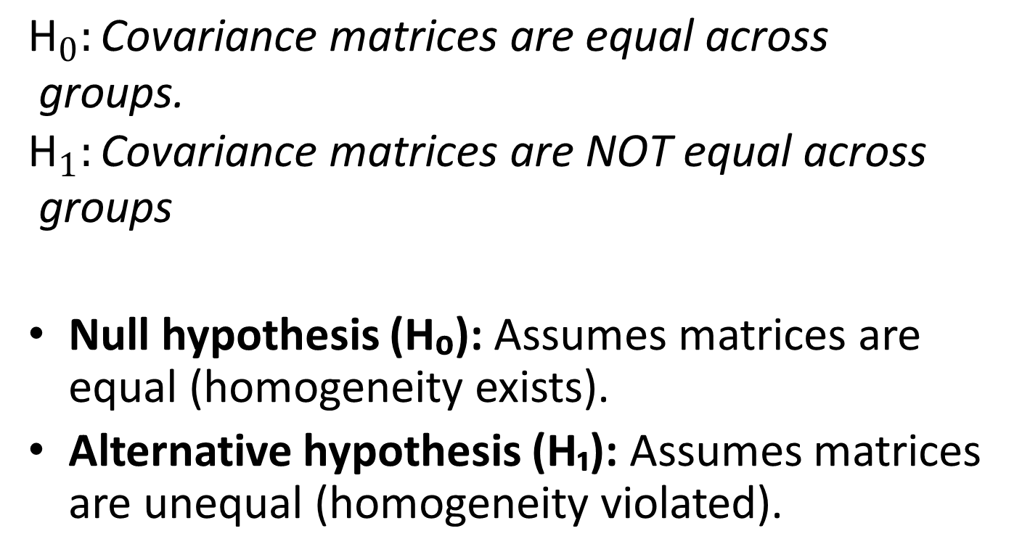
Null and Alternative Hypothesis
$${\text{H}}_{0}:\text{Covariance} \text{matrices} \text{are} \text{equal} \text{across} \text{groups}\text{.}$$
$${\text{H}}_{1}:\text{Covariance} \text{matrices} \text{are} \text{NOT} \text{equal} \text{across} \text{groups}$$
Null hypothesis (H₀): Assumes matrices are equal (homogeneity exists).
Alternative hypothesis (H₁): Assumes matrices are unequal (homogeneity violated).

Slide 21
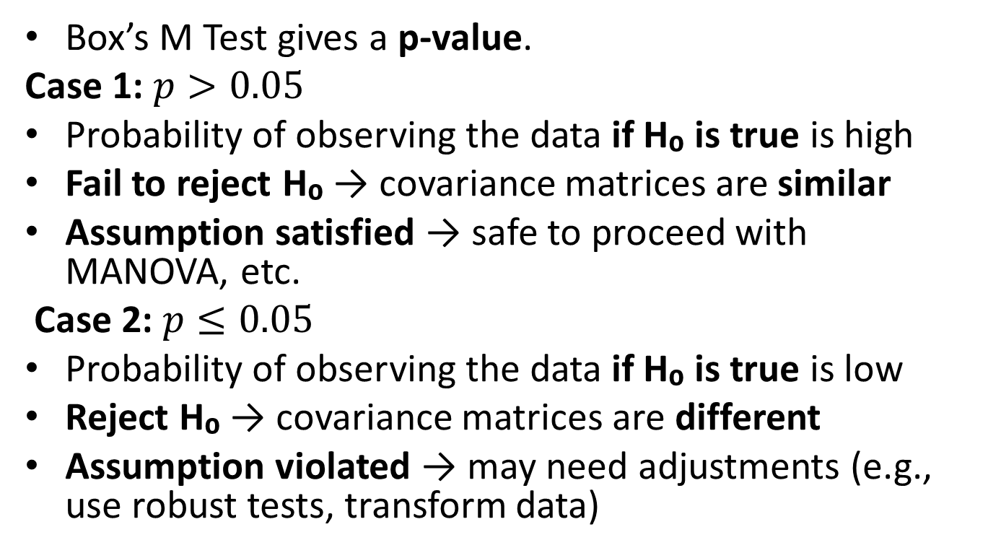
Interpreting the p-value
Box’s M Test gives a p-value.
Case 1: $p>0.05$
Probability of observing the data if H₀ is true is high
Fail to reject H₀ → covariance matrices are similar
Assumption satisfied → safe to proceed with MANOVA, etc.
Case 2: $p≤0.05$
Probability of observing the data if H₀ is true is low
Reject H₀ → covariance matrices are different
Assumption violated → may need adjustments (e.g., use robust tests, transform data)

Slide 22
Summary result
If p > 0.05, your groups’ covariances are similar → test assumption is okay.
If p ≤ 0.05, your groups’ covariances are different → assumption is broken.

Slide 23
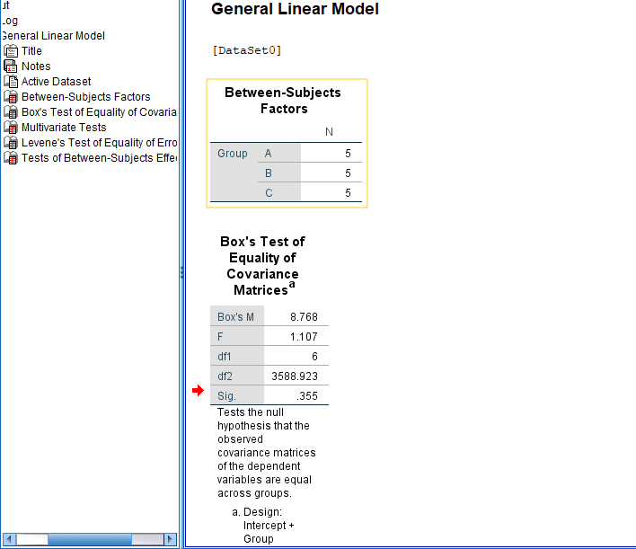
SPSS: Homogeneity tests (Box’s M)

Slide 24
The result mean:
Null hypothesis of Box’s M:
Covariance matrices are equal across groups.
Since p = 0.355 > 0.05:
We fail to reject the null hypothesis
We do not have enough evidence to say matrices are different
Therefore:
The assumption of homogeneity of variance–covariance matrices is satisfied.

Slide 25
A simple intuition
Think of a court case:
Null hypothesis = “The defendant is innocent”
p-value = strength of evidence against innocence
Your p-value = 0.355
That’s like saying:
“There is a 35.5% chance this evidence could happen even if the defendant is innocent.”
That’s far too weak to declare guilt.
So, the judge says:
Not guilty (fail to reject H₀)
The Box’s M test is non-significant because the p-value (0.355) is greater than the chosen significance level of 0.05, indicating insufficient evidence to reject the null hypothesis of equal covariance matrices.

Slide 26
What If the Assumption Is Violated?
Use Pillai’s Trace instead of Wilks’ Lambda.
Apply data transformations.
Use robust or alternative multivariate methods.
Interpret results with caution.

Slide 27
Key Takeaways
Homogeneity of variance–covariance is a core assumption in multivariate analysis.
It extends homogeneity of variance to multiple variables.
Understanding this assumption improves interpretation and research quality.
Homogeneity → The rule / assumption
Box’s M test → The inspection method to check the rule
Just like:
“Normality” is checked using Shapiro–Wilk
“Equal variances” is checked using Levene’s test
“Equal covariance matrices” is checked using Box’s M test
This logical link is exactly what examiners expect.

