Slide 1

Objects
objects

Slide 2
Introduction
JavaScript object is a non-primitive data-type that allows you to store multiple collections of data.

Slide 3

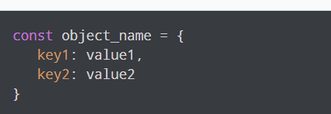
JavaScript Object Declaration
The Syntax To Declare An Object Is:
Here, an object object_name is defined. Each member of an object is a key: value pair separated by commas and enclosed in curly braces {}

Slide 4
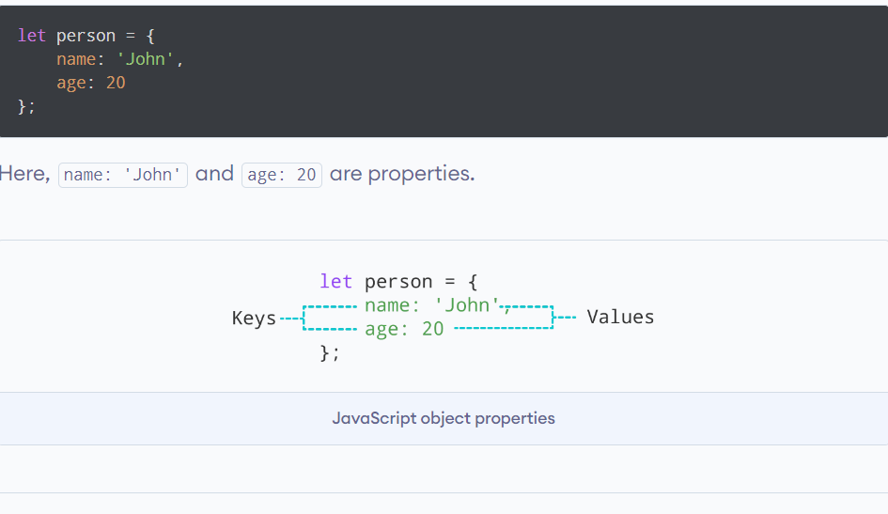
JavaScript Object Properties
In JavaScript, "key: value" pairs are called properties. For example,

Slide 5
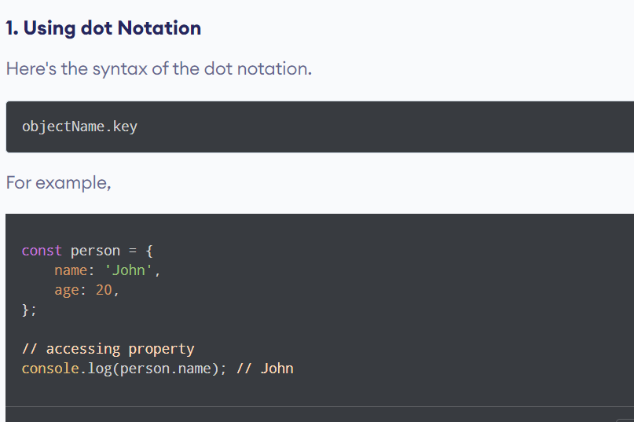
Accessing Object Properties
We can access the value of a property by using its key.

Slide 6
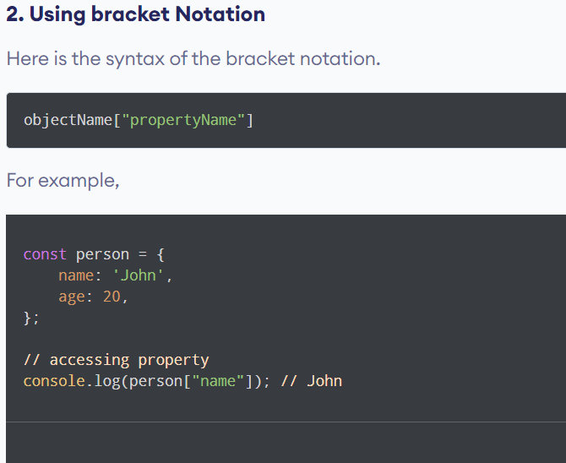
Accessing Object Properties
We can access the value of a property by using its key.

Slide 7
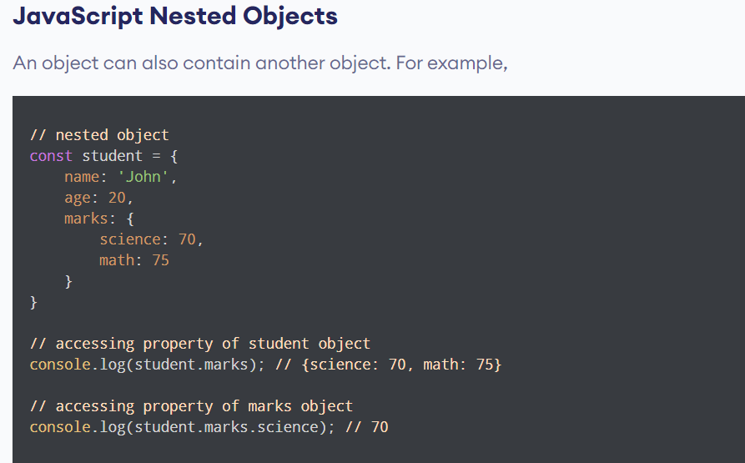

Slide 8
JavaScript Object Methods
In JavaScript, an object can also contain a function. For example,

Slide 9
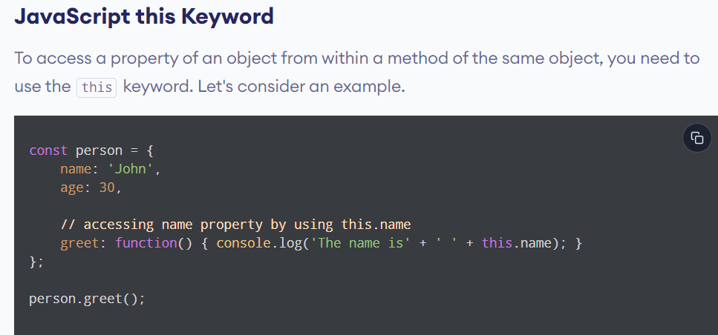
Objects

Slide 10

“Business opportunities are like buses. There’s always another one coming.”
Richard Branson

Slide 11

Thank you
M.Latif
kharmangi129@gmail.com

