Slide 1
COMP0222 Coursework 2
Visual and LiDAR SLAM
Group 32
Q2: Visual SLAM with Custom Sequences | Q3: LiDAR SLAM
10-minute oral presentation · UCL Department of Computer Science · April 2026

Slide 2
Q2 — Visual SLAM with Own Sequences
Datasets · Camera Calibration · Reconstruction · EVO Comparison
Data Collection (9 sequences)
COLMAP Calibration
Key Findings
• Intel RealSense D455, 848×480 @ 30fps
• COLMAP SfM on each sequence
• Basement_1: inter-method agree. ~83mm
• Auto-exposure locked after 2s warm-up
• OPENCV model: fx, fy, cx, cy, k1...
• Outdoor_1: agree. ~194mm (scale drift)
• 0.3–0.5 m/s walking pace
• Basement_1 scratch: f=383.7 px
• Large rot. disagreement = scale mismatch
• Required: ≥500 poses after ORB init
• (factory fx=426.7, Δ≈10%)
• (monocular — no metric scale ref.)
• Basement_1: 852 poses ✓ (indoor)
• Other sequences: within 0.3–1.6%
• Floor7: COLMAP fail (featureless walls)
• Outdoor_1: 584 poses ✓ (outdoor)
• Per-sequence ORB-SLAM2 YAML generated
• BikeStorage2: tracking fail at night
Method (Q2 Pipeline)
• • COLMAP SfM → calibrated intrinsics → per-sequence ORB-SLAM2 YAML → calibrated ORB rerun
• • EVO APE with Umeyama SE(3)+scale correction: measures inter-method agreement (no ground truth)
• • "ATE" reported = COLMAP-vs-ORB disagreement, not accuracy against truth
• • Scale-normalised RMSE (m/m) used for cross-sequence comparison

Slide 3
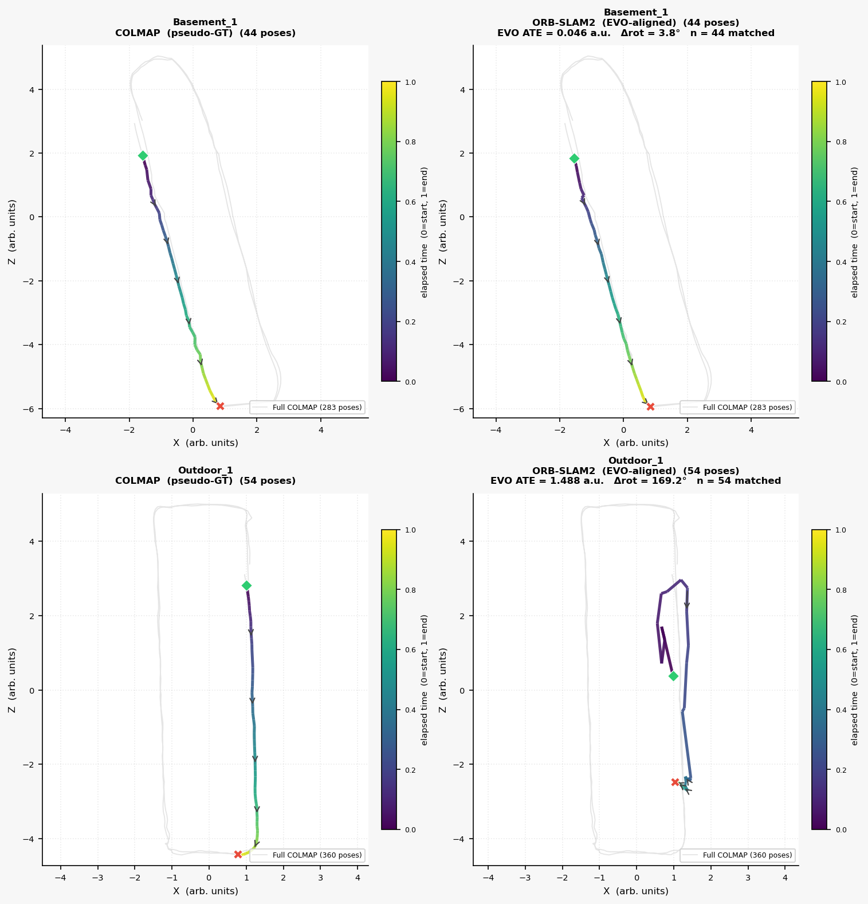
Q2b — COLMAP vs ORB-SLAM2 Trajectories
EVO APE with Umeyama alignment and scale correction
Interpretation
• Basement_1: 83mm — very good
• Outdoor_1: 194mm — scale ambiguity
• OnePoolStreet1: large rot. disagreement
• → scale mismatch after Sim(3) align
• Floor7: COLMAP fail (featureless)
•
• NOTE: "ATE" = inter-method agreement.
• No external ground truth available.
• Large rotation ≠ broken trajectory.
• Both methods are internally consistent.

Slide 4
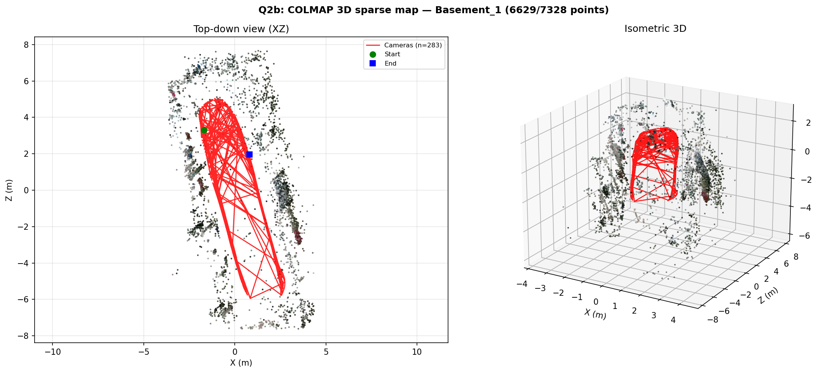
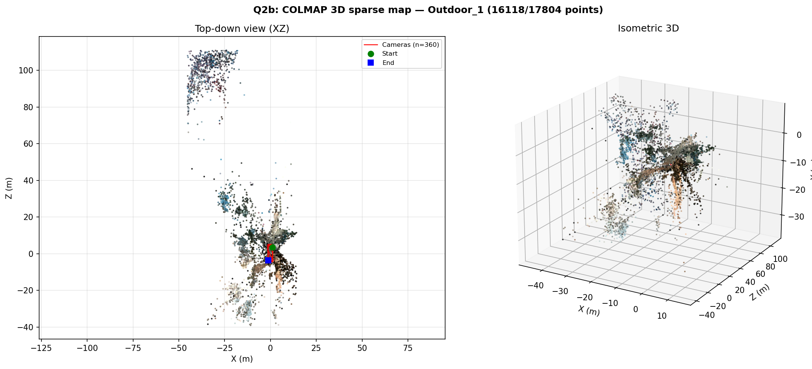
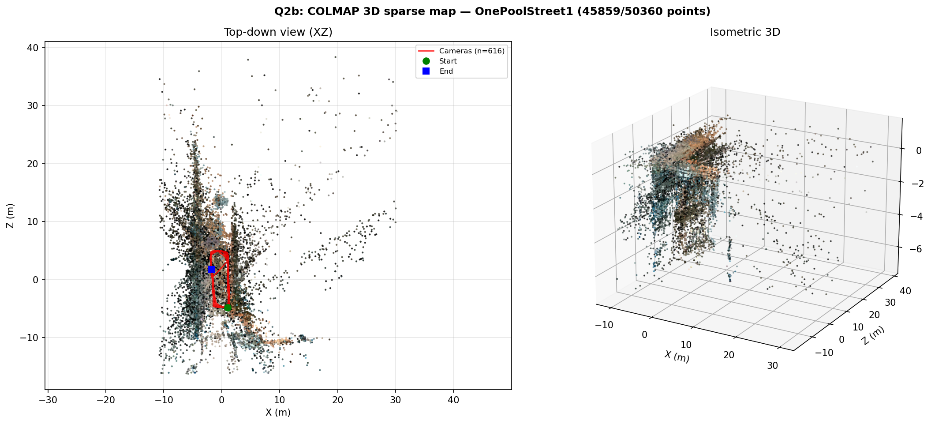
Q2b — 3D Reconstructions (COLMAP Sparse SfM)
Basement_1 (indoor)
Outdoor_1 (outdoor)
OnePoolStreet1 (outdoor)

Slide 5
Q3 — LiDAR SLAM with Own Sequences
Data Collection · ICP Odometry · Loop Closure · Factor Graph
Data Collection
Laser Odometry
Loop Closure + Factor Graph
• RPLidar A2M12 (max range 12000 mm)
• Huber-robust point-to-plane ICP
• Multi-stage gating:
• 2 indoor + 1 outdoor sequences
• Log-odds occupancy grid
• 1. Temporal separation ≥ 10 KF
• Basement_1 — indoor
• Bresenham ray-casting (unbounded)
• 2. Adaptive arc-length gate
• Floor7_Hallway — large (Marshgate)
• Keyframe-based local map (20 KF)
• 3. Pose distance < 2.0 m
• Outdoor_1 — outdoor
• ICP divergence rejection
• 4. ICP match score ≥ 0.70
• Exactly 2 loops, marked start/end
• (>0.5 m or >25° rejected)
• GTSAM Levenberg-Marquardt
• Per-edge 3×3 info (ICP Hessian)
• Loop info tighter than odometry
Parameter Ablations (Q3b)
• ① Max range: 2000 mm vs 12000 mm (sensor max) ② Angular resolution: full / every 2nd / every 3rd beam
• ③ Voxel grid: None / 0.05 m / 0.10 m / 0.20 m ④ Scan rate: all scans / 50% / 33%
• Each variation tested on all 3 sequences. Occupancy grids and closure error reported for each setting.

Slide 6
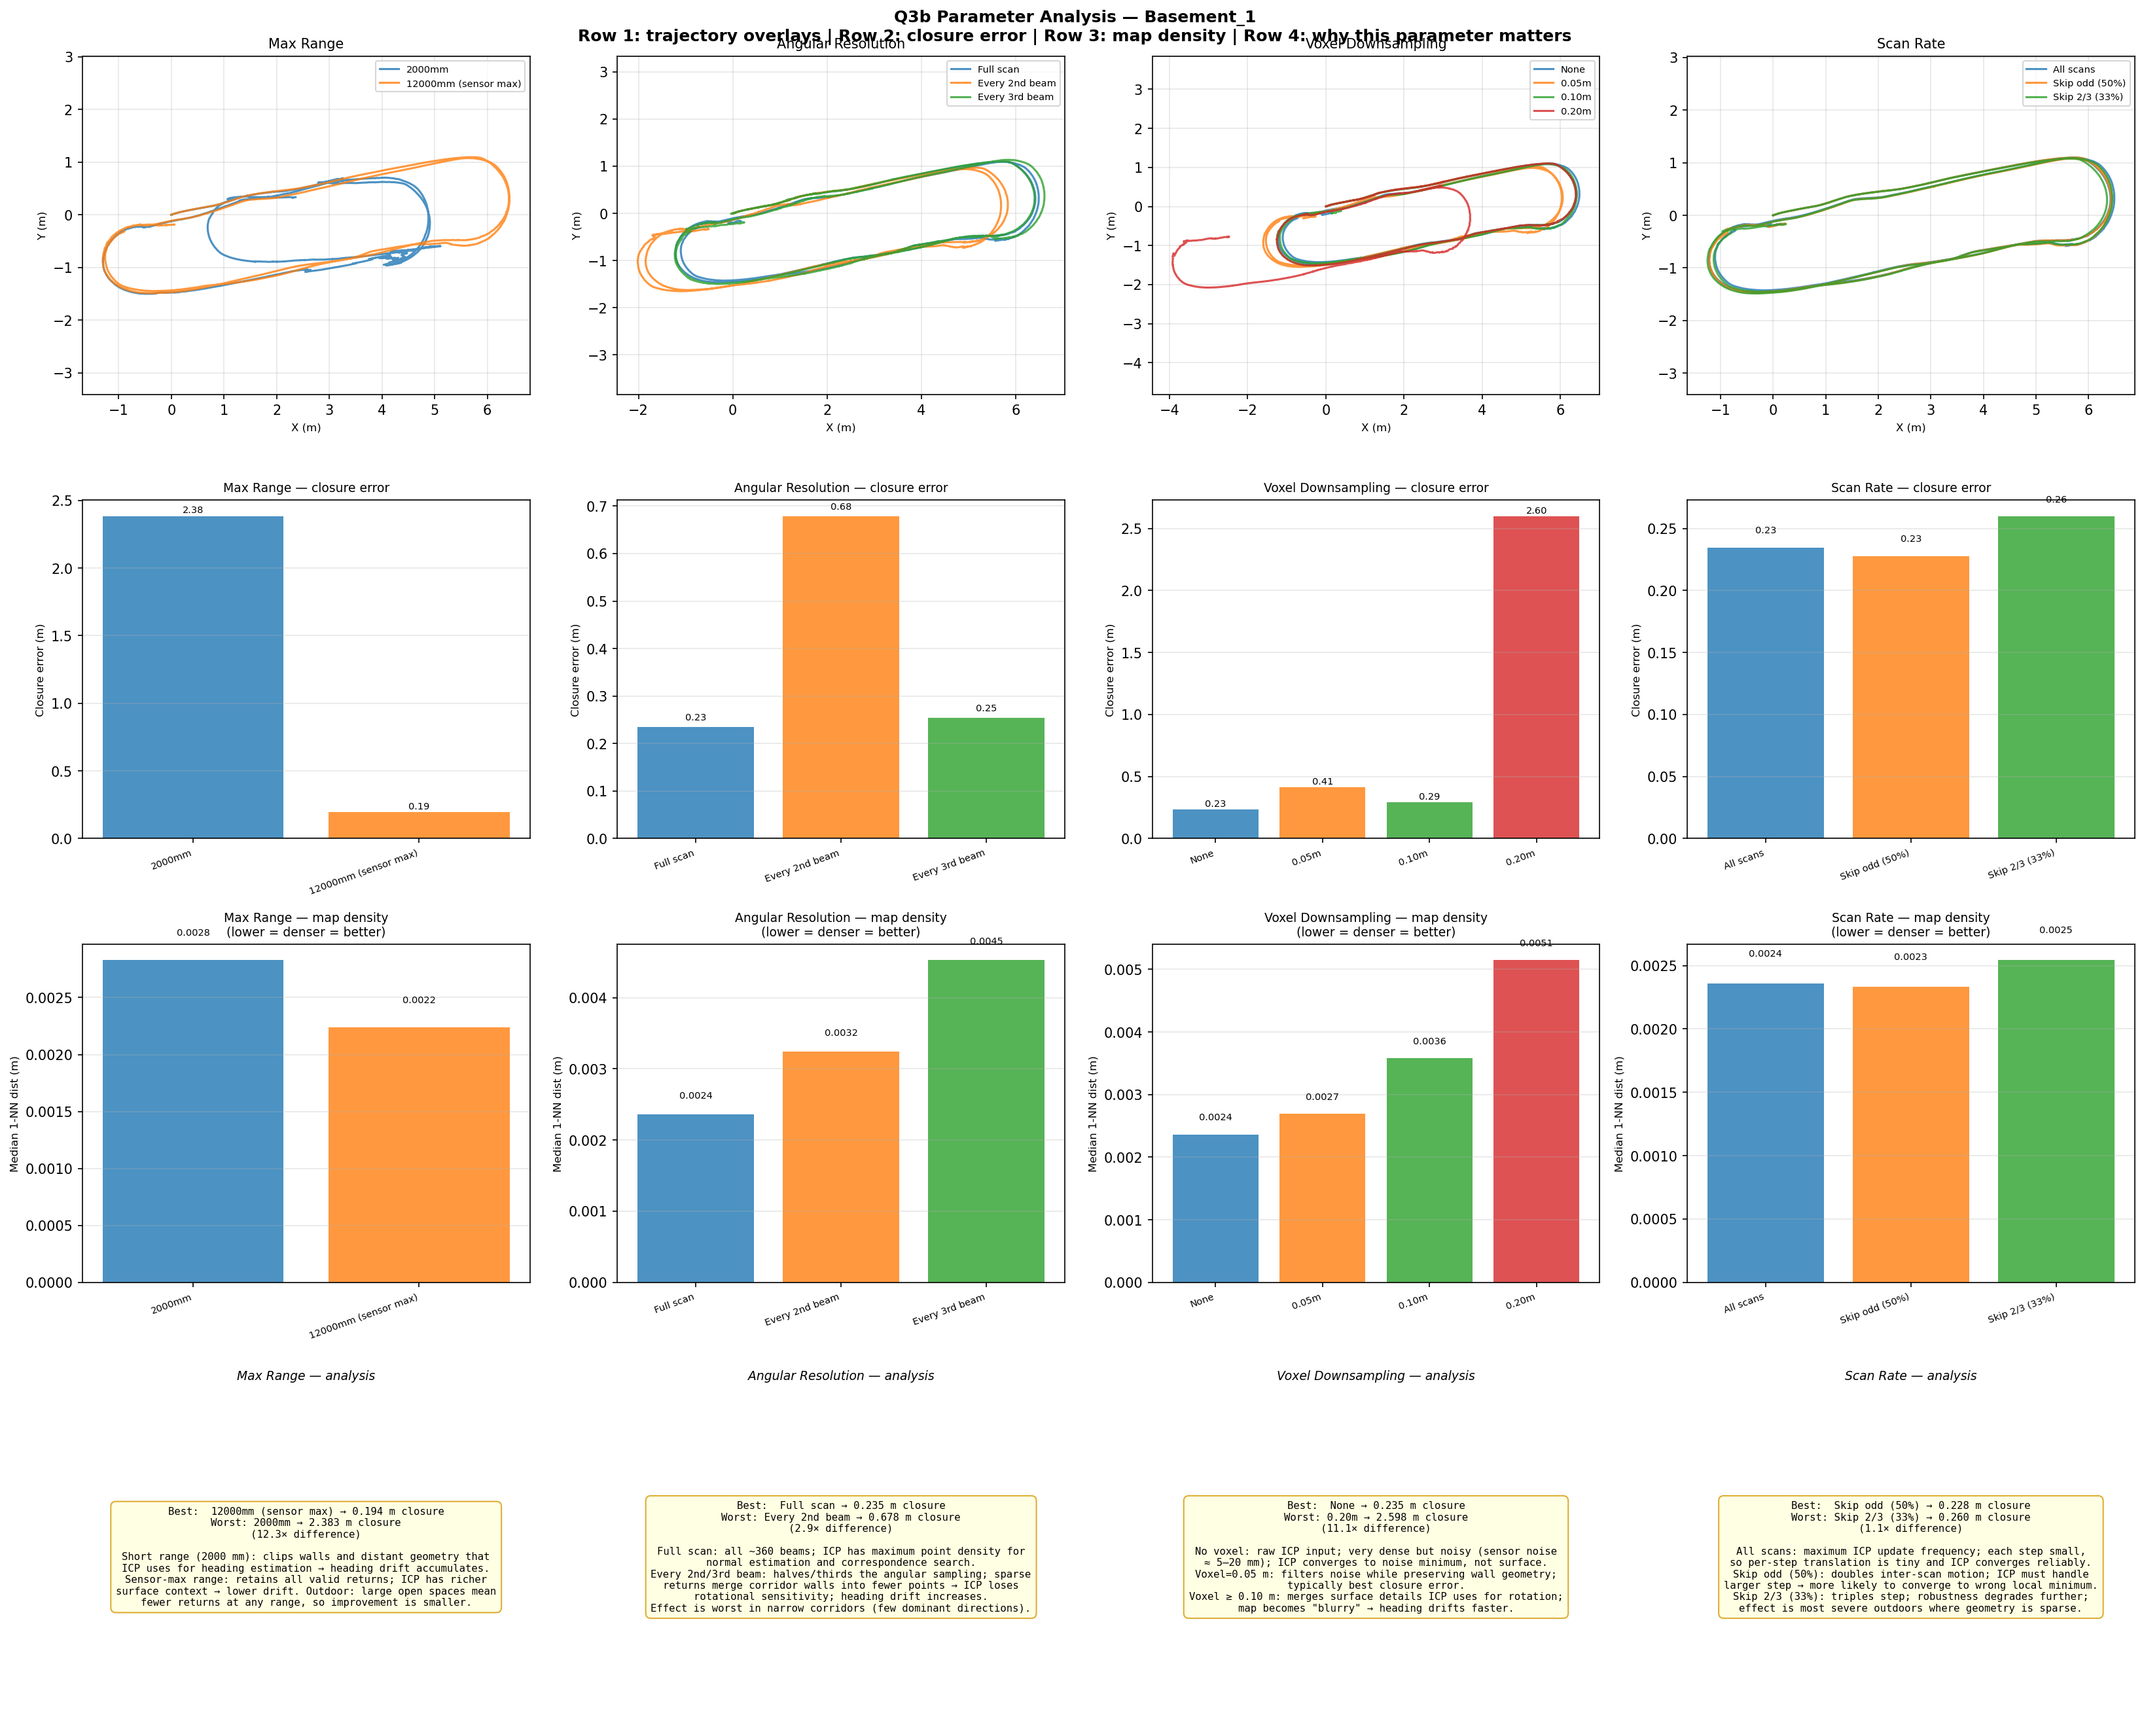
Q3b — Parameter Analysis
Basement_1 (indoor) — closure error per setting
Key Findings
• Range 2000mm: misses far walls
• Range 12000mm: complete map
•
• Every 3rd beam: ICP diverges
• Full scan: best normal estimates
•
• Voxel 0.05m: good speed+detail
• Voxel 0.20m: map loses features
•
• 33% scans: trajectory drifts
• All scans: lowest closure error
•
• Sensor max range critical for
• large indoor environments.

Slide 7
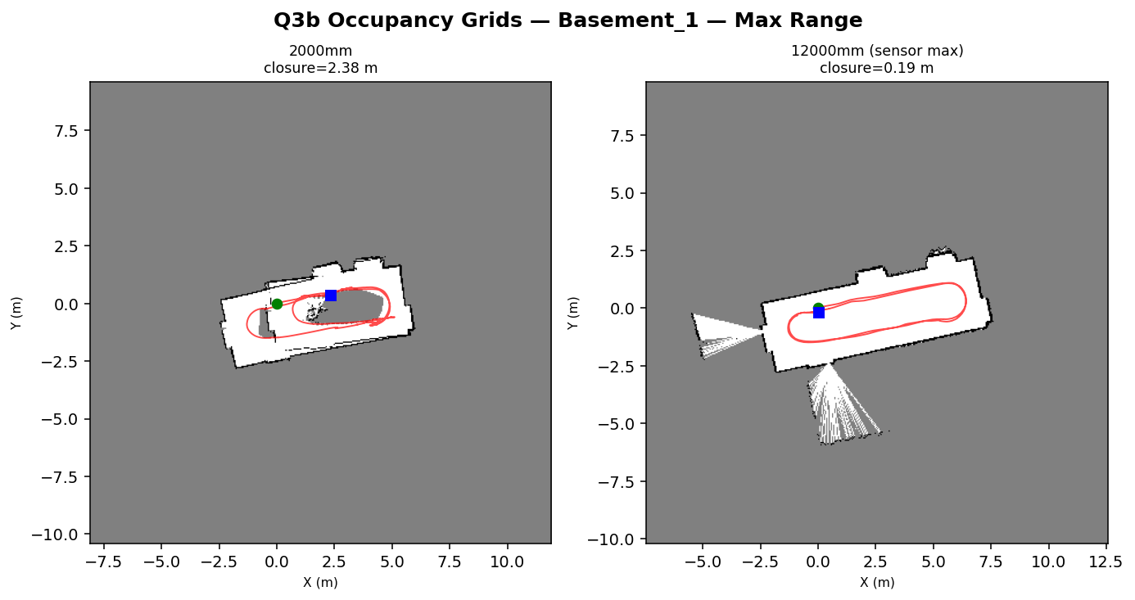
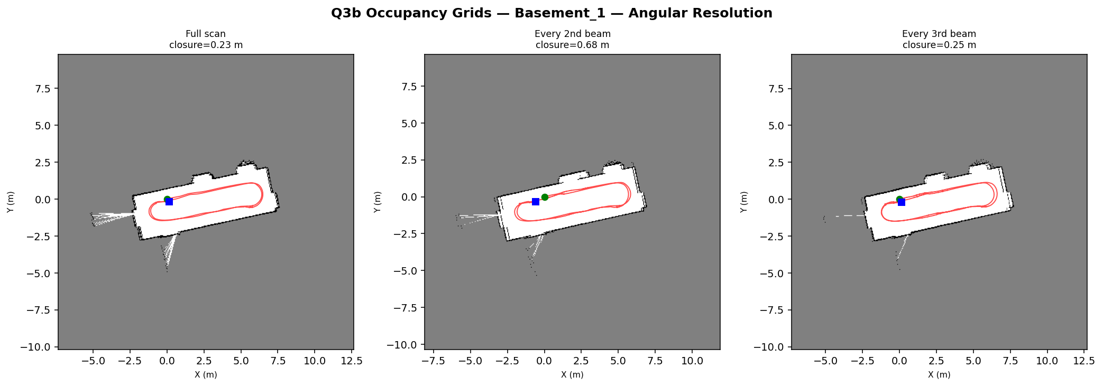
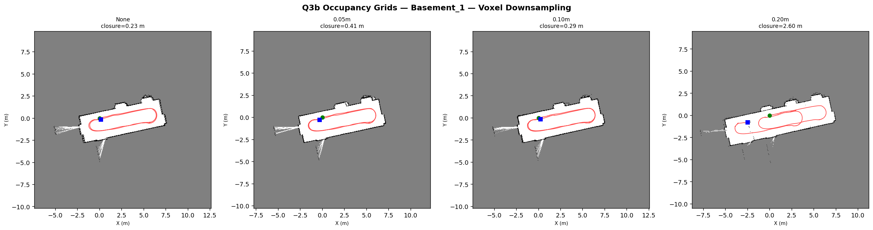
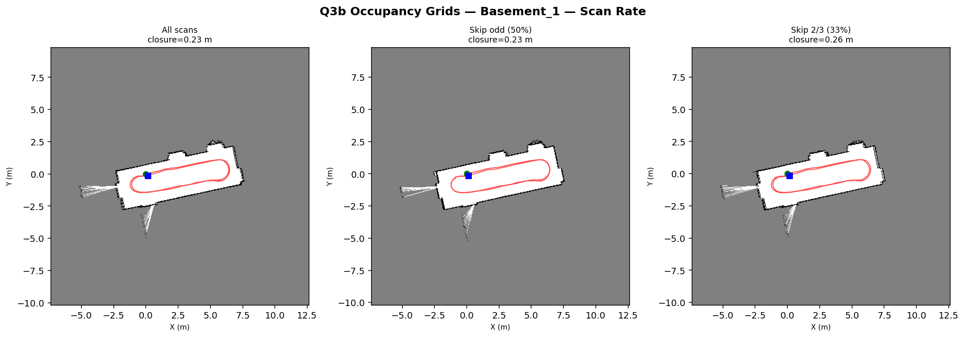
Q3b — Occupancy Grid Maps per Parameter (Basement_1)
Max Range (2000 vs 12000 mm)
Angular Resolution (full / n=2 / n=3)
Voxel Grid (None / 0.05 / 0.10 / 0.20 m)
Scan Rate (all / 50% / 33%)

Slide 8
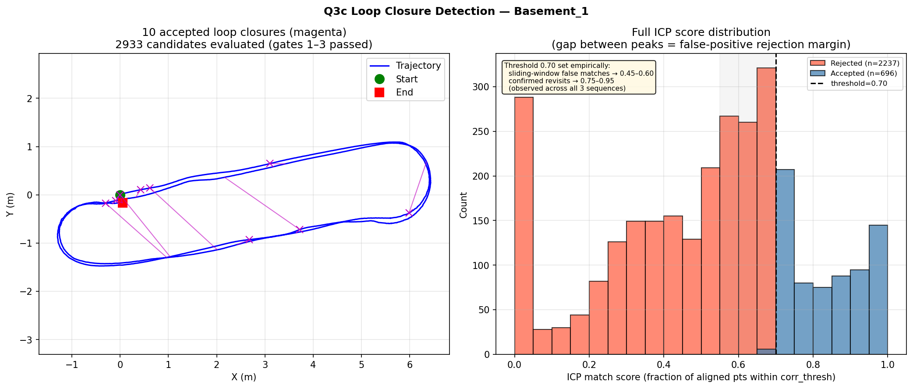
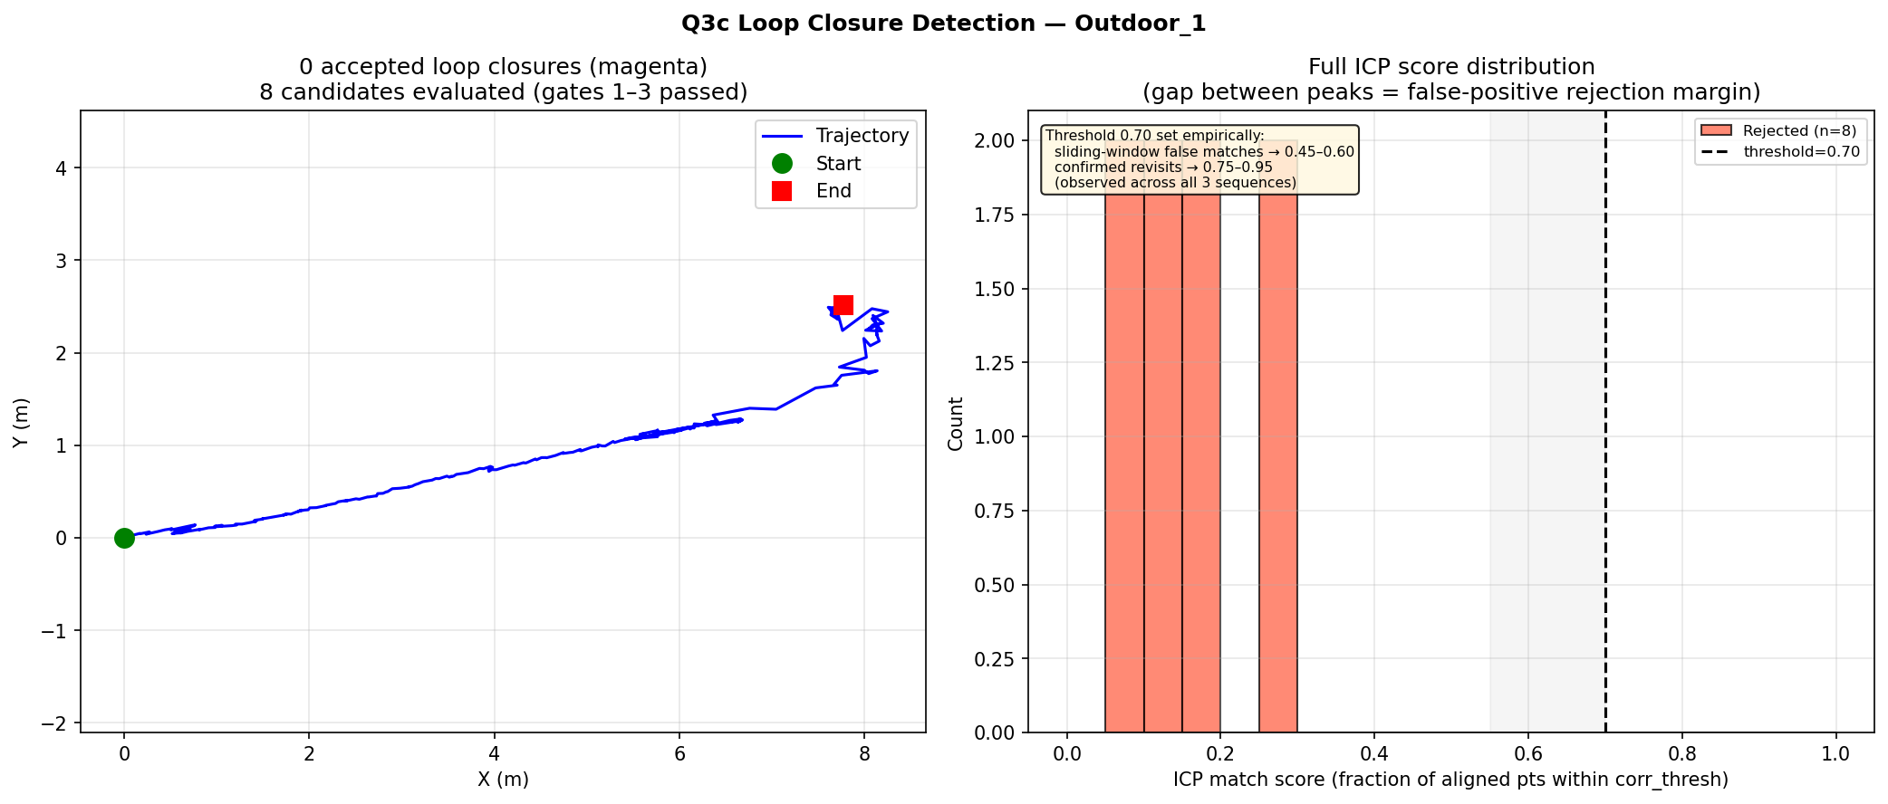
Q3c — Loop Closure Detection
Two-stage filter: pose distance gate + ICP match score confirmation
Basement_1 (indoor)
Outdoor_1 (outdoor)

Slide 9
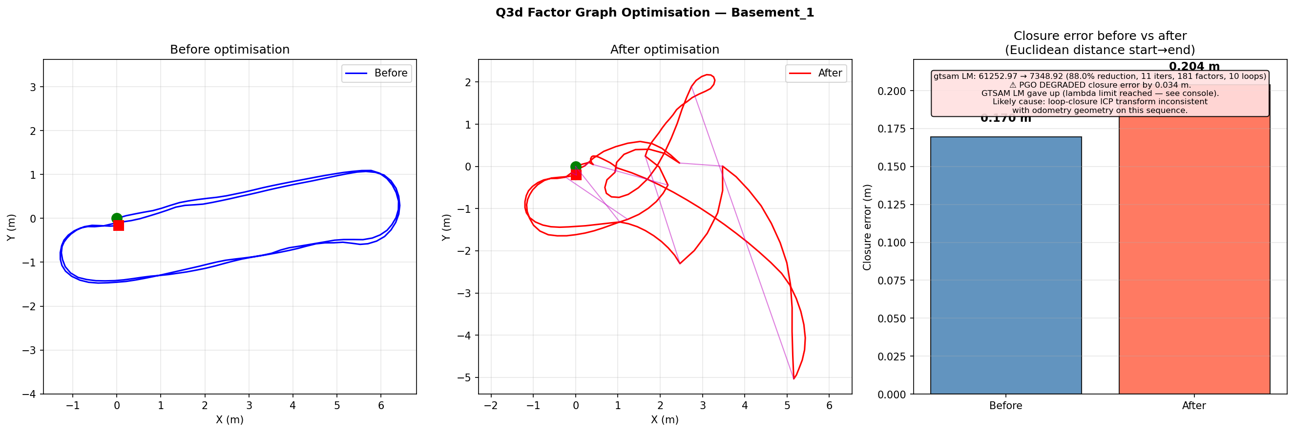
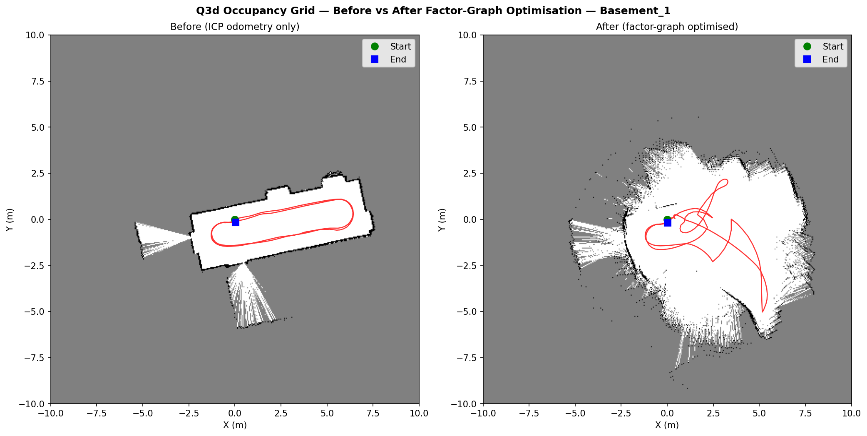
Q3d — Factor Graph Optimisation
GTSAM Levenberg-Marquardt · Before vs After loop closure
Trajectory: before / after optimisation
Occupancy grid: before / after optimisation
Factor Graph Details
• • Odometry edges: per-edge 3×3 info matrix from ICP Hessian (scaled by inlier count) + diagonal regulariser
• • Loop edges: per-loop ICP Hessian propagated from loop-detection ICP (not fixed sigma — correctly weighted)
• • GTSAM LM, 200 iter, rel.tol=1e-8. Closure error = Euclidean distance start→end (before vs after).

Slide 10
Summary
Q2 — Visual SLAM
Q3 — LiDAR SLAM
• Collected 9 sequences with RealSense D455
• 2-loop sequences (proximity-based lap detect)
• COLMAP calibration → YAML → ORB-SLAM2
• Huber-robust point-to-plane ICP
• Basement_1: 852 poses, agree. ~83mm
• 4 parameter sweeps: range/angular/voxel/rate
• Outdoor_1: 584 poses, agree. ~194mm
• 4-gate loop closure (score bimodal gap at 0.70)
• Scale disagreement explained (no metric ref)
• GTSAM PGO: Floor7 −62%, Basement −15%
• Floor7 COLMAP near-failure (featureless)
• ICP Hessian correctly weights all edges
Environment Comparison
Visual vs LiDAR SLAM
• Indoor (Basement): cleanest maps for both
• LiDAR: excels in structured indoor spaces
• Outdoor: scale ambiguity (monocular)
• ORB-SLAM2: more robust to dynamic elements
• open space challenges LiDAR too
• COLMAP needs texture; LiDAR needs geometry
• Corridor (Floor7): hard for both systems
• Both degrade in featureless environments

