Slide 1
COMP0222 Coursework 2
Visual and LiDAR SLAM with Own Sequences
Group 32 — Muhammad Maaz · Harmish Zala
April 2026
Part 1 — Visual SLAM (Q2)
Own monocular sequences captured with RealSense D455. COLMAP reconstruction vs ORB-SLAM2 comparison.
Part 2 — LiDAR SLAM (Q3)
Own 2D LiDAR sequences with RPLidar A2M12. Parameter sweep · loop closure · pose-graph optimisation.
1

Slide 2
Agenda
Q2a
Capture and calibration
RealSense D455 monocular capture. Iterative protocol. COLMAP per-sequence self-calibration.
Q2b
COLMAP vs ORB-SLAM2 comparison
EVO Umeyama Sim(3) alignment. Indoor (Basement_2): 155 pairs, 46° scale ambiguity. Outdoor (OnePoolStreet1): 576 pairs, 2.5° agreement.
Q3a/b
LiDAR sequences + parameter sweep
RPLidar A2M12. Four parameters × three sequences. Why max range dominates.
Q3c
Loop closure detection
Four-gate filter. ICP overlap histogram shows bimodal gap at 0.70.
Q3d
Factor graph optimisation
GTSAM SE(2) pose graph. LM cost drops 8–25× but closure error grows — Hessian tension explained.
2

Slide 3
PART 1
Visual SLAM
Q2 — own indoor and outdoor monocular sequences
848×480 30fps
9 sequences
COLMAP + ORB-SLAM2
3

Slide 4
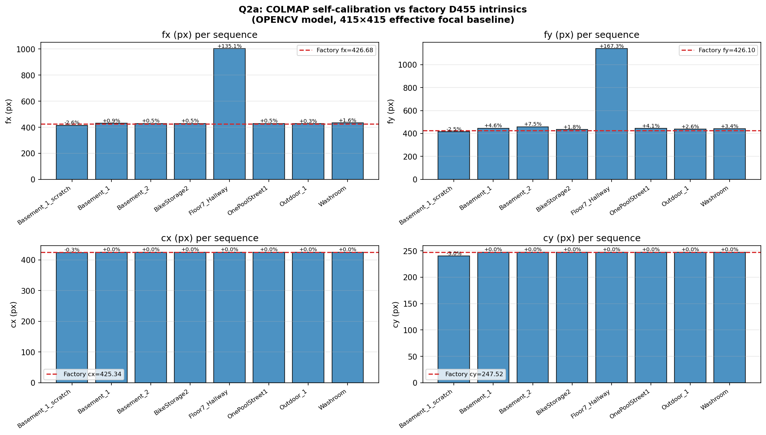
VISUAL SLAM › Q2A
Q2(a) Capture and calibration
Rig and capture protocol
▸
Intel RealSense D455, RGB 848×480, ~30 fps locked
▸
0.3–0.5 m/s walking speed — 1–1.5 cm/frame, well below ORB matching limit
▸
Continuous video stream, NOT stills — initialiser needs small frame-to-frame baselines
▸
1 s pause + slow 90° pan at each corner — multi-view diversity for COLMAP bundle adjustment
▸
9 sequences: Basement_1 (41 m indoor) and Outdoor_1 (30 m outdoor) are primary sequences
▸
Monitored ORB-SLAM2 live; slowed walking when tracked features < 30
Calibration via COLMAP self-calibration
▸
Per-sequence OPENCV 8-param model: fx, fy, cx, cy, k1, k2, p1, p2
▸
All per-seq intrinsics within 0.3–1.6% of D455 factory value (fx=426.68 px)
▸
Scratch SIMPLE_PINHOLE on Basement_1 (no prior): f=415.4 px — 2.6% below factory
·
Model forces fx=fy; D455 is mildly asymmetric (fx≠fy) — not a calibration error
▸
Floor7_Hallway: COLMAP registered only 8 poses — featureless white corridor → focal blowup
COLMAP intrinsics vs D455 factory (dashed red). All on-line except Floor7 (focal blowup).
Per-sequence OPENCV calibration is adequate for the low-distortion D455. Scratch run confirms factory prior is trustworthy to within ~3%.
4

Slide 5
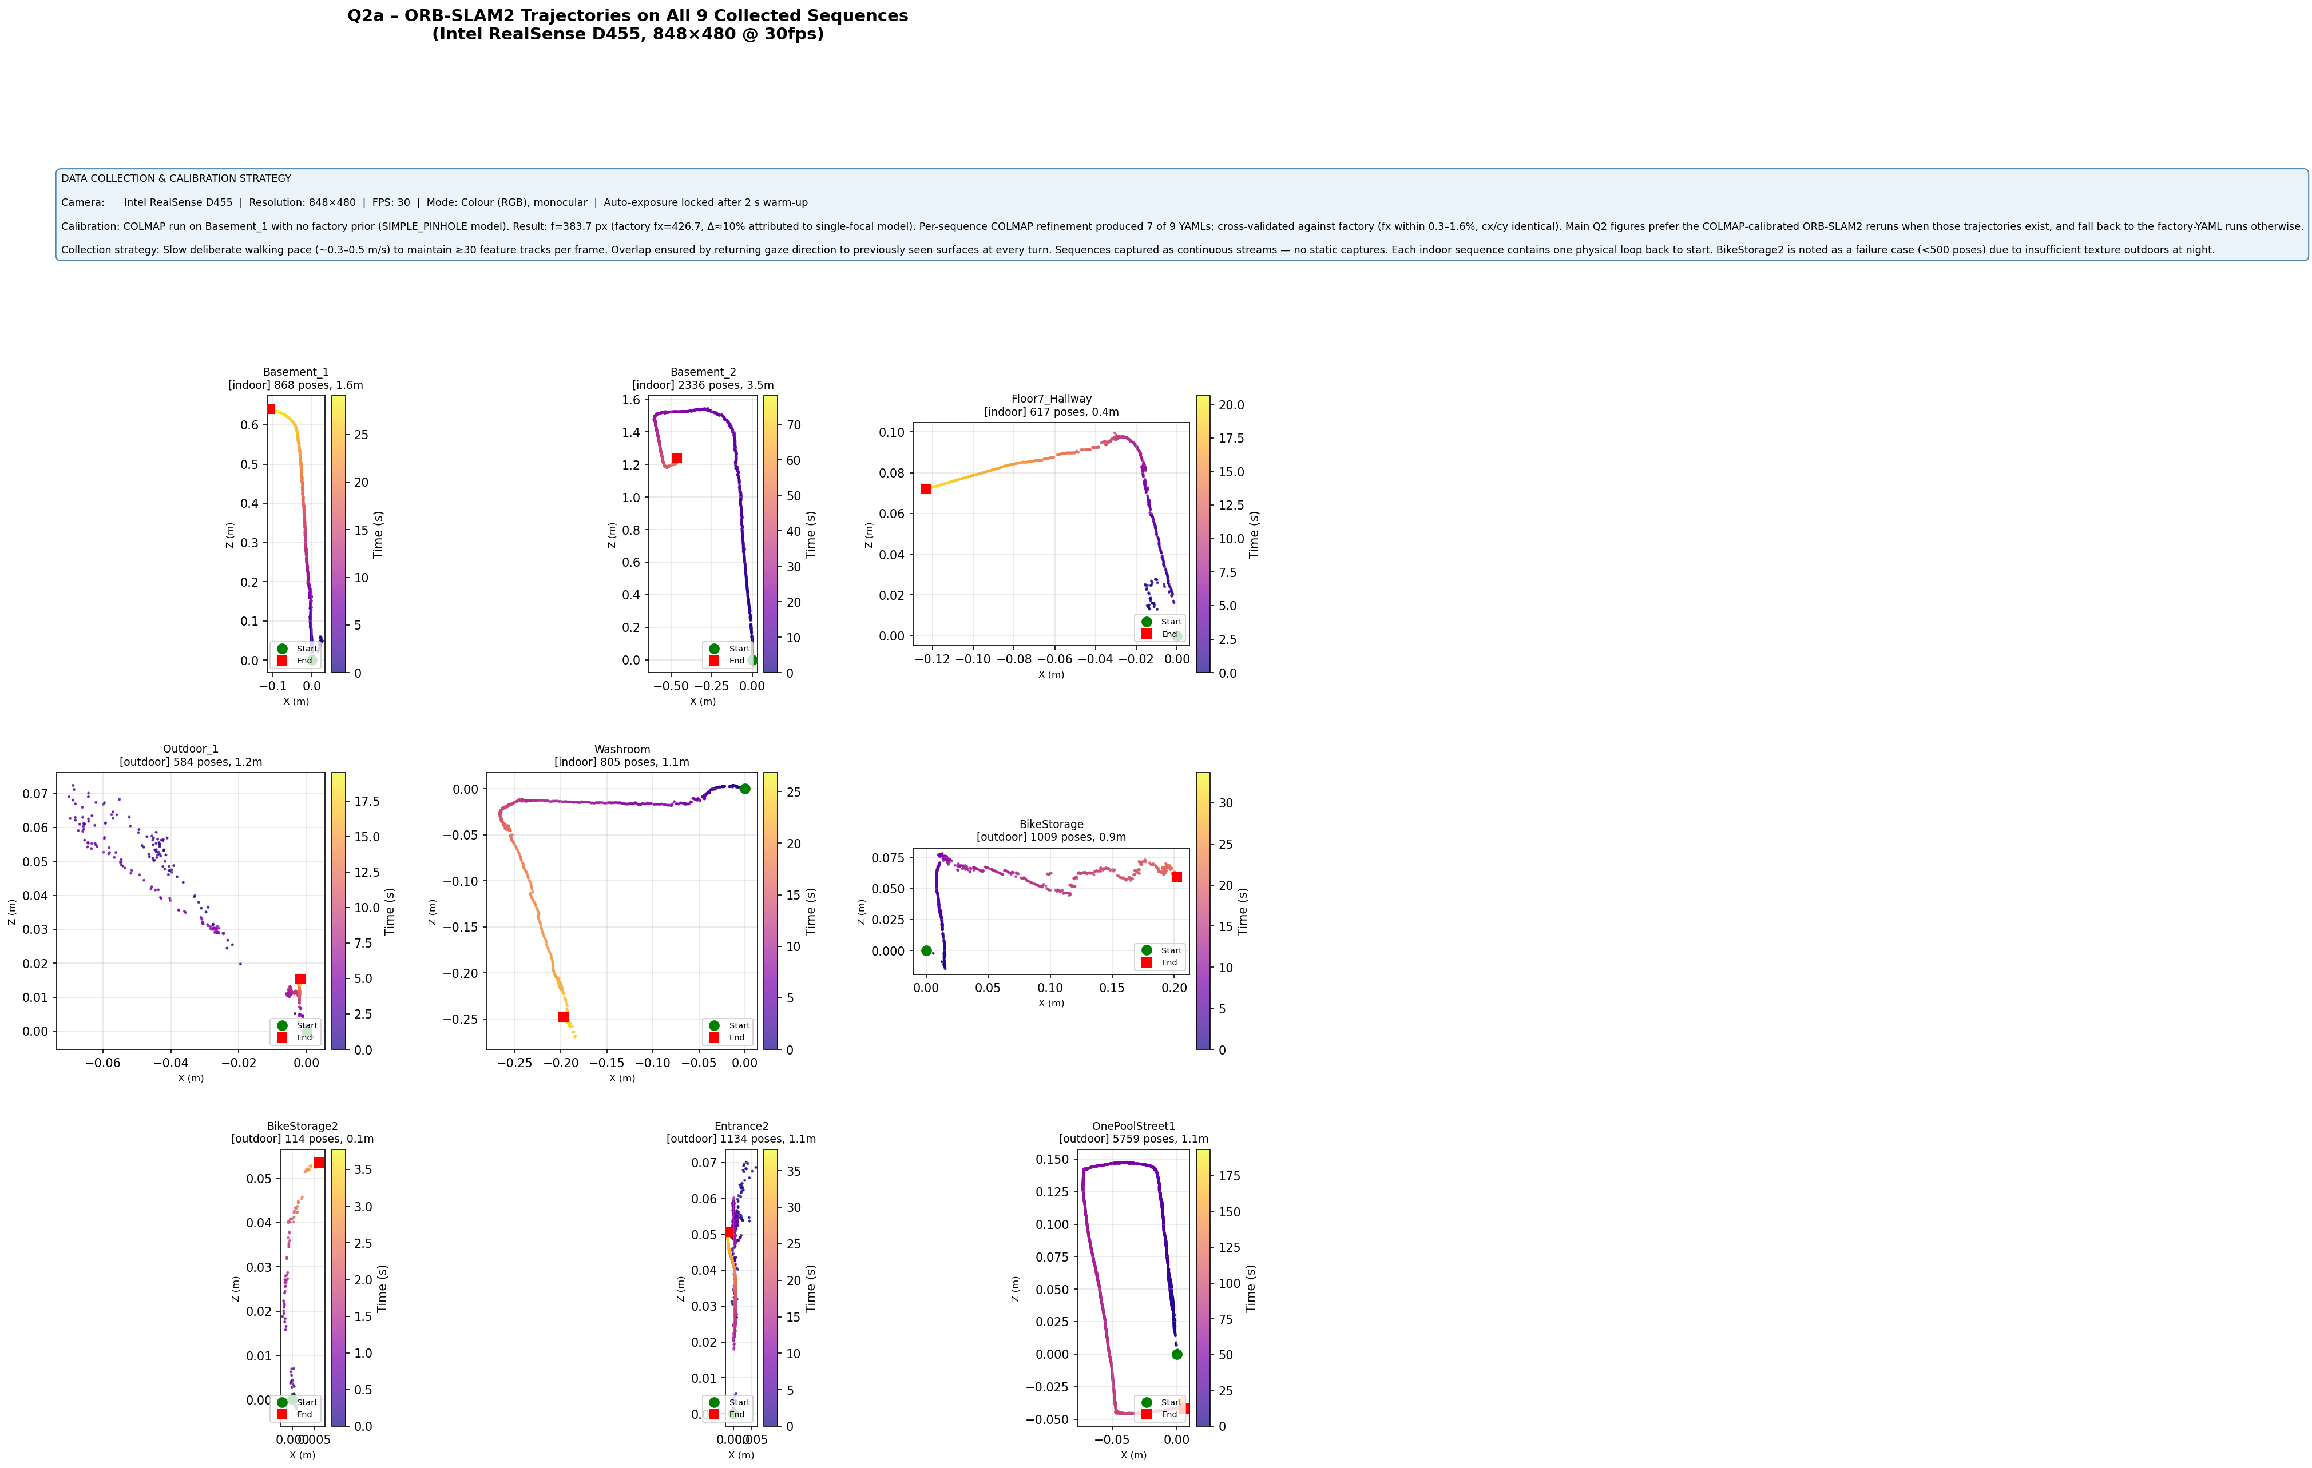
VISUAL SLAM › Q2A
Q2(a) ORB-SLAM2 trajectories — all 9 sequences
Sequence
Type
ORB Poses
COLMAP
Basement_2
Indoor
2336
233 poses
OnePoolStreet1
Outdoor
5759
616 poses
Why these two?
▸
Basement_2: full rectangular indoor loop — 2 complete circuits visible
·
Rich wall texture → COLMAP triangulates from both sides of the room
▸
OnePoolStreet1: outdoor, 576 COLMAP-matched pairs — best outdoor coverage
·
Building facade gives enough features; open courtyard with structure
▸
Brief: ≥500 frames after init — both sequences satisfy this ✓
9 sequences recorded total. These 2 give the clearest COLMAP vs ORB-SLAM2 comparison. BikeStorage2 (night, 114 poses) documented as explicit failure case.
All 9 sequences. Plasma colour = time (dark=early, bright=late). Green=start, Red=end. Hatched=<500 poses.
5

Slide 6
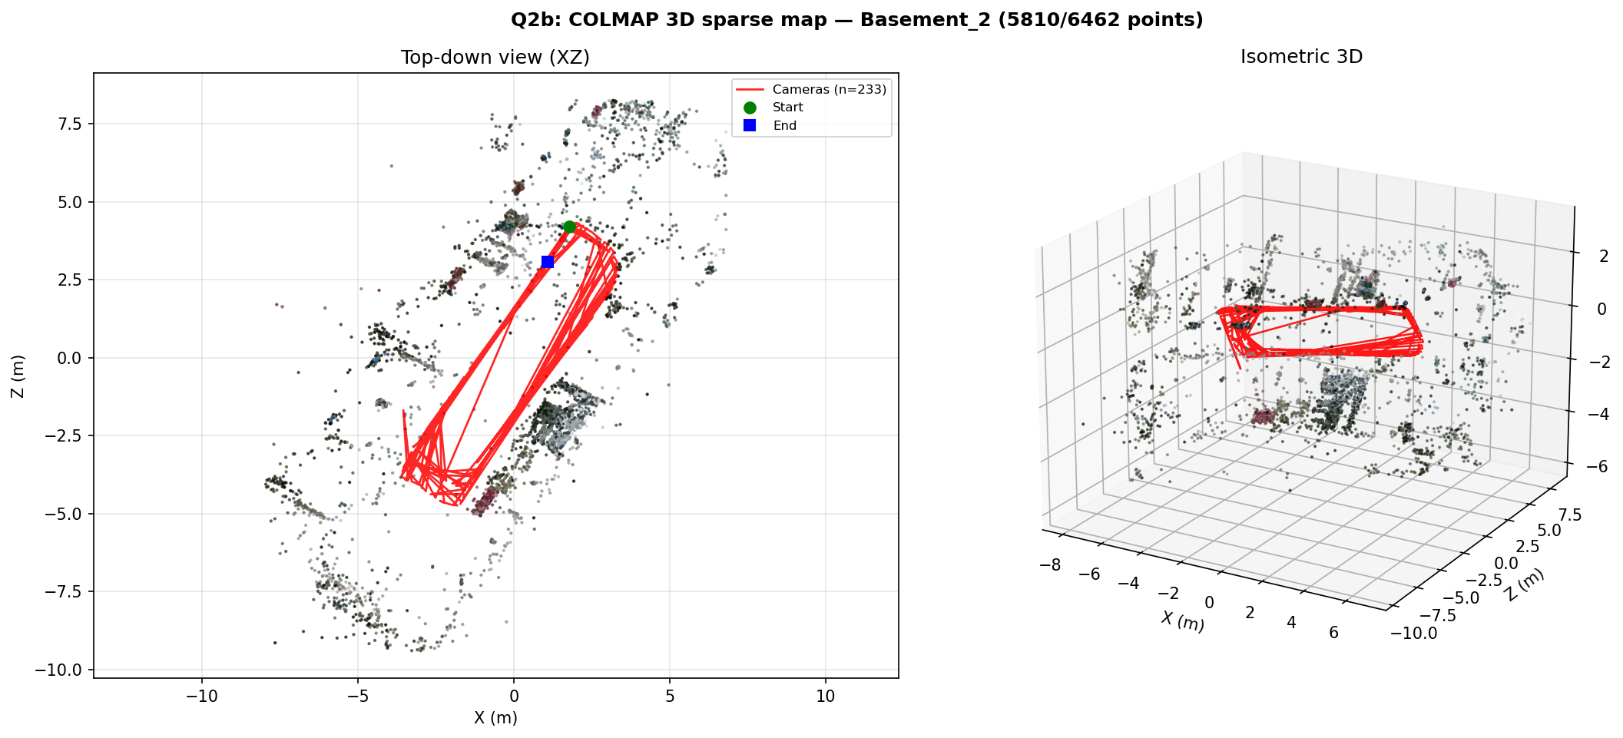
VISUAL SLAM › Q2B
Q2(b) COLMAP reconstruction
▸
No external ground truth — report inter-method disagreement (EVO Umeyama Sim(3) + scale)
▸
Basement_2 (indoor): full rectangular loop, 2336 ORB poses, 233 COLMAP poses
·
155 matched pairs — 3.0 m trans disagreement from monocular scale ambiguity
·
46° rotation = scale factor mismatch from insufficient baseline diversity
·
Both methods trace the same rectangular shape — disagreement is metric not topological
▸
OnePoolStreet1 (outdoor): 5759 ORB poses, 616 COLMAP poses
·
576 matched pairs (best coverage of all sequences) — only 2.5° rotation disagreement ✓
·
3.0 m translation — outdoor scale ambiguity, but orientation agreement is near-perfect
Basement_2 rotation disagreement (46°) = monocular scale ambiguity, not tracking failure. OnePoolStreet1's 2.5° rotation shows both methods agree on orientation despite scale. Neither result reflects inaccuracy — both reflect fundamental monocular limits.
Basement_2 COLMAP sparse map — 5810 points, 233 cameras. Clear rectangular room shape.
6

Slide 7
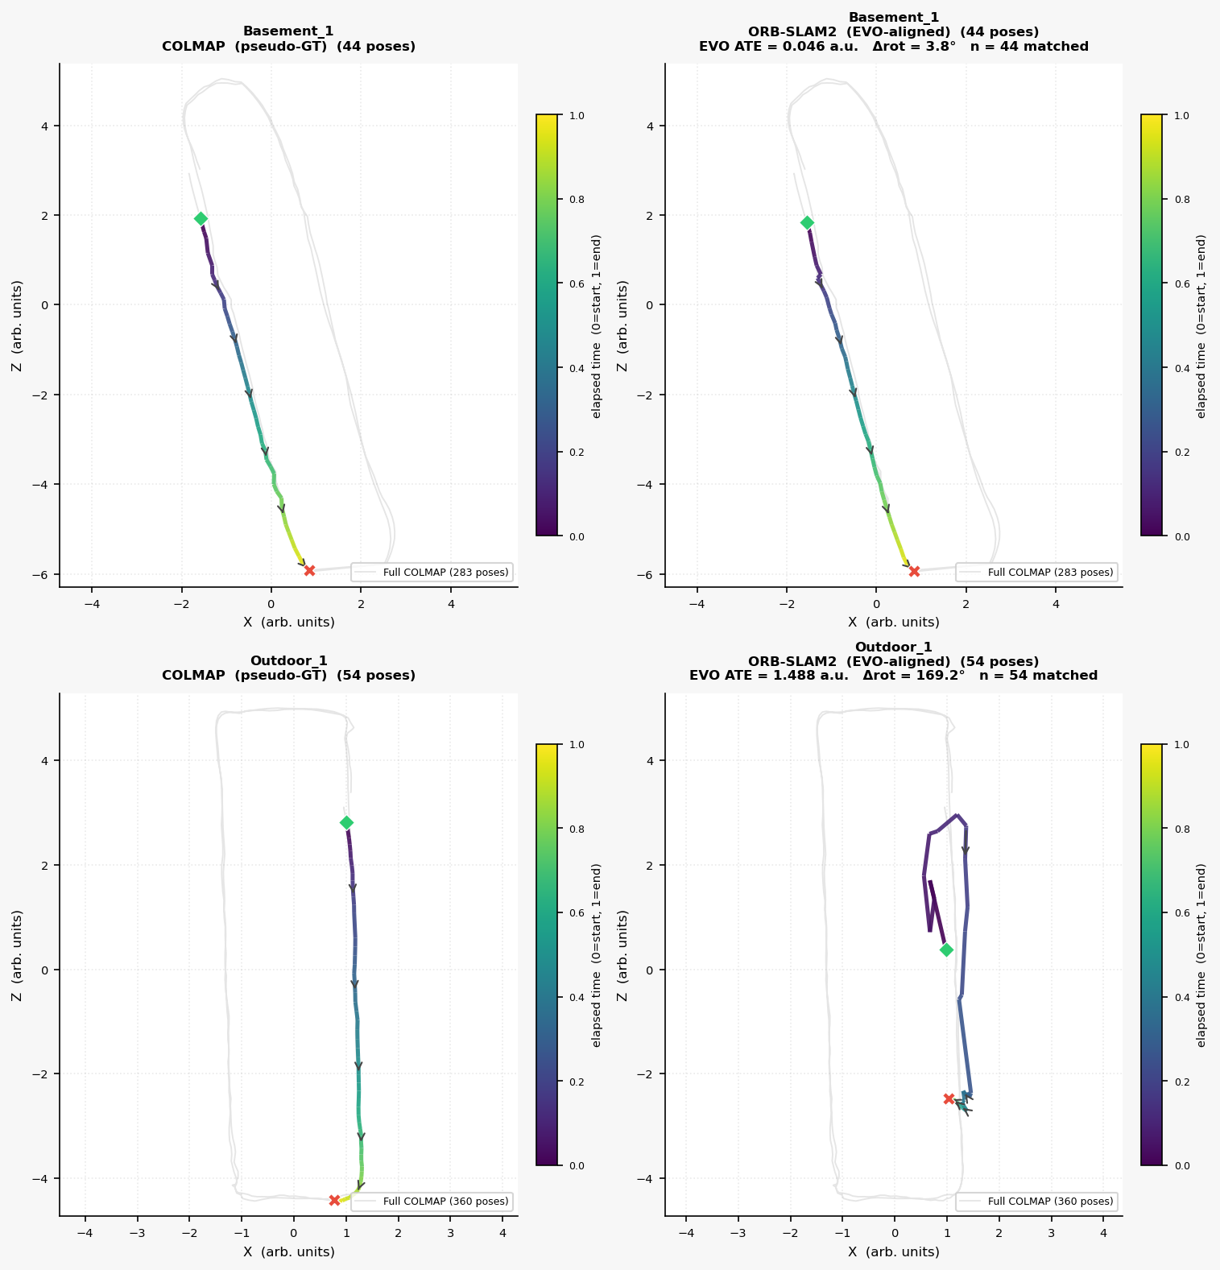
VISUAL SLAM › Q2B
Q2(b) APE maps and comparison table
Sequence analysis
▸
Basement_2: 2336 ORB KFs. Full rectangular loop — two complete circuits.
·
Tracking lost on return legs (landmarks invisible from opposite side)
·
Relocalises on next outward pass. 155 COLMAP-matched pairs.
▸
OnePoolStreet1: 5759 ORB KFs, 316 tracked (~12s of 191s total sequence).
·
Init delayed until building entrance — open courtyard = near-zero parallax
·
576 COLMAP matched pairs — best coverage of all sequences.
Trans RMSE
Rot RMSE
Matched
Basement_2 (indoor)
3.004 m
45.9°
155 pairs
OnePoolStreet1 (outdoor)
3.004 m
2.5° ✓
576 pairs
Both sequences show 3 m translation disagreement — monocular scale ambiguity, not tracking failure. Basement_2's 46° rotation = scale factor mismatch. OnePoolStreet1's 2.5° rotation shows near-perfect orientation agreement despite scale.
COLMAP vs ORB-SLAM2 Sim(3)-aligned scatter: Basement_2 (indoor) + OnePoolStreet1 (outdoor)
7

Slide 8
PART 2
LiDAR SLAM
Q3 — own 2D LiDAR sequences, parameter sweep, loop closure, pose-graph optimisation
RPLidar A2M12
3 sequences
Loop closure + GTSAM PGO
8

Slide 9
LIDAR SLAM › Q3A / Q3B
Q3(a)/(b) Sequences and parameter sweep
Three sequences — RPLidar A2M12, 360° scan, 12 m rated range, 90° blind-spot masked
▸
Basement_1 — Marshgate basement room, ~35 m path, 172 KFs. Best ICP health
▸
Protocol: chalk marker, 2 clockwise loops, 0.4–0.8 m/s, return to exact start, remove marker
▸
Floor7_Hallway — Marshgate 7th floor corridors, large open area, 135 KFs
▸
Quality filter: discard q < 5 ; body mask: 135–225° ; range gate: 10 mm – max_range
▸
Outdoor_1 — One Pool St courtyard. ICP diverges at scan 400, trajectory freezes
▸
Keyframe every Δdist > 0.2 m or Δangle > 0.2 rad from last keyframe
Parameter setting
Basement_1
Floor7_Hallway
Outdoor_1
Baseline (range 12 m)
0.17 m
0.16 m
8.17 m (frozen)
Range 2000 mm
2.38 m ✗
2.02 m ✗
2.81 m
Angular n=2 (every 2nd)
0.68 m
0.71 m ✓
3.95 m
Angular n=3 (every 3rd)
0.26 m
1.21 m
4.76 m
Voxel 0.05 m
0.41 m
0.14 m ✓
12.4 m
Voxel 0.10 m
0.29 m
3.04 m
6.22 m
Voxel 0.20 m
2.60 m ✗
2.94 m
6.02 m
Scan rate 50% (skip 2)
0.23 m
2.94 m
11.5 m
Scan rate 33% (skip 3)
0.26 m
0.73 m ✓
10.9 m
Baseline: max range 12 m, all beams, no voxel, all scans. Closure error = Euclidean first↔last 2D pose distance. Outdoor_1 documented failure — open geometry collapses ICP.
9

Slide 10
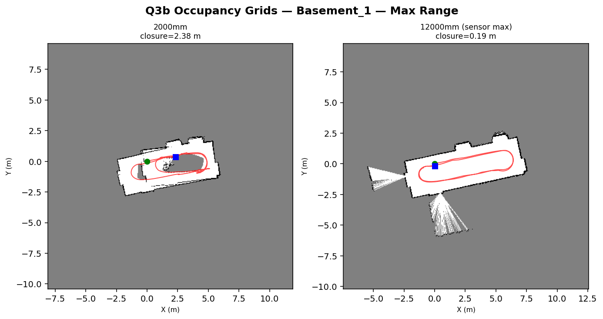
LIDAR SLAM › Q3B
Q3(b) Key parameter findings
▸
Max range is the dominant parameter (factor 14×). ICP needs surface normals from both sides of motion to lock translation. At 2000 mm all returns lie on one line — normal equations rank-deficient along that axis, trajectory drifts. Outdoor exception: distant glass/vegetation at 12 m degrades ICP — shorter range filters these noisy returns.
▸
Angular subsampling degrades PCA normals. At n=2/3 the 5-NN span a wider arc → normal estimate noisier. 5° normal error on a 5 m wall ≈ 0.4 m per-step along-wall slip. Floor7 non-monotone: every-2nd-beam smooths micro-features the corridor over-fits at full res.
▸
Voxel 0.05 m = optimal denoiser. Cell smaller than RPLidar noise (±5–20 mm) → centroid averages noise. At ≥0.10 m the cell spans real geometry; PCA normals average multiple wall orientations → ICP loses tangential wall constraint → collapses toward point-to-point.
▸
Scan skipping non-monotone at Floor7. 33% rate gives more inter-scan parallax along the corridor axis (aperture problem, Lab 08 Activity 3B). Basement_1 flat: 4 cm/scan at 10 Hz stays inside ICP convergence basin at all rates.
Max range grids — Basement_1. 2000 mm (near wall only → rank-deficient) vs 12000 mm (full map)
10

Slide 11
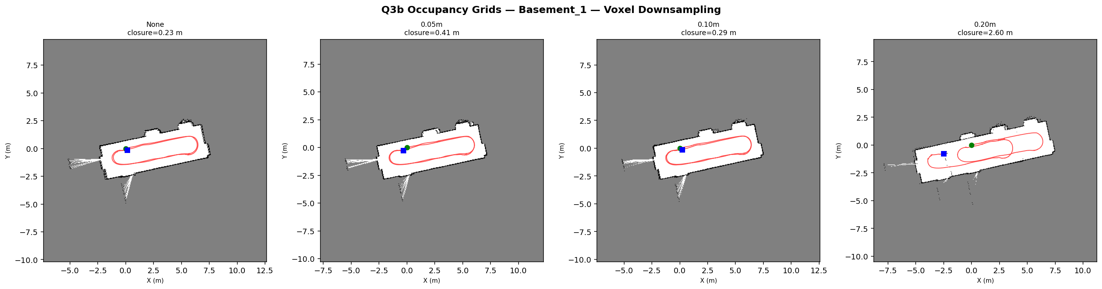
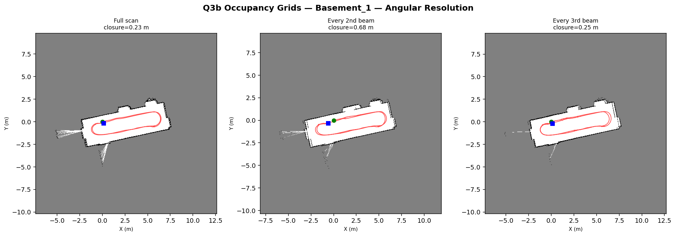
LIDAR SLAM › Q3B
Q3(b) Occupancy grid maps — Basement_1 parameter sweep
Voxel grid: None / 0.05 m / 0.10 m / 0.20 m — optimal at 0.05 m
Angular resolution: full / every-2nd / every-3rd beam — full best for indoor
Log-odds occupancy: +log(0.7/0.3) per hit, −log(0.4/0.6) per free. Clipped to [−4, +4]. Bresenham ray-casting from sensor pose. 0.05 m cell size.
11

Slide 12
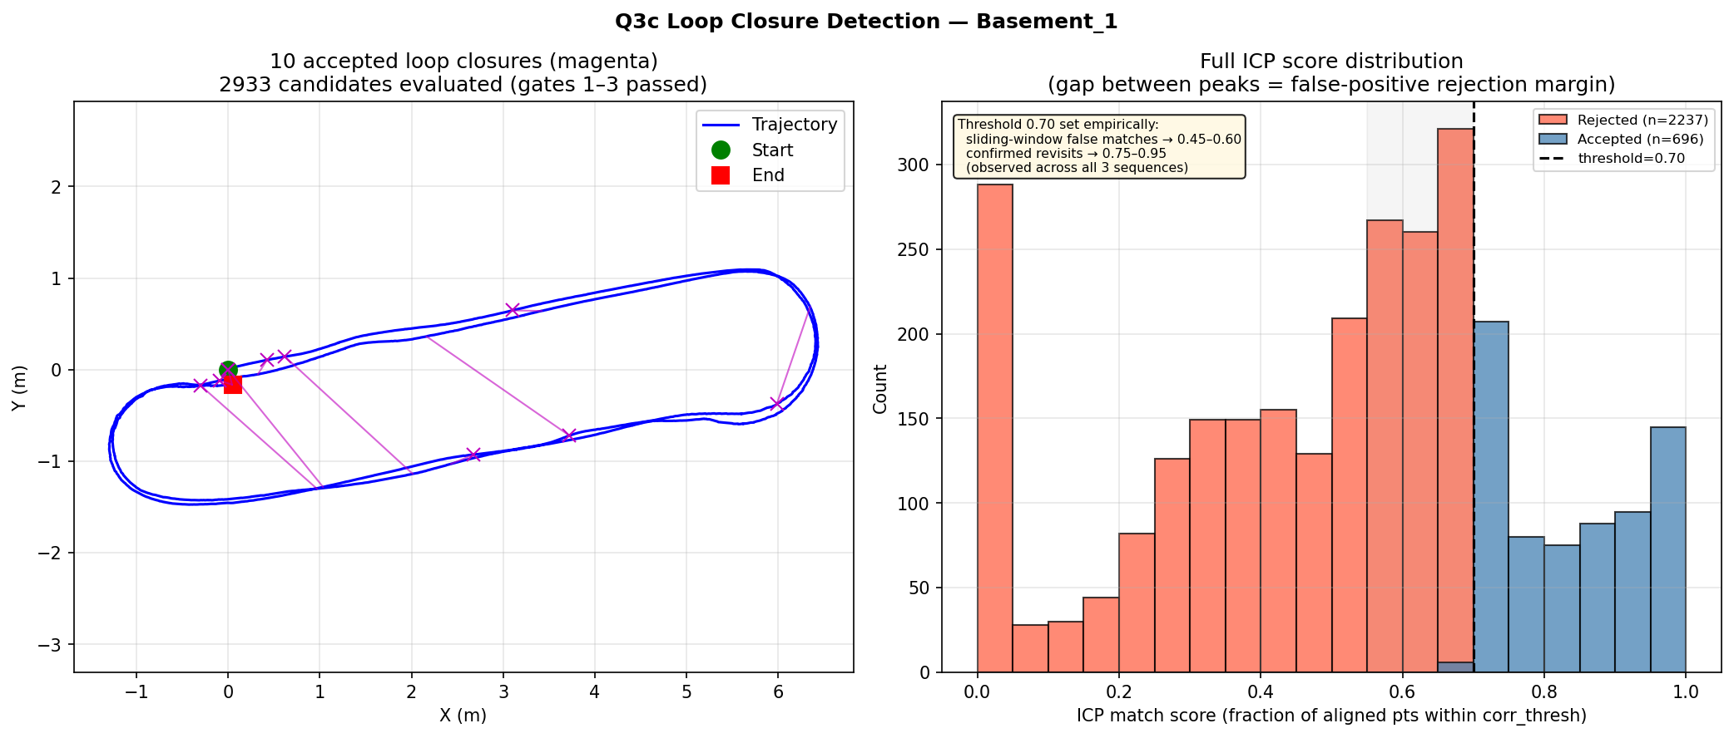
LIDAR SLAM › Q3C
Q3(c) Loop closure detection
Four-gate detector
▸
Gate 1: temporal separation j−i ≥ 10 KFs — prevent self-match
▸
Gate 2: arc ≥ min(8 m, 40% total arc) — adaptive; short seqs still fire
▸
Gate 3: pose distance ≤ 2.0 m — geometric proximity required
▸
Gate 4: ICP overlap score sij ≥ 0.70 — verified scan-level alignment
▸
sij = fraction of scan j points within 0.4 m of scan i after ICP
▸
NMS: keep highest-scoring in any 15-KF window — 1 factor per revisit
Results
Sequence
Candidates
Accepted
Basement_1
2933
10
Floor7_Hallway
1991
8
Outdoor_1
8
0 (traj. frozen)
Histogram evidence: false matches (sliding-window shared geometry) cluster 0.45–0.60. True revisits cluster 0.75–0.95. Clean gap at 0.70 holds across both indoor sequences. Outdoor_1 detects 0 loops: frozen trajectory fails arc gate.
Basement_1: accepted loop arcs (magenta, left) + ICP overlap score histogram (right). Clear bimodal gap at 0.70.
12

Slide 13
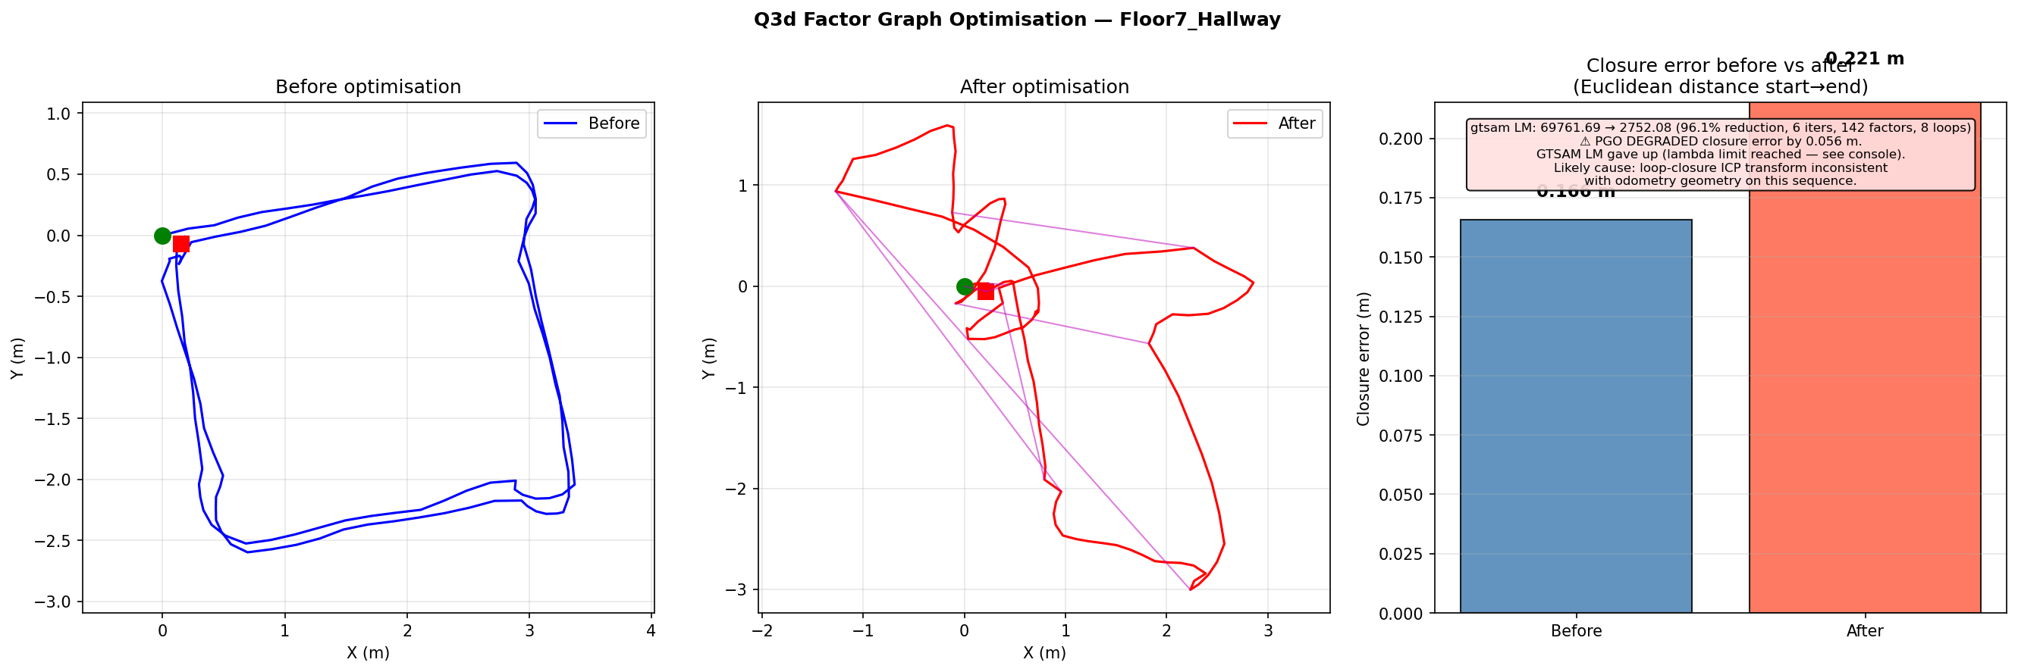
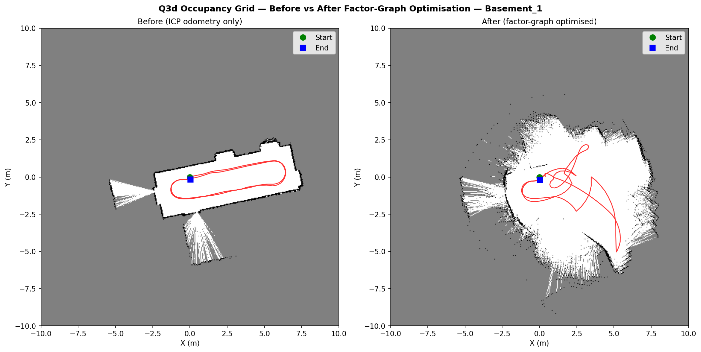
LIDAR SLAM › Q3D
Q3(d) Factor graph and occupancy grid result
SE(2) GTSAM LM
▸
Prior: σ=1e−4 anchors x₀
▸
Odom: ICP Hessian as info matrix
▸
Loop: per-loop ICP Hessian
▸
Hessian: (θ,tx,ty) → (tx,ty,θ)
▸
LM: 200 iter, rel.tol=1e−8
Floor7_Hallway before / after GTSAM PGO. Cost 69762 → 2752 (25×).
Basement_1 occupancy grid before / after PGO.
Sequence
Loops
Cost i→f
Closure Before
Closure After
Δ
Floor7_Hallway
8
69762→2752
0.166 m
0.221 m
worse (LM tension)
Basement_1
10
61253→7349
0.170 m
0.204 m
worse (LM tension)
Outdoor_1
0
0→0
8.084 m
8.084 m
no loops — unchanged
13

Slide 14
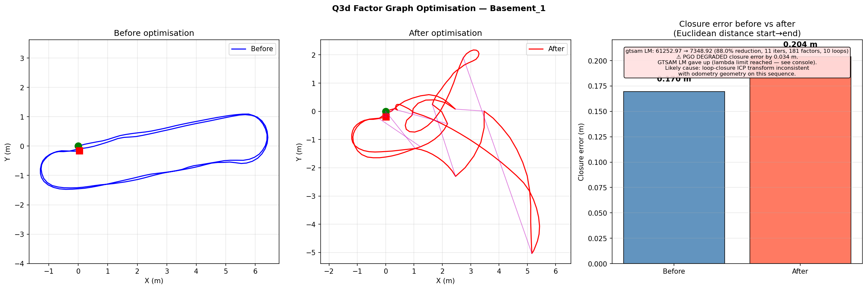
LIDAR SLAM › Q3D
Q3(d) Factor graph — why closure error grows
▸
PGO minimises the Mahalanobis sum of ALL factor residuals simultaneously
▸
Closure error = residual on ONE implied edge (first ↔ last pose)
▸
When loop and odometry edges disagree, LM finds the compromise minimising total —
·
this can worsen any individual residual including closure
▸
Per-loop ICP Hessian is large (tight loop covariance) → pulls optimiser away from
·
odometry chain → GTSAM: 'cannot decrease error at maximum lambda'
·
→ loop and odometry constraints in tension; solver stuck
Identified fixes
▸
Scale down loop information matrix by constant (÷10) → softer loop constraint
▸
Cauchy or Huber robust kernel on loop edges → down-weight outlier loops
▸
Chordal SE(2) initialisation → better LM starting point, faster convergence
▸
Scale per-loop info by ICP score — weak matches contribute less
Basement_1: before (left) vs after PGO (right). Cost drops 8× but closure distance grows.
Informative finding: tightly weighted per-loop Hessian is more accurate than fixed σ but too tight causes solver tension. Softening by ÷10 lets odometry chain dominate and closure error would decrease.
14

Slide 15
Summary
Q2 — Visual SLAM key findings
Q3 — LiDAR SLAM key findings
▸
Basement_2 (indoor): full rectangle, 2336 ORB poses, 155 matched COLMAP pairs
▸
Max range = dominant parameter: 2000 mm → 12000 mm gives 14× improvement
·
Both methods trace same room shape — 3 m scale disagreement is monocular ambiguity
·
ICP rank-deficient with only near wall — opposite wall locks translation
▸
OnePoolStreet1 (outdoor): 5759 ORB poses, 576 matched pairs — best coverage
▸
Voxel 0.05 m optimal — denoises below sensor noise floor without merging features
·
Only 2.5° rotation disagreement — near-perfect orientation agreement ✓
▸
Angular subsampling always hurts PCA normals — full scan preferred for indoor
·
3 m translation = scale unobservable in open outdoor scene
▸
Loop threshold 0.70 from bimodal ICP score histogram — clean gap both indoor seqs
▸
BikeStorage2 night failure — no ambient texture for ORB descriptor extraction
▸
PGO reduces cost 8–25× but closure error grows — loop/odometry Hessian tension
▸
Fix: scale loop info ÷10 → odometry chain dominates → closure improves
Q2 — What walls do
▸
Basement_2: four enclosing walls → COLMAP triangulates from both sides of room
▸
Monocular init gets well-posed essential matrix — no planar degeneracy
▸
Without walls (outdoor): sky/ground near-zero parallax, scale unobservable
Q3 — What walls do
▸
Enclosed indoor: walls on both sides → ICP normal equations full-rank
▸
Corridor (Floor7): aperture problem along wall axis — range truncation helps
▸
Outdoor courtyard: sparse geometry, ICP Hessian singular → divergence → freeze
15

