Slide 1
QUIZ GAME

Slide 2
Introduction
A quiz is a form of game or mind sport in which players attempt to answer questions correctly on one or several specific topics.
Quiz game is a collection of number of different types of quizzes like mathematics ,Islamic ,general knowledge and Computer science, etc.
A user can play all of the quiz and can attempt one.
There will be limited number of questions and for each correct answer user will get a credit score.
By playing quiz games user will come to know about his/her level and can learn additional knowledge.

Slide 3
Purpose
Test and challenge players' knowledge across various subjects.
Make learning fun and enjoyable by turning it into a game.
Help you assess your own knowledge and identify areas for improvement.
Expand players' knowledge base through exposure to new information
Provide an entertaining and educational platform for players of all ages.

Slide 4
WORKING

Slide 5
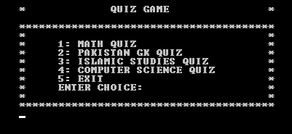

Slide 6
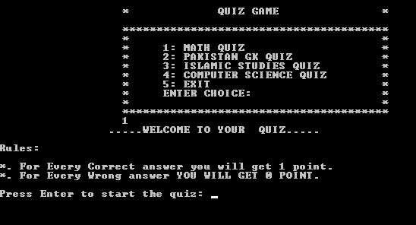

Slide 7
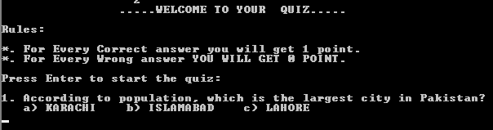

Slide 8


Slide 9
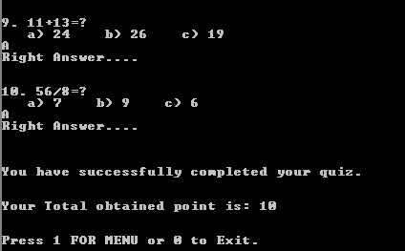

Slide 10
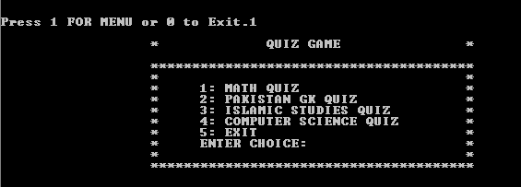

Slide 11
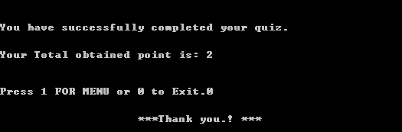

Slide 12
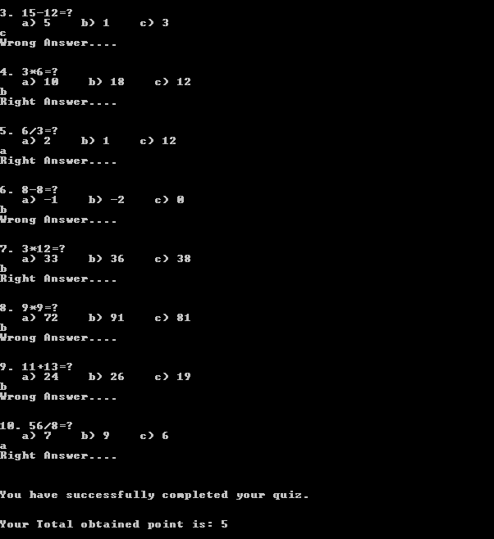

Slide 13
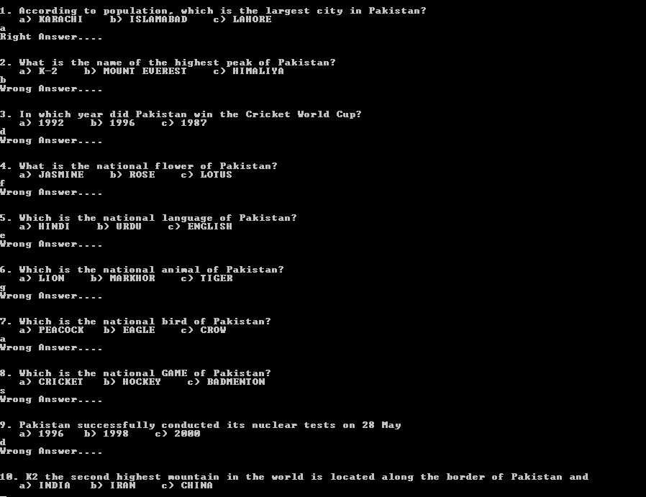

Slide 14
THANK YOU

