Slide 1


VERIFICATION OF Ethernet MAC LAYER
Graduation Project Final Discussion
sponsored By : PYRAMIDTECH DR. Ahmed Abou-Auf
DR. Mostafa Ghouneem
Eng. ALI Maher

Slide 2
Team members
Nada Yehia Elsayed
Mohammad Wael Monir
Mariam Hossam Abd-Elghaffar
Muhammad Majid Abdul-Halim
Mounir Essam Mounir

Slide 3
agenda
Introduction to Ethernet Protocol
Ethernet MAC IP
Ethernet UVM Architecture
TX Operation
TX Verification
RX Operation
RX Verification
Control Verification
MII Operation
MII Verification
Code Coverage
Future work

Slide 4

INTRODUCTION TO ETHERNET Protocol

Slide 5
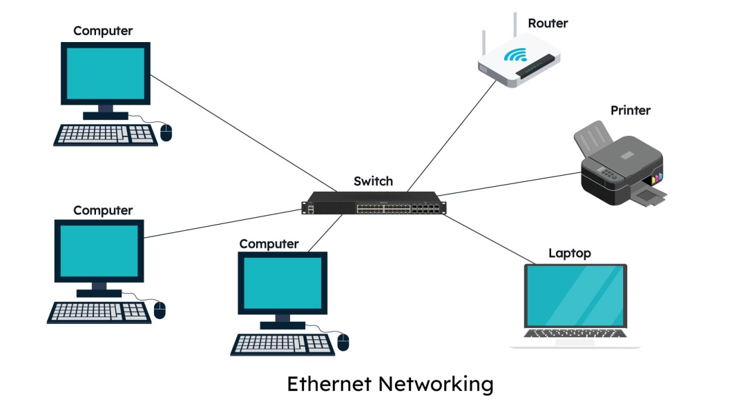
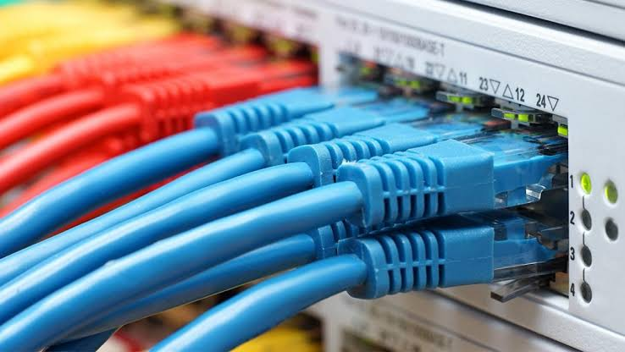
Introduction to Ethernet
Ethernet is the most widely used wired Local Area Network (LAN) technology, standardized by IEEE 802.3.
Key Features:
  Operates at the Physical (Layer 1) and Data Link (Layer 2) of the OSI model.
  Supports multiple data rates, including 10 Mbps, 100 Mbps, 1 Gbps, and higher

Slide 6
Ethernet MAC IP

Slide 7
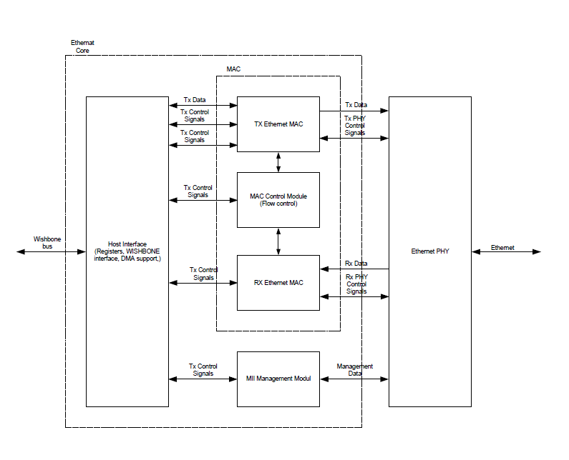
Ethernet MAC IP
  The Ethernet MAC is the lower sublayer of Layer 2 that interfaces higher-layer protocols with the Ethernet physical layer.
  This project verifies the open-source Ethernet MAC IP from OpenCores

Slide 8
Ethernet UVM Architecture

Slide 9
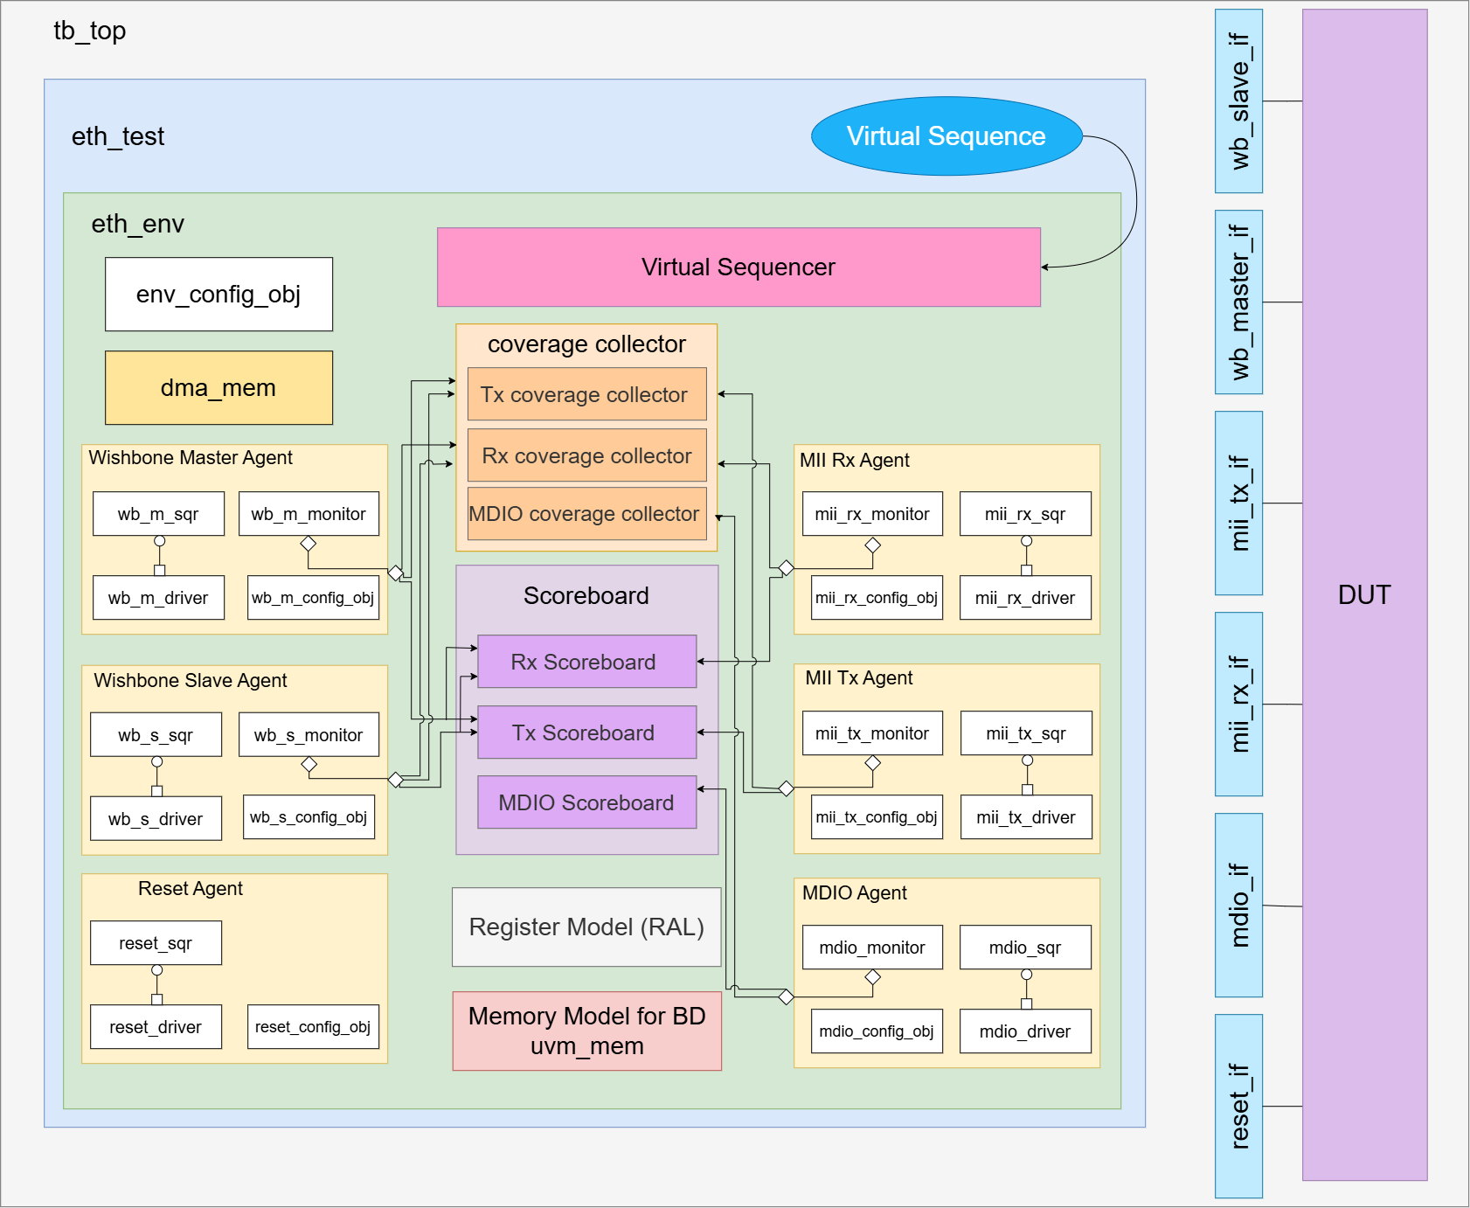
Ethernet UVM Architecture

Slide 10
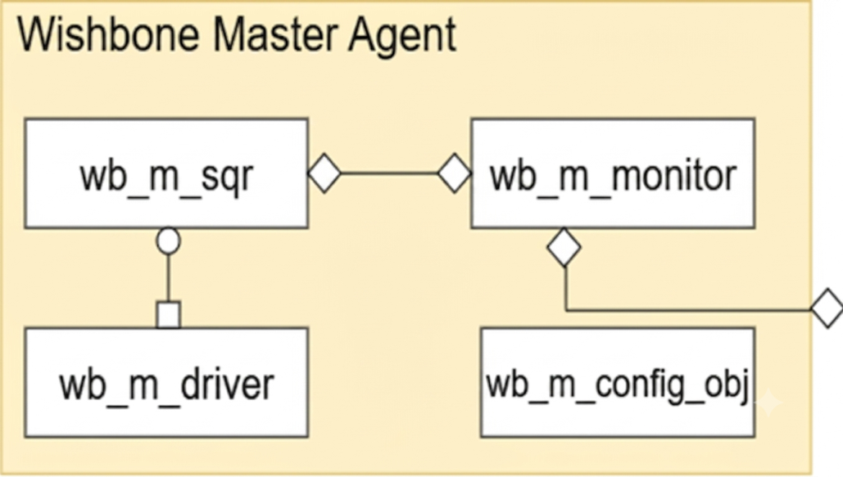
Ethernet UVM Components
Wishbone Master Agent (Reactive)
Models the external memory that the DUT accesses via its WISHBONE master port.
The DUT initiates every transaction.

Slide 11
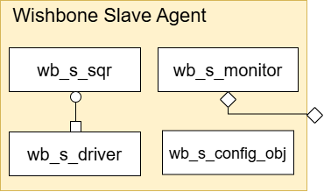
Ethernet UVM Components
Wishbone Slave Agent (Active)
Models the host processor (RISC/CPU) that configures the MAC.
The testbench initiates all transactions.

Slide 12
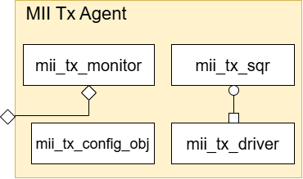
Ethernet UVM Components
MII Tx Agent (Active)
Simulates the Ethernet PHY transmitter interface.
Includes a monitor to capture transmitted frames by the DUT.

Slide 13
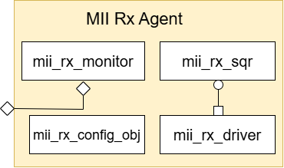
Ethernet UVM Components
MII Rx Agent (Active)
Simulates the Ethernet PHY receiver interface.
Sends Ethernet frames to the DUT through the MII RX interface.

Slide 14
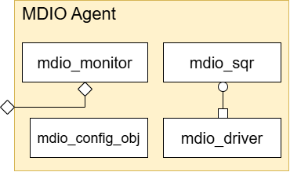
Ethernet UVM Components
MDIO Agent (Active)
Models the PHY chip on the MDIO management interface.
Initiates all MII management transactions for configuration and status read of the physical device.

Slide 15
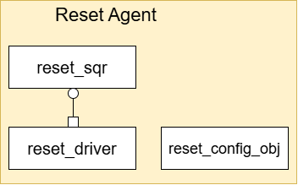
Ethernet UVM Components
Reset Agent (Active)
Controls the RST_I signal to the DUT independently of any other sequence.
Drives RST_I high/low for programmable durations

Slide 16
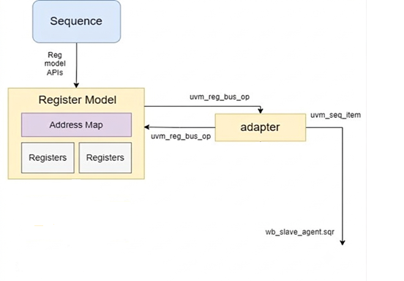
Register Abstraction Layer (RAL)
RAL provides an easy and organized way to access and verify DUT registers and buffer descriptors.

Slide 17
TX Operation

Slide 18
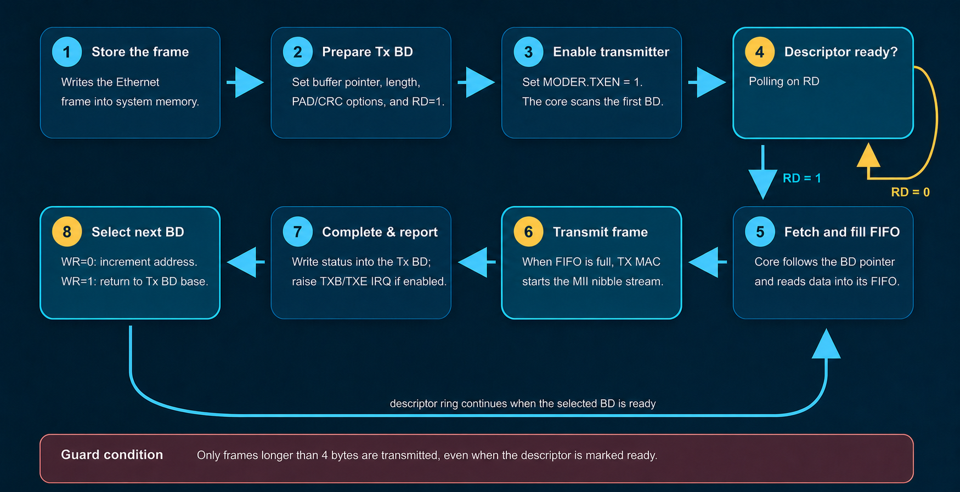
Basic frame transmission

Slide 19
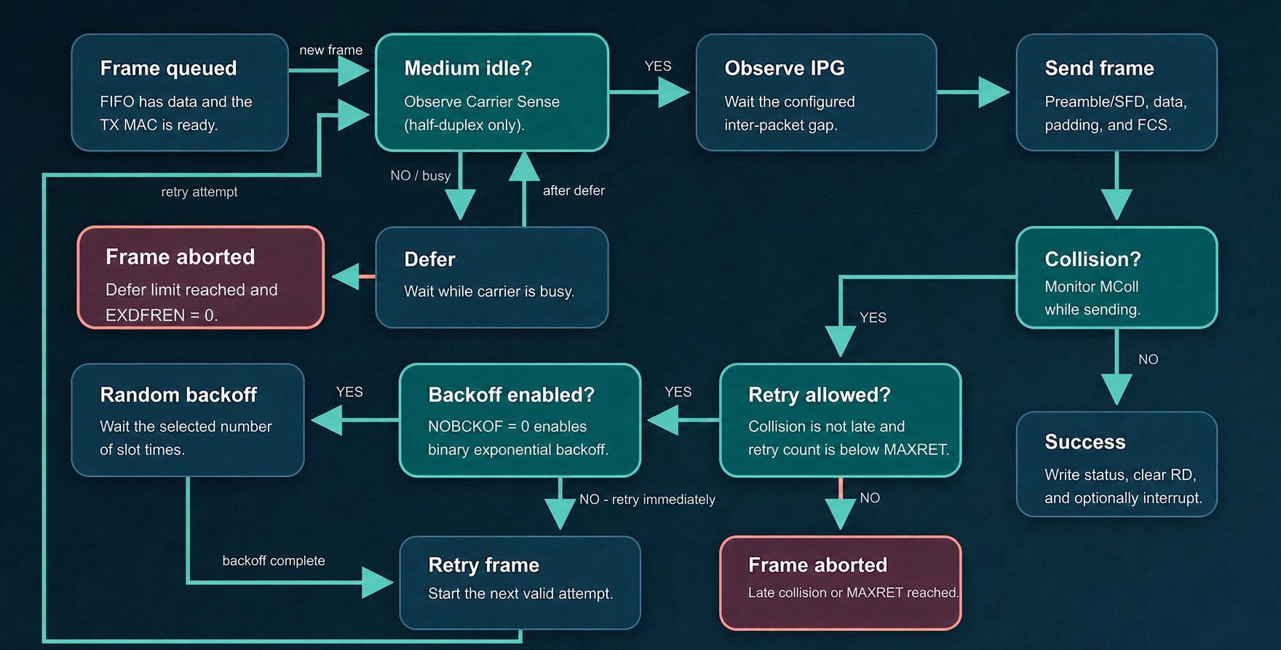
Half Duplex

Slide 20
TX Verification

Slide 21

Verification Plan
We put test plan for testing this features
All TX configurations (full/half duplex CRC, PAD,…etc)
Interframe gap time
Corner cases (Limits of frame length, retry count,…etc)
Errors (Huge frame, Underrun,…etc)
30 Constraint randomized test cases

Slide 22
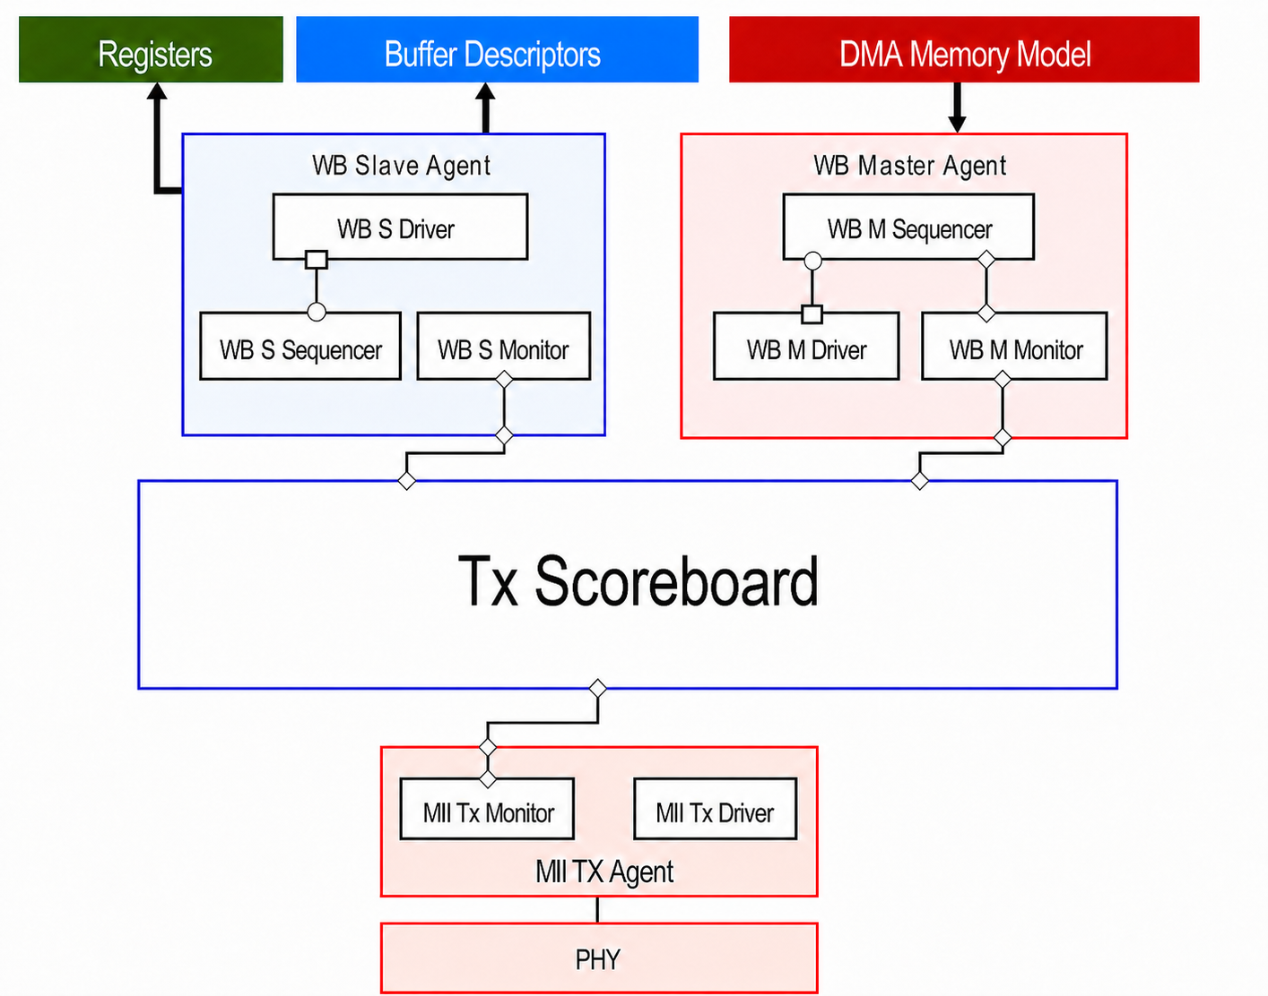
Verification Architecture

Slide 23
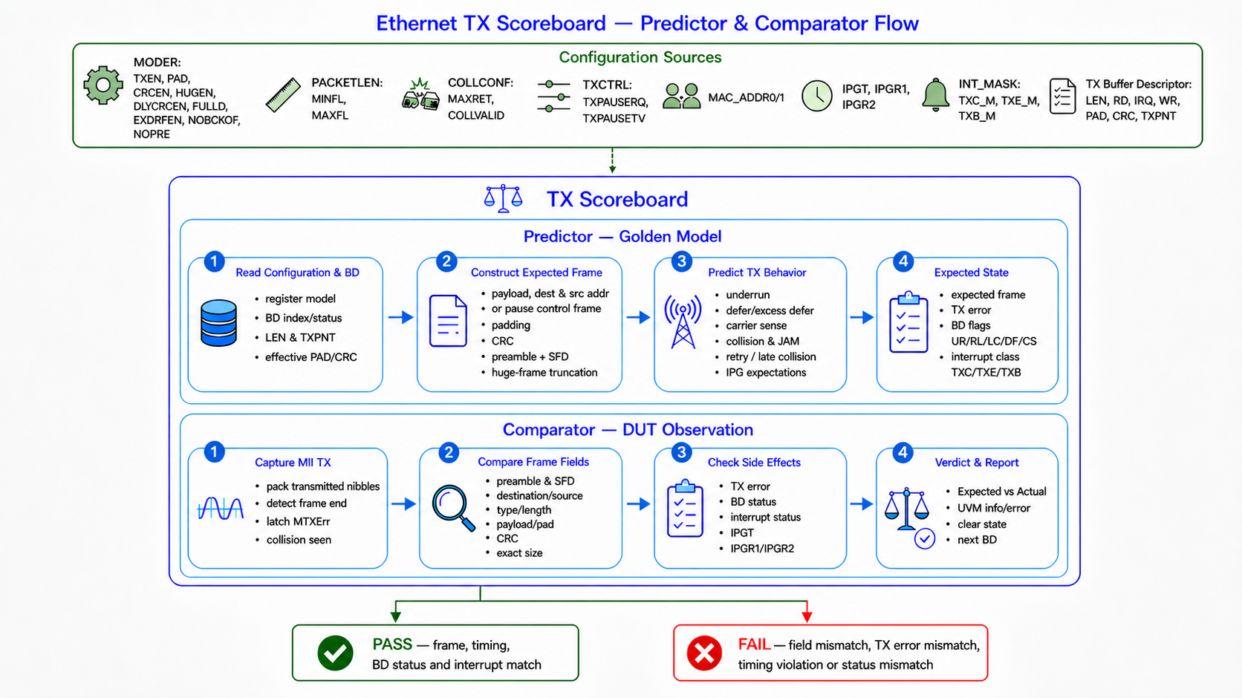
TX Scoreboard

Slide 24
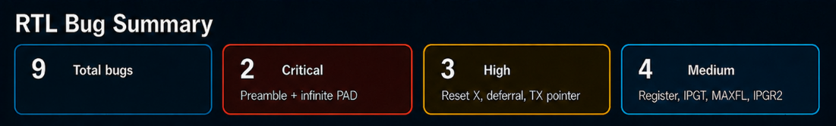
Bugs & Functional Coverage
Functional Coverage

Slide 25
RX Operation

Slide 26
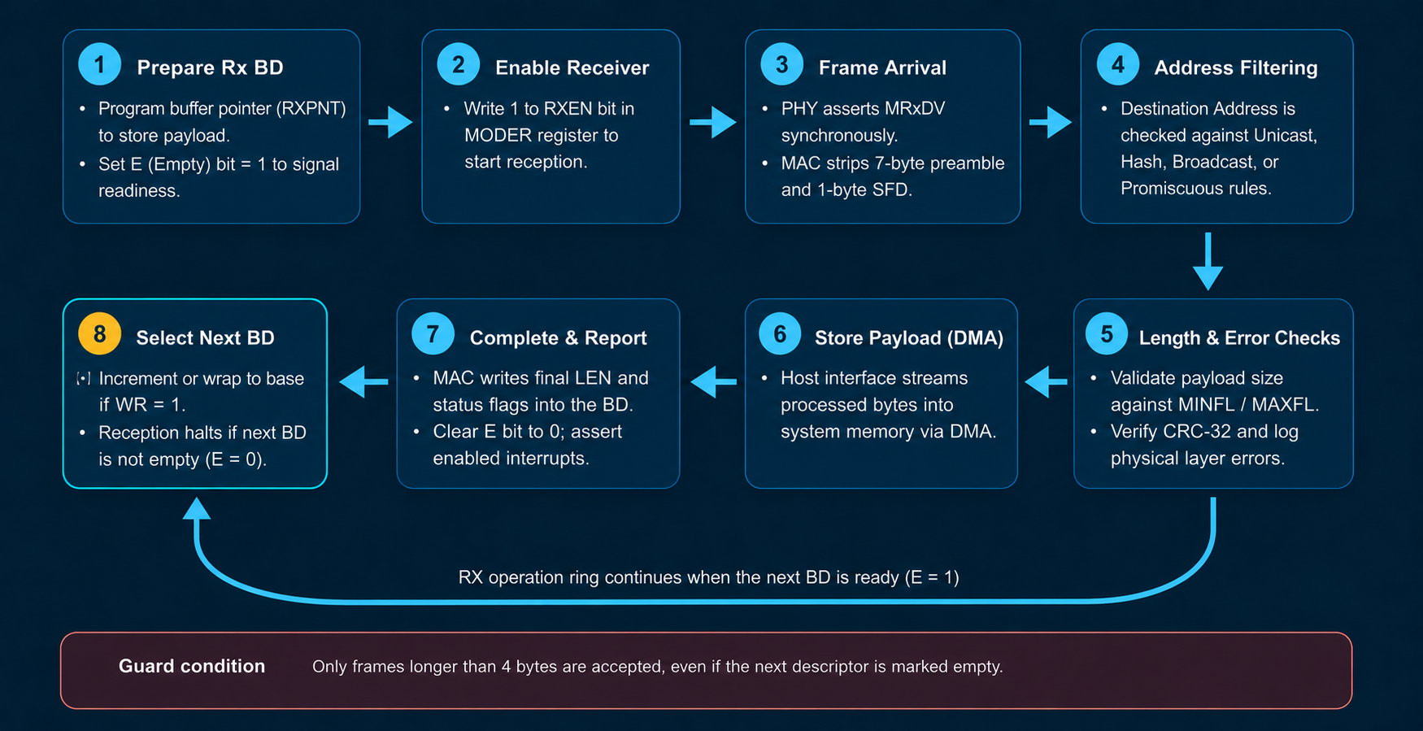
Basic Frame Reception

Slide 27
rX Verification

Slide 28
Configuration Registers
MODER Register
Reserved |  |  |  |  |  |  |  |  |  |  |  |  |  |  | RECSMALL
31 | 30 | 29 | 28 | 27 | 26 | 25 | 24 | 23 | 22 | 21 | 20 | 19 | 18 | 17 | 16
PAD | HUGEN | CRCEN | DLYCRCEN | Reserved | FULLD | EXDFREN | NOBCKOF | LOOPBCK | IFG | PRO | IAM | BRO | NOPRE | TXEN | RXEN
15 | 14 | 13 | 12 | 11 | 10 | 9 | 8 | 7 | 6 | 5 | 4 | 3 | 2 | 1 | 0

Slide 29
RX Buffer Descriptor
LEN | E | IRQ | WR | Reserved | CF | M | OR | IS | DN | TL | SF | CRC | LC
31:16 | 15 | 14 | 13 | 12:9 | 8 | 7 | 6 | 5 | 4 | 3 | 2 | 1 | 0
RXPNT [31:0] – Pointer to buffer in memory

Slide 30
Verification Plan
We developed a comprehensive test plan targeting these RX features:
➢ All RX MODER configurations
(PRO, BRO, IAM, HUGEN, RECSMALL, RXEN).
➢ Address Recognition & Filtering combinations
(Exact Match, Unicast Miss, Broadcast, and Multicast Hash).
➢ Corner cases & Frame Boundaries
(MINFL logic with RECSMALL, MAXFL truncation vs. Jumbo frames).
➢ Error Injection & Robustness Testing
(Single-bit/Multi-bit MAC address mismatches, Byte Reversal).
➢ Extensive Constrained-random test sequences to cross-cover all feature combinations.

Slide 31
RX ARCHITECTURE
Registers
Buffer Descriptor
DMA
RAL Model
WB Slave Agent
WB Master Agent
WB S Driver
WB S Monitor
WB M Driver
WB M Monitor
Rx Scoreboard
if
DUT
MII Rx Monitor
MII Rx Driver
MII Rx Agent
MII Rx Sequencer
PHY
Ethernet Frame

Slide 32
RX ARCHITECTURE
Registers
Buffer Descriptor
DMA
RAL Model
WB Slave Agent
WB Master Agent
WB S Driver
WB S Monitor
WB M Driver
WB M Monitor
Rx Scoreboard
if
DUT
MII Rx Monitor
MII Rx Driver
MII Rx Agent
MII Rx Sequencer
Ethernet Frame
PHY

Slide 33
RX ARCHITECTURE
Registers
Buffer Descriptor
DMA
RAL Model
WB Slave Agent
WB Master Agent
WB S Driver
WB S Monitor
WB M Driver
WB M Monitor
Rx Scoreboard
if
DUT
MII Rx Monitor
MII Rx Driver
Ethernet Frame
MII Rx Agent
MII Rx Sequencer
PHY

Slide 34
RX ARCHITECTURE
Registers
Buffer Descriptor
DMA
RAL Model
WB Slave Agent
WB Master Agent
WB S Driver
WB S Monitor
WB M Driver
WB M Monitor
Rx Scoreboard
if
DUT
MII Rx Monitor
MII Rx Driver
MII Rx Agent
MII Rx Sequencer
Ethernet Frame
PHY

Slide 35
RX ARCHITECTURE
Registers
Buffer Descriptor
DMA
RAL Model
WB Slave Agent
WB Master Agent
WB S Driver
WB S Monitor
WB M Driver
WB M Monitor
Rx Scoreboard
Reconstructed Eth Frame
if
DUT
MII Rx Monitor
MII Rx Driver
MII Rx Agent
MII Rx Sequencer
Ethernet Frame
PHY

Slide 36
Registers
Buffer Descriptor
DMA
RAL Model
WB Slave Agent
WB Master Agent
WB S Driver
WB S Monitor
WB M Driver
WB M Monitor
Rx Scoreboard
Reconstructed Eth Frame
if
DUT
MII Rx Monitor
MII Rx Driver
MII Rx Agent
MII Rx Sequencer
Ethernet Frame
PHY

Slide 37
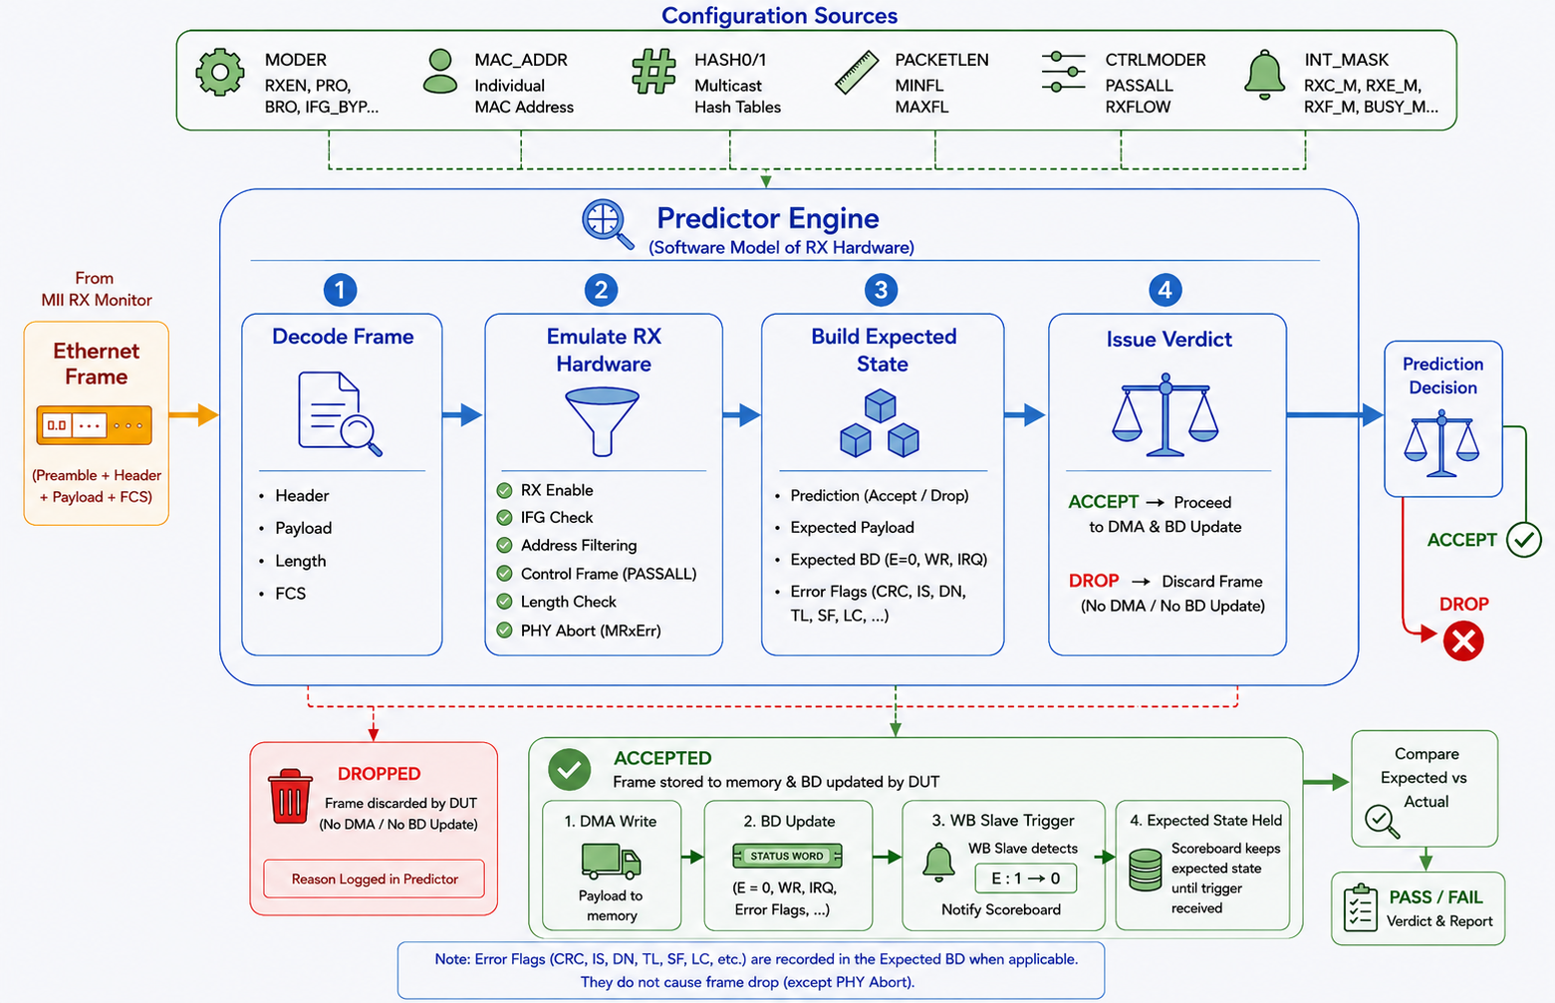

Slide 38
Registers
Buffer Descriptor
DMA
RAL Model
WB Slave Agent
WB Master Agent
WB S Driver
WB S Monitor
WB M Driver
WB M Monitor
MII Rx FIFO
Predictor
Comparator
Payload Queue
MII Rx FIFO
MII Rx Monitor
MII Rx Driver
if
DUT
MII Rx Sequencer
MII Rx Agent
PHY

Slide 39
BUG
✅Expected: LEN = 512 | TL = 1
❌Actual: LEN = 0 | TL = 0
Receiving Oversized Frame (HUGEN=0)
IS
ByteCnt = MaxFL
(512)
Reset Logic
Status Logic
Reset Counter
ByteCnt drops to 0
Check: Is ByteCnt > 512 ?
512 > 512 ➡️ FALSE
TL Bit remains 0
End of Frame ➡️ Write to BD
Actual Result: LEN = 0, TL = 0

Slide 40
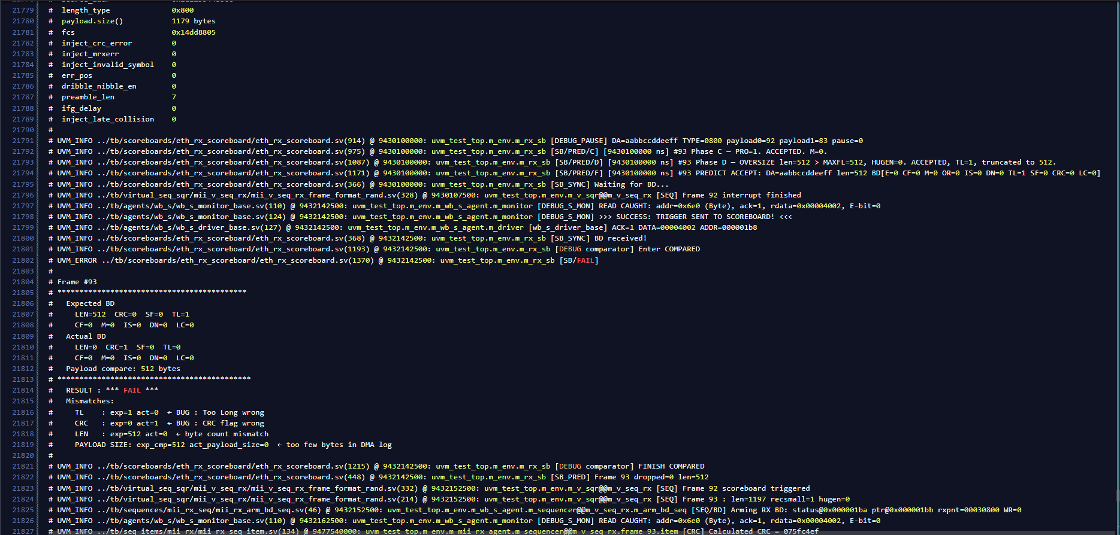

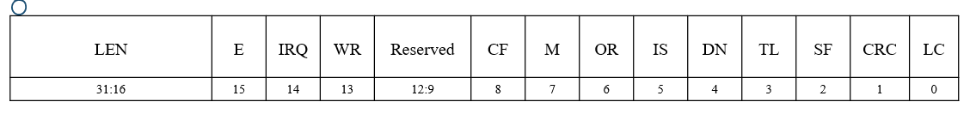
BUG
0000 0000 0000 0000 0100 0000 0000 0010

Slide 41
Functional Coverage

Slide 42
Control Verification

Slide 43
Verification Plan
We put test plan for testing this features
All Control Moder configurations (TXFLOW, RXFLOW, PASSALL, Interrupts…etc).
Verify PAUSE Timer Functionality.
Corner cases (Limits of frame length, delay CRC,…etc).
Error Injection & Robustness Testing
Constraint randomized test cases

Slide 44
Sending Pause Control Frame
Enable and Configuration: Set CTRLMODER (TXFLOW) then Write TXCTRL with TXPAUSETV and PAUSE request
NO
Host Send Request TPAUSERQ =1
TX Active?
Control Tackes Over
(TX-MAC)
Start Control Frame.
(TXStartFrm)
PAD + FCS
Yes
Wait for current transmission to end
Frame Sent.
Ready for new frame
Release
Request Latch
TPAUSERQ = 0
Signal Completion
(TXEndFrm)
Transmit through PHY
Generated Pause Control Frame (64 Bytes)
Destination Add.
Source Add.
Type
0x8808
Opcode
0x0001
Pause time
Reserved/Padding
FCS
6 Bytes
6 Bytes
2 B
2 B
2 B
42 Bytes
4 Bytes

Slide 45
Receiving Pause Control Frame
Incoming frame from PHY
Valid Pause frame
DA=01-80-C2-00-00-01 or own MAC
Type = 0x8808, Opcode = 0x0001
NO
Normal Data Frame
Yes
TX not Blocked
NO
CTRLMODER.RXFLOW = 1?
Yes
Dropped
NO
PASSALL =1
Store to Memory
Load Pause Timer
YES
Yes
PASSALL = 1
Store Frame
BD.CF = 1
Store frame
BD.CF = 1
NO
Set Interrupt RXC
Set Interrupt RXB
Only RXC fires not RXB
TX MAC Paused
Timer Reach 0 (TX Resume)

Slide 46
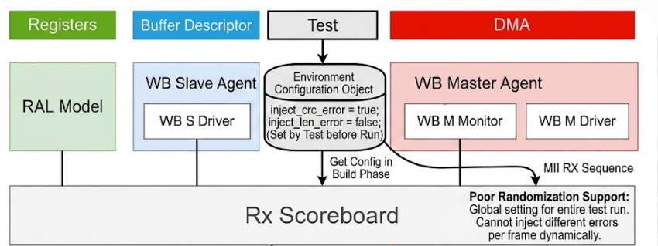
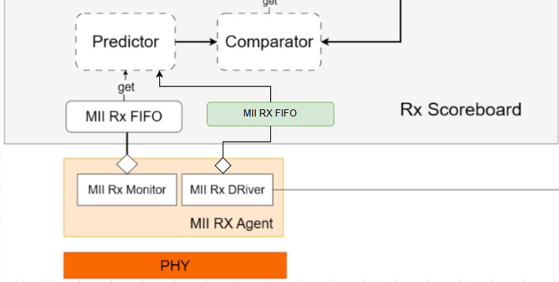
Problems & Solutions in RX
1: Inject error and drive it to scoreboard
2: Frame synchronization.
3: Control Frame synchronization.
4: Reset Payload after each frame.

Slide 47
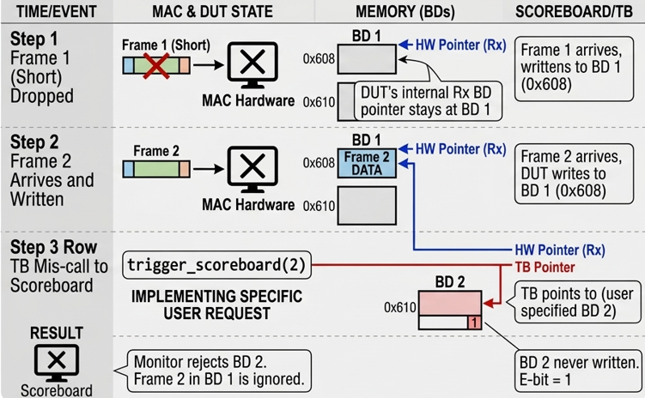
Problems & Solutions in RX
1: Inject error and drive it to scoreboard
2: Frame synchronization.
3: Control Frame synchronization.
4: Reset Payload after each frame.

Slide 48
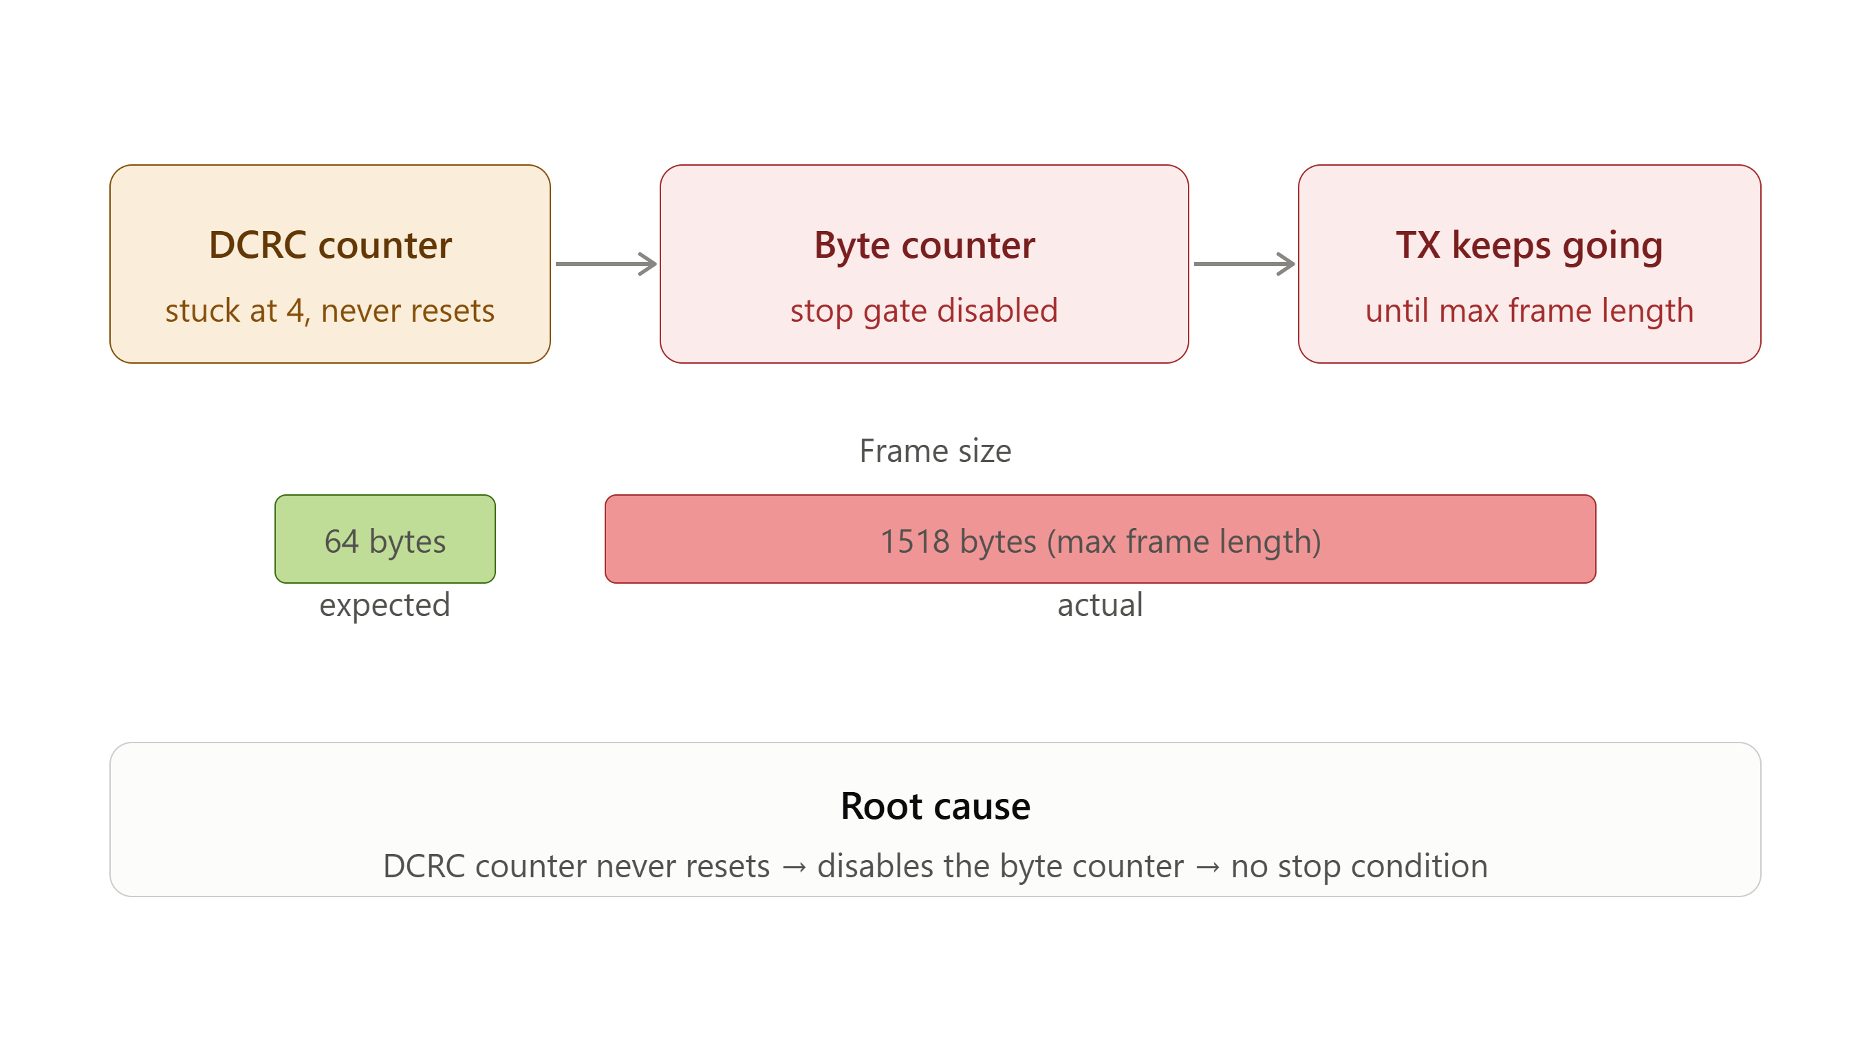
BUGS

Slide 49

MII Operation

Slide 50
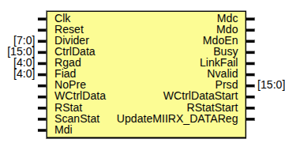
Scope & Objective
Scope: DUT files under test
  eth_miim.v
    eth_clockgen.v
    eth_shiftreg.v
    eth_outputcontrol.v
Objective: reach 100% functional coverage, maximize code coverage

Slide 51
MII Verification

Slide 52
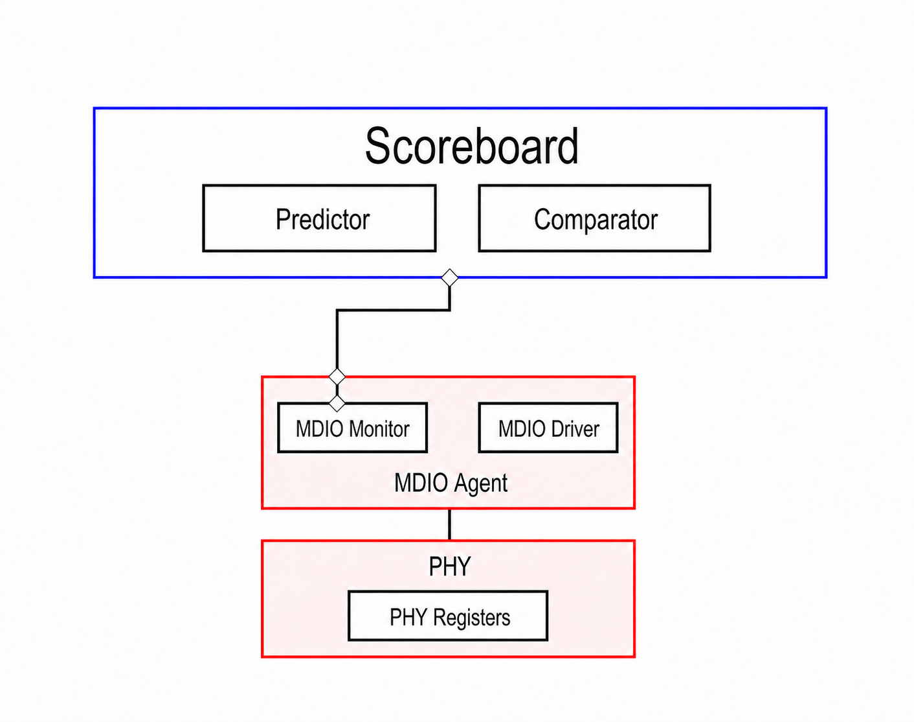
TestbencH Architecture

Slide 53
Test Suite Overview
15 test cases, divided mainly in three categories:
  Reset & Clock Generation
  Writing to PHY
  Reading From PHY
Target:
  Protocol correctness
  Register/priority edge cases
  Timing/corner-case

Slide 54

Functional Coverage Results
MIIM Functional Coverage:

Slide 55
RTL Bugs
MIIM-Bug-001:
  Description: In-flight MIIM operation abort permanently deadlocks Busy.
  Severity: High.
  Root Cause: Nvalid signal is left set with no path to 0.
    Busy = ... | InProgress | InProgress_q3 | Nvalid;
  Trigger: Normal register write
  Recovery: only a full core reset clears it.

Slide 56
CODE COVERAGE

Slide 57


Code Coverage
Reasons for Not Achieving 100% Coverage:
  Unreachable code in RTL.
  Reserved bits in the Register file.
  Need for direct test cases.
Before Exclusion
After Exclusion

Slide 58
Future work

Slide 59

Future Work
Implement direct test cases to achieve higher code coverage.
Back-to-Back (B2B) configuration: connecting two instances of the DUT/environment directly to each other.

Slide 60
Thank you

