Slide 1
Team members
Mariam Hossam Abd-Elghaffar
Mohammad Wael Monir
Muhammad Majid Abdul-Halim
Mounir Essam Mounir
Nada Yehia Elsayed

Slide 2
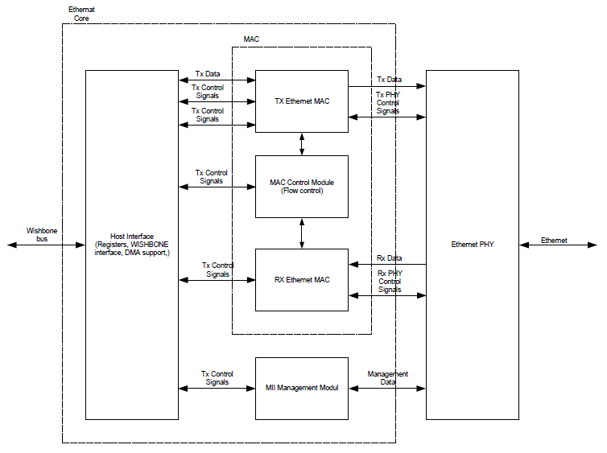
Design Block Diagram

Slide 3
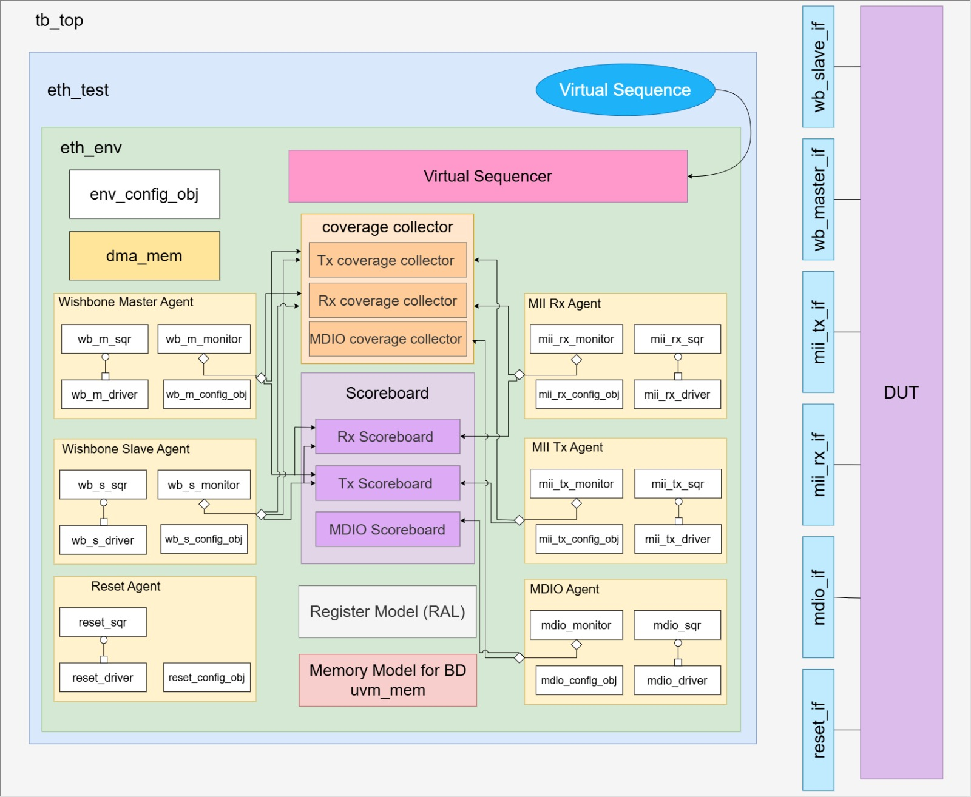
Testbench Architecture

Slide 4



Results
Found 10 bugs
Functional coverage
Code coverage

