Slide 1


VERIFICATION OF Ethernet MAC LAYER
Graduation Project Final Discussion

Slide 2

INTRODUCTION TO ETHERNET Protocol

Slide 3
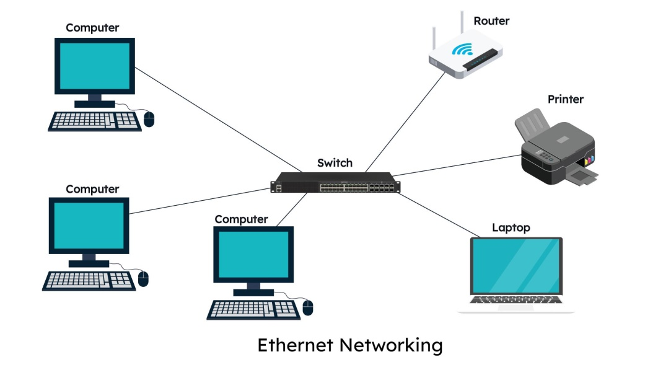
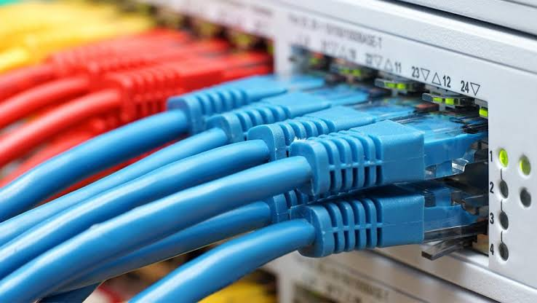
Introduction to Ethernet
Ethernet is the most widely used wired Local Area Network (LAN) technology, standardized by IEEE 802.3.
Key Features:
Operates at the Physical (Layer 1) and Data Link (Layer 2) of the OSI model.
Supports multiple data rates, including 10 Mbps, 100 Mbps, 1 Gbps, and higher

Slide 4
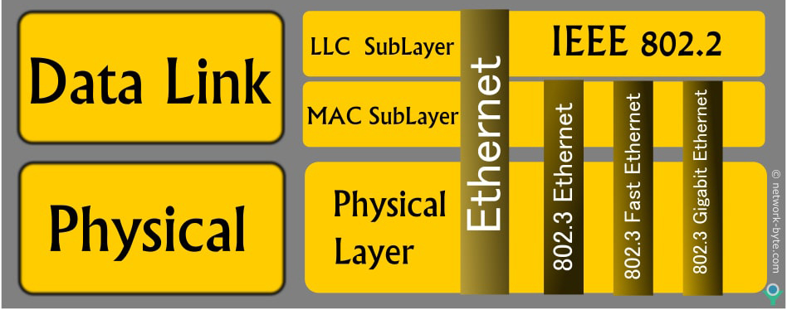
Ethernet MAC layer
The Ethernet Media Access Control (MAC) layer is the lower sublayer of the Data Link Layer (Layer 2) in the OSI model. It provides the interface between higher-layer protocols (such as IP) and the physical Ethernet interface.
The MAC performs several functions:
Frame transmission and reception
Address filtering
Error detection
Flow control
Media access control

Slide 5
Ethernet MAC IP

Slide 6
Ethernet MAC IP
Open-source Ethernet MAC IP core implemented by OpenCores.
OpenCores: Open-source repository of free, reusable hardware IP cores (processors, controllers, interfaces).
Key Specifications
Standard:10/100 Mbps Ethernet
Interface: MII (Media Independent Interface) for PHY connection
Control Bus: Wishbone slave for CPU access

Slide 7
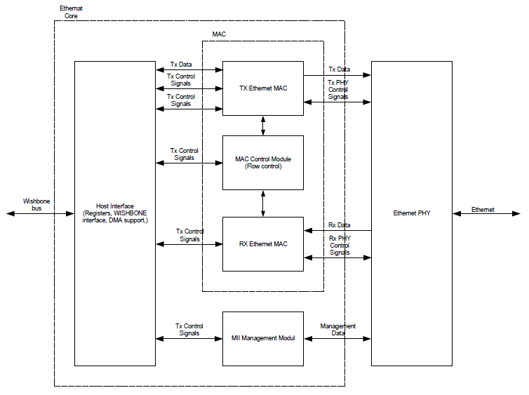
Ethernet MAC IP
Block Diagram

Slide 8
Ethernet UVM Architecture

Slide 9
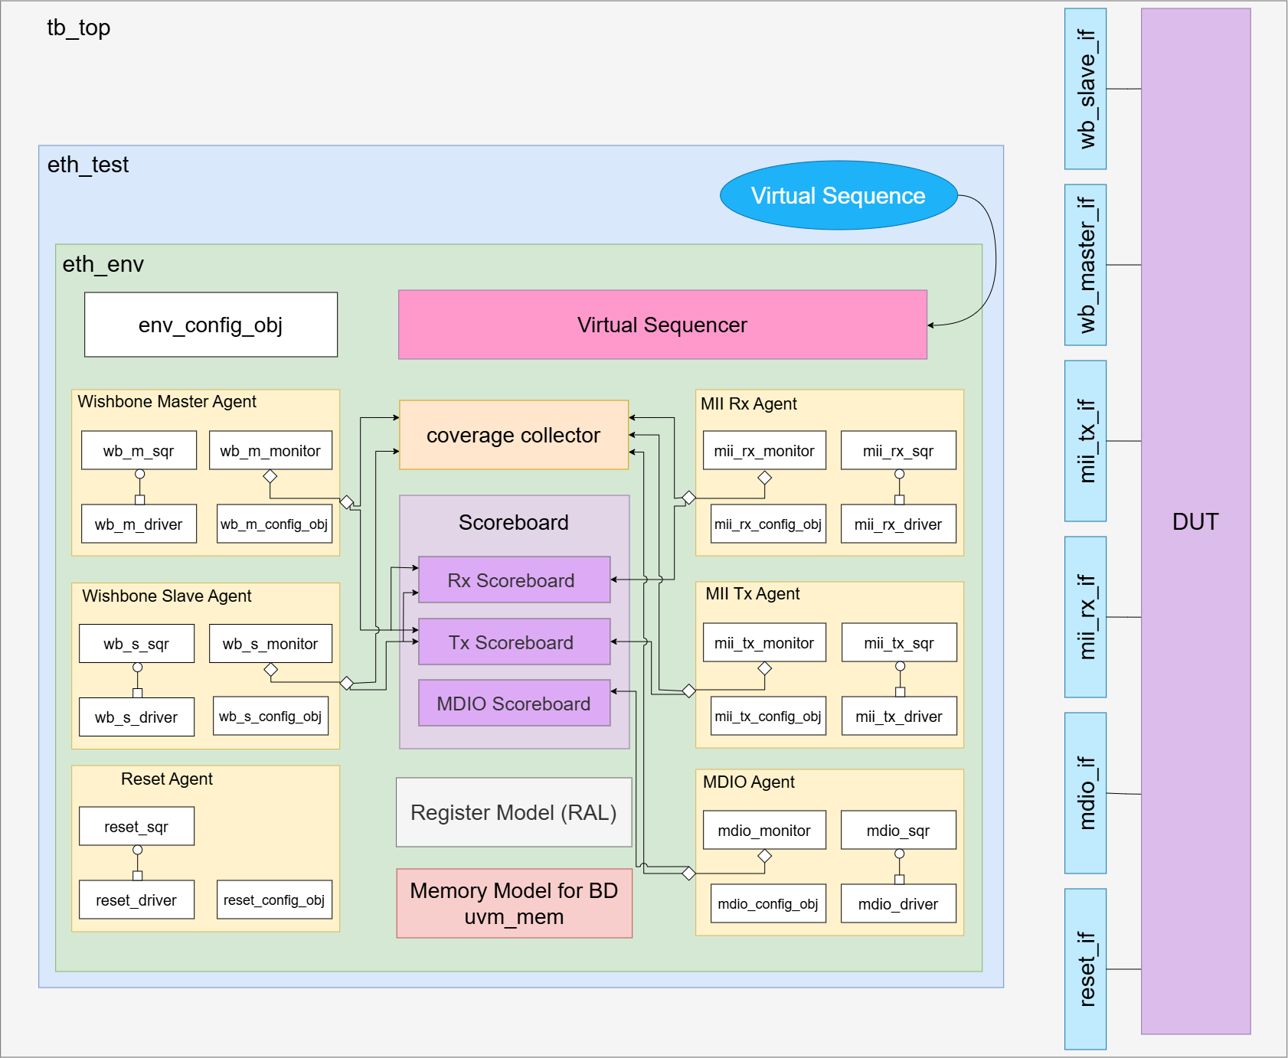
Ethernet UVM Architecture

Slide 10
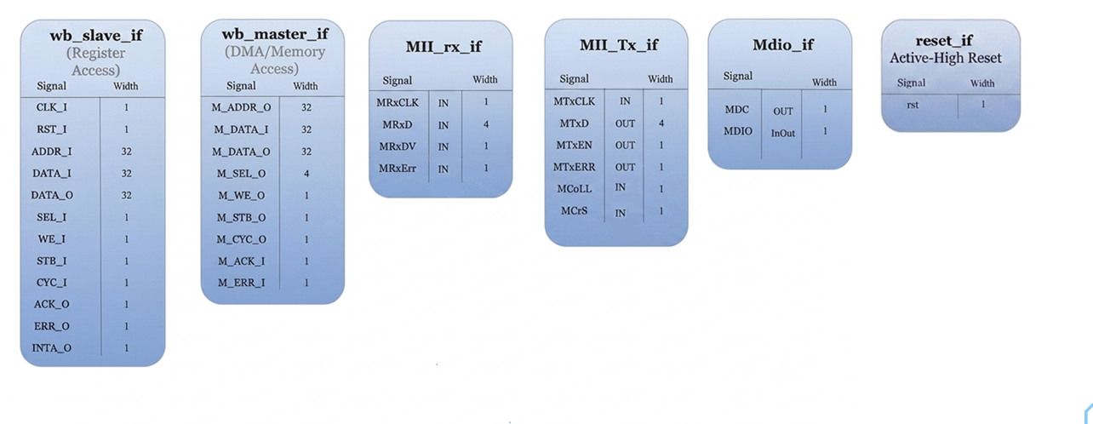
Ethernet Interfaces

Slide 11
Ethernet UVM Components
Runs from the test.
Controls multiple agents at the same time.
Starts sequences on different sequencers in the required order.
Stores handles to every agent's real sequencers:
The virtual sequence runs on the virtual sequencer and starts sequences on the correct real sequencer.
Virtual Sequence
Virtual Sequencer

Slide 12
Ethernet UVM Components
Wishbone Master Agent — Reactive
Wishbone Slave Agent — Active
Models the external memory that the DUT accesses via its WISHBONE master port.
The DUT initiates every transaction.
Models the host processor (RISC/CPU) that configures the MAC.
Writes configuration registers
Reads status registers (as INT_SOURCE)
Reads/writes Buffer Descriptors in internal RAM
The testbench initiates all transactions.

Slide 13
Ethernet UVM Components
MII Tx Agent — Active
MII Rx Agent — Active
Simulates the Ethernet PHY transmitter interface.
Includes a monitor to capture transmitted frames by the DUT and interface signals.
Can inject PHY events such as:
- Collision (MColl)
- Carrier Sense (MCrS)
Simulates the Ethernet PHY receiver interface.
Sends Ethernet frames to the DUT through the MII RX interface.
Used to verify the MAC receiver functionality.

Slide 14
Ethernet UVM Components
MDIO Agent —Active
Reset Agent — Active
Controls the RST_I signal to the DUT independently of any other sequence.
Drives RST_I high/low for programmable durations
Models the PHY chip on the MDIO management interface.
Initiates all MII management transactions for configuration and status read of the physical device.

Slide 15
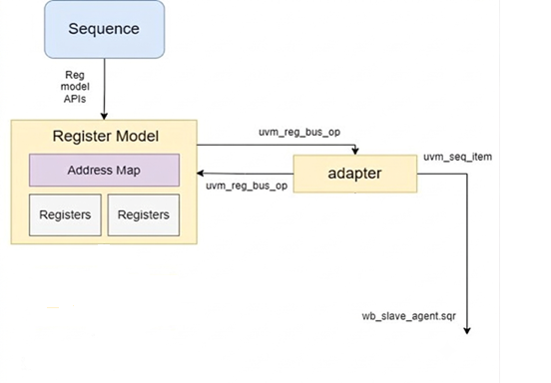
Ethernet UVM Components
Register Abstraction Layer (RAL)
RAL provides an easy and organized way to access and verify DUT registers and buffer descriptors.

Slide 16
Ethernet UVM Components
Scoreboard
Checks that the DUT behaves correctly.
Receives data from the monitors.
Predicts the expected results based on the test configuration.
Compares the expected results with the actual DUT outputs.
Reports an error if there is any mismatch.

Slide 17
Ethernet UVM Components
TX Scoreboard verifies
RX Scoreboard verifies
Transmitted packet contents
Frame length , CRC and Padding
Buffer Descriptor (BD) status
Collision handling
JAM sequence
Retry count and retry limit
Interrupt generation
Inter-Packet Gap (IPG)

Slide 18
Ethernet UVM Components
Coverage Collector
Measures how much of the design has been tested from :
Register configurations
Buffer Descriptor fields
Packet sizes
CRC and padding options
Collision and retry settings
Interrupts
Full-duplex and half-duplex modes
Error conditions

Slide 19
TX Operation

Slide 20
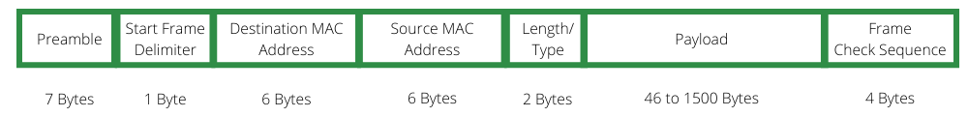
Frame Structure
Preamble (7 bytes): Alternating 0101... pattern for clock sync
SFD (1 byte): Start Frame Delimiter (10101011) marks frame start
Destination MAC (6 bytes): Target station address
Source MAC (6 bytes): Originating station address (set by MAC core)
Type/Length (2 bytes): Ethernet type (0x0800=IPv4, 0x0806=ARP)
Payload (46-1500 bytes): User data
CRC (4 bytes): Cyclic Redundancy Check (appended by MAC)

Slide 21
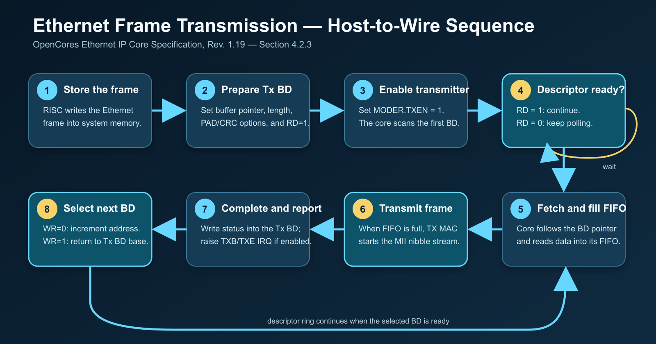
Transmission Operation

Slide 22
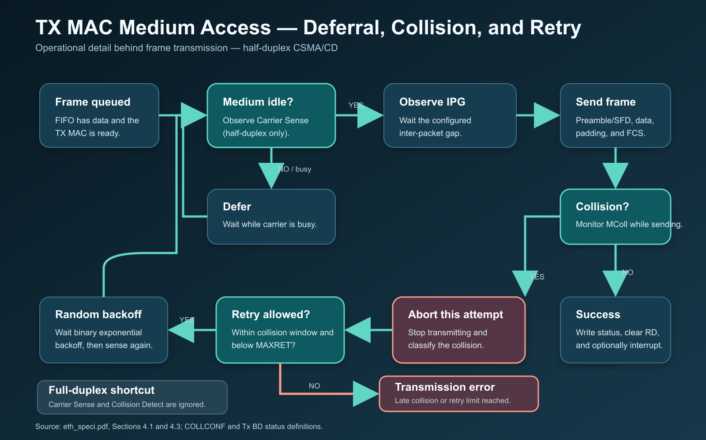
Transmission Operation

Slide 23
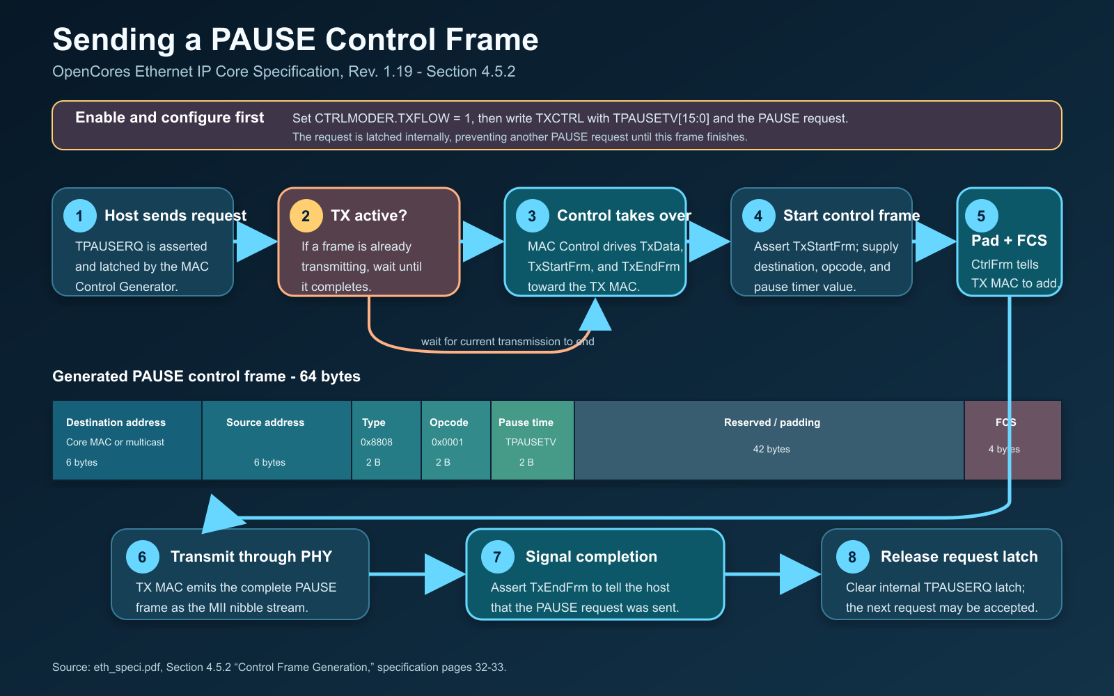
Transmission Operation

Slide 24
TX Verification

Slide 25
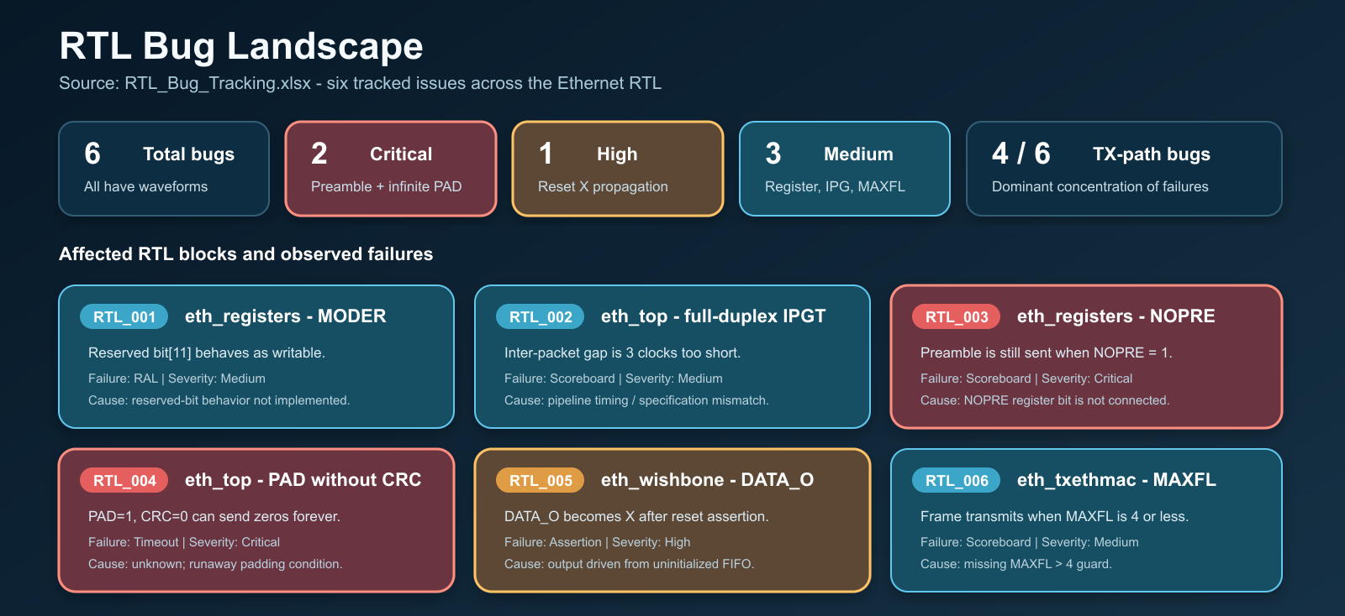
BUGS

Slide 26
Coverage

