Slide 1


MIIM Operation

Slide 2
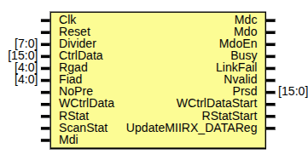
Scope & Objective
Scope: DUT files under test
eth_miim.v
eth_clockgen.v
eth_shiftreg.v
eth_outputcontrol.v
Objective: reach 100% functional coverage, maximize code coverage

Slide 3
MIIM Verification

Slide 4
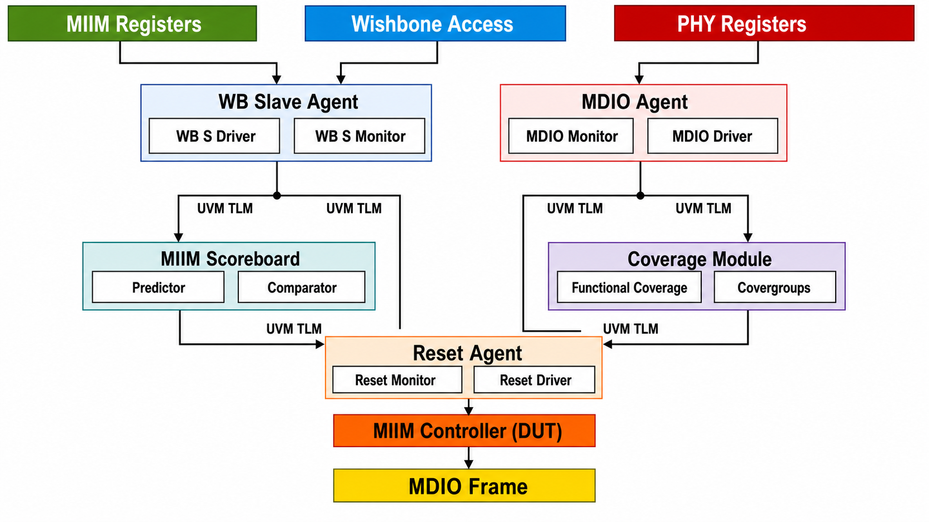
TestbencH Architecture

Slide 5
Test Suite Overview
21 directed test cases, divided mainly in three categories:
Reset & Clock Generation
Writing to PHY
Reading From PHY
Target:
Protocol correctness
Register/priority edge cases
Timing/corner-case

Slide 6

Functional Coverage Results
MIIM Functional Coverage:

Slide 7
RTL Bugs
MIIM-Bug-001:
Description: In-flight MIIM operation abort permanently deadlocks Busy.
Severity: High.
Root Cause: Nvalid signal is left set with no path to 0.
Busy = ... | InProgress | InProgress_q3 | Nvalid;
Trigger: Normal register write
Recovery: only a full core reset clears it.

