Slide 1

MyAustralianVisa
// 2027
MyAustralianVisa
Understand Your
Migration Pathway
in Context.
Data Intelligence
Platform
Independent
Category

Slide 2

MyAustralianVisa
The Problem
The data exists.
Understanding it is the problem.
01
02
6+ hrs
Fragmented sources
Separate portals to research one occupation pathway.
Lost per skilled migrant researching their visa options.
Occupation codes, invitation rounds, state nomination quotas and visa subclasses are scattered across multiple government sources — with no single view.

Slide 3
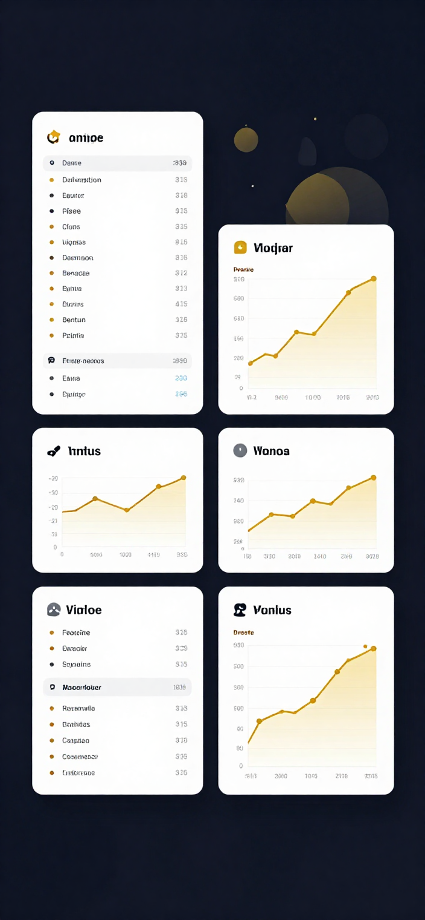
MyAustralianVisa
The Solution
One profession-centric view of Australian skilled migration data.
Search
Compare
Explore & Understand
Find your occupation by name or ANZSCO code instantly.
Evaluate visa subclasses 189, 190 and 491 side by side.
Uncover historical invitation trends and state nomination patterns in full context.

Slide 4
MyAustralianVisa
Platform Workflow
How It Works
STEP 1
STEP 2
STEP 3
STEP 4
Search
Compare
Explore
Understand
Enter your profession name or ANZSCO code to find your occupation.
Compare visa subclasses 189, 190 and 491 side by side.
Review historical invitation rounds and state nomination trends.
See your profession in full migration context with evidence-based data.

Slide 5



MyAustralianVisa
Page 05
Real User Journey
Software Engineer, ANZSCO 261313
Step 01
Step 02
Step 03
Search
Review Pathways
Compare & Explore
Alex enters "Software Engineer" or ANZSCO 261313 and instantly sees a profession-centric migration overview.
Alex reviews Subclass 189, 190 and 491 eligibility side by side, with invited points and round history at a glance.
Alex compares state nomination trends and historical invitation patterns to understand the best pathway in context.

Slide 6
MyAustralianVisa
Platform Features
Core Product Capabilities
What the Platform Does
State Insights
Official-Source Data
01
Profession Search
Search by occupation name or ANZSCO code to instantly surface relevant visa pathways.
02
Subclass Comparison
Invited-Points History
Compare visa subclasses 189, 190 and 491 side-by-side for any given occupation.
CONTEXTUAL INTELLIGENCE
03
Historical Trend Visualisation
Explore months of invitation round history and points-score trends over time.

Slide 7

MyAustralianVisa
Why It Matters
Clarity over complexity. Context over confusion.
01
Reduce fragmentation
One view consolidates occupation codes, invitation rounds, state nomination and subclass data.
02
Easier to interpret
Public data made accessible — structured, searchable and presented in plain context.
03
Evidence-based context
Descriptive, not predictive. Grounded in official sources to support informed research.

Slide 8
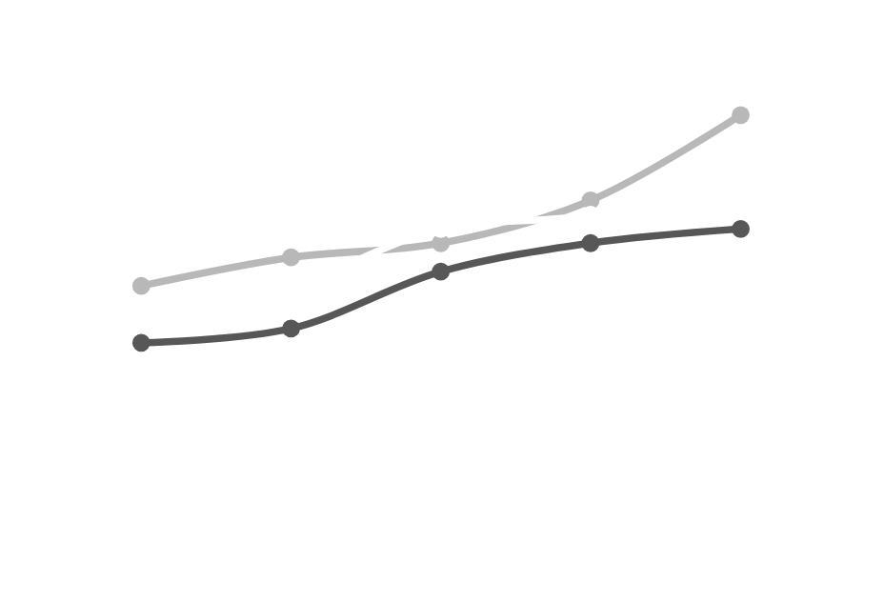
MyAustralianVisa
Platform Scale & Proof
Real data. Real coverage. Built on official sources.
500+
searchable professions and ANZSCO occupations covered across skilled migration visa subclasses.
Months of invitation
round history
36+
Professions with observed invitation data
300+

Slide 9

MyAustralianVisa
Roadmap
Commercial Potential & Future Opportunities
01
Alerts & Saved Occupations
Personalised alerts for invitation rounds, saved profession watchlists, and custom dashboards for users.
Near-Term
02
Employer & Recruiter Insights
Subscription tiers, employer-facing profession intelligence, and recruiter dashboards for workforce planning.
Mid-Term
03
API Access & State Comparisons
API and data licensing, deeper state-by-state comparisons, and integration with migration advisory platforms.
Longer-Term

Slide 10

MyAustralianVisa
// 2027
Explore your
profession.
LET'S CONNECT
Open to
Partnership · Pilot · Licensing
Platform
Independent

