Slide 1

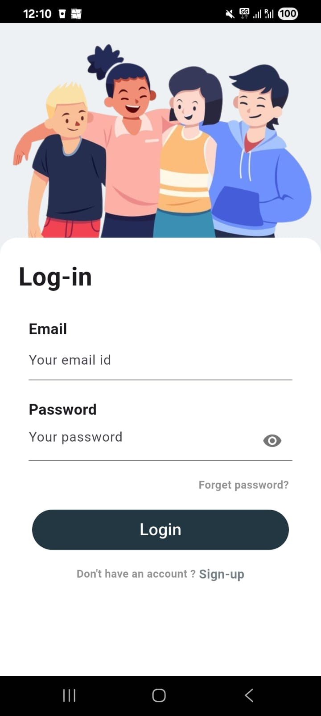
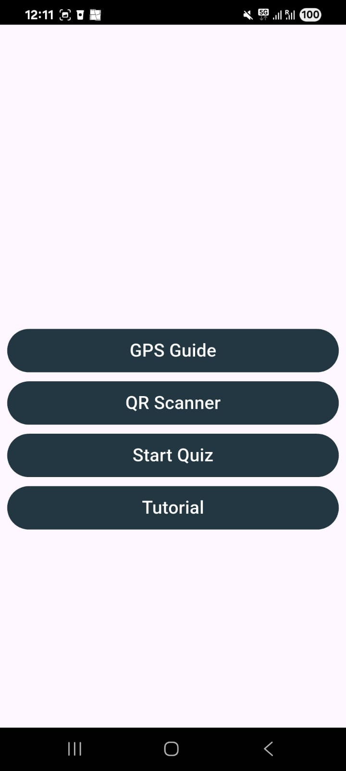
(a)
(b)
(c)

Slide 2
Very unlikely
Unlikely
Neutral
Likely
Very likely
No answer

Slide 3
Situated Learning
Importance of context and social interactions in learning
Information Processing Theory
Acquisition, processing, and retention of information
AUMOR-AR
UX Design Principles
Simplicity, consistency, feedback, affordance
Spatial Cognition and Navigation
Perception and navigation of spatial environments

Slide 4
Project Planning
Prioritization
First Increment
Project Planning
Monitoring and Optimization
Continuous Integration & Development
Subsequent Increments
Development and Testing
Scaling and Expansion
Feedback Loop

Slide 5





Slide 6
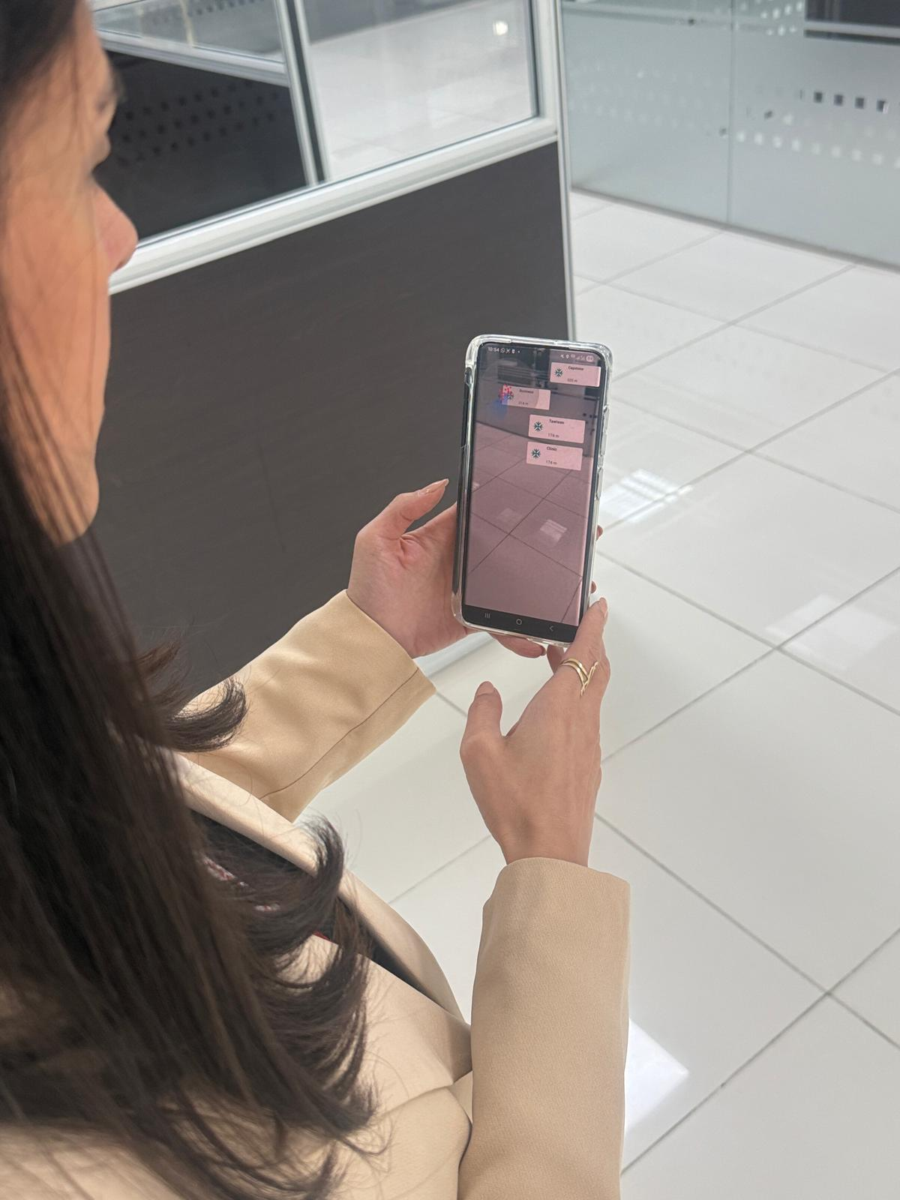
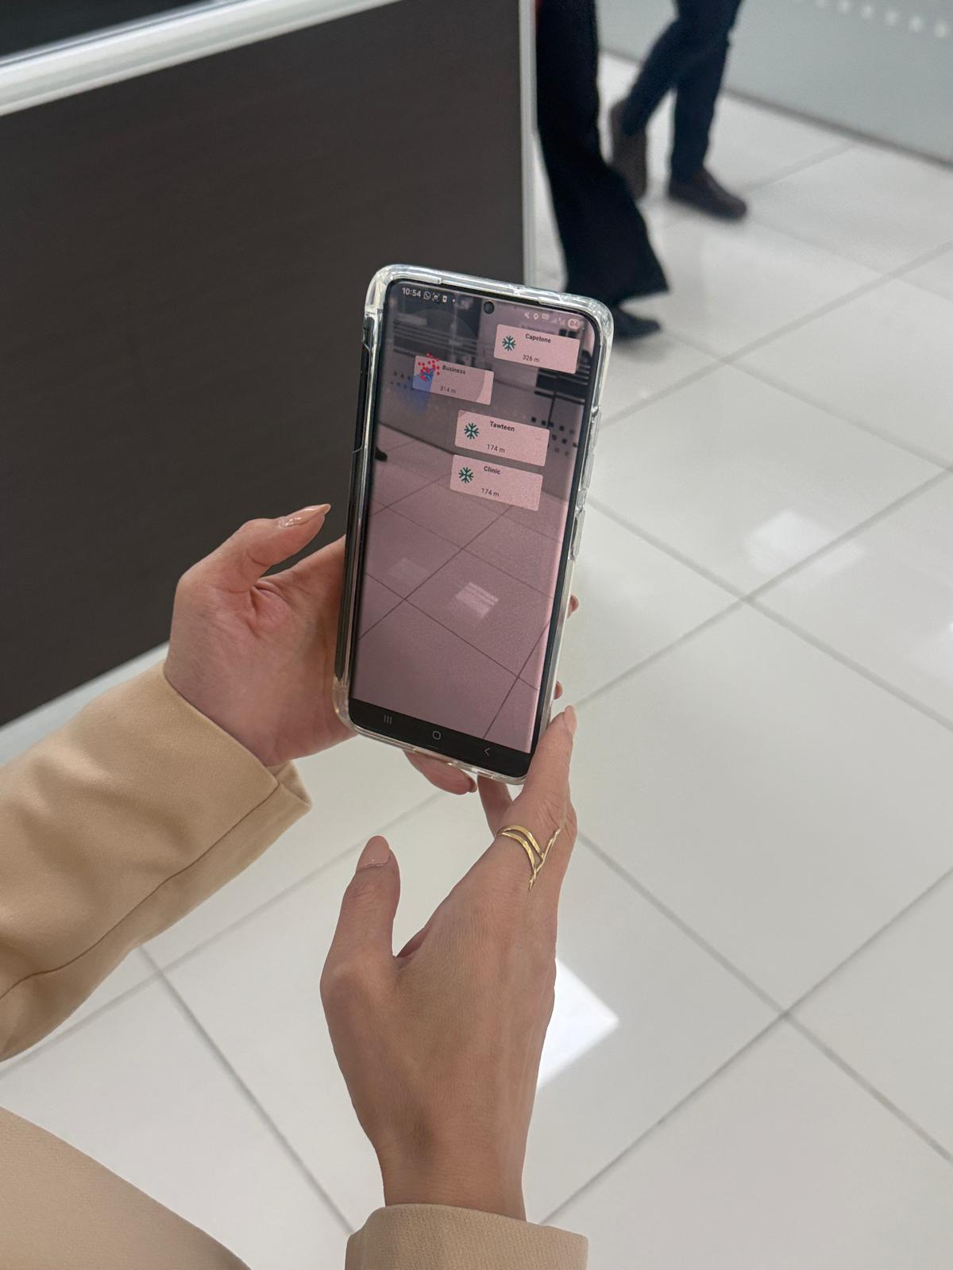
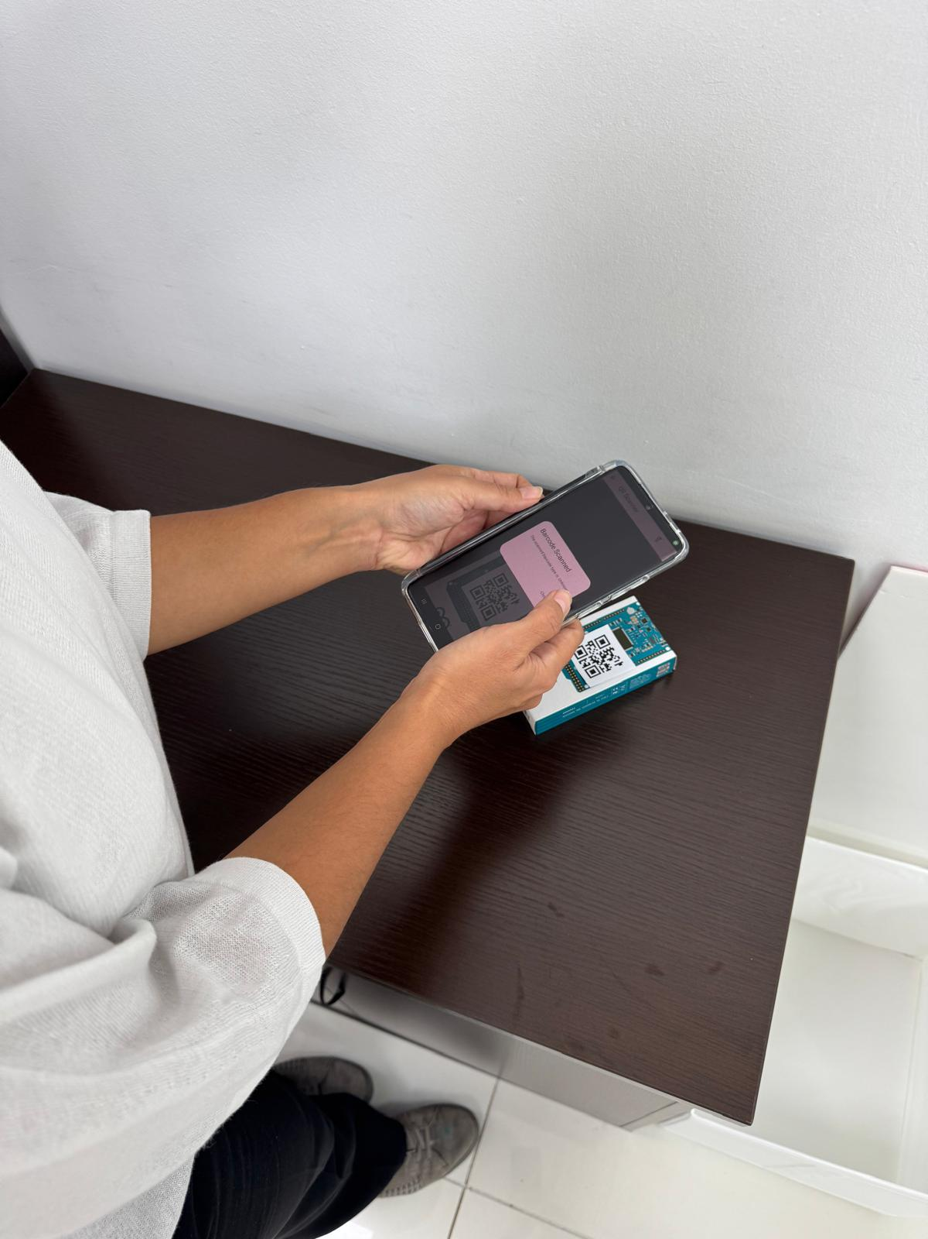
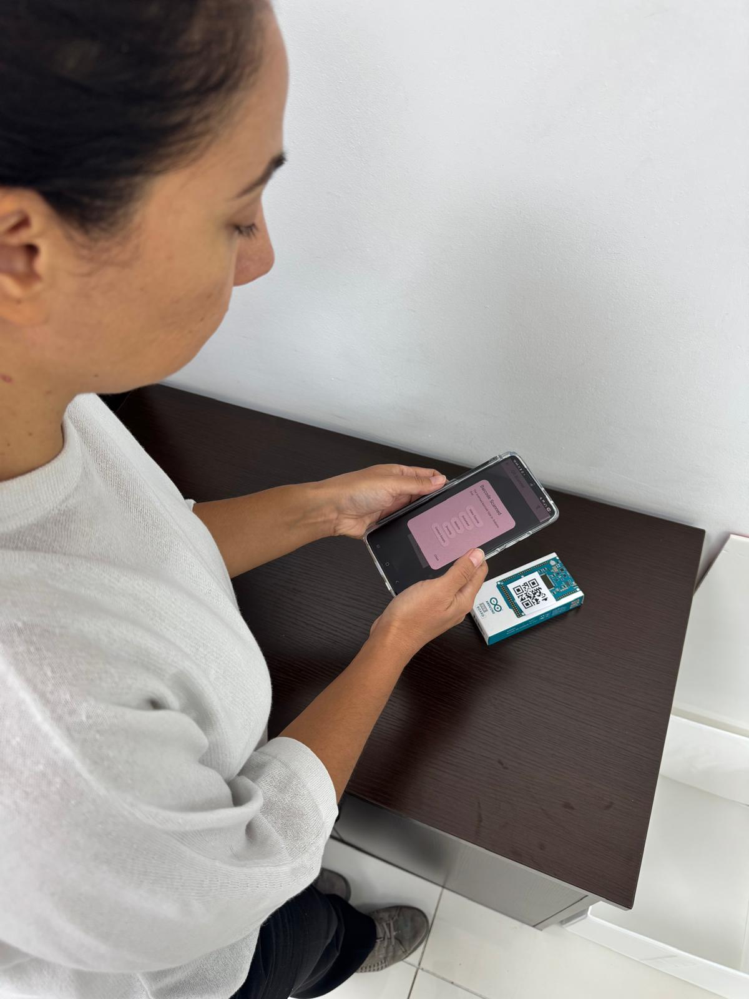
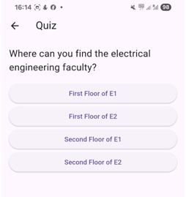
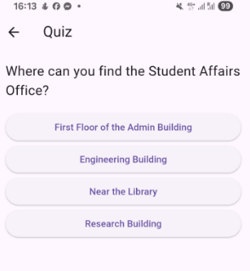
(a)
(b)
(c)
(d)
(e)
(f)

Slide 7
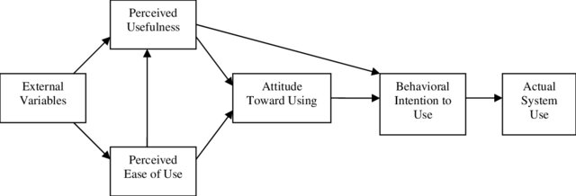
• H1: PEOU has a positive effect on PU.
• H2: PU has a positive effect on ATU.
• H3: PEOU has a positive effect on ATU.
• H4: ATU positively influences BIU.
• H5: PU positively influences BIU.
• H6: BIU positively AU.
Perceived Usefulness
H₂
H₅
External Variables
Attitude Toward Use
Behavioural Intention to Use
H₆
Actual System Use
H₄
H₁
Perceived Ease of Use
H₃

Slide 8
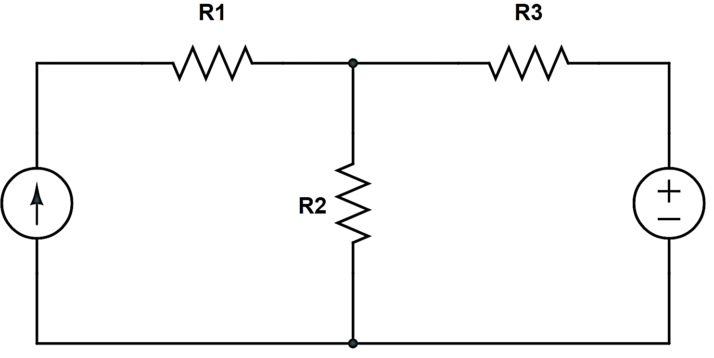
1

Slide 9
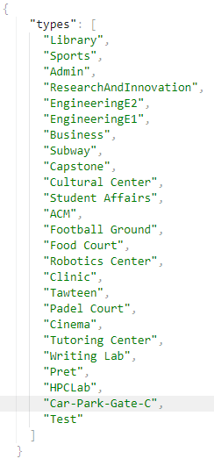
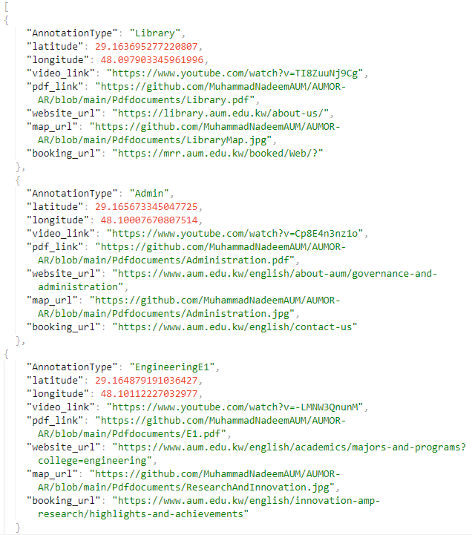
(a)
(b)

Slide 10
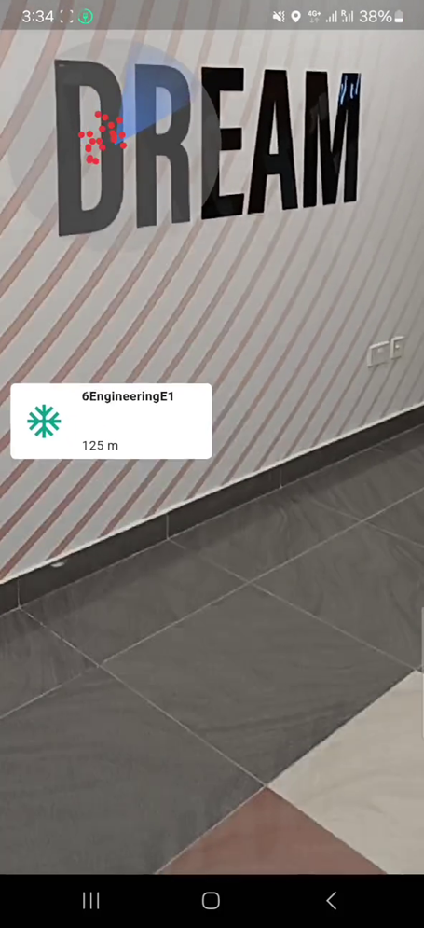
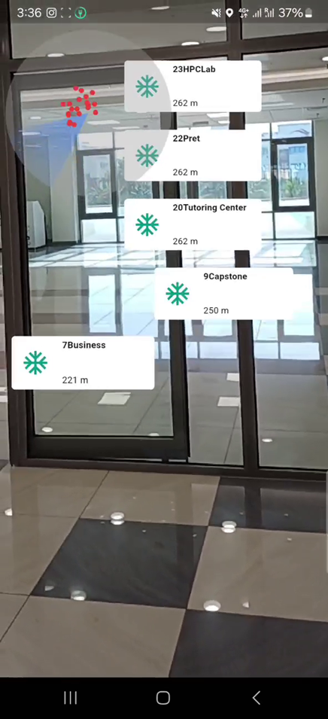
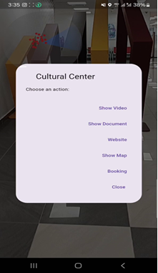
(a)
(b)
(c)

Slide 11
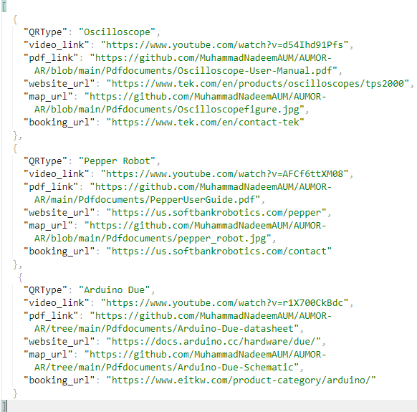
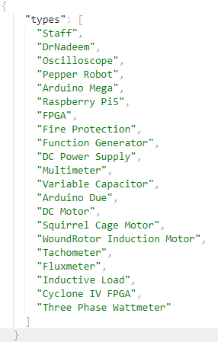
(a)
(b)

Slide 12



Slide 13
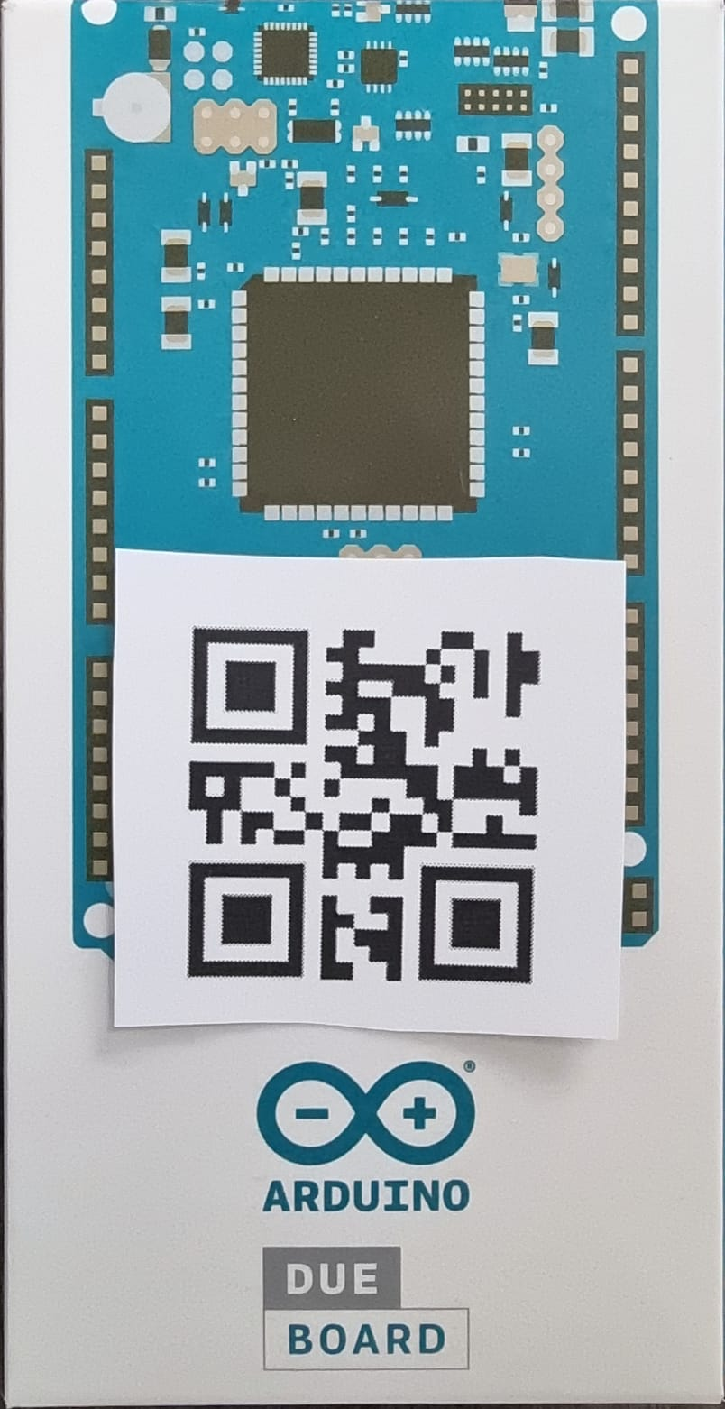
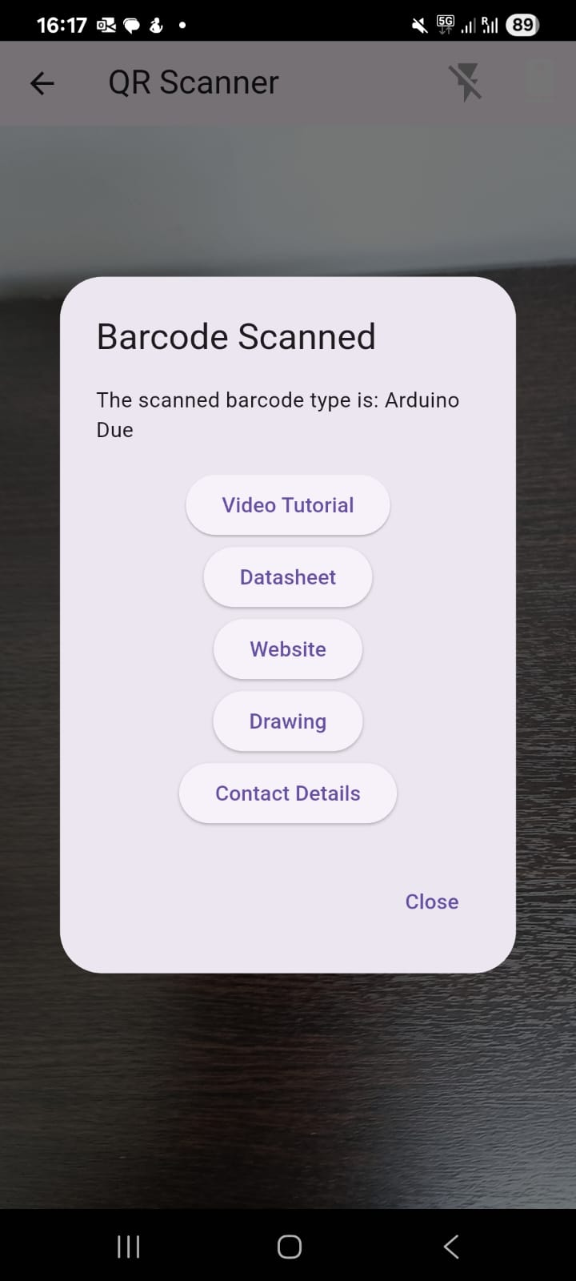
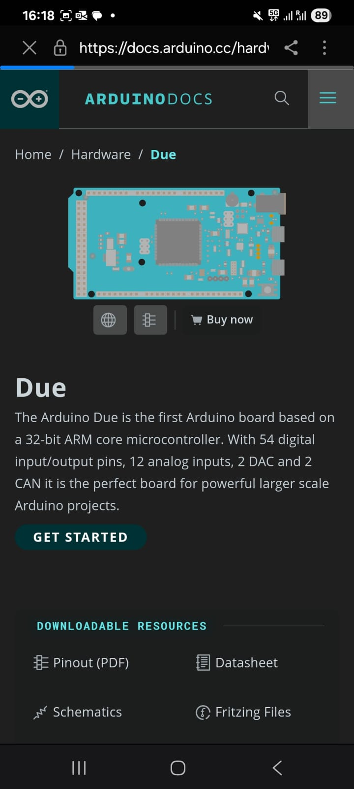
(a)
(b)
(c)

