Slide 1
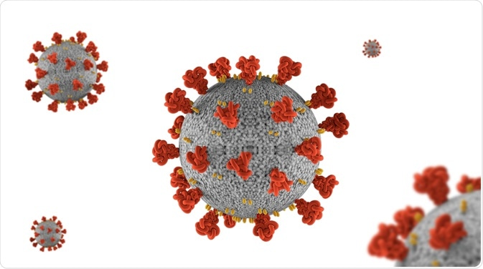
Title
Name of Presenter

Slide 2
Dataset Description
This dataset is a collection of the COVID-19 data maintained by Our World in Data. They update it daily and will keep updating throughout the duration of the COVID-19 pandemic. It includes the data of 65 different variables. The Dataset contains information from 22 February 2020 to till now. It consists of 132644 records with 65 different columns such as total_cases, new_cases, total_deaths etc.
Project Objective
Analyze the COVID-19 dataset to explore meaningful information and train a machine learning model so that to predict new cases and new death at early stage. Government will be beneficial from this project to take suitable action at early stage after prediction.

Slide 3
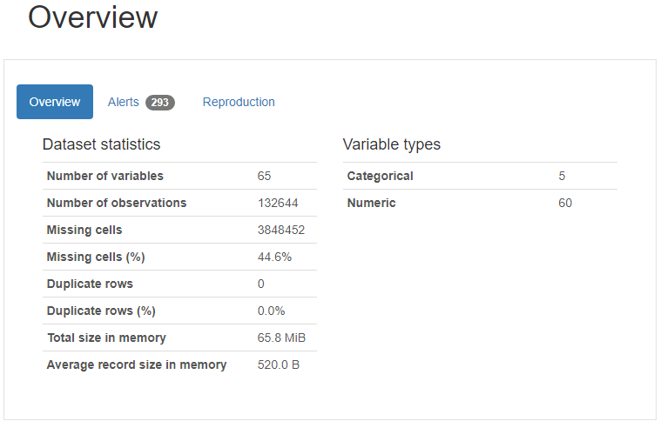
Dataset Description
Notes:
This is the general overview of the dataset, as it indicate that there are 65 unique column, and 132644 total records. There are 3848452 cell which contains NaN values that mean there is need to pre-process the data. There is no duplicate records etc.

Slide 4
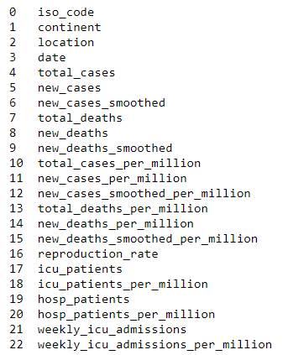
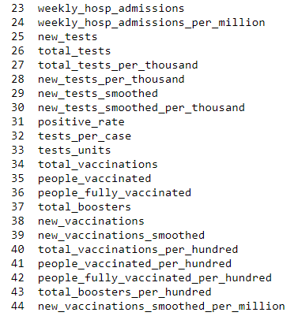
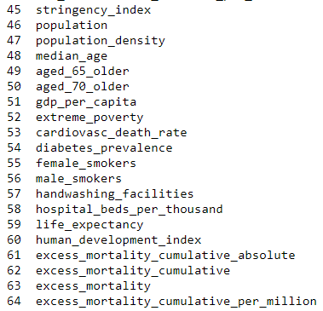
Dataset Description
Total Columns
Notes:
These are the names of 65 unique columns in dataset.

Slide 5
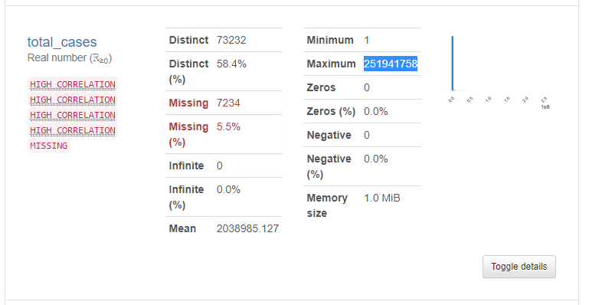
Dataset Description
Notes:
This is description of ‘total_cases’ column. 5.5% values are missing in it. There is no 0 in it.

Slide 6
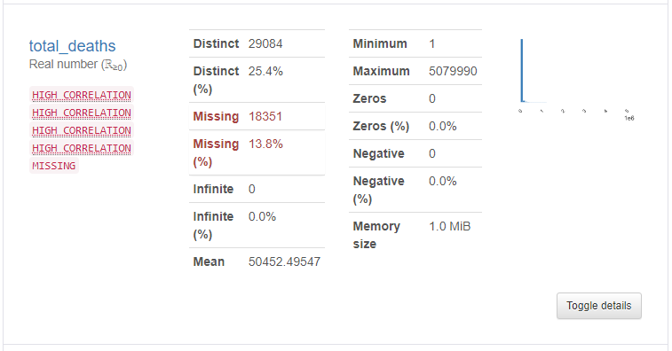
Dataset Description
Notes:
This is description of ‘total_death’ column. 13.8% values are missing in it. This column 29084 distinct value which mean many values are similar that is not bad for this case.

Slide 7
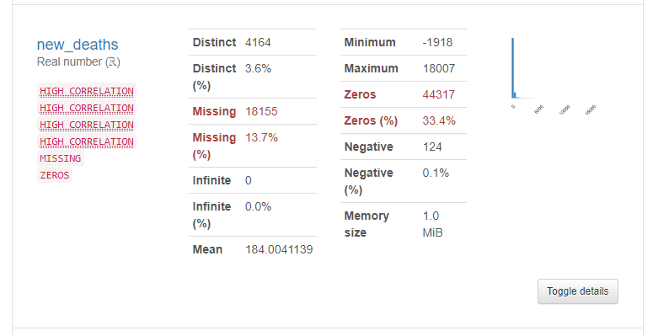
Dataset Description
Notes:
This is description of ‘total_death’ column. 13.7% values are missing in it. It is important to note that 18007 are maximum number of death in one day and -1918 are minimum number of death. Death can never be negative, therefore, we need to replace these negative values with 0.

Slide 8
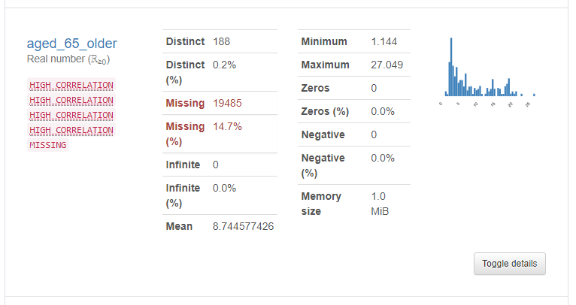
Dataset Description
Notes:
As shown that minimum 1 and maximum 27 people older than 65 got covid+ per day.

Slide 9
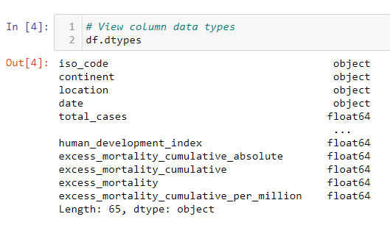


Dataset Pre-Processing
Notes:
We first show the data type of each column in dataset and convert them all to float in order to make readable to algorithm. Also check the duplicate values in dataset which is 0.

Slide 10
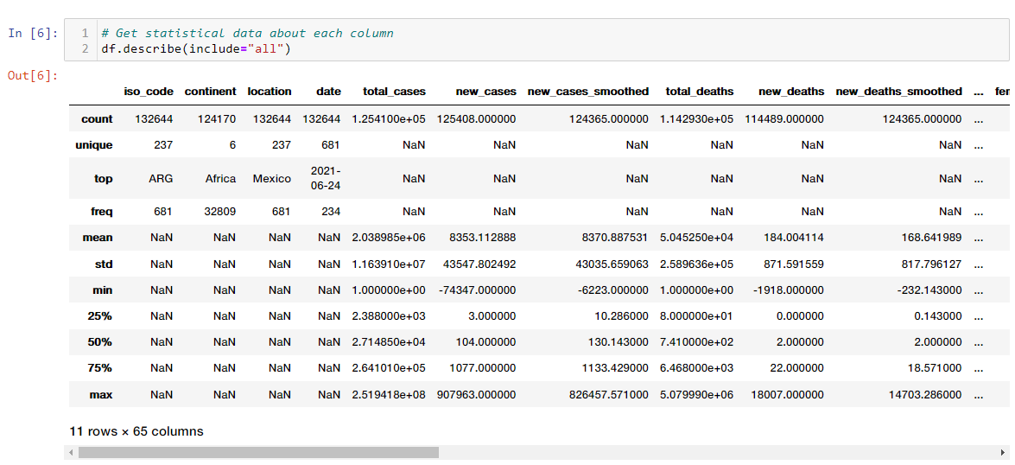
Dataset Pre-Processing
Notes:
Check the statistic of each column in order to know the nature of data in it. Most of the column contains NaN values which is necessary to tacle.

Slide 11
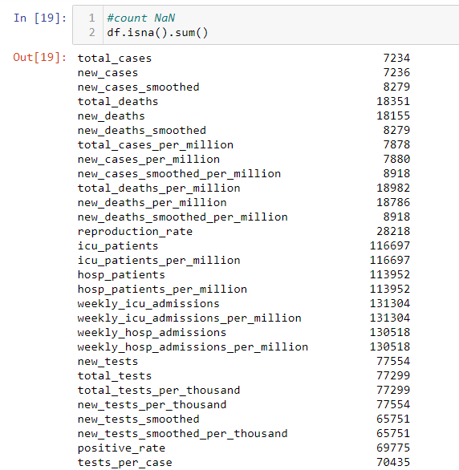
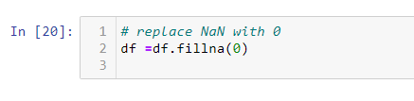
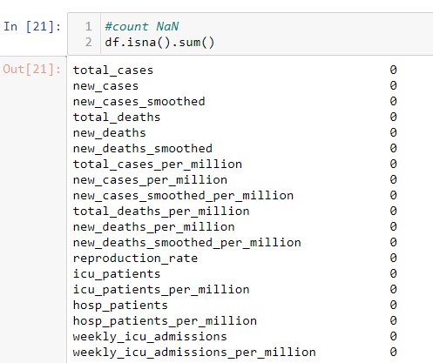
Dataset Pre-Processing
Notes:
We calculate the number of NaN values in each column. Then replace the NaN values with 0, and finally show the number of NaN values in each column which is now 0. That’s mean there is no NaN value in dataset.

Slide 12
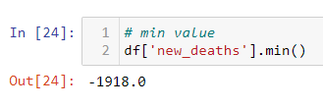



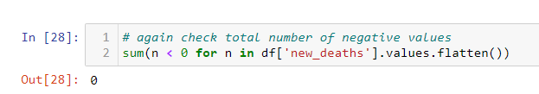
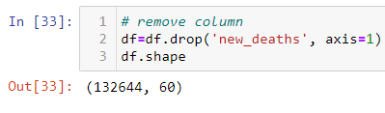
Dataset Pre-Processing
Notes:
As shown that 18007 is the maximum death per day but -1918 is minimum death per day which can not be possible. So, we check the total negative values in ‘new_deaths’ column replace them with 0. we drop new death column from original dataset and save it separately as our target column.

Slide 13
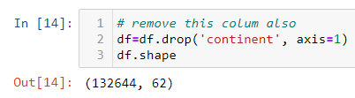

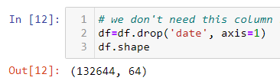
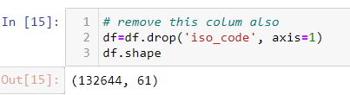
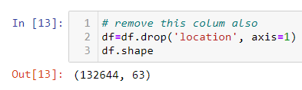
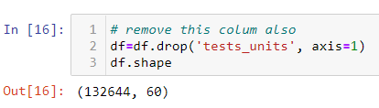
Dataset Pre-Processing
Notes:
.reset_index() function is also used for handling the NaN and infinite value if any in dataset. After that we start to drop the column which we don’t want to input the our algorithm. Because there is no need to input date, location, or iso_code for training the machine learning algorithms.

Slide 14
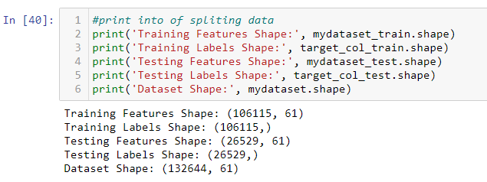
Dataset Pre-Processing
Notes:
Then split the dataset into 80% and 20% ratio for training and testing samples accordingly. A list of training and testing data with labels are shown.

Slide 15
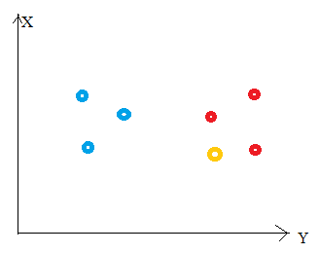
Algorithm
The method K Nearest Neighbor (KNN) is simple to learn and implement.
The K Nearest Neighbor method is a type of supervised learning technique that is used for classification and regression.
It's critical to understand how to pick K value and distance measure.
Notes:
We included K Nearest Neighbor algorithm for training and prediction. As, this is very simple to understand and implement. It work to find the nearest neighbor with the help of selected hyperparameter value.

Slide 16
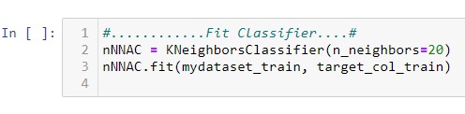

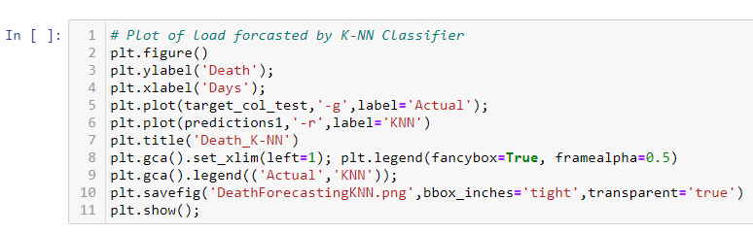
Algorithm Implementation
Notes:
First initialize the algorithm with 20 number of n value. One can change and adjust the value. Accuracy also depends on this value. Then feed unseen data and plot the predicted results.

Slide 17

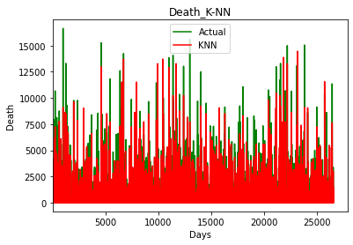
Algorithm Results
Notes:
We use accuracy as evaluation matrices. Our model is capable to predict almost 48.5% good. Its accuracy is bit low because of large of dataset with several number of columns. Also,

Slide 18
Results
Dataset contains 65 columns and 132644 records
There are 44.0% cells with missing values
Several columns contain NaN values
Some columns contain negative values which is human error
New case and death rate of age more than 65 is comparatively high
K Nearest Neighbor algorithm can efficiently predict the new cases and new death before occurrence
Government can take the appropriate decision before occurrence

Slide 19
Limitations
Dataset does not contain the information about recovered cases
Dataset contains several columns which don’t make sense for this project
Several columns contain NaN values
New_deaths columns contain negative values which mean there is human error which should be considered
Due to very large dataset, machine learning algorithms can’t train accurately

Slide 20
Tools
Numpy: a library used for working with arrays. It also has functions for working in domain of linear algebra, fourier transform, and matrices.
Pandas: a library offers data structures and operations for manipulating numerical tables and time series.
Pandas_Profiling: an open source Python library with which we can quickly do an exploratory data analysis with just a few lines of code.
Matplotlib: a plotting library for the Python programming language and its numerical mathematics extension NumPy
Sklearn: Scikit-learn is a free software machine learning library for the Python programming language.

Slide 21
Thank You

