Slide 1
Nuclei Segmentation
Reimagined.
Hybrid CNN-Transformer Architectures for Digital Pathology
Shahoud Shahid · Muhammad Noor · Saif Shahzad
FAST-NUCES, Islamabad, Pakistan
CONFERENCE PAPER
1 / 14

Slide 2
Why is this hard?
Nuclei segmentation in histopathology faces four compounding challenges.
01
02
03
04
Dense Overlap
Morphological Diversity
Staining Variability
Tissue Heterogeneity
Closely packed leukaemia cells defeat classical watershed algorithms.
Size, shape, chromatin texture vary dramatically across cell types.
H&E protocols differ lab-to-lab, causing domain shift.
Breast tissue models fail on lung or colon — no free generalization.
2 / 14

Slide 3
Cancer grading
depends on
every cell.
190K+
labeled nuclei · PanNuke
19
tissue types covered
5
nucleus classes segmented
Accurate nuclei maps unlock tumor microenvironment analysis, prognosis modeling, and precision oncology.
3 / 14

Slide 4
The field needed a bridge.
OUR WORK
2015
2019
2021
2023
U-Net
HoverNet
ViT
CellViT
+ CART
Great spatial detail
Over-segments clusters
Instance separation
Limited global context
Long-range attention
Expensive on small patches
Local + global
Efficient inference ✓
4 / 14

Slide 5
One encoder.
Three outputs.
ViT-Small Encoder
Multi-task Loss
ImageNet pre-trained · Patch embeddings
Transformer blocks → feature maps
L_total = λ₁·L_{cls} + λ₂·L_{bin} + λ₃·L_{hv}
L_{cls}
Class-weighted cross-entropy · penalizes minority classes harder
CART replaces last-half MHSA
L_{bin}
Binary segmentation · nucleus vs. background
Classification
HV Maps
Binary Mask
5 nucleus classes
Instance separation
Nucleus detection
L_{hv}
Horizontal + vertical distance regression · enables instance splits
6 / 14

Slide 6
CART: Transformers
that think like CNNs.
Context-Aware Re-Parameterizable Transformer — our novel contribution.
01
02
03
Training
Re-param
Inference
Two branches run in parallel:
3×3 kernels (local texture) +
1×1 kernels (channel mixing).
Learns multi-scale features.
→
At convergence, 1×1 weights
are zero-padded to 3×3 and
added to the 3×3 branch.
y = (W₃ₓ₃ + Pad(W₁ₓ₁)) ∗ x
→
Single 3×3 convolution.
Zero overhead vs standard
CNN — deployment-ready
for clinical edge devices.
7 / 14

Slide 7
What changes
when we unfreeze?
Constrained
Improved
✗ Frozen ViT backbone
✓ Unfrozen ViT backbone
✗ Decoder branches only
✓ Full end-to-end training
VS
✗ 10 epochs
✓ 30 epochs + early stopping
✗ Standard cross-entropy
✓ Class-weighted loss
✗ ImageNet features only
✓ AMP for training stability
8 / 14

Slide 8
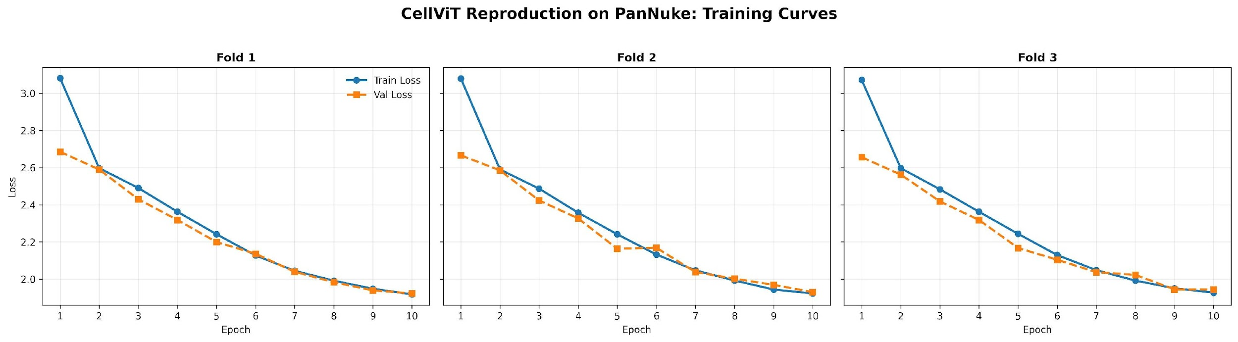
Training Curves
CellViT on PanNuke · 3-Fold Cross-Validation · 10 Epochs each
Loss converges consistently across all 3 folds — validation tracks training closely, no overfitting
8 / 15

Slide 9
+94%
improvement in Mean Panoptic Quality
Frozen baseline: 7.32% → Improved pipeline: 14.22%
9 / 14

Slide 10
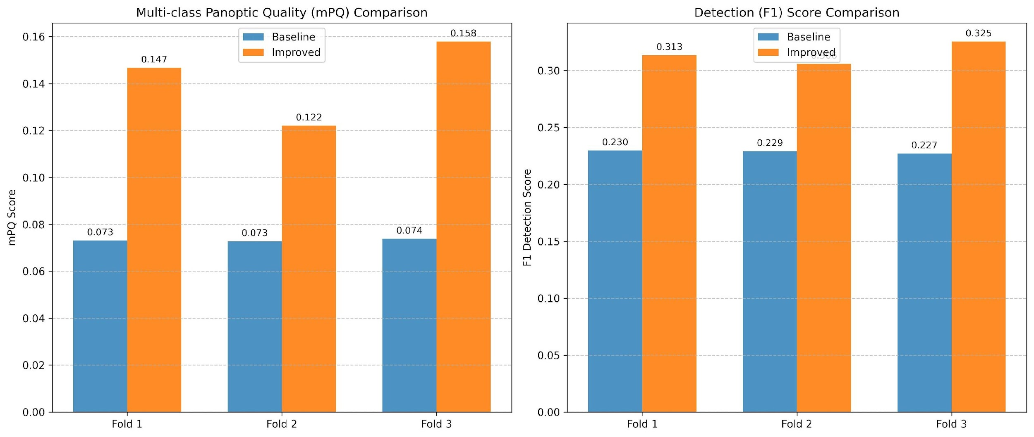
Fold-by-Fold Performance Gains
Baseline (frozen ViT) vs Improved (unfrozen + class-weighted loss) · mPQ and F1 Score
Improved model doubles mPQ (0.073→0.14+) and boosts F1 detection (0.23→0.32+) across all folds
10 / 15

Slide 11
Consistent gains
across all three folds.
Fold | Constrained mPQ | Improved mPQ | Gain | Paper Target
Fold 1 | 7.30% | 14.67% | +101% | 47.88%
Fold 2 | 7.28% | 12.20% | +68% | 47.76%
Fold 3 | 7.38% | 15.79% | +114% | 49.15%
Mean | 7.32% | 14.22% | +94% | 48.27%
Paper target = original CellViT paper at full compute. Gap reflects our resource-constrained setting.
10 / 14

Slide 12
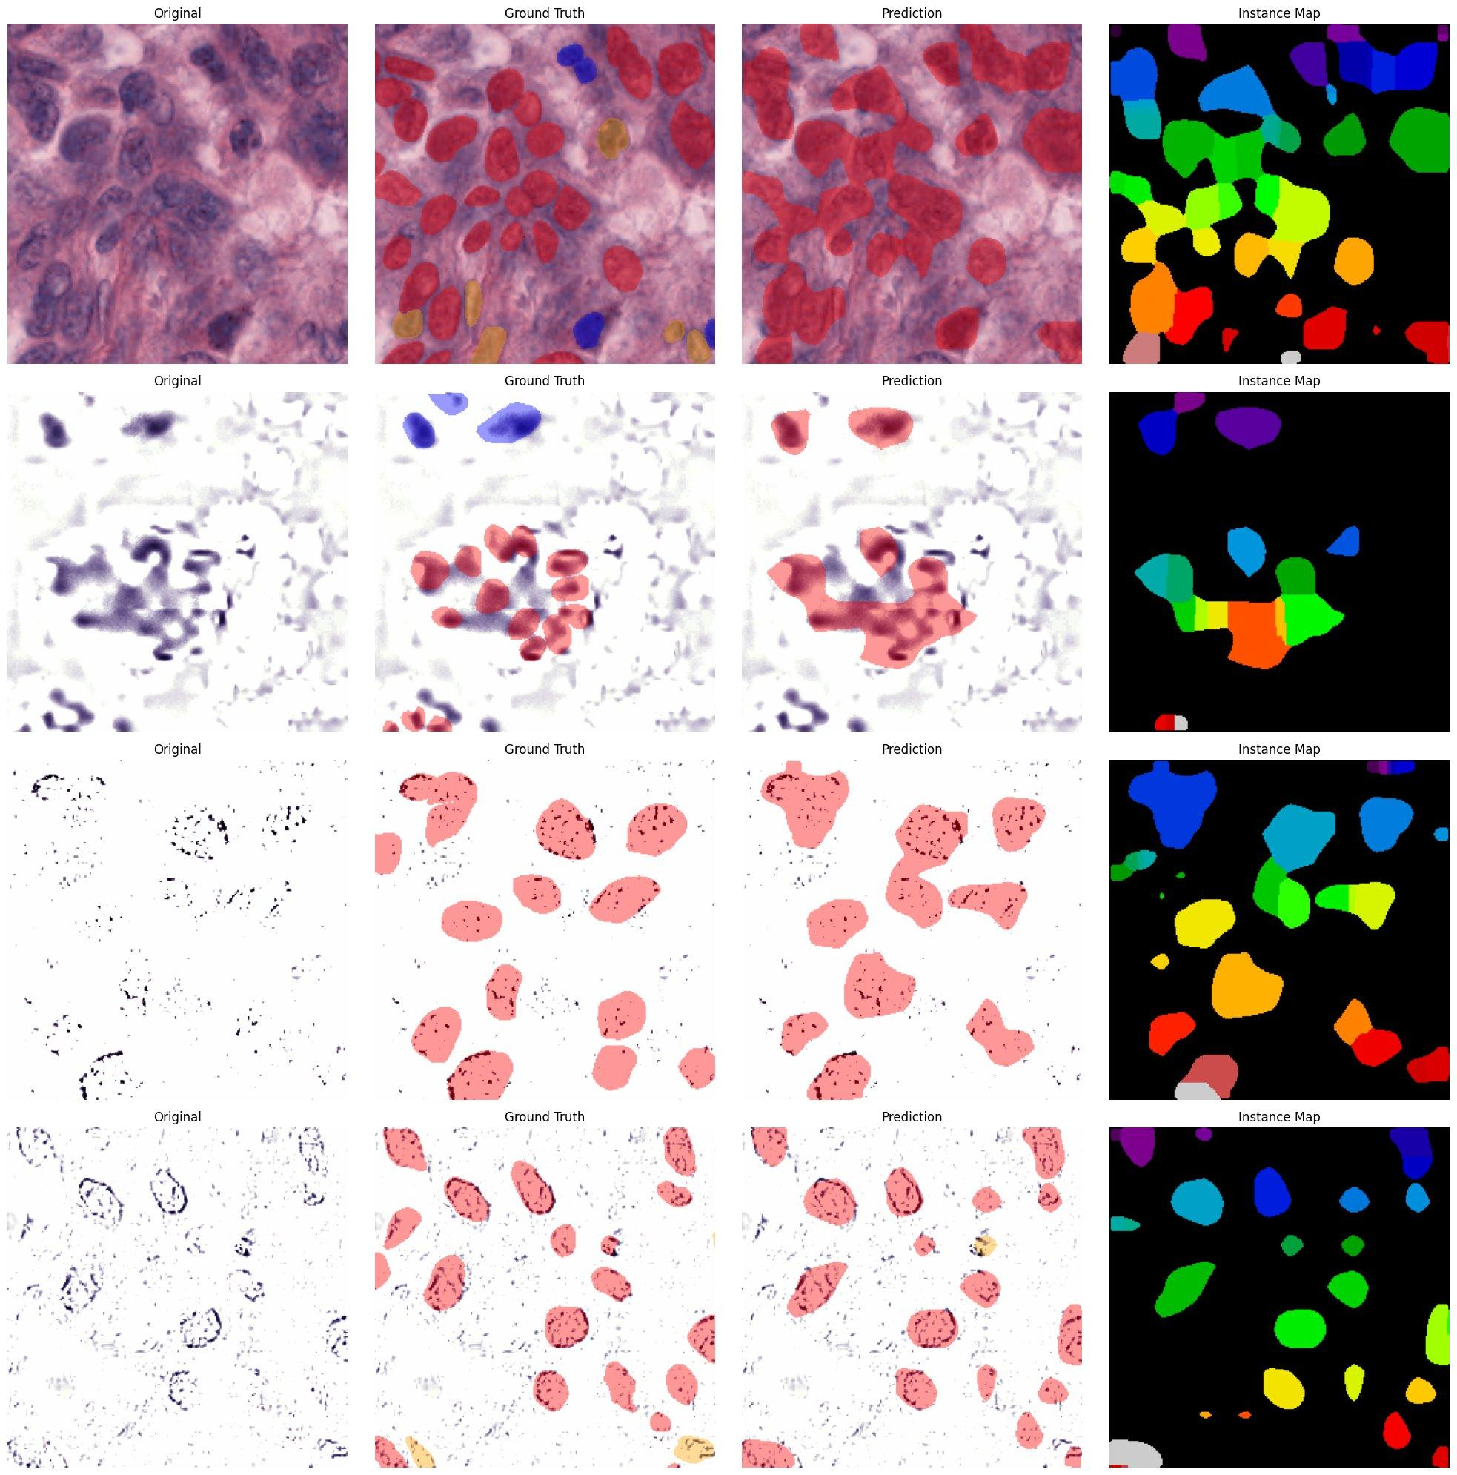
Sample Predictions: Baseline
Frozen ViT backbone · Standard cross-entropy loss · Original | Ground Truth | Prediction | Instance Map
Baseline struggles with class boundaries and instance separation — epithelial and connective tissue often merged
11 / 15

Slide 13
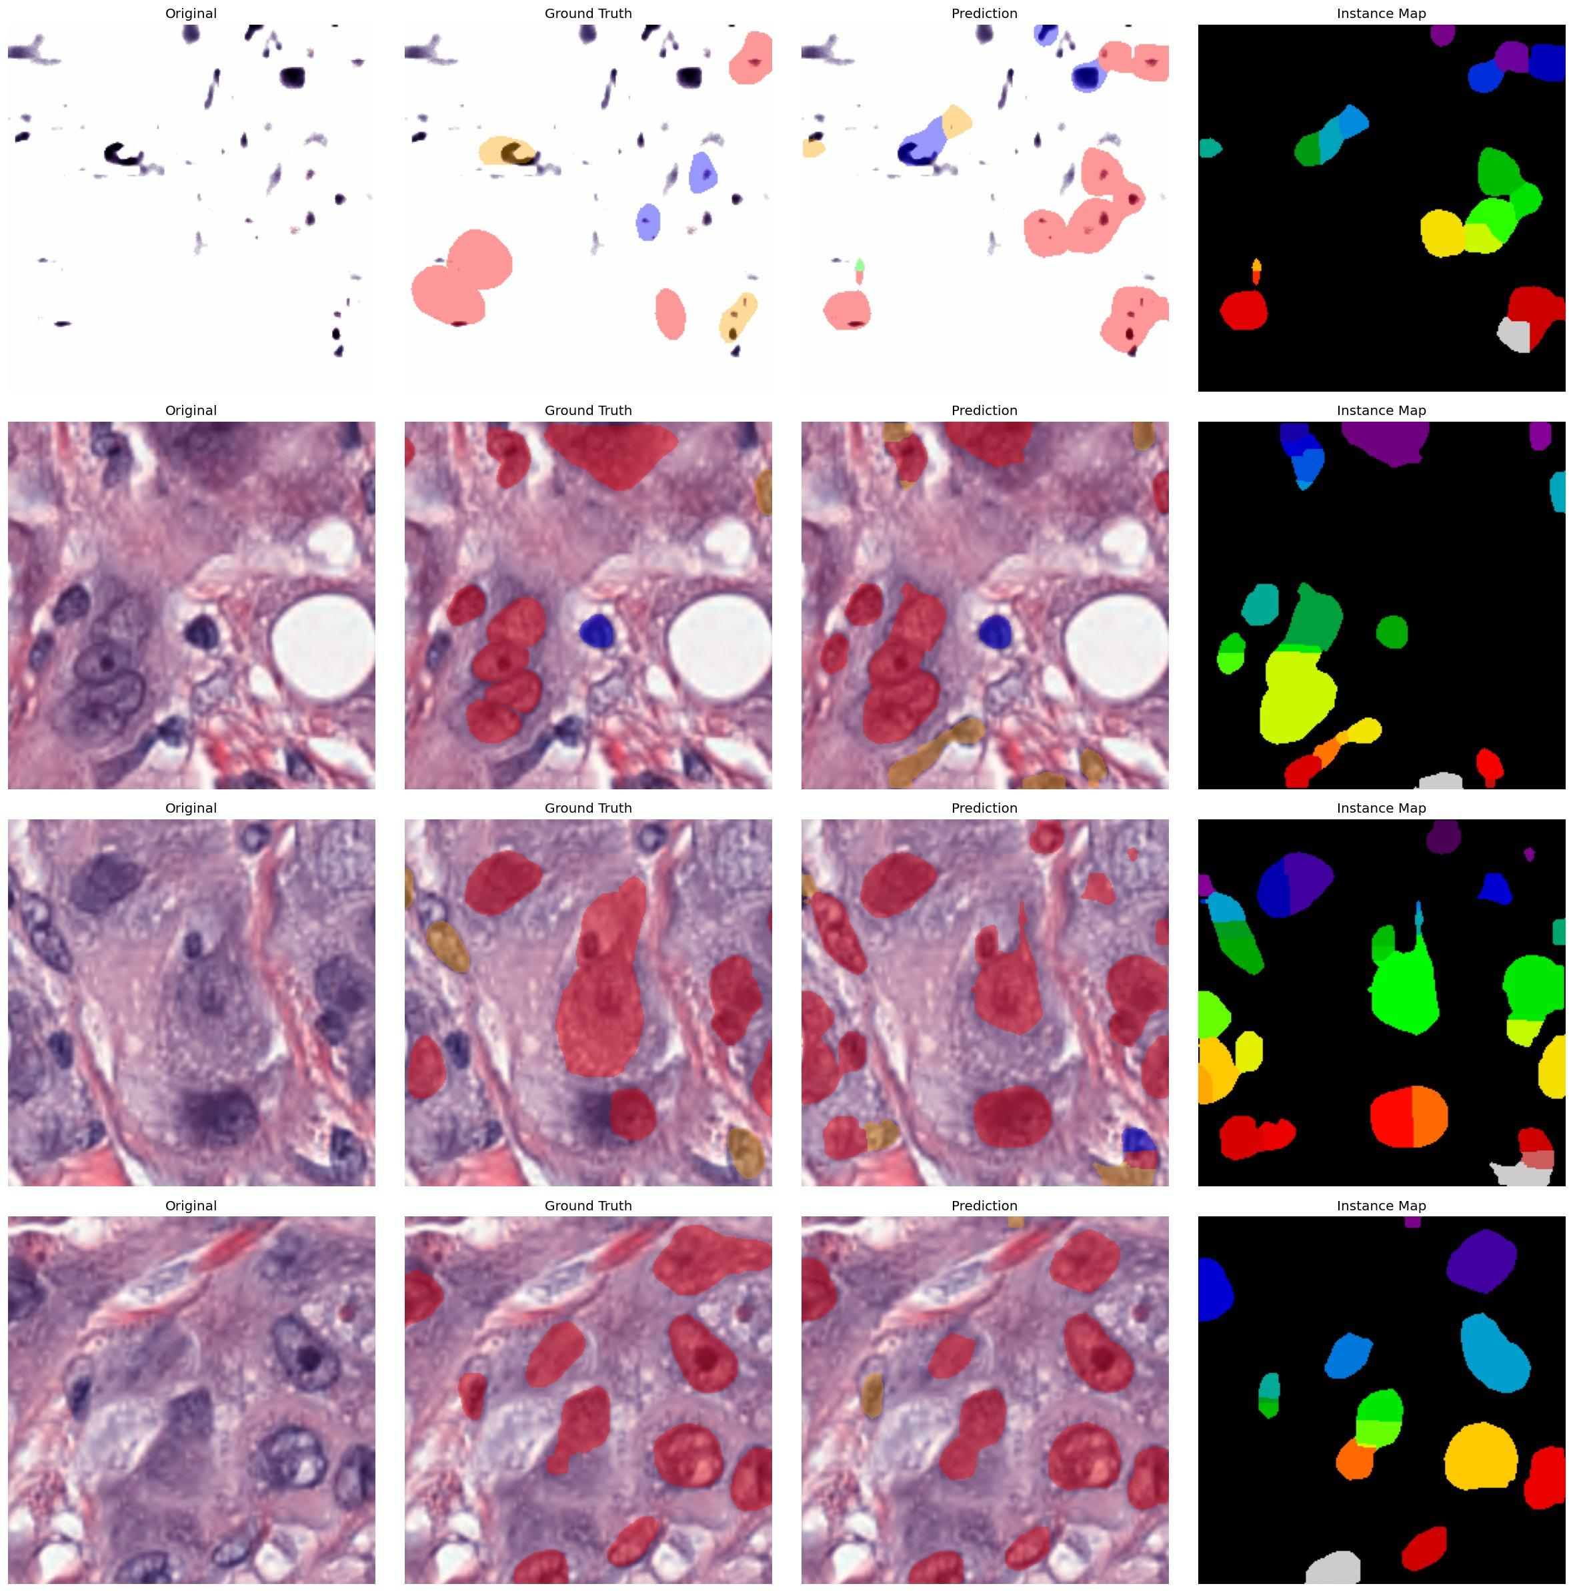
Sample Predictions: Improved
Unfrozen ViT backbone · Class-weighted loss · Original | Ground Truth | Prediction | Instance Map
Improved model captures finer boundaries, better nuclei class discrimination and cleaner instance separation
12 / 15

Slide 14
Key Conclusions
01
02
03
Hybrid architectures are essential for scalable digital pathology.
Unfreeze the backbone — ImageNet features alone can't capture chromatin.
Class-weighted loss rescues minority classes (Dead +2.5×).
04
05
Strong generalization across unseen staining and tissue types.
CART proves Transformer quality at CNN inference cost.
12 / 14

Slide 15
Thank You.
Authors
Acknowledgements
Shahoud Shahid i232515@isb.nu.edu.pk
Muhammad Noor i232520@isb.nu.edu.pk
Saif Shahzad i232634@isb.nu.edu.pk
Dr. Qurat Ul Ain
Mr. Zohair Ahmed
Mr. Ubaid Ur Rehman
For their invaluable guidance
throughout this research.
FAST-NUCES, Islamabad, Pakistan
14 / 14

