Slide 1
Adult Census Income Prediction

Slide 2
Objective:
Development of a predictive model to classifiy whether a person earns more than 50K dollars per annum or not.. The model will determine the same using some parameters like age, workclass, educational qualifications, country, etc
Benefits:
Can be used by Governmental / Non-Governmental / Private agencies where people needed to be classified on the basis of their annual income
For eg : in granting scholarships or waivers to needy students, for different schemes by government for poor ones, etc

Slide 3
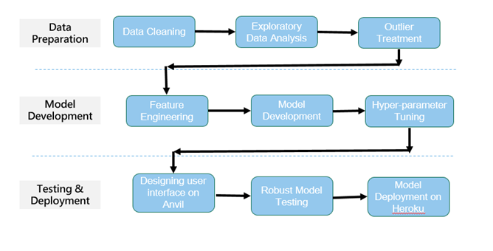
Architecture

Slide 4
Data Validation and Data Transformation :
Missing Values – All the missing values were replaced with the value being repeated the most number of times.
Numerical Columns - All the numerical features were standardized, preventing any data leakage by using data pipelines.
Categorical Columns - Either label encoding or one hot encoding was done to treat the categorical features

Slide 5
Data Insertion in Database:
Cassandra Database - The dataset was imported to cassandra database from where we can access it with the help of python
Insertion of files in the table - All the data is uploaded into a table named “adult_data” into which is present inside a database named “my_database”.

Slide 6
Model Training:
Data Export from Db :
The accumulated data from db is exported to python and read using pandas
Performing EDA to get insight of data like identifying distribution , outliers ,trend
among data etc.
Check for null values in the columns. If present impute the null values.
Encode the categorical values with numeric values.
Perform Standard Scalar to scale down the values.

Slide 7
Model Selection –
Different classification models were compared and hyperparamater tuning was done via gridsearchcv on the best performing one that is CatBoost Classifier

Slide 8
Prediction:
The model is made in such a way to maximise the accuracy and also other performance metrics so that the predictions are as accurate as possible
The average accuracy after cross validation was observed to be 84 percent and average f1 score as 69 in 10 validations.

