Slide 1

California Housing Price Prediction
Presented By: Muhammad Osama

Slide 2
Introduction
Objective:
Predict median house values using geographic, economic, and demographic features.
Dataset:
  Source: 1990 U.S. Census.
  Size: 20,640 entries, 10 features.
Key Features: median_income, ocean_proximity, total_rooms, geographic coordinates.
Importance:
Real-world application for real estate pricing and policy-making.

Slide 3
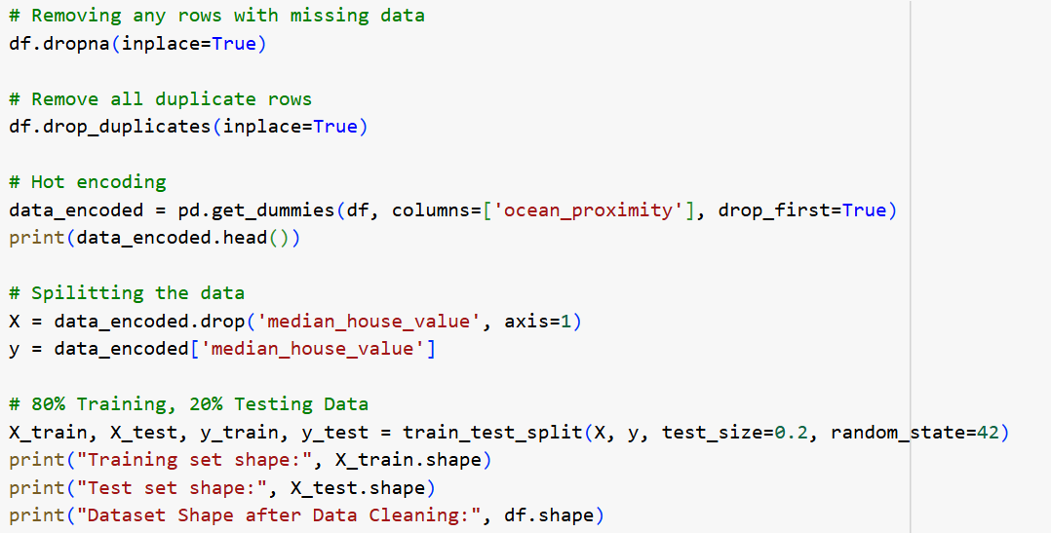
Data Preprocessing
Importing Libraries: Importing all necessary libraries
Missing Values: Dropped rows with missing total_bedrooms.
Duplicates: Removed duplicates.
Encoding: One-hot encoded ocean_proximity into 5 binary columns.
Train Test Split: 80% training, 20% testing.

Slide 4
Correlation Matrix
Correlation measures the statistical relationship between two variables, indicating the strength their linear relationship, ranging from -1 to +1 with 0 indicating no linear relationship
Strong Positive Correlation: median_income: +0.69
  Higher income strongly predicts higher house prices.
Negative Correlation: ocean_proximity_INLAND: -0.48
  Inland locations correlate with lower prices.
Feature | Correlation with Target:
median_house_value | 1
median_income | 0.688075
ocean_proximity_<1H OCEAN | 0.256617
ocean_proximity_NEAR BAY | 0.160284
ocean_proximity_NEAR OCEAN | 0.141862
total_rooms | 0.134153
housing_median_age | 0.105623
households | 0.065843
total_bedrooms | 0.049686
ocean_proximity_ISLAND | 0.023416
population | -0.02465
longitude | -0.045967
latitude | -0.14416
ocean_proximity_INLAND | -0.484859

Slide 5
Performance Metric MAE and MSE
Mean Absolute Error : Average of absolute differences between predicted and actual values
  Easy to Interpret: Directly represents average error in the target’s units
  Robust to Outliers: Less sensitive to extreme errors
  Ignores Error Severity: Treats large and small errors equally
Mean Squared Error: Average of squared differences between predicted and actual values.
  Penalizes Large Errors: Highlights severe mistakes
  Hard to Interpret: Squared units (e.g., dollars²) lack intuitive meaning.
  Outlier Sensitivity: Overemphasizes rare, extreme errors (e.g., skewed by a few poor predictions).

Slide 6
Algorithms & Hyperparameters
Linear Models:
  Simple Linear Regression is a statistical method used to model the relationship between two variables: Y=β0​+β1​X+ε
    One independent variable (X) – the predictor or input.
    One dependent variable (Y) – the outcome or target
  Lasso Regression adds an L1 regularization penalty which helps reduce model complexity and performs feature selection by shrinking some coefficients to zero
    Best alpha=100 (Lasso)
  Ridge Regression adds an L2 regularization penalty which reduces coefficient size but does not set any of them exactly to zero.
    Best alpha= 10 (Ridge)
ElasticNet Regression combines both L1 and L2 regularization penalties, balancing feature selection (L1) and coefficient shrinkage (L2)
  alpha=0.1, l1_ratio=0.5

Slide 7
Algorithms & Hyperparameters
Gradient Boosting (GBR):
  GridSearchCV: n_estimators=300, learning_rate=0.1, max_depth=5.
  Grid Search to 27 combination
  K Fold cv = 5
MLPRegressor:
  Complex pattern unstructured data
  Architecture: 2 hidden layers (10, 5 neurons). Max iter = 5000
SVR:
  kernel=linear, C=100, epsilon=0.1

Slide 8
Model Performance Comparison
Gradient Boosting (GBR): GBR outperforms others due to non-linear pattern capture and tuning.
Model | MAE | MSE
Gradient Boosting (GBR) | 31,709 | 2.28×10⁹
MLP | 48,249 | 4.47×10⁹
Linear Regression | 50,413 | 4.80×10⁹
ElasticNet | 50,452 | 4.81×10⁹
Ridge | 51,232 | 5.01×10⁹
Lasso | 51,257 | 5.02×10⁹
Support Vector Regression | 49,232 | 5.02×10⁹

Slide 9
Actual vs. Predicted Values
Visual: Scatter plots for GBR, Linear Regression, and SVR.
  GBR: Points cluster tightly around the red ideal line.
  Linear Models: Wider spread, higher deviation.
Takeaway:
  GBR’s predictions align closely with actual prices.

Slide 10
Actual vs. Predicted Values

Slide 11
Thank you

