Slide 1

WHO AM I?
"Code is my canvas. I don’t just build apps—I engineer experiences."
Hey! I’m Muhammad Owais, a passionate Full-Stack Developer and Computer Systems Engineering student at NED University (Class of 2026). With a CGPA of 3.76/4.00, I balance academic rigor with real-world impact.
I specialize in:
MERN & Django Stacks
Real-Time Applications (WebSockets, Socket.IO)
Clean APIs & Modern Frontends (React, Next.js, TailwindCSS)
I’m obsessed with:
Building efficient backends
Crafting intuitive UIs
Solving problems with code
Whether it’s creating a social media platform, e-commerce store, or secure real-time chat app, I bring a mix of logic, creativity, and scalability to every line of code.
🔧 Tools I Love:
Django · Django REST Framework · React.js · Next.js · Node.js · Express.js · Python · JavaScript
PostgreSQL · MongoDB · Sequelize ORM · WebSockets · Socket.IO · Tailwind CSS · Cloudinary

Slide 2
STAGE1: SINGLE-STORE INVENTORY SYSTEM
“Build a backend service to track product inventory for a single kiryana store.”
Solutions:
Simple REST API with SQLite for local storage.
Tracks stock-ins, sales, and manual removals.
Key Features:
“Lightweight database (SQLite).”
“Basic CRUD operations for products.”
“Stock updates via API endpoints.”
Technology Stack for Stage 1
Node.js: “Runtime environment for executing server-side JavaScript.”
Express.js: “Web framework for building RESTful APIs and handling HTTP requests.”
SQLite: “Lightweight, file-based database for local storage of product data.”
Sequelize: “ORM for defining the Product model and interacting with SQLite.”
Goal: “Efficient and straightforward inventory management for one store.”

Slide 3

Stage 1 - Design Decisions & Assumptions
Design Decisions:
Database: “SQLite chosen for simplicity and local storage—no server setup needed.”
Model: “Single Product table with name, sku, and quantity for stock tracking.”
API: “RESTful endpoints over CLI for flexibility and future scalability.”
Assumptions:
“Single store with multiple products.”
“No concurrent updates (sequential stock changes).”
“Manual removals treated as stock-outs.”
Why: “Prioritized ease of use and minimal setup for a small-scale system.”

Slide 4
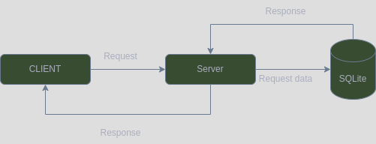
Stage 1 - API Design
API Endpoints:
POST /api/v1/product/create-productPurpose: Create a product.
Request: { "name": "Rice", "sku": "RICE001", "quantity": 10 }
Response: { "id": 1, "name": "Rice", "sku": "RICE001", "quantity": 10 }
GET /api/v1/product/get-all-productsPurpose: Fetch all products.
Response: [{ "id": 1, "name": "Rice", "sku": "RICE001", "quantity": 10 }, ...]
GET /api/v1/product/get-product/:skuPurpose: Fetch product by SKU.
Response: { "id": 1, "name": "Rice", "sku": "RICE001", "quantity": 10 }
PUT /api/v1/product/stock-in/:skuPurpose: Add stock.
Request: { "quantity": 5 }
Response: { "id": 1, "name": "Rice", "sku": "RICE001", "quantity": 15 }
PUT /api/v1/product/stock-out/:skuPurpose: Remove stock.
Request: { "quantity": 3 }
Response: { "id": 1, "name": "Rice", "sku": "RICE001", "quantity": 12 }

Slide 5
Stage2: Multi-Store Inventory System
“Support 500+ stores with a central product catalog, store-specific stock, and audit logs.
”
Solutions:
REST API with PostgreSQL for relational data.
Added store-specific products, categories, and inventory logs.
Key Features:
Multi-store support with Store and Product models.
JWT authentication for secure access.
Inventory logs for auditing stock changes.
Technology Stack for Stage 2
Node.js: Server-side runtime.
Express.js: API framework.
PostgreSQL: Relational database for multi-store data.
Sequelize: ORM for database interactions.
JWT: Authentication via tokens.
express-rate-limit: API request throttling (100 req/min).
Goal: Scalable and secure inventory management for multiple stores.

Slide 6
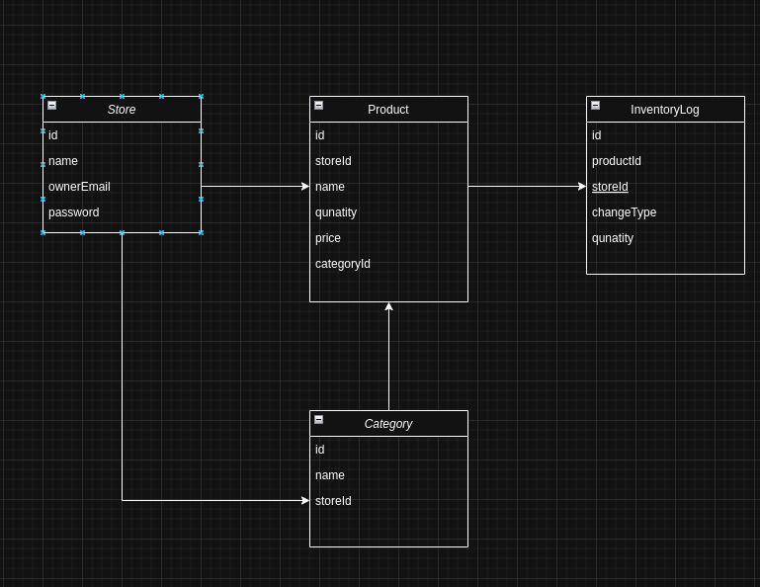
Stage 2 - Design Decisions & Assumptions
Design Decisions:
Database: PostgreSQL for relational integrity and scalability.
Model: “Store, Category, Product, and InventoryLog for store-specific tracking.”
Scaling: JWT authentication to restrict access per store.
Rate Limiting: Added express-rate-limit for API stability.
Assumptions:
Each store manages its own products and categories.
Authenticated users (store owners) access their data only.
Stock changes are logged for auditing.

Slide 7
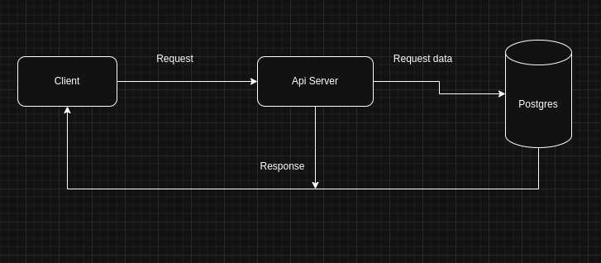
Stage 2 - API Design
API Endpoints:
POST /api/v2/store/create-store (24pt)
Purpose: Create a store” (20pt)
Request: { "name": "Kiryana1", "ownerEmail": "owner@example.com",
"password": "pass123" }
Response: { "id": "uuid", "name": "Kiryana1", ... }
POST /api/v2/product/create-product/:storeId
Purpose: Create a product for a store (JWT)
Request: { "name": "Rice", "quantity": 10, "price": 5.99, "categoryId":
"uuid" }
Response: { "id": "uuid", "name": "Rice", ... }
PUT /api/v2/product/stock-in/:id
Purpose: Add stock with logging (JWT)
Request: { "quantity": 5 }
Response: { "id": "uuid", "name": "Rice", "quantity": 15, ... }
GET /api/v2/logs/show-logs/:storeId
Purpose: Fetch logs with date filtering (JWT)
Query: ?startDate=2025-04-01&endDate=2025-04-04
Response: [{ "id": "uuid", "changeType": "IN", ... }, ...]

Slide 8
STAGE3: SCALABLE INVENTORY SYSTEM
“Scale to thousands of stores with real-time stock sync, high concurrency, and auditability.”
“
”
Solutions:
Added read/write separation in PostgreSQL for concurrency.
Introduced Redis for caching and async event-driven updates.
Key Features:
Horizontal scalability with master/slave DB setup.
Redis caching for faster log retrieval.
Async events via Redis Pub/Sub for near real-time stock updates.
Technology Stack for Stage 3
Node.js: Server-side runtime.
Express.js: API framework.
PostgreSQL: Relational database for multi-store data.
Sequelize: ORM for database interactions.
JWT: Authentication via tokens.
express-rate-limit: API request throttling (100 req/min).
Redis: Caching and Pub/Sub for async events.
moment-timezone: Date handling for log filtering.
Goal: Scalable and secure inventory management for multiple stores.

Slide 9
Stage 3 - Design Decisions & Assumptions
Design Decisions:
Database: PostgreSQL with read/write separation (master for writes, slave for reads).
Caching: Redis for caching inventory logs to reduce DB load.
Async Events: Redis Pub/Sub for event-driven stock updates.
Time Handling: moment-timezone for consistent date filtering across regions.
Assumptions:
High concurrency handled via DB pooling and caching.
Stock sync relies on Redis subscribers.
Cache invalidation ensures data consistency.

Slide 10
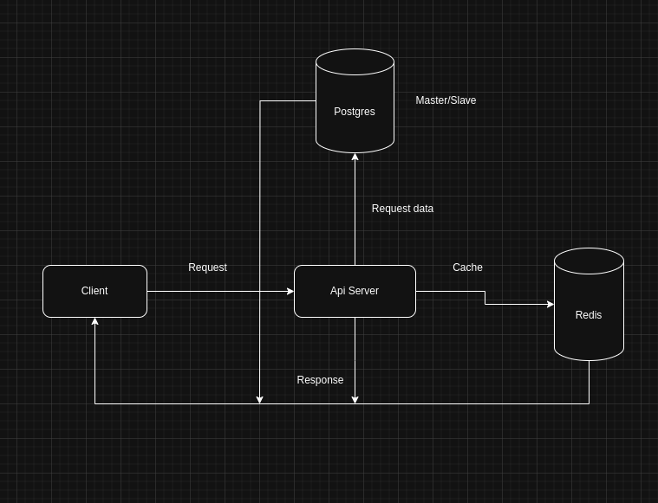
STAGE 3 - API DESIGN
API Endpoints:
PUT /api/v2/product/stock-in/:id
Purpose: Add stock with logging
Request: { "quantity": 5 }
Response: { "id": "uuid", "name": "Rice", "quantity": 15, ... }
GET /api/v2/logs/show-logs/:storeId
Purpose: Fetch logs with caching and date filtering (JWT)
Query: ?startDate=2025-04-01&endDate=2025-04-04
Response: [{ "id": "uuid", "changeType": "IN", ... }, ...]
DELETE /api/v2/logs/delete-log/:id
Purpose: Delete a log and clear cache (JWT)
Response: { "message": "Log deleted successfully" }

