Slide 1
Cyclist Casual Customer retention
Presented by: Muhammad Owais
Last updated: 17-03-2025

Slide 2
Outline
Asking the right questions
Preparing the data
Processing the data
Analysis
Visualization
Sharing the data

Slide 3
Roadmap
STAGE 01
Asking the right questions.
Preparing the data.
STAGE 03
Processing the data, i.e., cleaning.
STAGE 02
STAGE 04
STAGE 05
Analyzing the data to find insights and trends.
Sharing the data and providing recommendations.

Slide 4
Asking the right questions
Analyze trends in casual customers’ travel behaviors.
Identify how those trends can be applied to retain said customers.
Provide recommendations for Cyclist’s marketing strategies.
Focusing on the US market only.

Slide 5

Preparing the data
The data was accessed through the public divvy trips website (See Sources at the end).
This dataset was generated by gathering data from the 600 docking stations of the bikes.
Limited to the first Quarter of 2019 and 2020.
Provides a good subset of the data to perform the analysis (Over 70,000+ rows of data)

Slide 6
Processing the data
Storing | cleaning | Simplifying
All project files under 1 parent file (.csv, .R and .rmd). | Removing duplicates and outliers. | Separating columns (i.e. date-time to date and time).
Uploading the combined dataset to the RStudio IDE. | Fixing data-types. | Appropriate naming conventions.

Slide 7

Processing the data (cont.)
10s of thousands of entries, difficult to process in spreadsheets.
Relying on Rstudio for the processing and analysis of the case study.
Looked for trends with the start and end stations, specifically the traffic of casual customers.
The time and day of the week were also considered.

Slide 8
Analysis
A noticeable pattern was discovered.
Casuals rode more than members.
Thursday seems to be the busiest day for casuals to use Cyclist.

Slide 9
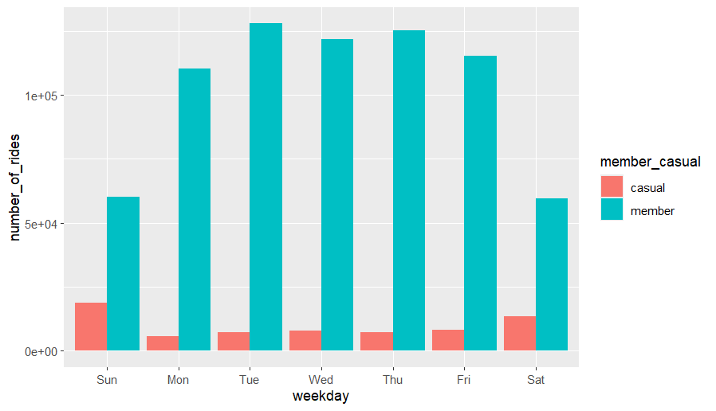
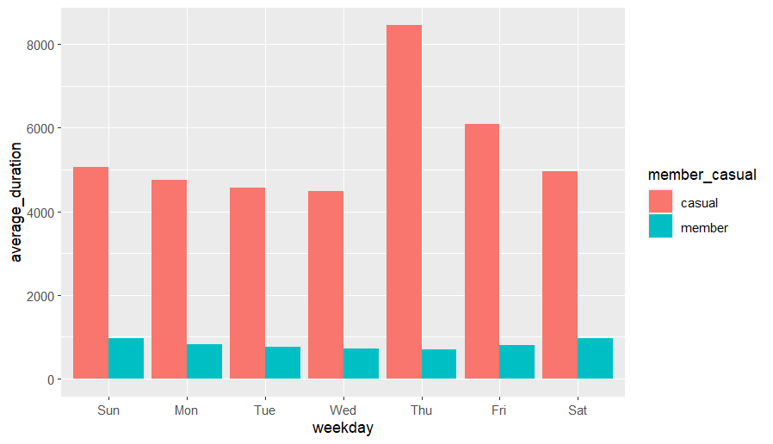
Analysis (CONT.)
Number of rides by rider-type
Average duration of riding during each day of the week

Slide 10
Analysis (CONT.)
Start and end stations were also analyzed.
It was discovered that “Streeter Dr and Grand Ave” was the one station with the most traffic of casual riders.
“Lake shore Dr and Monroe St” came in second in terms of casual customers’ traffic.

Slide 11
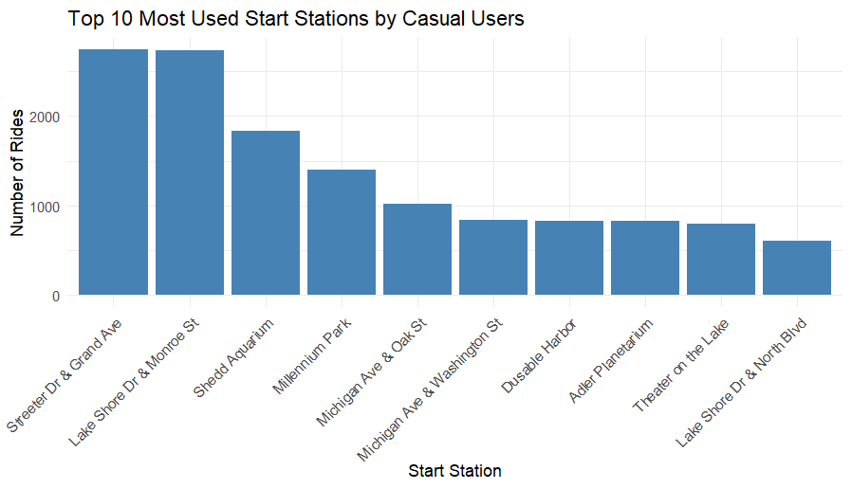
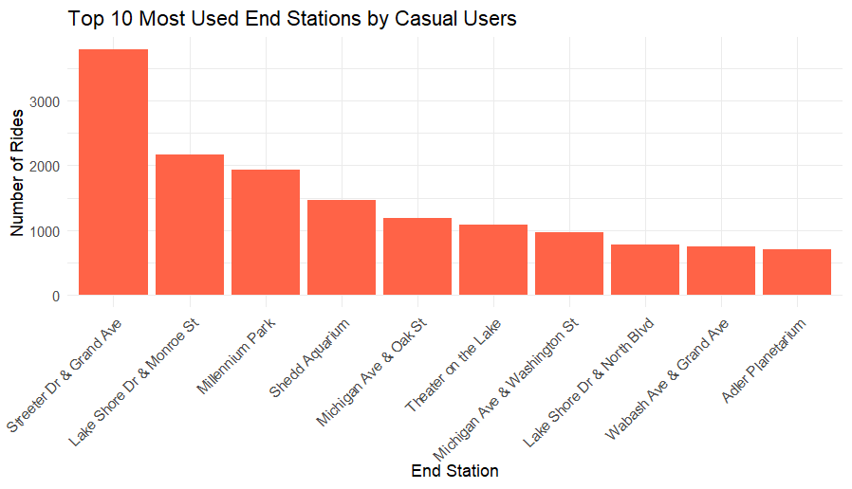
Analysis (CONT.)

Slide 12
Analysis (CONT.)
Finally, hours travelled were cross-referenced with top start and end stations.
Once again, It was “Streeter Dr and Grand Ave” with the most traffic of casual riders, the peak being during morning and afternoon.
“Lake shore Dr and Monroe St” also came in second in terms of casual customers’ traffic, the peak was, once again, during morning and afternoon.

Slide 13
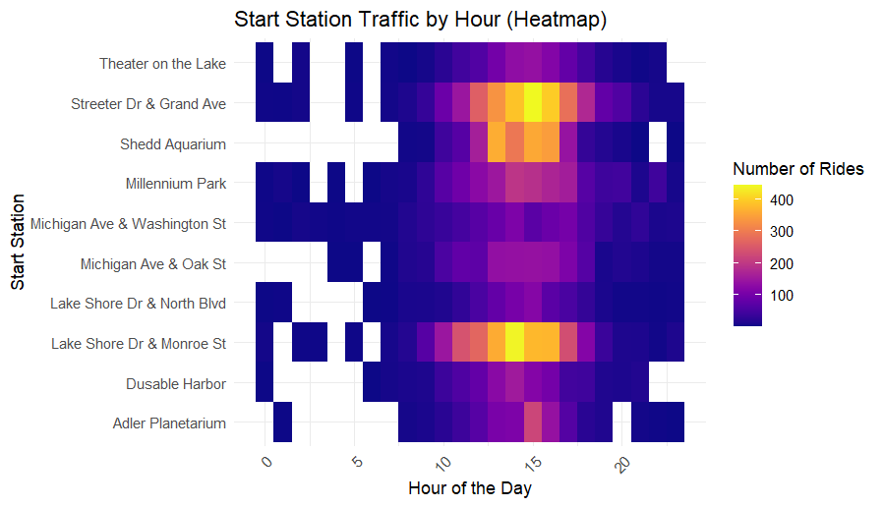
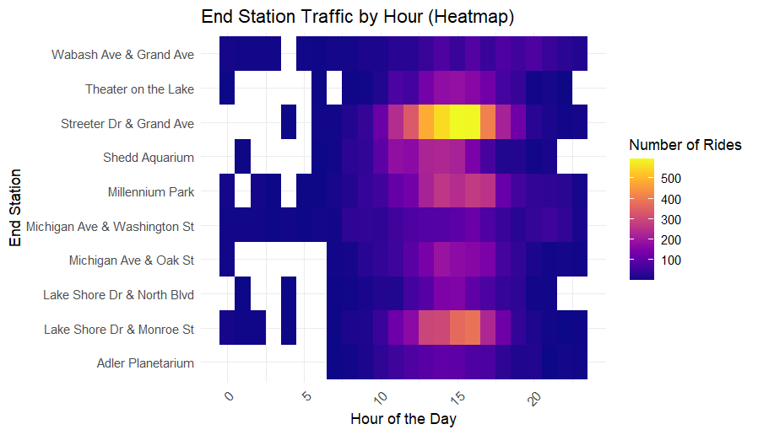
Analysis (CONT.)

Slide 14
Share (Key insights)
Casual Riders Prefer Weekends | Longer Rides for Casual Riders | Peak Hours
Casual riders tend to use bikes more on weekends, while members use bikes consistently throughout the week. | Casual riders have longer average ride durations compared to members. | Casual riders are the most active during morning and evening rush hours (8-9 AM and 5-6 PM).

Slide 15
Act (Actionable recommendations)
Weekend Membership Promotions | Incentivize Longer Rides | Loyalty Programs
Offer discounted weekend-only memberships to attract casual riders who primarily use bikes on weekends. | Introduce rewards or discounts for casual riders who exceed a certain ride duration, encouraging them to convert to annual members. | Implement loyalty programs that reward frequent casual riders with discounts or perks for converting to annual memberships.

Slide 16



QUESTIONS

Slide 17
References and citations
Coursera | Online courses & credentials from top educators. Join for free | Coursera. (n.d.). Coursera. https://www.coursera.org/learn/google-data-analytics-capstone/supplement/7PGIT/case-study-1-how-does-a-bike-share-navigate-speedy-success
Bucket loading. . . (n.d.). https://divvy-tripdata.s3.amazonaws.com/index.html
Google Data Analytics Certificate (Completed March 2025)
Markdown Basics. (n.d.). https://rmarkdown.rstudio.com/authoring_basics.html
Introduction to the viridis color maps. (n.d.). https://cran.r-project.org/web/packages/viridis/vignettes/intro-to-viridis.html
Plotting multiple variables. (n.d.). Statistical Consulting Centre. https://scc.ms.unimelb.edu.au/resources/tips-for-using-r/r-scripts

