Slide 1
Analysis Of Algorithm
Huffman Coding

Slide 2
Problem Statement
Text and media files often have repetitive or redundant data
Reducing file size helps in faster transmission and saves storage
Challenge: How to compress data effectively without losing any information?

Slide 3
Huffman Coding
Huffman Coding is a technique of compressing data to reduce its size without losing any of the details. It was first developed by David Huffman.
The idea is to assign variable-length codes to input characters.
The variable-length codes assigned to input characters are Prefix Codes, means the codes (bit sequences) are assigned in such a way that the code assigned to one character is not the prefix of code assigned to any other character.

Slide 4
Huffman Coding
Huffman Coding is generally useful to compress the data in which there are frequently occurring characters.
There are mainly two major parts in Huffman Coding
Build a Huffman Tree from input characters.
Traverse the Huffman Tree and assign codes to characters.
The method which is used to construct optimal prefix code is called Huffman coding.

Slide 5
Huffman Coding Implementation
A lossless data compression algorithm
Use Proprity queue(min heap)
Uses variable-length codes based on character frequency
Frequently occurring characters are assigned shorter codes
Rare characters are assigned longer codes

Slide 6

How Huffman Coding Works (Reading Text)
Suppose the string below is to be sent over a network.
"ASCII is technically a 7-bit encoding, but modern computers store each character using 8 bits because memory is byte-addressable, and one byte equals 8 bits."
Each character occupies 8 bits. There are a total of 15 characters in the above string. Thus a total of 8*15= 120 bits are required to send this string.
Using the Huffman Coding technique, we can compress the string to a smaller size.

Slide 7


How Huffman Coding Works (Analyze the frequency)
Huffman coding is done with the help of the following
Sort the characters(nodes) in increasing order of the frequency using priority queue(min heap)

Slide 8

How Huffman Coding Works (Build Huffman Tree)
Take two minimum nodes(characters having minimum frequency) from the queue and add .
Always assign the minimum frequency to the left child and assign the second minimum frequency to the right child while adding.
Remove these two minimum frequencies from Queue and put new frequency in queue.
4
1
3
B
D

Slide 9

How Huffman Coding Works (Build Huffman Tree)
1
Repeat the steps until all the nodes have used or taken out.
Remove these two minimum frequencies from Queue and put new frequency in queue.
9
4
5
4
A
1
3
B
D

Slide 10
How Huffman Coding Works (Build Huffman Tree)
Repeat the steps until all the nodes have used or taken out.
The process ends as all nodes have used.
15
1
6
9
C
4
5
4
A
1
3
B
D

Slide 11
How Huffman Coding Works (Build Huffman Tree)
For each non-leaf node, assign 0 to the left edge and 1 to the right edge
15
0
1
1
6
9
C
0
1
4
5
4
0
1
A
1
3
B
D

Slide 12
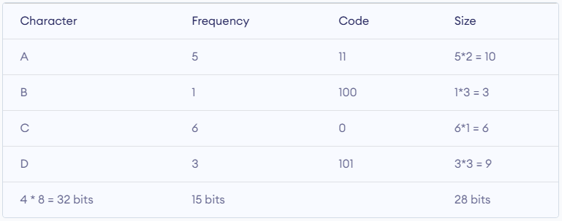
How Huffman Coding Works (Generate Compression Table)
For sending the above string over a network, we have to send the tree as well as the above compressed-code. The total size is given by the table below.
Without encoding, the total size of the string was 120 bits. After encoding the size is reduced to 32+15+28 = 75

Slide 13
How Huffman Coding Works
The encoded data is : 1000111110110110100110110110
Case | Formula | Example Result
Without Encoding | Total bits / total characters = 8 bits/char (fixed size) | e.g., 120 bits / 15 chars = 8 bits/char
After Huffman Encoding | Total compressed size / total characters | e.g., 75 bits /15 chars = 5 bits/char
Minimum number of bits required to transfer the message after encoding = total compressed size Example: → 75 bits (vs original 120 bits)

Slide 14
How Huffman Coding Works (Huffman Decoding)
"To decode, we start at the root of the Huffman tree and follow the bits of the encoded string (0 = left, 1 = right) until we reach a leaf node. At that point, we output the character and return to the root to decode the next character."
15
0
1
1
The encoded data is : 100 01111101101101 00110110110
6
9
C
0
1
4
5
4
Decoded data is :
0
1
A
1
3
B
D

Slide 15
Advantages of Huffman Coding
Reduced Storage Space
Huffman coding compresses data by representing frequently occurring characters with fewer bits. This reduces the overall size of the data, leading to lower storage usage and efficient memory utilization.
Faster Data Transmission
Since compressed data takes fewer bits, the message size decreases. Transmission time = message size / bandwidth Smaller message size means faster transmission over a network.

Slide 16
Applications of Huffman Coding
File Compression: Huffman coding is used in tools like WinZIP, 7-Zip, and RAR to reduce file sizes for storage and sharing.
Image Compression: In JPEG image format, Huffman coding compresses image data to reduce file size while maintaining quality.
Video Compression: In video formats like MPEG and MP4, Huffman coding is used as part of entropy coding to compress video streams efficiently.
Multimedia Messaging: Compressed images, audio, or video in mobile messaging often use Huffman coding as part of the compression process

