Slide 1
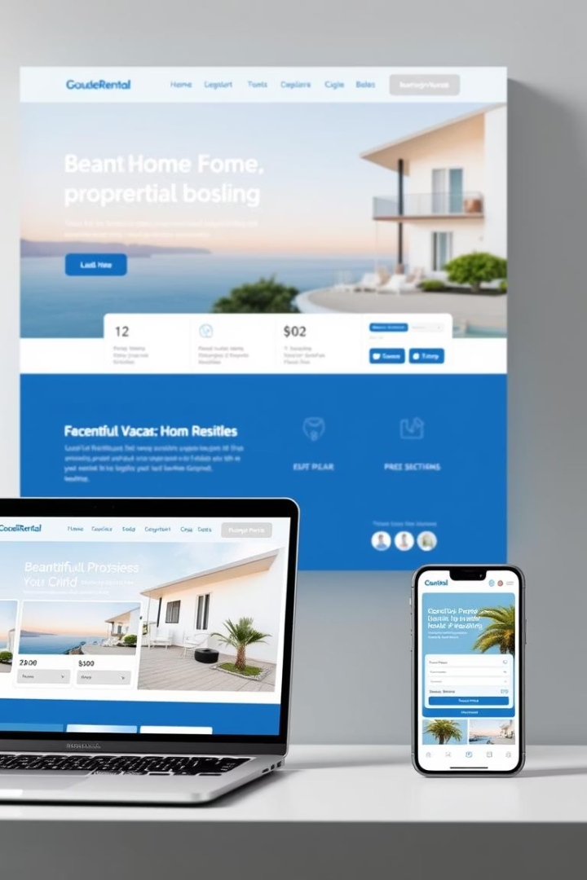
WanderInn: Home Rental & Booking System
WanderInn is a comprehensive accommodation platform designed to connect travelers with property owners for short-term rentals. The system provides a user-friendly interface for finding and booking accommodations while enabling property owners to list and manage their rentals effectively.
Developed by a talented team of three developers - Muhammad Rafay (22i-0948), Arham Khalid (22i-1156), and Maaz Khan - this platform addresses common pain points in the rental market such as high service fees, lack of transparency, and limited availability of well-reviewed listings.

Slide 2
System Architecture
Client-Server Architecture
MVC Architecture
Subsystems
WanderInn employs a separation between frontend (Next.js) and backend (Node.js/Express) for optimal performance and scalability.
The backend is organized using the Model-View-Controller pattern for clean code organization and maintenance.
The platform is divided into Frontend (Next.js UI), Backend (Node.js/Express API), Database (MongoDB Atlas), and Integration subsystems.
The deployment architecture spans client devices (web browsers and mobile devices), web servers, API servers, and database servers, creating a robust and responsive system for users across different platforms.

Slide 3
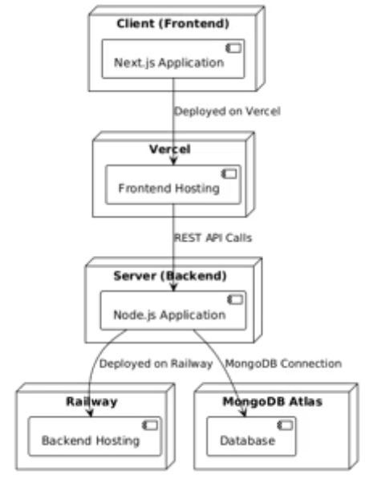
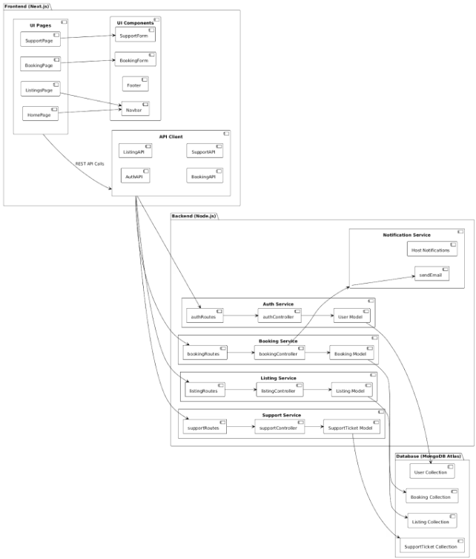
Deployment Diagram
Component Diagram

Slide 4
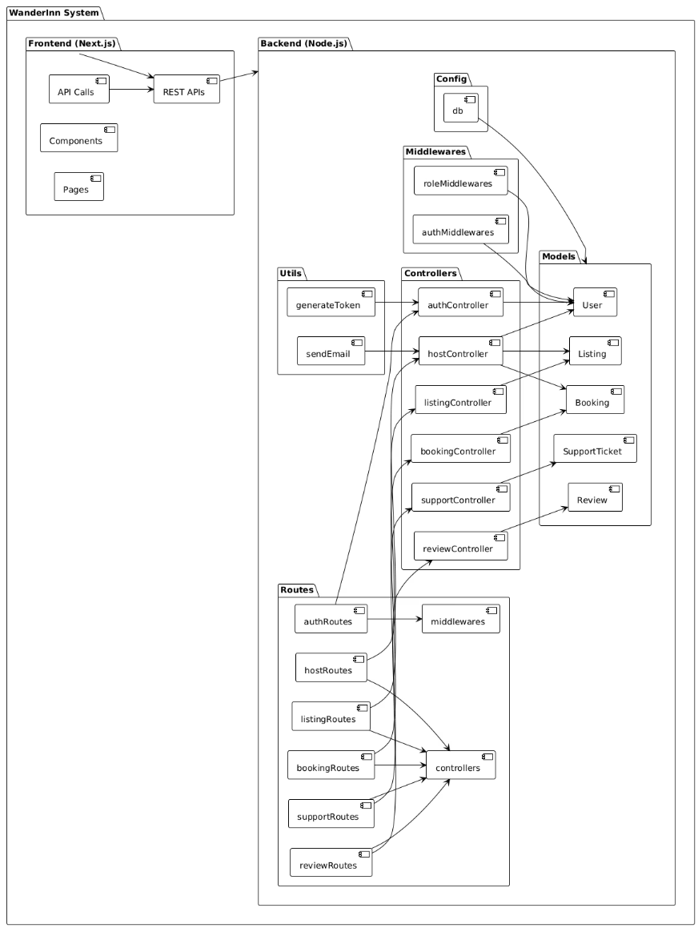
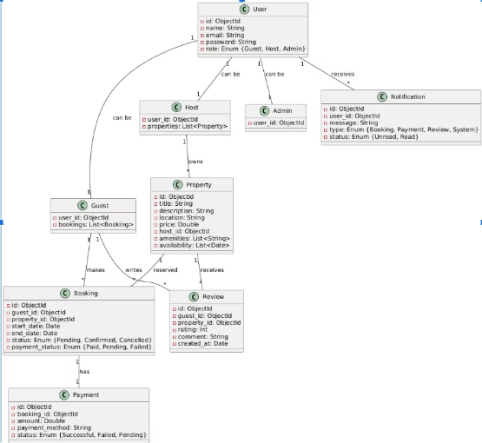
Package Diagram Class Diagram

Slide 5










System Components
Property Listings
User Management
Manages creation and display of rental properties with details and images.
Handles authentication, profiles, and user preferences for both hosts and guests.
Booking System
Processes reservations, payments, and booking confirmations.
Support & Notifications
Provides customer support and sends alerts to users.
Reviews System
Enables users to rate and review properties and hosts.

Slide 6
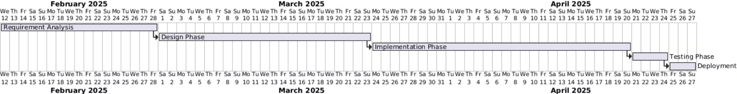




Project Planning
Work Breakdown
Project divided into User Authentication, Property Listings, Booking System, Reviews, and Administration components.
Sprint 2
Implemented Advanced Filtering, Host Cancellation Policy, Trending Destinations, and Admin Moderation.
Sprint 1
Burndown
Focused on User Authentication, Property Listings, Image Upload, and Booking Confirmation features.
Project completed ahead of schedule with consistent velocity throughout development phases.

Slide 7
User Stories
User Registration
Property Listing
Property Filtering
As a user, I want to sign up with my email so that I can create an account. System should create the account with valid credentials and show error for duplicate emails.
As a host, I want to add a new property listing so that guests can book it. System should add property with complete details and reject submissions with missing mandatory fields.
As a guest, I want to filter properties based on amenities so that I can find a property that meets my needs. System should display matching properties or show "No Listings Found" message.
These user stories guided development by ensuring features were built with clear acceptance criteria and user-centered design principles.

Slide 8
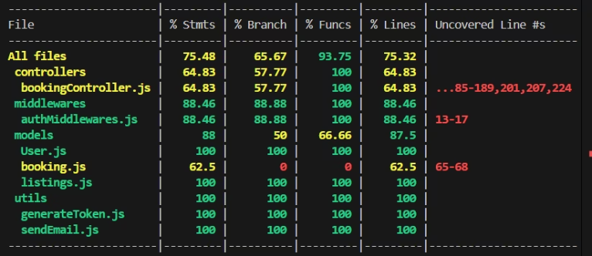
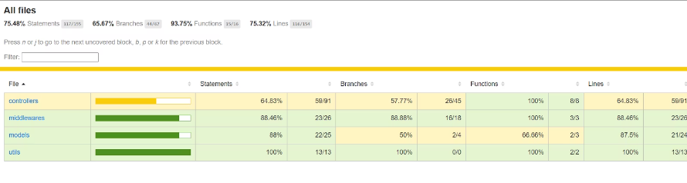




Testing Approach
White Box Testing
Ceate a Listing - Blackbox
Coverage Results
Input Field
Boundary Values
title
Minimum: 1 character, Maximum: 255 characters
description
Minimum: 1 character, Maximum: 1000 characters
price
Minimum: 1, Maximum: 1,000,000
bedrooms
Minimum: 1, Maximum: 50
bathrooms
Minimum: 1, Maximum: 50
maxGuests
Minimum: 1, Maximum: 100
Black Box Testing
Employed Equivalence Class Partitioning for user registration and Boundary Value Analysis for property listings to ensure robust input validation.
White Box Testing
Used JTEST for unit testing controllers, middleware, models, and utility functions to verify internal logic.
Coverage Analysis
Achieved 75.48% statement coverage, 65.67% branch coverage, 93.75% function coverage, and 75.32% line coverage.
Well-Covered Areas
User Model (100%), Authentication Middleware (88.46%), and Utility Functions (100%) received thorough testing.

Slide 9
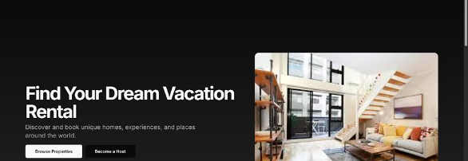

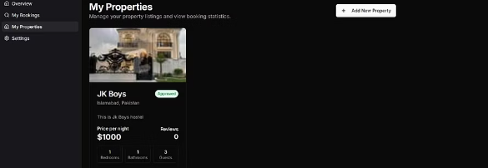
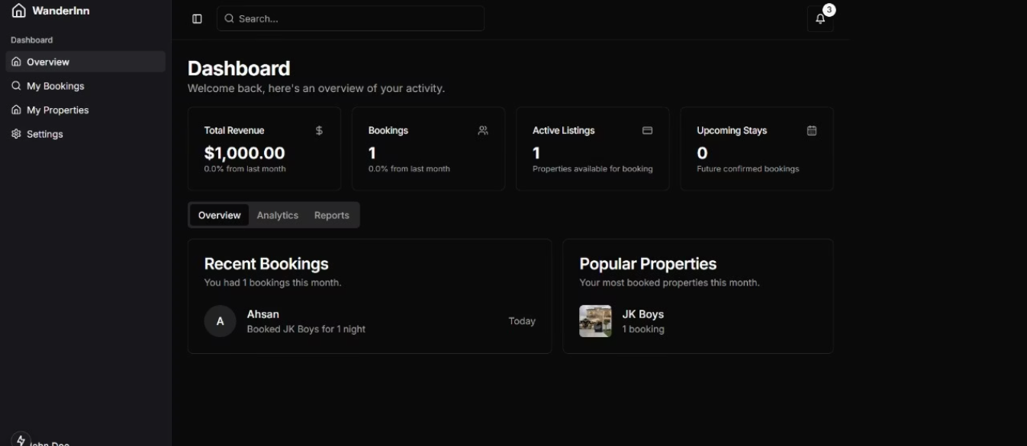
Implementation Results
The team successfully implemented all planned features with a clean, intuitive interface. Muhammad Rafay focused on backend development and documentation, Maaz Khan handled frontend development and UI/UX design, while Arham Khalid worked on backend development, testing, and served as Scrum Master.

Slide 10




Future Enhancements & Lessons Learned
AI-Powered Recommendations
Virtual Tours
Suggest properties based on user preferences and booking history to enhance user experience.
Allow hosts to add 360° virtual property tours for immersive property previews.
In-App Messaging
Multi-language Support
Implement real-time chat between hosts and guests to improve communication.
Expand market reach with localization for international users.
Key lessons learned include the importance of early planning, how clear communication reduces rework, and the value of burndown charts as indicators of team health and progress. The project was completed ahead of schedule thanks to detailed planning and regular team check-ins.

Slide 11
Thank You
We appreciate your time and attention.
Looking forward to your questions and feedback!

