Slide 1

HUMAN RESOURCE MANAGEMENT
Global Edition 12e
Chapter 7
Interviewing Candidates
Part 2 Recruitment and Placement
Copyright © 2011 Pearson Education
GARY DESSLER
PowerPoint Presentation by Charlie Cook The University of West Alabama
Notes:
Human Resources Management 12e Gary Dessler
Copyright © 2011 Pearson Education
1–1

Slide 2
LEARNING OUTCOMES
Main types of selection interviews.
Structured situational interview.
Explain and illustrate each guideline for being a more effective interviewer.
Give several examples of situational questions, behavioral questions, and background questions that provide structure.
The steps in a streamlined interview process.

Slide 3
Basic Types of Interviews
Selection Interview
Types of Interviews
Appraisal Interview
Exit Interview
Notes:
Managers use several interviews at work. For example, an appraisal interview is a discussion, following a performance appraisal, in which supervisor and employee discuss the employee’s ratings and possible remedial actions. When an employee leaves a firm, one often conducts an exit interview. This aims at eliciting information that might provide some insight into what’s right or wrong about the firm. Many techniques in this chapter apply to appraisal and exit interviews. However, we’ll postpone a fuller discussion of these two interviews until Chapters 9 and 10 and focus here on selection interviews.

Slide 4
Selection Interview Structure
Selection Interview Characteristics
Interview structure
Interview content
Interview administration
Notes:
We can classify selection interviews according to:
1. How structured they are
2. Their “content”—the types of questions they contain
3. How the firm administers the interviews

Slide 5
Selection Interview Formats
Interview Structure Formats
Unstructured (nondirective) interview
Structured (directive) interview
Notes:
In unstructured (or nondirective) interviews, the manager follows no set format. A few questions might be specified in advance. Most selection interviews fall in this category.
In structured (or directive) interviews, the employer lists job-oriented questions ahead of time, and possible predetermined answers for appropriateness and scoring.

Slide 6
Interview Content
Types of Questions Asked
Situational interview
Behavioral interview
Job-related interview
Stress interview
Notes:
We can also classify interviews based on the “content” or the types of questions asked in the interview. At work, situational, behavioral, and job-related questions are most important.

Slide 7
Administering the Interview
Unstructured sequential interview
Structured sequential interview
Panel interview
Ways in Which Interview Can be Conducted
Mass interview
Phone interviews
Computerized interviews
Video/Web-assisted interviews
Notes:
Employers also administer interviews in various ways: one-on-one or by a panel of interviewers; sequentially or all at once; and computerized or personally.

Slide 8
How to Design and Conduct An Effective Interview
The Structured Situational Interview
Use either situational questions or behavioral questions that yield high criteria-related validities.
Step 1: Analyze the job.
Step 2: Rate the job’s main duties.
Step 3: Create interview questions.
Step 4: Create benchmark answers.
Step 5: Appoint the interview panel and conduct interviews.
Notes:
In creating structured situational interviews, people familiar with the job develop questions based on the job’s actual duties. They then reach consensus on what are and are not acceptable answers. The procedure is as outline in this slide.

Slide 9
FIGURE 7–2 Examples of Questions That Provide Structure
Situational Questions
1. Suppose a more experienced coworker was not following standard work procedures and claimed the new procedure was better. Would you use the new procedure?
2. Suppose you were giving a sales presentation and a difficult technical question arose that you could not answer. What would you do?
Past Behavior Questions
3. Based on your past work experience, what is the most significant action you have ever taken to help out a coworker?
4. Can you provide an example of a specific instance where you developed a sales presentation that was highly effective?
Background Questions
5. What work experiences, training, or other qualifications do you have for working in a teamwork environment?
6. What experience have you had with direct point-of-purchase sales?
Job Knowledge Questions
7. What steps would you follow to conduct a brainstorming session with a group of employees on safety?
8. What factors should you consider when developing a television advertising campaign?
Notes:
Figure 7-2 illustrates several examples of structured job knowledge, situational, background or behavioral interview questions.

Slide 10
FIGURE 7–3 Suggested Supplementary Questions for Interviewing Applicants
How did you choose this line of work?
What did you enjoy most about your last job?
What did you like least about your last job?
What has been your greatest frustration or disappointment on your present job? Why?
What are some of the pluses and minuses of your last job?
What were the circumstances surrounding your leaving your last job?
Did you give notice?
Why should we be hiring you?
What do you expect from this employer?
What are three things you will not do in your next job?
What would your last supervisor say your three weaknesses are?
What are your major strengths?
How can your supervisor best help you obtain your goals?
How did your supervisor rate your job performance?
In what ways would you change your last supervisor?
What are your career goals during the next 1–3 years? 5–10 years?
How will working for this company help you reach those goals?
What did you do the last time you received instructions with which you disagreed?
What are some things about which you and your supervisor disagreed? What did you do?
Which do you prefer, working alone or working with groups?
What motivated you to do better at your last job?
Do you consider your progress in that job representative of your ability? Why?
Do you have any questions about the duties of the job for which you have applied?
Can you perform the essential functions of the job for which you have applied?
Notes:
Figure 7-3 contains a sampling of technical questions to be asked in interviews.

Slide 11
Using a Streamlined Interview Process
Prepare for the interview
Knowledge and experience
Motivation
Intellectual capacity
Personality factor
Formulate questions to ask in the interview
Intellectual factor
Motivation factor
Personality factor
Knowledge and experience factor
Conduct the interview
Have a plan
Follow your plan
Match the candidate to the job
Notes:
Managers are busy people who may not always have the time or inclination to follow all of the interview steps suggested thus far. If so, here, from one employment expert, is a streamlined approach that may come in handy.

Slide 12
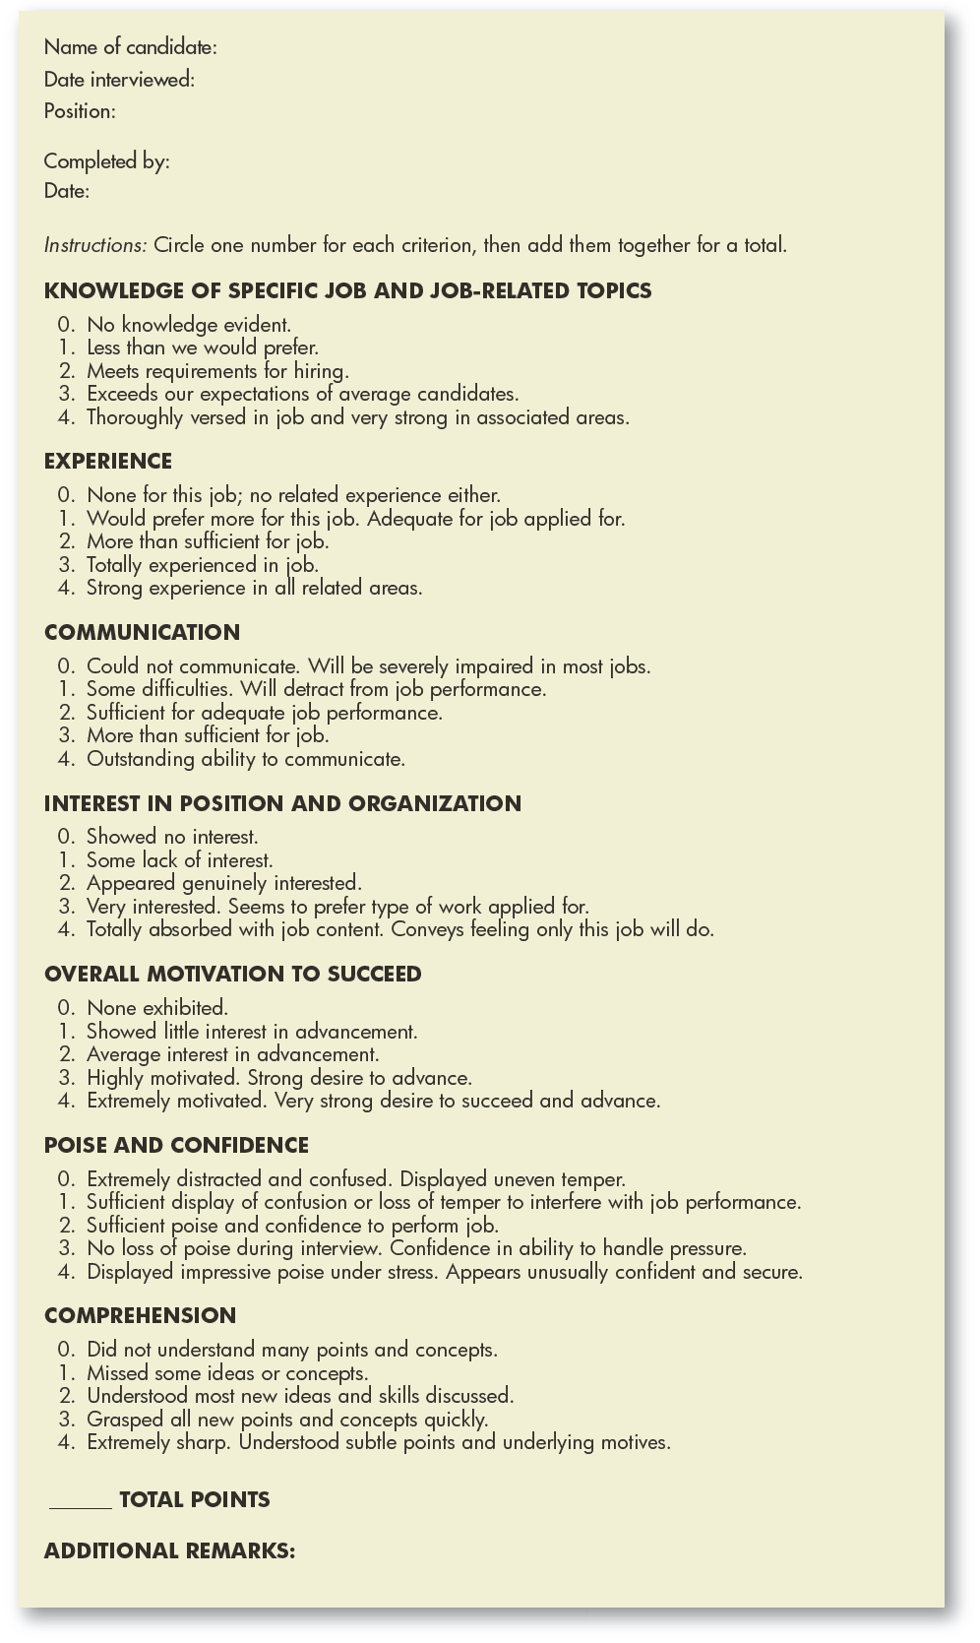
FIGURE 7–4 Interview Evaluation Form
Notes:
A manager can use an interview evaluation form such as the one in Figure 7-4 to compile his or her impressions of an applicant.

Slide 13
FIGURE 7–5 Interview Questions to Ask
What is the first problem that needs the attention of the person you hire?
What other problems need attention now?
What has been done about any of these to date?
How has this job been performed in the past?
Why is it now vacant?
Do you have a written job description for this position?
What are its major responsibilities?
What authority would I have? How would you define its scope?
What are the company’s five-year sales and profit projections?
What needs to be done to reach these projections?
What are the company’s major strengths and weaknesses?
What are its strengths and weaknesses in production?
What are its strengths and weaknesses in its products or its competitive position?
Whom do you identify as your major competitors?
What are their strengths and weaknesses?
How do you view the future for your industry?
Do you have any plans for new products or acquisitions?
Might this company be sold or acquired?
What is the company’s current financial strength?
What can you tell me about the individual to whom I would report?
What can you tell me about other persons in key positions?
What can you tell me about the subordinates I would have?
How would you define your management philosophy?
Are employees afforded an opportunity for continuing education?
What are you looking for in the person who will fill this job?
Notes:
Sample questions that interviewees may wish to ask during interviews are presented in Figure 7-5.

Slide 14
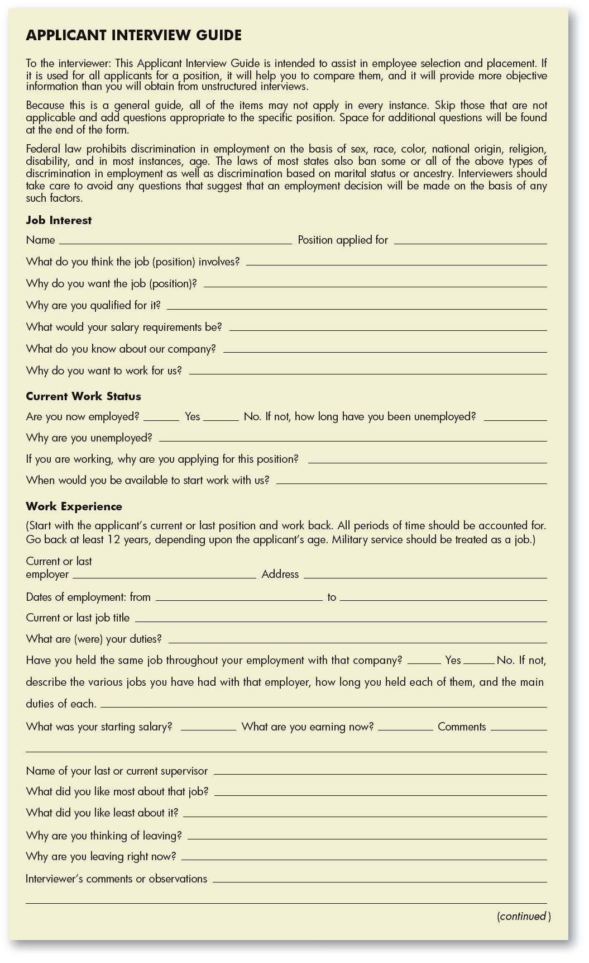
FIGURE 7–A1 Structured Interview Guide

Slide 15
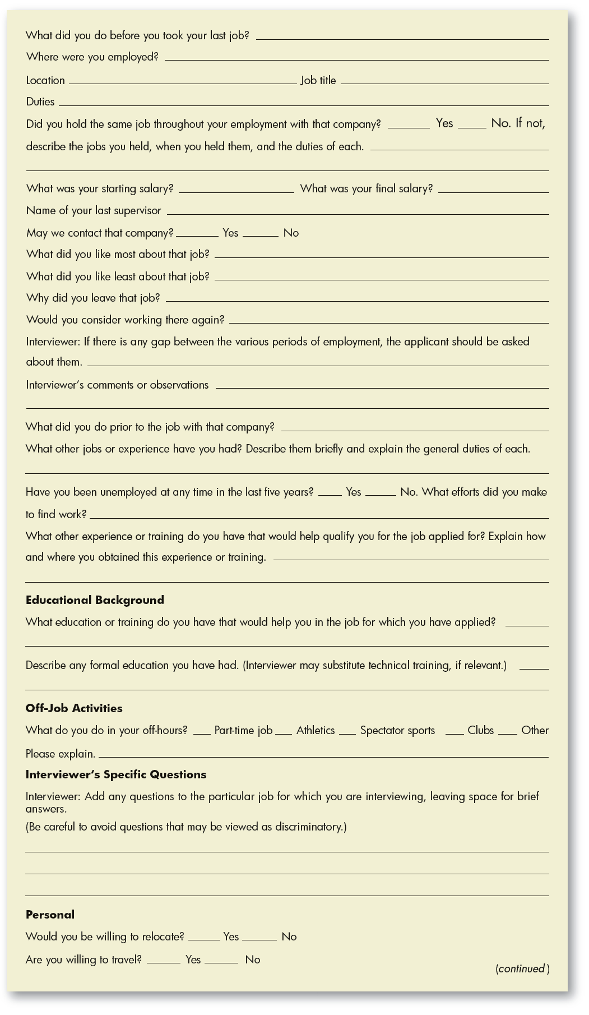
FIGURE 7–A1 Structured Interview Guide (cont’d)

Slide 16
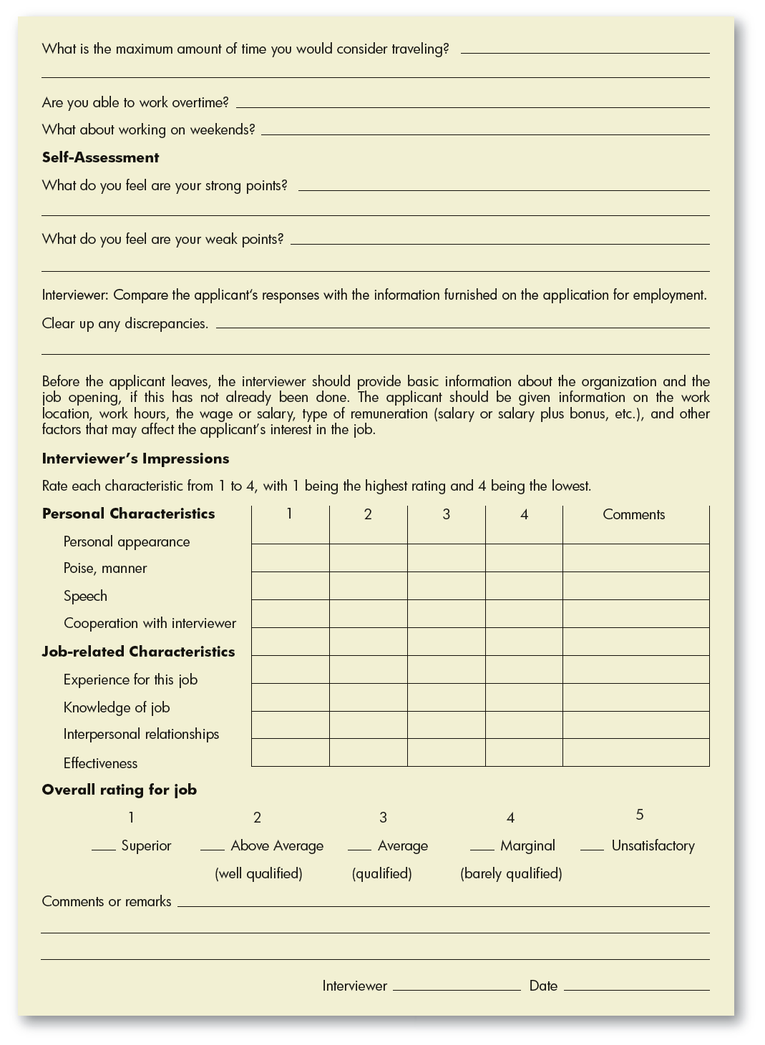
FIGURE 7–A1 Structured Interview Guide (cont’d)

