Slide 1
WHMIS
Pharmaceutical Distribution ERP
System Presentation
PREPARED FOR
MASTER PHARMACUTICALS DISTRIBUTOR
A product of Virtual Wisdom Technologies (SMC-Private) Limited
August 2026 · Confidential

Slide 2
THE OPPORTUNITY
Pharmaceutical distribution is uniquely unforgiving
The everyday details that quietly erode a distributor's margin
Bonus stock hides your true cost
Free “bonus” goods change what stock really costs — ignore them and every margin looks better than it is.
Expiry is money on a timer
Batches expire; ship the wrong one and stock becomes a write-off instead of a sale.
Credit sales strain cash flow
Pharmacies buy on credit — without limits and aging, overdue money hides in plain sight.
Trade schemes applied by hand drift
Inconsistent, unmeasured schemes cost more than you think and treat customers unequally.
WHMIS is engineered around exactly these realities — so the system protects your margin while your team simply does its job.
Confidential · WHMIS · Virtual Wisdom Technologies (SMC-Private) Limited
2
Notes:
Frame the client's world before the product: these four realities are where distributor profit quietly leaks. WHMIS is built around them.

Slide 3
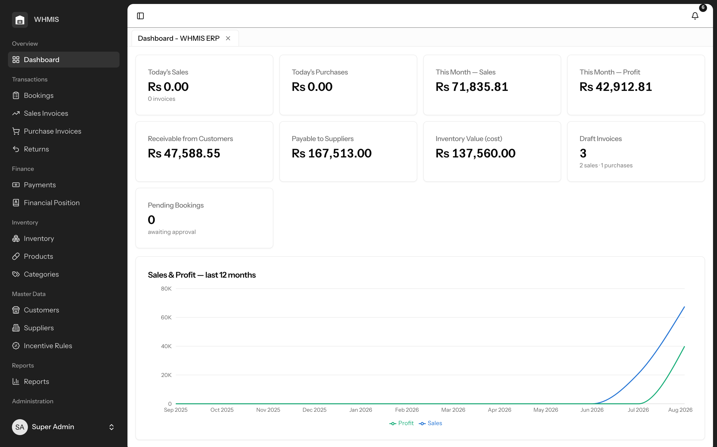
THE PLATFORM
One connected system
Purchase → stock → book → sell → collect → report — reconciled automatically
▸ Every step of the business in a single, always-current source of truth — no more scattered spreadsheets and registers.
▸ Purpose-built for pharma: batch & expiry tracking, bonus-stock handling, and a true cost that includes free goods.
▸ Localised for Pakistan — PKR pricing with GST / NTN / STRN / CNIC on every party and document.
▸ Runs on ordinary cPanel hosting, in any browser — nothing special to install.
Confidential · WHMIS · Virtual Wisdom Technologies (SMC-Private) Limited
3
Notes:
The dashboard is the first screen the team sees each day — today's sales and purchases, month sales and profit, receivables vs. payables, inventory value, and a 12-month trend. It turns hindsight into foresight.

Slide 4
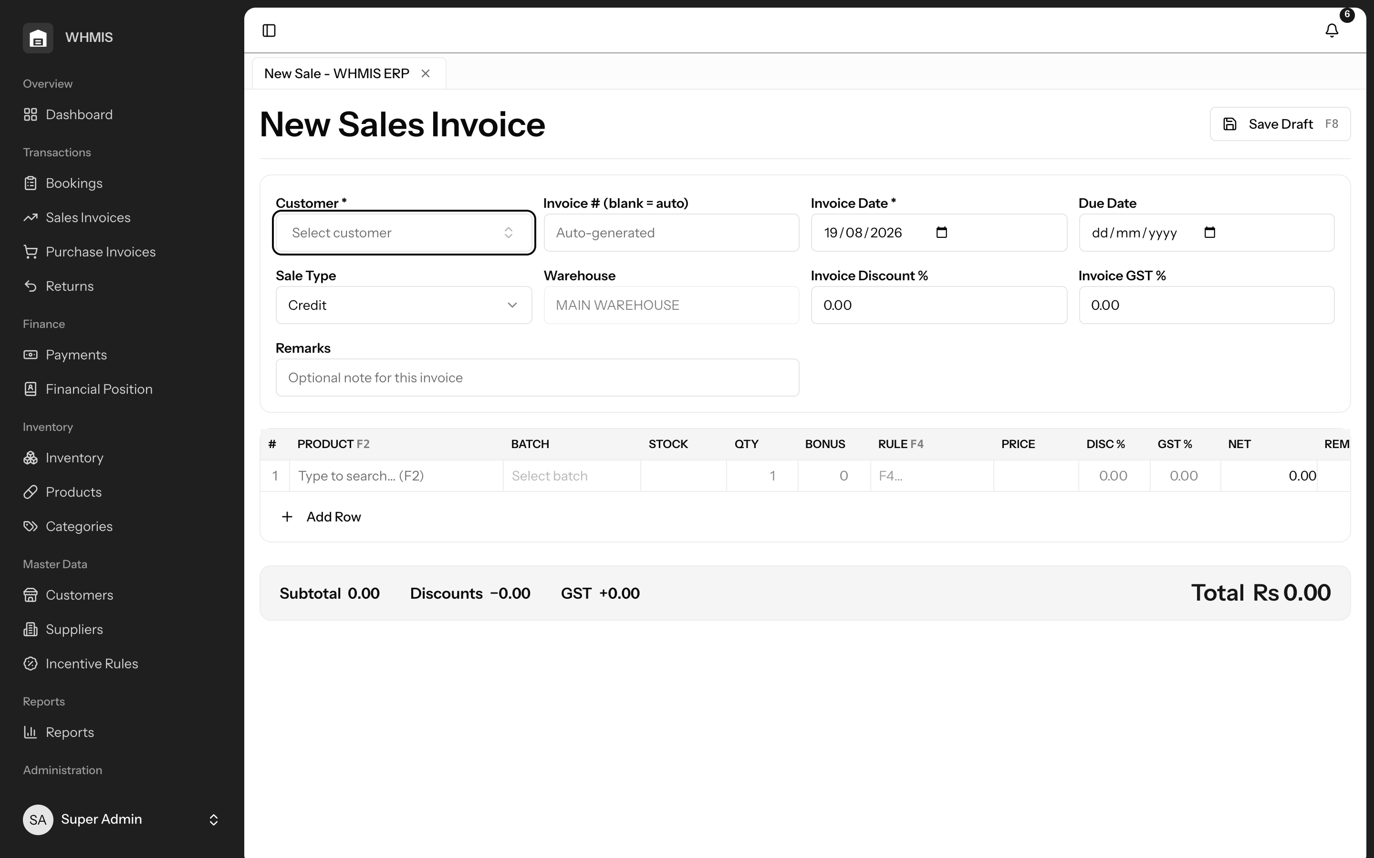
TRANSACTIONS
Sell & book — faster billing, controlled credit
From field order to posted invoice, without re-keying or risk
▸ Keyboard-fast invoice entry built for high daily volumes — bill in seconds, not minutes.
▸ Stock is drawn from the earliest-expiry batch automatically; you never oversell or ship expired goods.
▸ Customers over their credit limit are blocked before a credit invoice can post — cash flow protected.
▸ Field bookings flow through approval into a ready-to-bill invoice, carrying their trade schemes with them.
Confidential · WHMIS · Virtual Wisdom Technologies (SMC-Private) Limited
4
Notes:
Sales invoices are raised on a keyboard-driven grid; pricing, discount, GST, batch stock and credit are applied automatically and re-verified on the server before posting. Bookings mirror the same fast entry, then submit → approve → convert to a draft sale in one step.

Slide 5
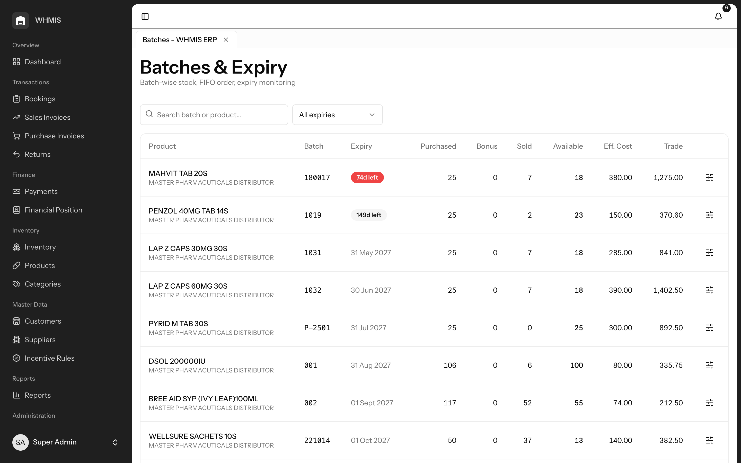
INVENTORY
Buy & stock — true cost, zero expiry waste
Honest margins, and older stock out the door before it expires
▸ Free bonus units fold into each batch's effective cost, so profit is always calculated truthfully.
▸ Expiry-first (FIFO) issuing pushes the earliest-expiring batch out first, minimising write-offs.
▸ Near-expiry and low-stock situations are surfaced early — you act before a loss or a shortage.
▸ Every unit's movement in and out is recorded in an append-only history you can always trust.
Confidential · WHMIS · Virtual Wisdom Technologies (SMC-Private) Limited
5
Notes:
Purchases capture batch, expiry and bonus units; on posting, stock is created and bonus dilutes the batch's effective cost. Stock is tracked per batch, consumed earliest-expiry-first, with full traceability.

Slide 6
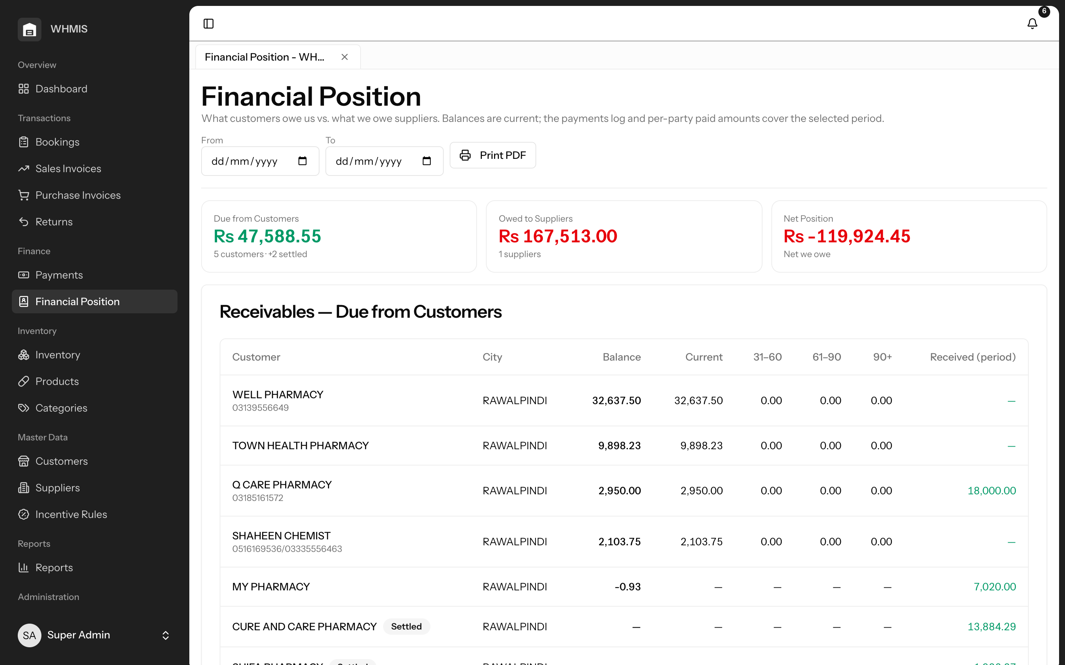
FINANCE
Money & position — know where you stand
Receivables vs. payables, and the net position between them — right now
▸ A single Financial Position screen: Due from Customers, Owed to Suppliers, and Net Position, headlined.
▸ Receivables and payables with aging buckets, so overdue accounts and upcoming bills stand out instantly.
▸ Receipts and payments allocate against invoices; balances and aging update the moment money moves.
▸ Pick any date range and print the whole position statement to PDF for owners, banks or auditors.
Confidential · WHMIS · Virtual Wisdom Technologies (SMC-Private) Limited
6
Notes:
Profit on paper means little if cash is stuck in receivables while supplier bills come due. The Financial Position screen answers 'can we meet our commitments this week?' — receivables, payables, net position, and a full payment log for any period.

Slide 7
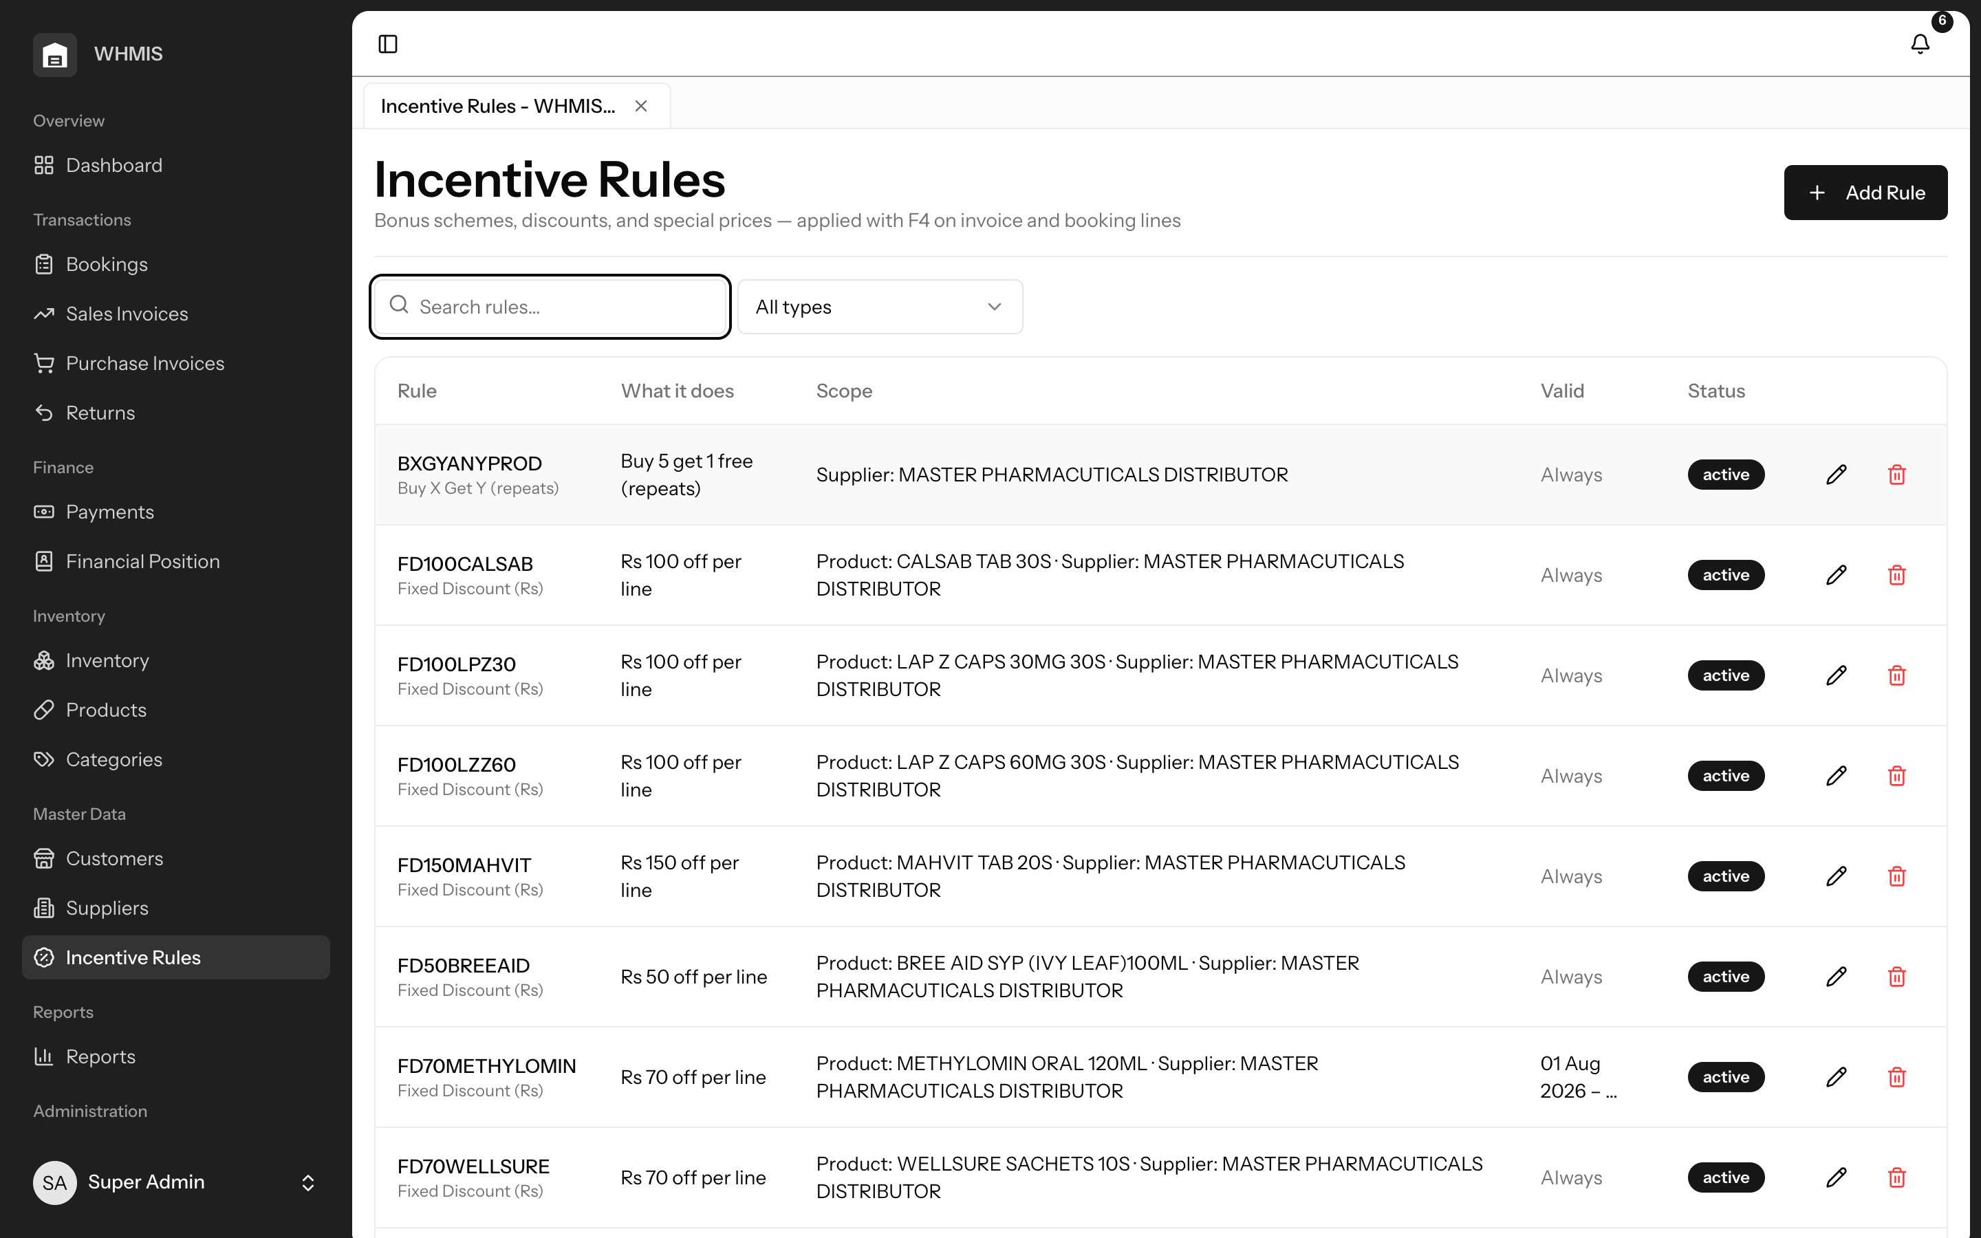
SALES ENABLEMENT
Trade schemes & clean returns
Consistent pricing you can measure — and reversals that never drift
▸ Define each scheme once — bonus, slab bonus, percentage or fixed discount, special price — and target it precisely.
▸ Rules only fill the invoice line, so your team keeps the final say; the Incentives Given report shows their true cost.
▸ Sales returns restore stock to the exact batches sold and refund proportionally; purchase returns reverse supplier balances.
▸ Returns post immediately with the right credit and debit notes — inventory and ledgers stay perfectly in step.
Confidential · WHMIS · Virtual Wisdom Technologies (SMC-Private) Limited
7
Notes:
Schemes are a major cost most distributors can't quantify. Defining them centrally makes pricing consistent and, for the first time, measurable. Returns are handled exactly — back to the right batch, at the right value — with no manual adjustment.

Slide 8
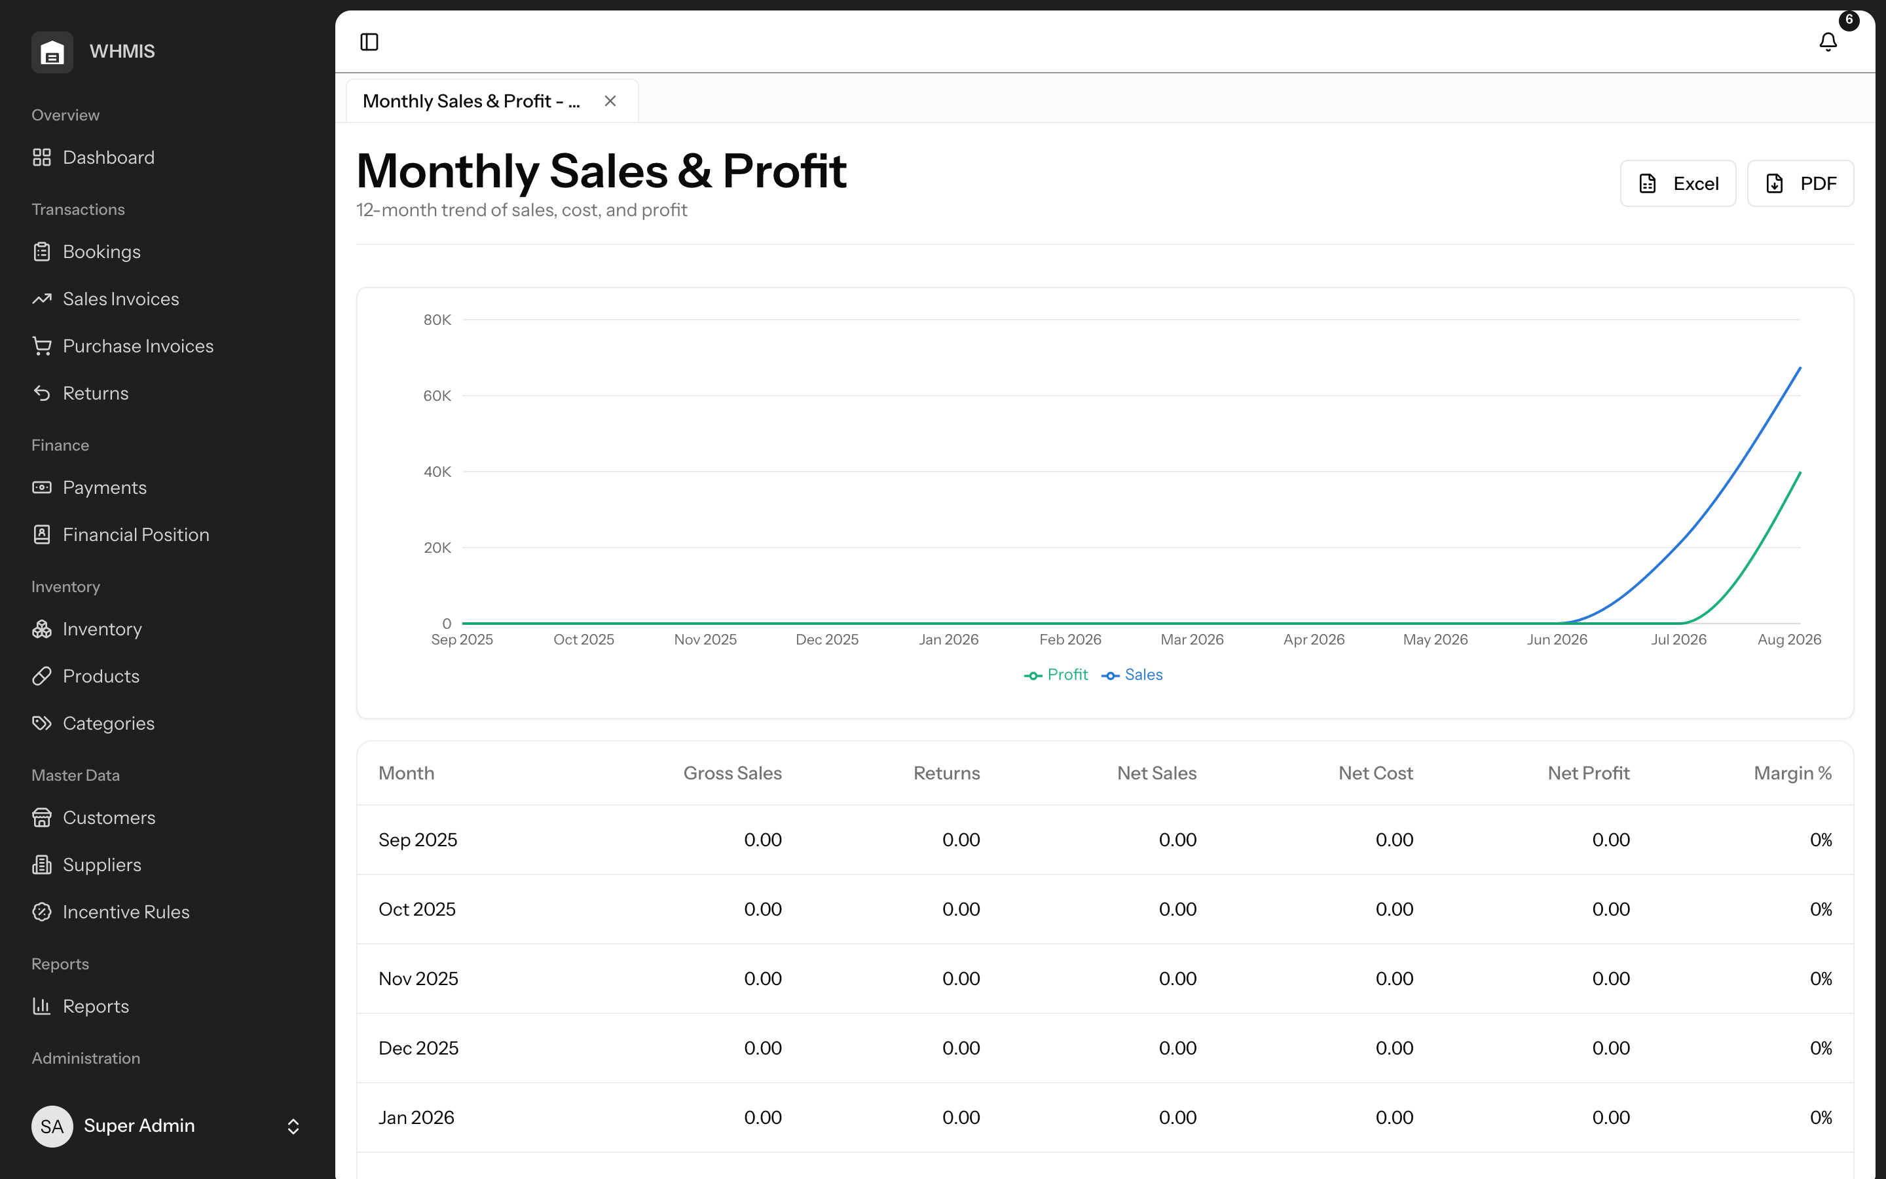
INSIGHTS
Seventeen reports, one click to export
The views a distributor needs to run — and defend — the business
▸ Sales, Purchases, Inventory and Financial reports — registers, profitability, aging, stock, expiry and more.
▸ Each renders with totals and, where useful, a chart — no spreadsheets to build or maintain.
▸ One click exports any report to Excel or PDF for owners, auditors and partners.
▸ Everyone works from the same trusted figures — you spend time deciding, not assembling.
Confidential · WHMIS · Virtual Wisdom Technologies (SMC-Private) Limited
8
Notes:
Seventeen ready-made reports across Sales, Purchases, Inventory and Financial. Nothing to configure — the insight is already there, on screen and exportable.

Slide 9
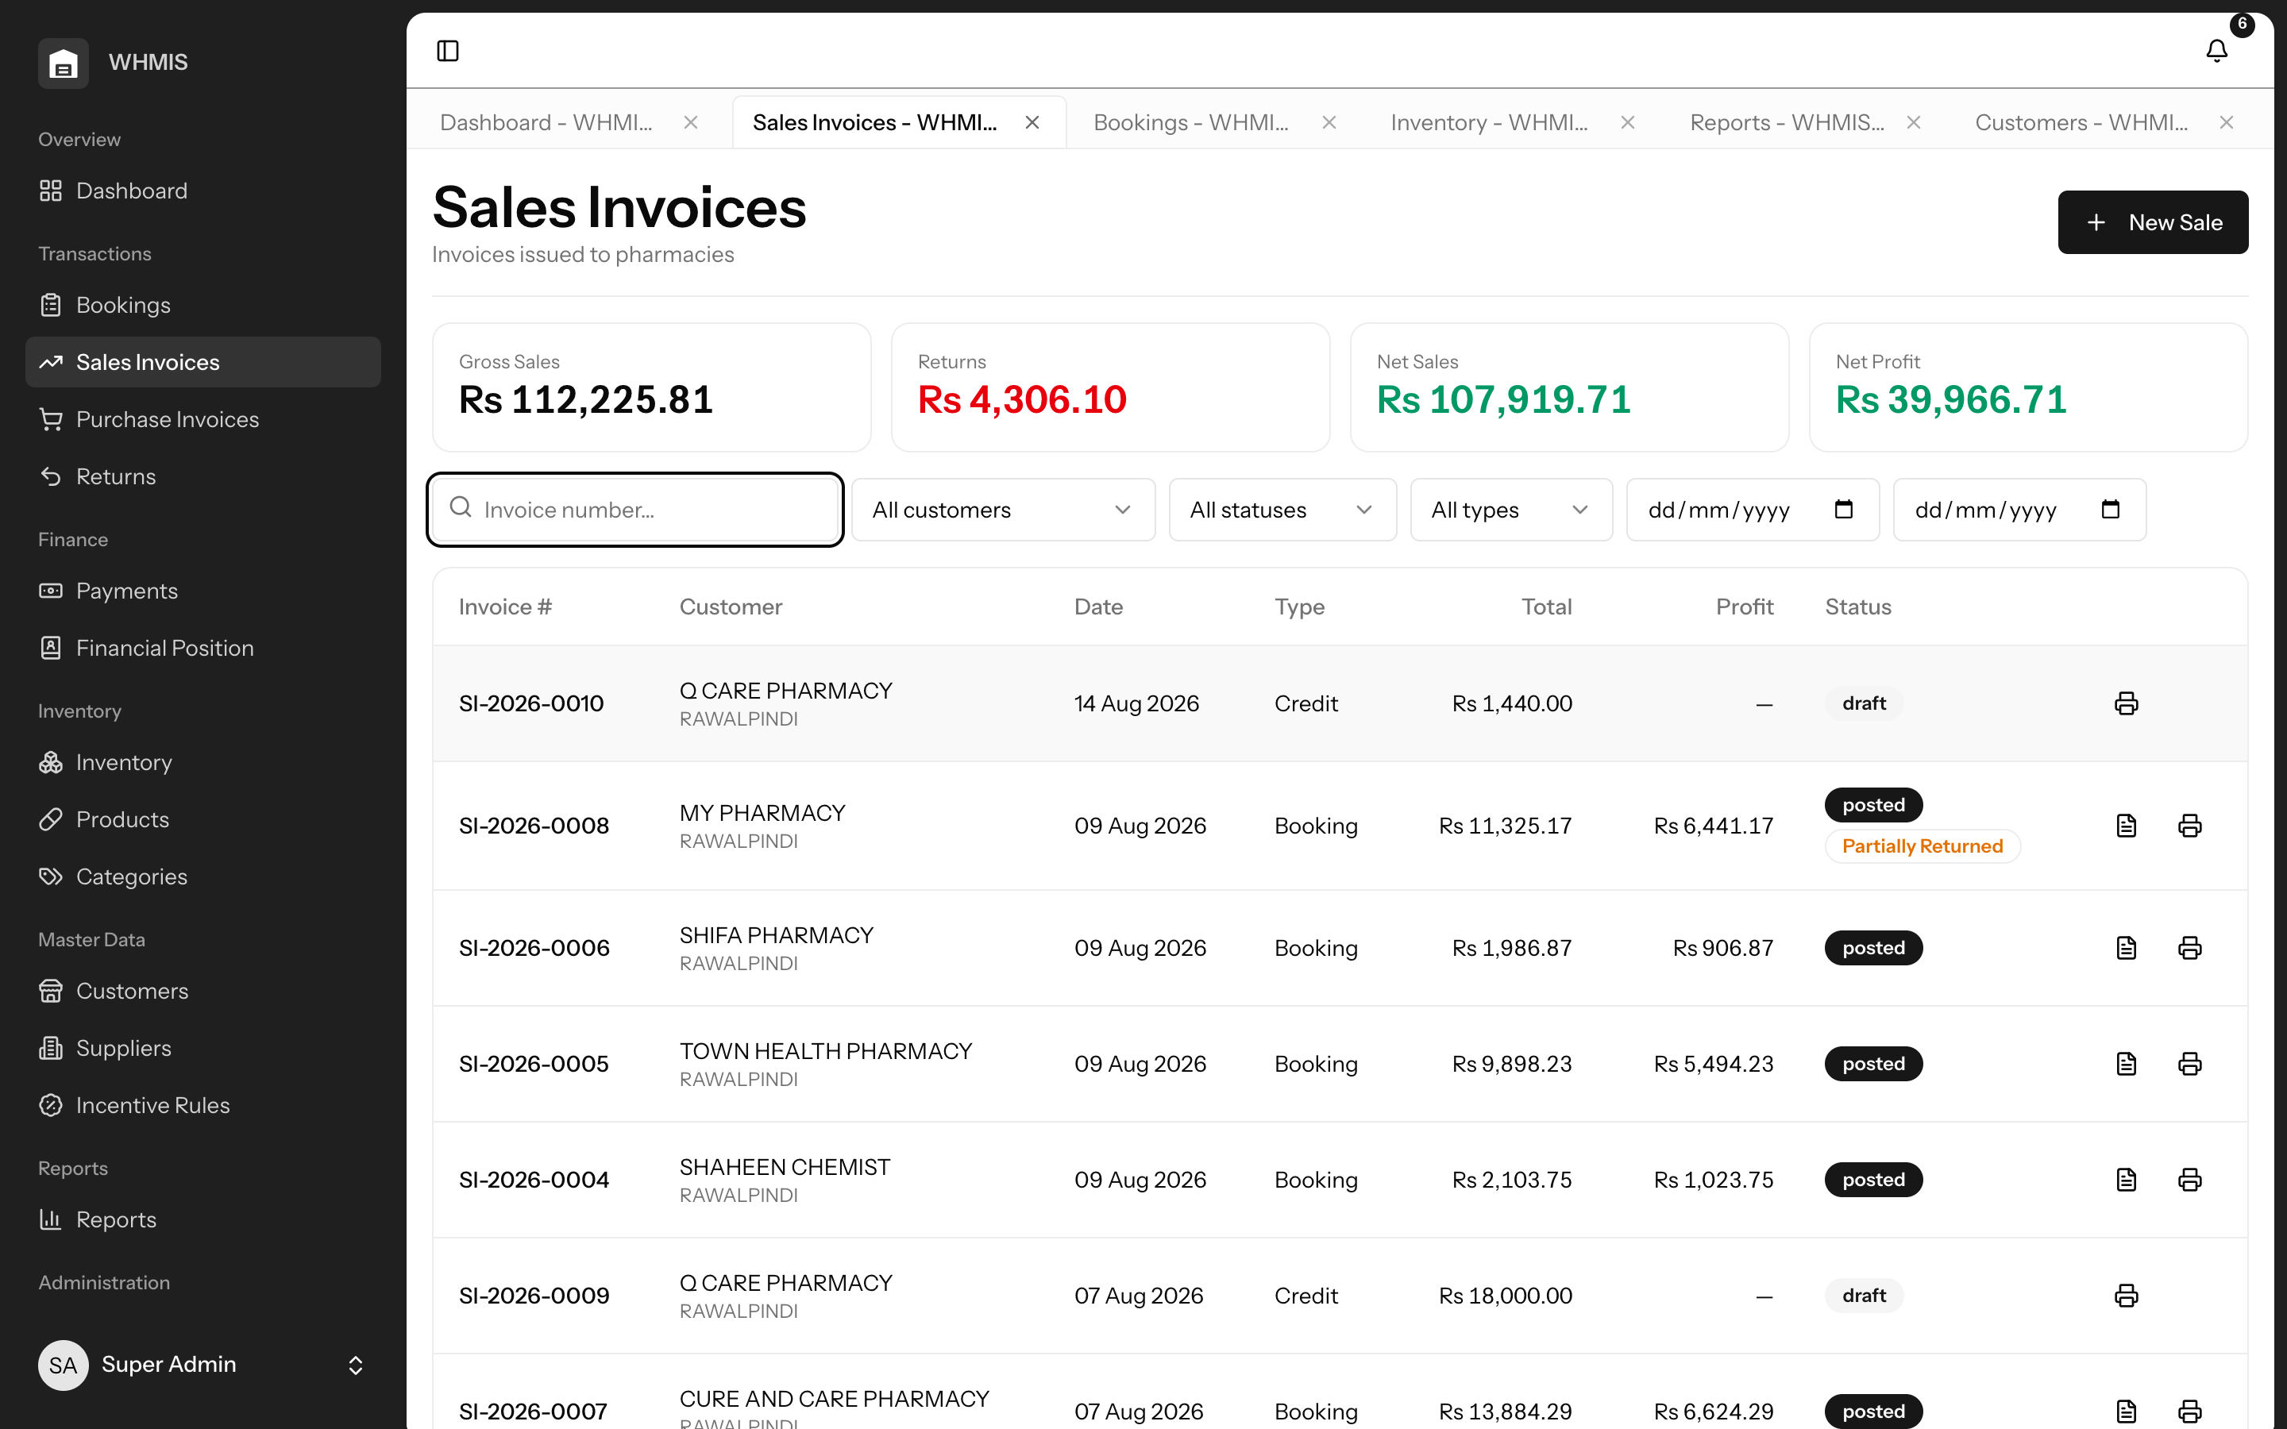
PLATFORM
Modern, safe, and localised
Many screens in one window, the right access for every role
▸ Open sales, bookings, inventory and reports as tabs in one window — switch instantly, each keeps its own state.
▸ Role-based access gates every sensitive action; bookers create orders but never touch billing or master pricing.
▸ Proactive alerts flag low stock, expiry, overdue balances and pending approvals before they cost you.
▸ Browser-based and cPanel-friendly, with your data in your own database, under your control.
Confidential · WHMIS · Virtual Wisdom Technologies (SMC-Private) Limited
9
Notes:
A tabbed workspace keeps the team in flow with no lost work. Role-based permissions protect data and margin; in-app alerts surface issues early. Deployment is low-risk — ordinary hosting, any browser, your data.

Slide 10
THE FIT
Why WHMIS fits Master Pharmacuticals Distributor
Built for how a pharmaceutical distributor in Pakistan actually works
1
One connected workflow — purchase to collection — with every figure reconciled automatically.
2
Purpose-built for pharma: batches, expiry, bonus stock, and a true cost that keeps margins honest.
3
Cash under control — credit limits, aging and a live net position protect working capital.
4
Trade schemes applied consistently and, at last, measured.
5
Localised for Pakistan: PKR and GST / NTN / STRN / CNIC throughout.
6
Low-risk to adopt: ordinary cPanel hosting, browser-based, your data in your own database.
Confidential · WHMIS · Virtual Wisdom Technologies (SMC-Private) Limited
10
Notes:
Close the loop: restate that every pharma-specific control they need is already here on day one — this is their requirement, met.

Slide 11
See it on your own data.
We would be glad to walk the team at Master Pharmacuticals Distributor
through a live, hands-on demonstration of WHMIS.
A product of
Virtual Wisdom Technologies (SMC-Private) Limited

Slide 12
NOTICE
Confidentiality
This document and the WHMIS platform it describes are the confidential and proprietary property of Virtual Wisdom Technologies (SMC-Private) Limited. It has been prepared exclusively for MASTER PHARMACUTICALS DISTRIBUTOR for the sole purpose of evaluating the system.
Its contents may not be copied, reproduced, distributed or disclosed to any third party, in whole or in part, without the prior written consent of Virtual Wisdom Technologies (SMC-Private) Limited.
© 2026 Virtual Wisdom Technologies (SMC-Private) Limited. All rights reserved.
Confidential · WHMIS · Virtual Wisdom Technologies (SMC-Private) Limited
11

