Slide 1
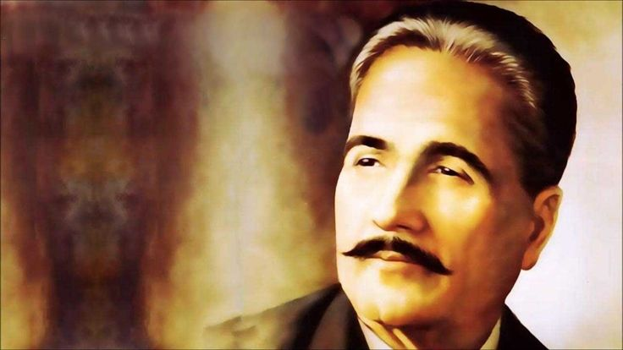
Shikwa and Jawab-e-Shikwa
By Dr Allama Muhammad Iqbal

Slide 2
Why I selected this book?
It is poetry book (I like poetry)
It is written by Allama Iqbal (my favorite poet)
It is in Urdu (easy to read)

Slide 3
What was it about?
Complain to God about his promises with Muslims
The reply of God

Slide 4
What I learn from it?
I got answers of all my complains from this book
God has not broken his promises
Instead it is the Muslims who have turned away from the Path.

