Slide 1

Comparative Analysis of Preprocessing Pipelines, Regularization Techniques, and Class Imbalance Handling for Epileptic Seizure Prediction Using Logistic Regression
Submitted By: Muhammad Salman | Course: Machine Learning | Semester Major Assignment

Slide 2

Introduction
Problem Statement
Epilepsy is a neurological disorder causing recurrent seizures. EEG signals record brain electrical activity. Manual seizure detection is time-consuming and requires experts. Machine learning can automatically classify seizure and non-seizure patterns.
Project Objective
Preprocessing
Investigate the impact of preprocessing pipelines
Regularization
Compare regularization techniques
Class Imbalance
Analyze class imbalance handling methods
Generalization
Evaluate model generalization performance

Slide 3
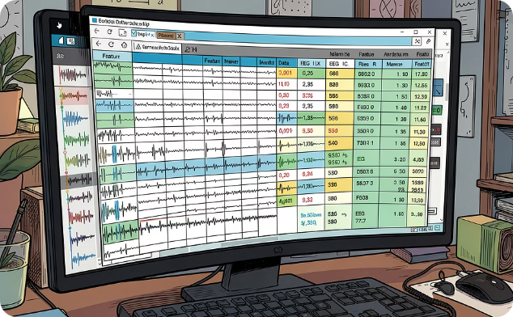
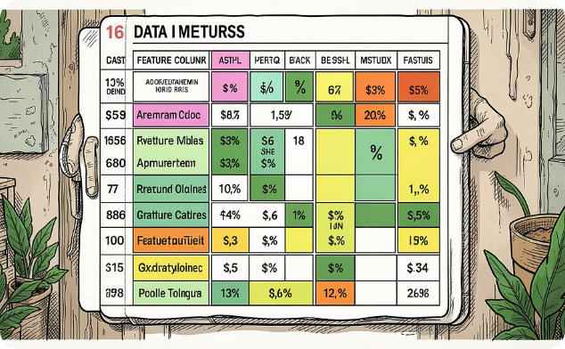
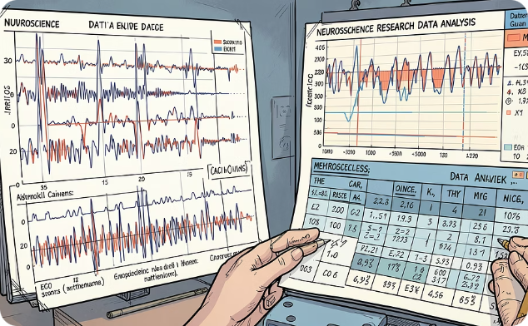
Datasets Used
Multiple datasets were used to evaluate model stability and generalization across different EEG signal configurations.
Dataset 1: Epileptic Seizure Recognition
Dataset 2: BEED_Data
Dataset 3: EEG Seizure Analysis
EEG signal dataset
16 features
11,500 EEG samples
178 features
Converted into binary classification
EEG signal dataset
16 features

Slide 4
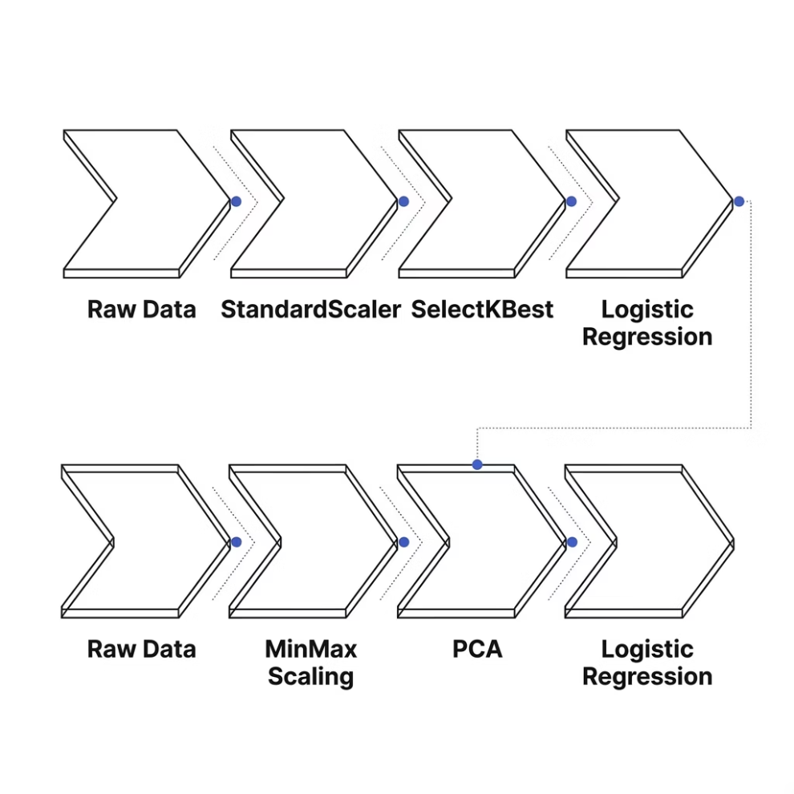
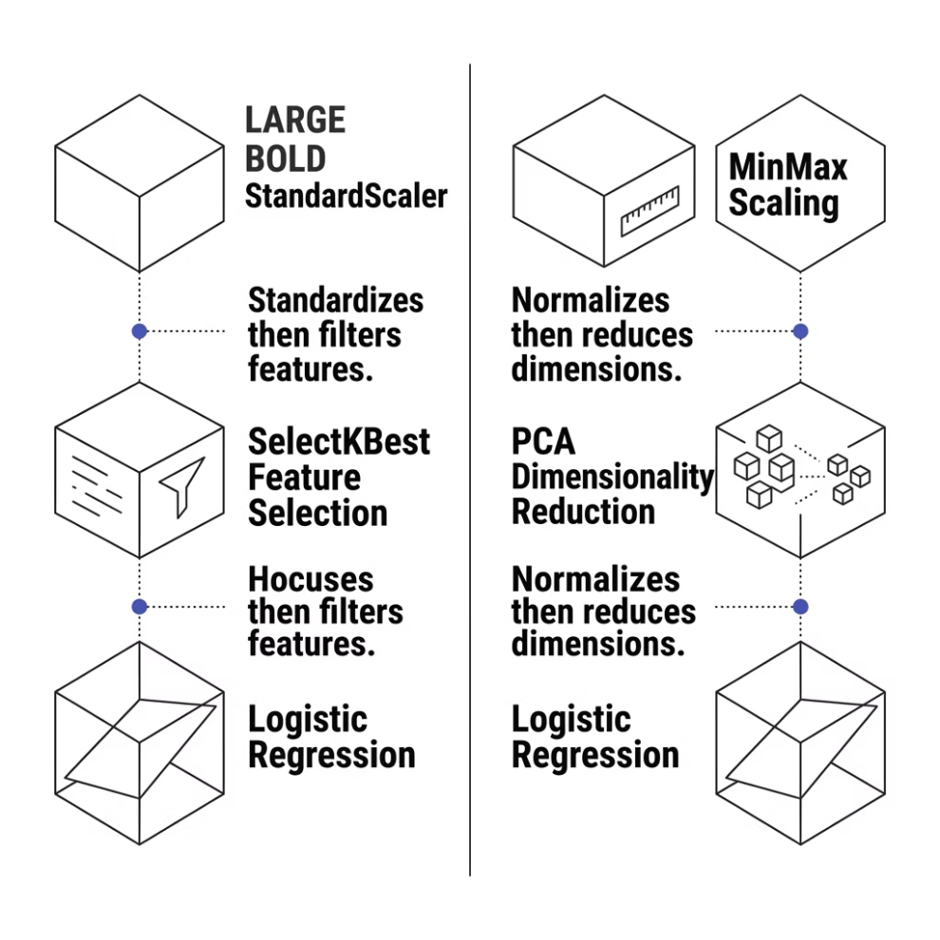
Preprocessing Pipelines
Pipeline A — Feature Selection
Remove irrelevant features, reduce noise, and improve prediction.
Pipeline B — Dimensionality Reduction
Reduce dimensionality, preserve 95% variance, and improve computational efficiency.

Slide 5
Logistic Regression & Regularization
Logistic Regression predicts seizure probability. Three regularization techniques were compared to control model complexity and prevent overfitting.
L1 (Lasso)
L2 (Ridge)
Elastic Net
Performs feature selection and produces sparse models by driving some coefficients to exactly zero.
Shrinks coefficients toward zero but retains all features, providing smoother regularization.
Combines L1 and L2 penalties, balancing sparsity and stability for a more flexible model.

Slide 6

Experimental Results — Pipeline A
Dataset
Regularization
Accuracy
F1 Score
Dataset 1
L1
81.09%
73.60%
Dataset 1
L2
81.04%
73.51%
Dataset 1
Elastic Net
81.04%
73.51%
Dataset 2
L1
45.75%
46.43%
Dataset 3
L1
45.75%
46.43%
Observation: Pipeline A achieved the best overall performance across all datasets and regularization methods, with Dataset 1 reaching over 81% accuracy.

Slide 7

Experimental Results — Pipeline B
Dataset
Regularization
Accuracy
F1 Score
Dataset 1
L1
80.30%
71.83%
Dataset 1
L2
80.43%
72.13%
Dataset 1
Elastic Net
80.30%
71.83%
Dataset 2
L2
43.94%
43.79%
Dataset 3
L2
43.94%
43.79%
Observation: Pipeline B performed worse than Pipeline A across all comparisons, suggesting that PCA-based dimensionality reduction lost valuable discriminative information.

Slide 8
Sparsity, Underfitting & Overfitting
Sparsity Analysis
Underfitting
Method
Zero Weights / Sparsity
Training Accuracy: 50.02%
Testing Accuracy: 49.44%
L1
5 zero weights (10% sparsity)
Overfitting
L2
0 zero weights (0% sparsity)
Training Accuracy: 48.17%
Testing Accuracy: 45.44%
L1 successfully removed irrelevant features, demonstrating its effectiveness for feature selection in high-dimensional EEG data.

Slide 9
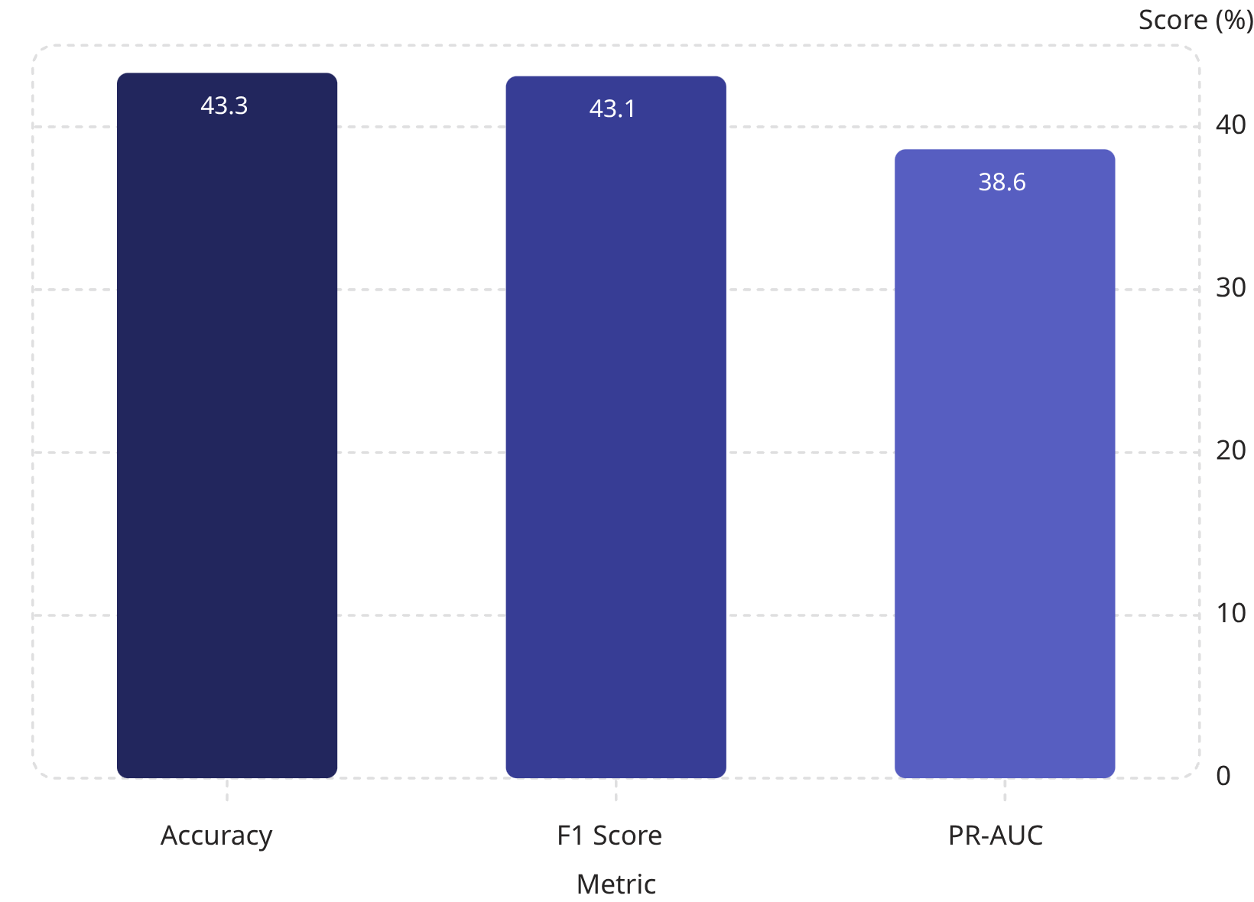
Class Imbalance Handling — SMOTE
Findings
SMOTE did not improve classification performance across any metric.
Synthetic samples may have introduced noise rather than useful signal.
Regularization provided greater benefits than oversampling for this task.

Slide 10
Conclusion & Future Work
Key Conclusions
Pipeline A outperformed Pipeline B — preprocessing order significantly affects performance.
L1 Regularization achieved the best balance between accuracy and feature selection.
Elastic Net performed similarly but did not consistently outperform L1.
SMOTE did not improve classifi

