Slide 1

WorkFusion: One Platform For Every Skill
AI-Powered Hybrid Employment Marketplace
Muhammad Sharjeel bin Riaz (F22-BS-CS-016) | Hamza Shahzad (F22-BS-CS-048) Live Demo: work-fusion2026-client-y2f9.vercel.app

Slide 2

Problem Statement
• Market Fragmentation: Employers are forced to use separate portals (Upwork/Fiverr for online freelancing, Rozee.pk for corporate jobs, and informal word-of-mouth for physical services).
• Broken Recruitment Pipelines: Existing systems lack unified contract-based, structured hiring workflows spanning bidding, scheduling, and milestone releases.
• Opaque & Manual Matching: Standard platforms offer basic keyword filters rather than smart, explainable matching or automated skill gap feedback.
• Invisible Local Labor: Qualified physical service workers (electricians, plumbers) remain digitally isolated with no verified reputation index.
• Absence of Security Interlocks: Crucial communication gates, verified contractor reviews, and escrow milestone guards are completely missing.

Slide 3
Literature Review
Platform | Focus Area | Strengths | Limitations
Upwork | Online Freelance Marketplace | Large user base, structured payment system | Limited enforcement of hiring workflow stages
Fiverr | Service-based freelance platform | Simple gig-based structure | Minimal application lifecycle tracking
Rozee.pk | Online Job Portal (Pakistan) | Job listing & employer database | Basic workflow control, limited status enforcement
WorkFusion (Our Unified Solution): Integrates digital freelancing and localized physical services under a strict, interview-gated hiring pipeline with explainable 7-factor weighted AI recommendations (achieving MAP = 1.00 / MRR = 1.00) and milestone feedback.

Slide 4
Business Scope & Modules
/

Slide 5
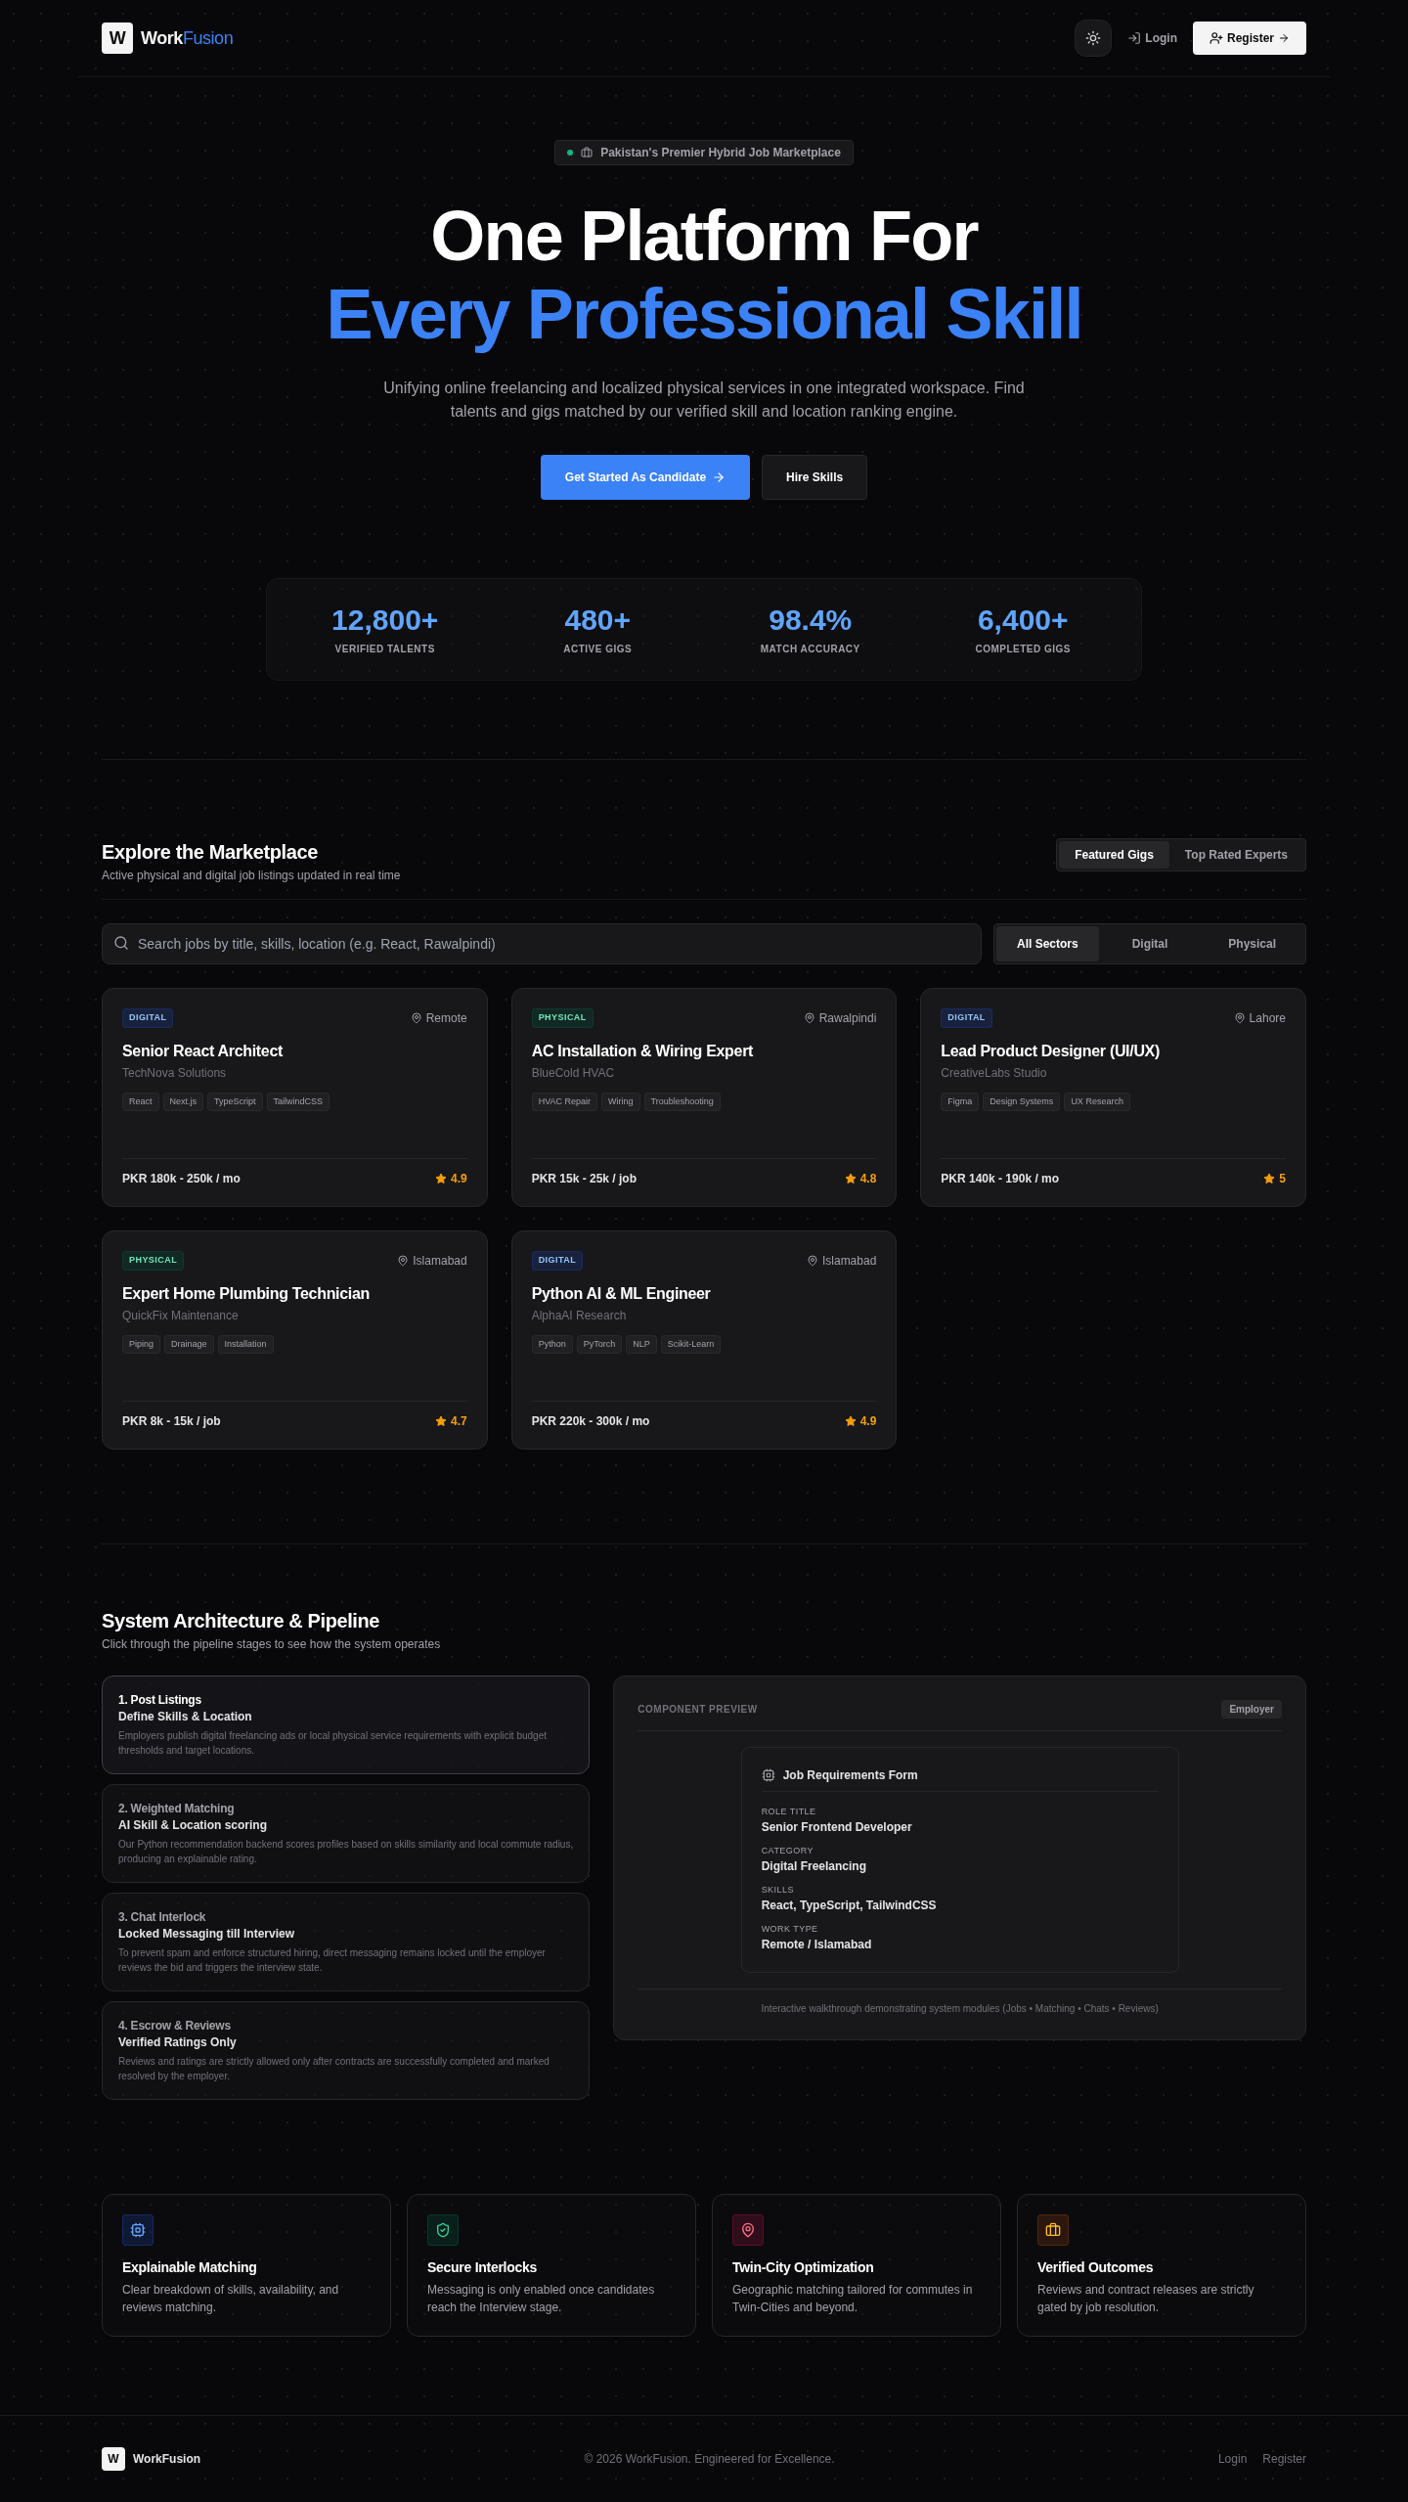
Business Scope & Platform Roles
• Employer Workspace: Publish digital or local physical jobs, evaluate AI candidate rankings with gap analysis, schedule interviews, and rate completed contracts.
• Service Seeker Workspace: Build profiles, receive personalized AI recommendations, apply to local/remote gigs, and chat directly once interviewed.
• Administrative Hub: Manage users, moderate job categories, monitor platform analytics, and suspend/restore accounts safely.
• Twin-City Commute Engine: Matches localized physical service requests based on commute distance and availability.
• Verified Feedback Loops: Reviews and rating releases are strictly locked until a job is marked 'Completed' by the employer.
BSc. Information Engg. Technology
5

Slide 6
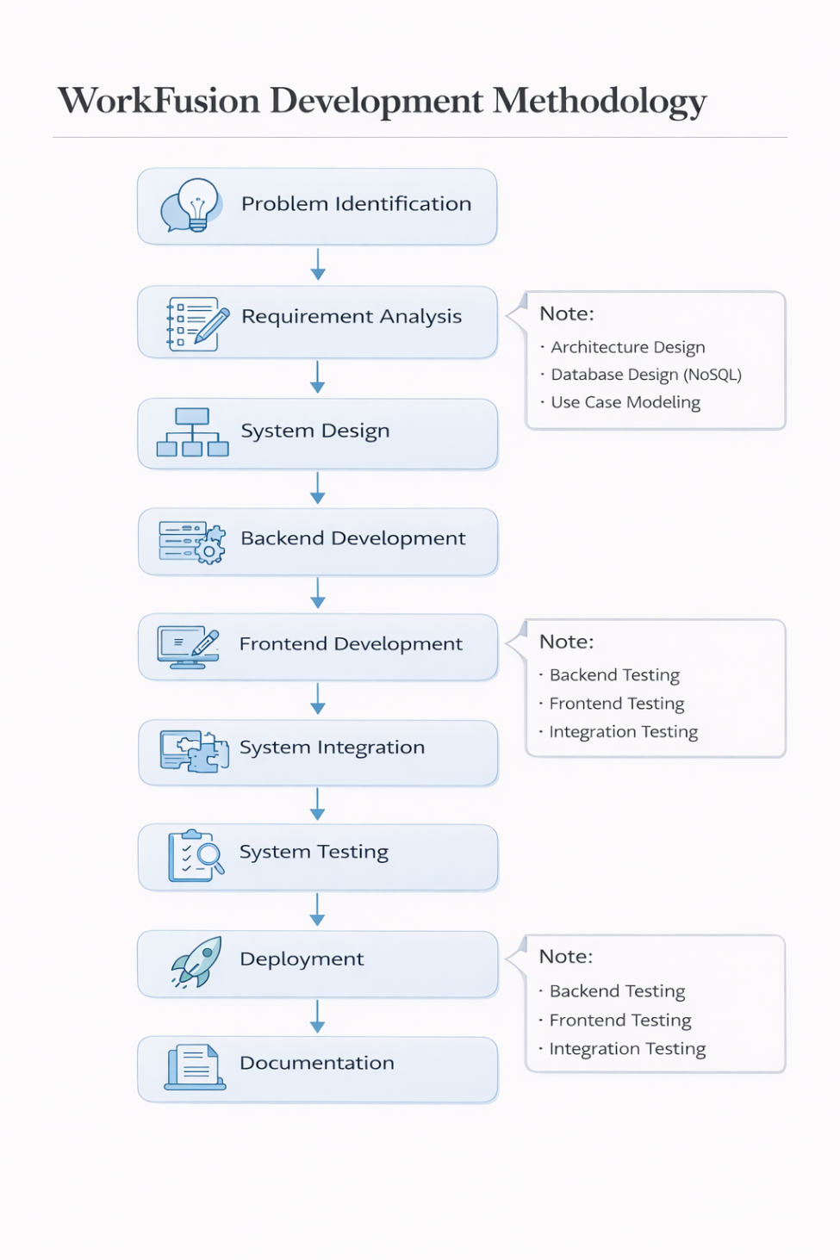
Methodology & Framework

Slide 7
System Architecture & Methodology
• Premium 3-Tier Stack: Next.js frontend, Node.js + Express API backend orchestrator, and stateless Python FastAPI AI matching microservice.
• Strict Architectural Contract: The frontend never communicates directly with MongoDB or the Python service; Node.js manages all transactions.
• Stateless Python Matching: FastAPI service receives clean text profiles via HTTP POST, computes similarities, and returns raw ranking vectors instantly.
• Structured Pipeline Workflow: Standard development lifecycle followed: Requirement Analysis -> Database Design -> API Controllers -> AI Models -> React Frontend -> Integration Testing.
• Production-Grade Security: Implements JWT token authorization with HTTP-only refresh cookies, bcrypt hashing, Helmet protection, and rate limiting.
Presentation Layer (Next.js)
React 18 • TypeScript • TailwindCSS • Framer Motion
Business Logic Layer (Node.js API)
Express.js Orchestrator • Security Middleware • JWT & bcrypt
Database (MongoDB Atlas)
Cloud Document Store • Search Indexes
AI Recommendation (Python)
FastAPI • scikit-learn • TF-IDF Cosine
BSc. Information Engg. Technology
7

Slide 8
Tools & Technology Stack
• Frontend Ecosystem: Next.js 14, React 18, TypeScript, TailwindCSS for responsive layouts, shadcn/ui components, and Framer Motion.
• Backend Orchestration: Node.js, Express.js REST APIs, Mongoose ODM, JSON Web Tokens (JWT), and bcrypt passwords.
• AI & Recommendation: Python 3.10, FastAPI, scikit-learn (for NLP, TF-IDF Vectorizer & Cosine Similarity), Pandas, and NumPy.
• Database & Hosting: Fully managed MongoDB Atlas, Vercel (frontend deployment), and Render (backend and FastAPI hosting).
• Development Tools: Git, npm, Playwright, and environments configured with secure dot-env variables.

Slide 9
Constraints & Limitations
• Simulated Escrow Gateway: Active financial payment gateways (like Stripe/EasyPaisa) are mocked; contract funding is currently simulated.
• Web-Only Platform: Built as a premium responsive web application; native iOS and Android packages are deferred to the future roadmap.
• Twin-Cities Calibration: Location proximity scoring and commute radiuses are primarily tailored for Islamabad and Rawalpindi.
• Communication Interlocks: Live text chat remains locked until the applicant reaches the 'Interview' stage to prevent recruiter spam.
• Stateless Recommendation Service: The Python FastAPI engine does not persist state, recalculating similarity scores dynamically on every request.

Slide 10
Work Breakdown & Timelines
Phase | Activity | Start Date | End Date | Duration (Days) | Responsible
Phase 1 | Literature Review | 01-10-2025 | 05-10-2025 | 5 | Sharjeel & Hamza
 | Requirement Analysis | 06-10-2025 | 10-10-2025 | 5 | Sharjeel & Hamza
 | Scope Definition | 11-10-2025 | 15-10-2025 | 5 | Sharjeel & Hamza
Phase 2 | System Architecture Design | 16-10-2025 | 22-10-2025 | 7 | Sharjeel
 | NoSQL Data Model Design | 23-10-2025 | 05-11-2025 | 14 | Sharjeel
 | User & Role Management | 06-11-2025 | 18-11-2025 | 13 | Sharjeel & Hamza
 | Authentication & Authorization | 19-11-2025 | 30-11-2025 | 12 | Hamza
 | Job Module Implementation | 01-12-2025 | 15-12-2025 | 15 | Hamza
 | Application Module Implementation | 16-12-2025 | 24-12-2025 | 9 | Hamza
Phase 3 | Employer Dashboard | 10-12-2025 | 18-12-2025 | 9 | Sharjeel & Hamza
 | Job Posting Interface | 15-12-2025 | 22-12-2025 | 8 | Sharjeel & Hamza
 | API Integration | 20-12-2025 | 27-12-2025 | 8 | Hamza
Phase 4 | Backend–Frontend Integration | 26-12-2025 | 05-01-2026 | 11 | Hamza
 | Workflow Validation | 06-01-2026 | 10-01-2026 | 5 | Sharjeel
Phase 5 | Stateless AI Matching & NLP | 01-02-2026 | 20-02-2026 | 20 | Sharjeel
 | Admin Panels & Core Analytics | 15-02-2026 | 28-02-2026 | 14 | Hamza
 | Production Cloud Deployment | 01-03-2026 | 15-03-2026 | 15 | Sharjeel & Hamza
 | Comprehensive Quality Assurance | 16-03-2026 | 30-05-2026 | 75 | Sharjeel & Hamza
 | Final Thesis & Presentation | 01-06-2026 | 18-06-2026 | 18 | Sharjeel & Hamza

Slide 11
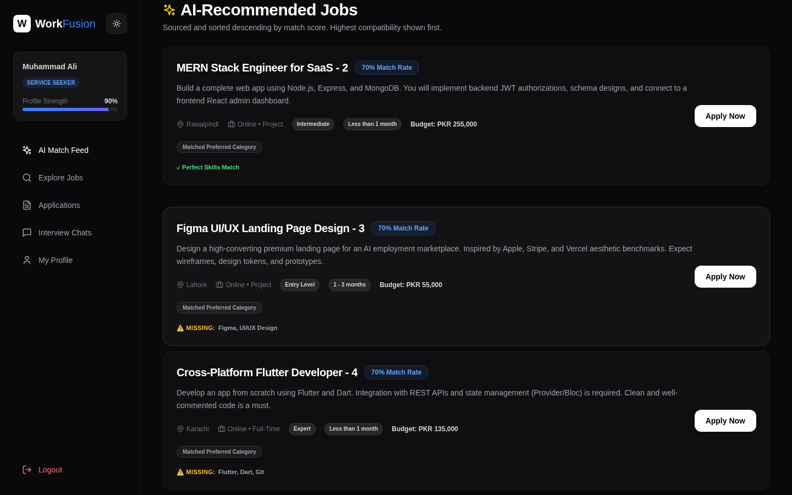
AI Recommendation Engine
• Advanced NLP Cleaners: Normalizes profiles, portfolio summaries, and job descriptions with hyphen preservation.
• TF-IDF Vectorization: Text properties are vectorized into numerical features using scikit-learn's stateless analyzer.
• 7-Factor Weighted Scoring: Scores profiles on skill overlap (cosine similarity), experience, portfolio fit, rating, category preference, availability, and twin-city proximity.
• Skill Gap Analysis: Highlights missing skills (e.g. React, Docker) dynamically with recommendations.
• Explainable AI: Matches include score explanations (e.g., 'React matched, Portfolio matched, Commute inside 5km').
• Evaluation Metrics: Achieved a Mean Average Precision (MAP) of 1.00 and Mean Reciprocal Rank (MRR) of 1.00.
BSc. Information Engg. Technology
11

Slide 12
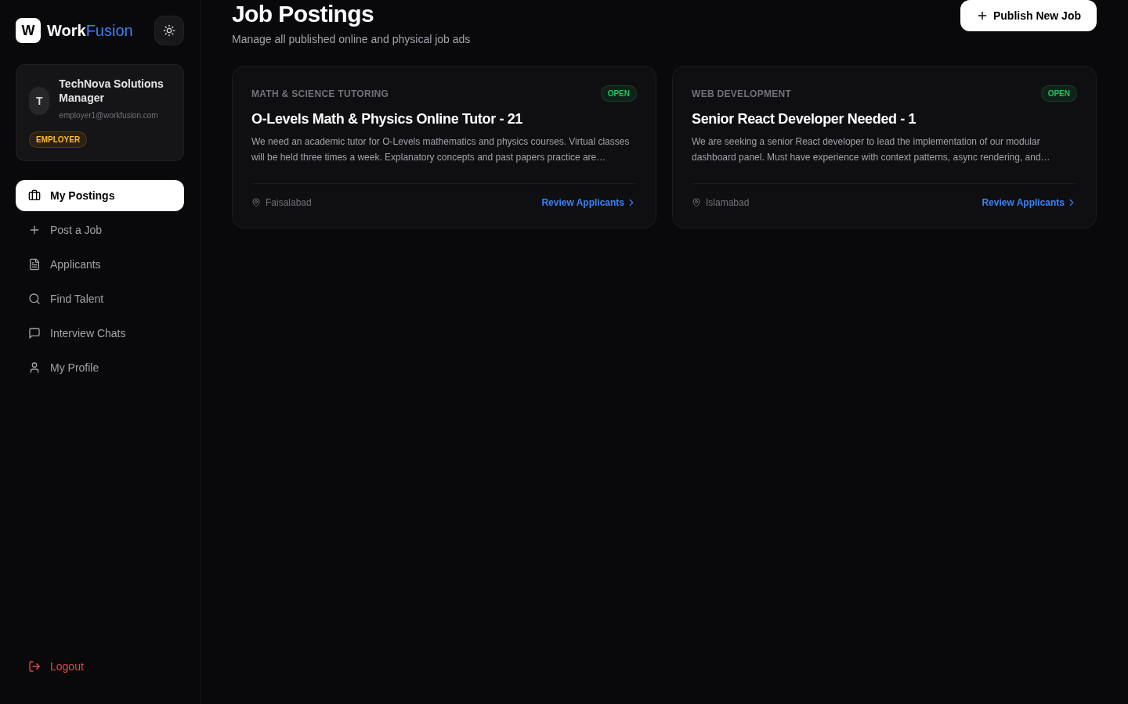
Employer Workspace
• Clean Dashboard: Real-time overview of active jobs, applicant counts, scheduled interviews, and recent platform logs.
• Job Advertising: Create digital freelancing contracts or localized on-site physical service ads with specific skill and budget bounds.
• AI Candidate Ranking: Instantly ranks all job applicants as soon as the employer opens the job applicant details.
• Workflow Status Control: Move candidates from Pending to Reviewed, schedule Interviews, hire, or complete projects.
• Interview Chat Gating: The messaging module is dynamically unlocked ONLY when the candidate reaches the 'Interview' stage.
BSc. Information Engg. Technology
12

Slide 13
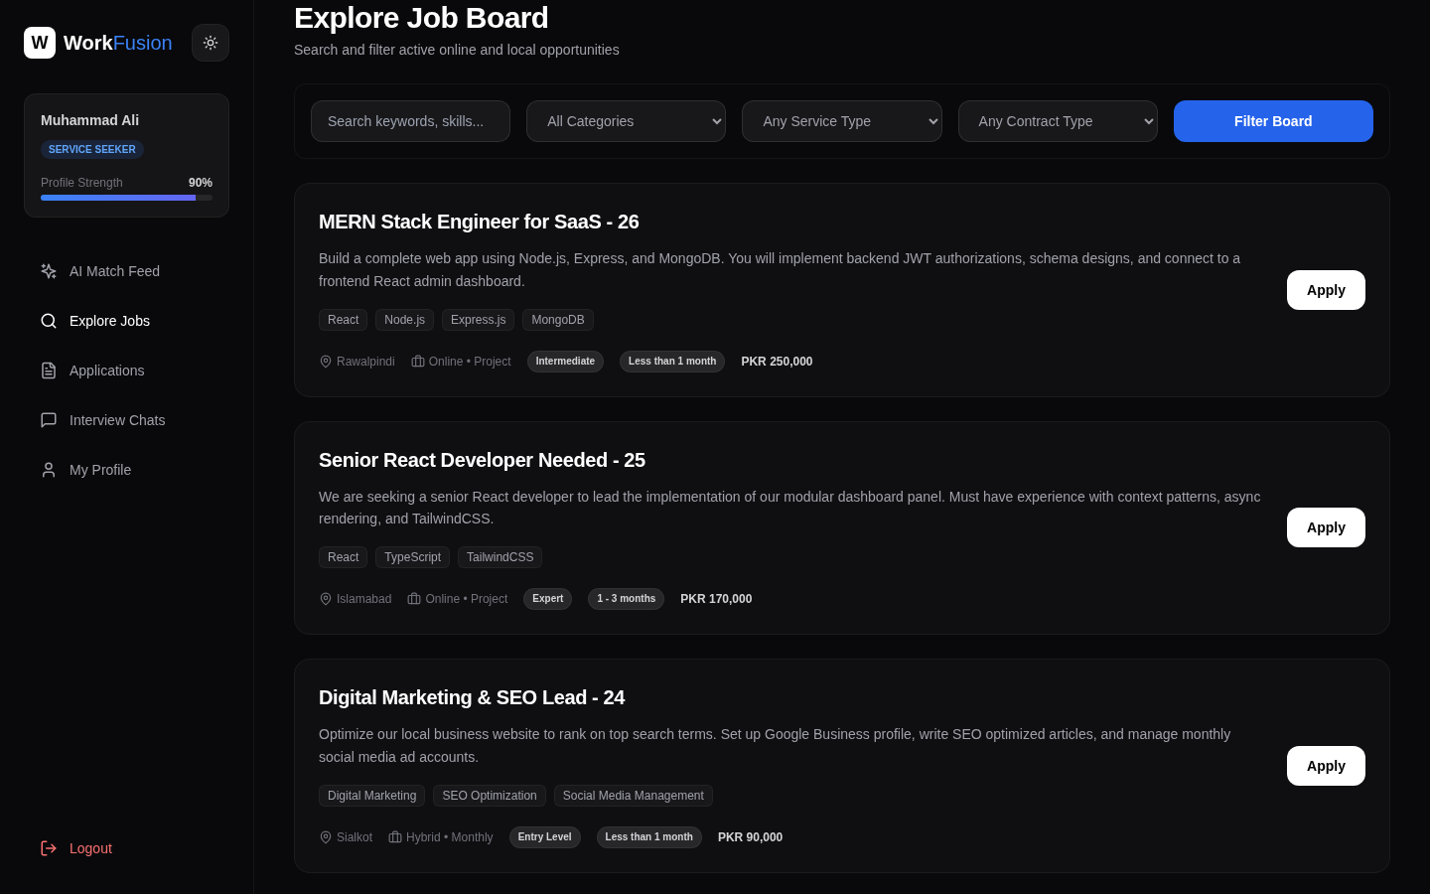
Seeker Workspace
• Intelligent Dashboard: Instant list of top recommended matches complete with score explanations and gap details.
• Advanced Gigs Discovery: Browse active digital/physical listings with filters for category, budget, location, and skills.
• Interactive Timelines: Real-time visual timeline showing current application statuses and feedback progress.
• Direct Communication: Chat in real-time with employers once your application is moved to the 'Interview' stage.
• Profile Strengths Meter: Visual progress tracker displaying overall profile completion and identifying missing details.
BSc. Information Engg. Technology
13

Slide 14
Conclusion & Future Work
• Successful Unification: Developed Pakistan's premier hybrid marketplace combining online digital freelancing and local physical task outsourcing.
• Validated Recommendation Model: Created an explainable weighted AI recommendations microservice achieving high evaluation accuracy (MAP = 1.00, MRR = 1.00).
• Anti-Spam Gating: Enforced robust hiring workflow interlocks, ensuring chat remains closed until interviews and reviews gate completed projects.
• Startup-Grade Aesthetics: Crafted a highly responsive, modern interface inspired by Stripe, Vercel, and Apple guidelines.
• Future Horizon: Highly modular architecture prepared for real-time payment gateways, voice-interview rooms, and mobile Progressive Web Apps (PWA).

Slide 15
References
• [1] Sommerville, Software Engineering, 10th ed., Pearson Education, 2016.
• [2] MongoDB Inc., MongoDB Manual. Available: https://www.mongodb.com/docs/ (Accessed Jan. 2026).
• [3] Node.js Foundation, Node.js Documentation. Available: https://nodejs.org/docs/ (Accessed Jan. 2026).
• [4] OpenJS Foundation, Express.js API Reference. Available: https://expressjs.com/ (Accessed Jan. 2026).
• [5] Meta Platforms Inc., React: A JavaScript Library. Available: https://react.dev/ (Accessed Jan. 2026).
• [6] Vercel Inc., Next.js Documentation. Available: https://nextjs.org/docs (Accessed Jan. 2026).
• [7] FastAPI, FastAPI Web Framework. Available: https://fastapi.tiangolo.com/ (Accessed Jan. 2026).
• [8] scikit-learn, Machine Learning Library. Available: https://scikit-learn.org/ (Accessed Jan. 2026).

Slide 16
Any Questions?
• Live Production Website: https://work-fusion2026-client-y2f9.vercel.app/
• Employer Credentials: employer1@workfusion.com (Password: password123)
• Candidate Credentials: seeker1@workfusion.com (Password: password123)
• Project Engineers: Muhammad Sharjeel bin Riaz & Hamza Shahzad
• Platform Tagline: One Platform For Every Skill

