Slide 1

WorkFusion: A Hybrid Marketplace for Online Freelancing and Physical Service Hiring
Muhammad Sharjeel bin riaz (f22-bs-cs-016)
Hamza Shahzad (f22-bs-cs-048)

Slide 2

Problem Statement
Lack of a structured hybrid service platform integrating both online and physical service-based job opportunities within a single system
Existing platforms primarily focus on either remote freelance work or traditional job listings, but not both
Absence of a unified workflow-driven solution supporting short-term, part-time, and contract-based roles across digital and physical domains
Limited organized platforms for students and job seekers seeking flexible earning opportunities such as one-day tasks or part-time shifts
Need for a controlled and structured recruitment environment that supports hybrid service-based hiring

Slide 3
Literature Review
Platform | Focus Area | Strengths | Limitations
Upwork | Online Freelance Marketplace | Large user base, structured payment system | Limited enforcement of hiring workflow stages
Fiverr | Service-based freelance platform | Simple gig-based structure | Minimal application lifecycle tracking
Rozee.pk | Online Job Portal (Pakistan) | Job listing & employer database | Basic workflow control, limited status enforcement

Slide 4
Business Scope
/
The WorkFusion platform is designed to support organizations that require a structured and controlled hiring workflow. This includes startups, small businesses, local enterprises such as restaurants or retail stores, and organizations managing full-time, part-time, or contract-based recruitment. The system enables centralized job posting, application tracking, and clearly defined hiring stages within a single platform.
The platform focuses specifically on enforcing role-based access and structured application lifecycle management. It is intended for environments where organized recruitment processes are required, ensuring transparency, workflow control, and proper separation of responsibilities between employers, job seekers, and administrators.

Slide 5
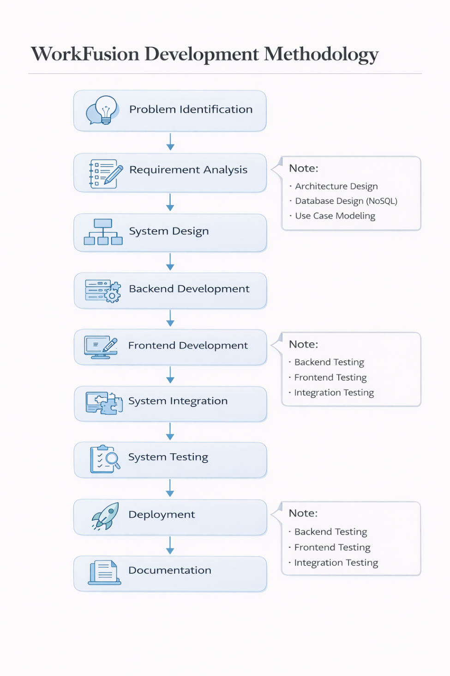
Methodology/Framework

Slide 6
Tools and Languages
Frontend Development
React.js
HTML5
CSS3
JavaScript
Backend Development
Node.js
Express.js
Database
MongoDB (NoSQL Document Database)
Development & Design Tools
Visual Studio Code
Postman (API Testing)
Git (Version Control)
PlantUML / Draw.io (System Modeling)

Slide 7
Constraints and Limitation
Hiring lifecycle is predefined and not fully customizable
Role structure is limited to employer, job seeker, and admin
Basic recommendation logic (no machine learning implementation)
Performance optimization for large-scale traffic was not evaluated
Security implementation is basic
Deployment intended for demonstration and academic validation

Slide 8
Work breakdown with timelines
Phase | Activity | Start Date | End Date | Duration (Days) | Responsible
Phase 1 | Literature Review | 01-10-2025 | 05-10-2025 | 5 | Sharjeel & Hamza
 | Requirement Analysis | 06-10-2025 | 10-10-2025 | 5 | Sharjeel & Hamza
 | Scope Definition | 11-10-2025 | 15-10-2025 | 5 | Sharjeel & Hamza
Phase 2 | System Architecture Design | 16-10-2025 | 22-10-2025 | 7 | Sharjeel
 | NoSQL Data Model Design | 23-10-2025 | 05-11-2025 | 14 | Sharjeel
 | User & Role Management | 06-11-2025 | 18-11-2025 | 13 | Sharjeel & Hamza
 | Authentication & Authorization | 19-11-2025 | 30-11-2025 | 12 | Hamza
 | Job Module Implementation | 01-12-2025 | 15-12-2025 | 15 | Hamza
 | Application Module Implementation | 16-12-2025 | 24-12-2025 | 9 | Hamza
Phase 3 | Employer Dashboard | 10-12-2025 | 18-12-2025 | 9 | Sharjeel & Hamza
 | Job Posting Interface | 15-12-2025 | 22-12-2025 | 8 | Sharjeel & Hamza
 | API Integration | 20-12-2025 | 27-12-2025 | 8 | Hamza
Phase 4 | Backend–Frontend Integration | 26-12-2025 | 05-01-2026 | 11 | Hamza
 | Workflow Validation | 06-01-2026 | 10-01-2026 | 5 | Sharjeel
Phase 5 | Backend Testing | 05-01-2026 | 12-01-2026 | 8 | Sharjeel
 | Frontend Testing | 08-01-2026 | 15-01-2026 | 8 | Sharjeel
 | Integration Testing | 12-01-2026 | 18-01-2026 | 7 | Hamza
 | Documentation Writing | 05-01-2026 | 25-01-2026 | 21 | Sharjeel
 | Final Submission | 31-01-2026 | 31-01-2026 | 1 | Sharjeel & Hamza

Slide 9
Conclusion
The proposed WorkFusion system achieves structured recruitment workflow management
The system enforces controlled application lifecycle transitions
Role-based access control ensures functional separation of users
Modular architecture supports maintainability and scalability
Implementation validates the feasibility of controlled hiring platforms

Slide 10
References
[1] Sommerville, Software Engineering, 10th ed., Pearson Education, 2016.
[2] MongoDB Inc., MongoDB Manual. Available: https://www.mongodb.com/docs/,Accessed: Jan. 2026.
[3] Node.js Foundation, Node.js Documentation. Available:https://nodejs.org/en/docs/, Accessed: Jan. 2026.
[4] OpenJS Foundation, Express.js Documentation. Available: https://expressjs.com/,Accessed: Jan. 2026.
[5] Meta Platforms Inc., React: A JavaScript Library for Building User Interfaces.Available: https://react.dev/, Accessed: Jan. 2026.
[6] R. T. Fielding, “Architectural styles and the design of network-based software ar-chitectures,” Ph.D. dissertation, Univ. of California, Irvine, 2000.

Slide 11
Any Questions?

