Slide 1
CONTENT MARKETING FOR LEAD GENERATION

Slide 2


Kevin Gold (kevin@nextleapstrategy.com)
Digital marketing since 1999
Recently, VP Marketing & Content for iNET Interactive
INC 5000 seven-consecutive years
Fast 55 six-consecutive years
Acquired by Penton Media in January 2015
Started Next Leap Strategy in 2016
Inbound marketing to help B2B companies generate more sales

Slide 3
DEFINITION
“Content marketing is the marketing and business process for creating and distributing relevant and valuable content to attract, acquire, and engage a clearly defined and understood target audience – with the objective of driving profitable customer action.”
[Content Marketing Institute]
Notes:
Today I am going to focus on one aspect of a solid B2B marketing strategy – to me a foundational aspect though that’s critical to everything else you can do. It’s content – or content marketing. What is content marketing? {read definition] - sounds simple “produce content, people will read it and buy, right?” Not so much. It is far more complicated than that because there is a TON of content. In the next 45 minutes I am going to do my best to hit the main point of a successful content marketing strategy. Unfortunately I can’t get super detailed in this amount of time. But my promise to you is that you’ll walk-away with enough tips, tricks and ideas to change course in how you may be approaching content marketing or plan to approach it in the future. Let’s get started.

Slide 4
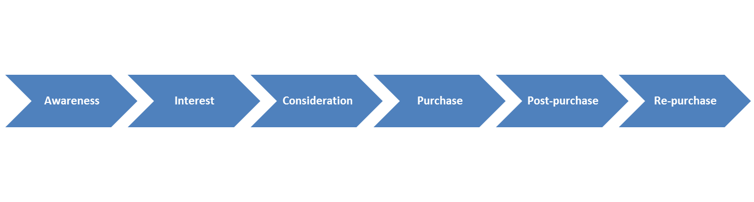
WHY CONTENT MARKETING
B2B BUYING PROCESS
Content fuels every aspect of your marketing strategy
67% of B2B buyers base their buying decisions on content.
Notes:
Content is King – it drives every aspect of digital marketing

Slide 5
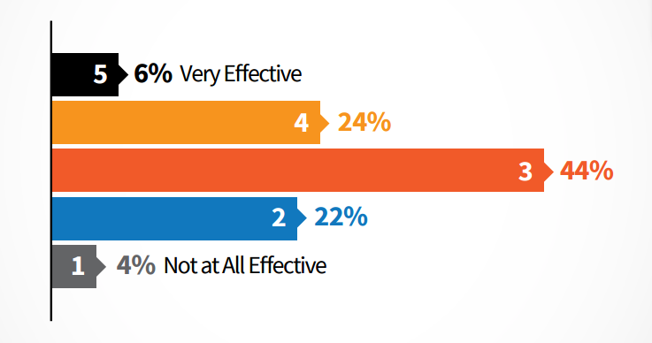
CONTENT CHALLENGE
80% of B2B marketers have a content marketing strategy.
48% (overall) do not have a written plan.
In 99% of cases, this means that they really have no clue what they’re doing.
SOURCE: Content Marketing Institute

Slide 6
BUSINESS PROCESS
Define Objective
Define Audience
Define Strategy
Map Audience to Content
TEST, MEASURE, REPEAT
Optimize to Objective
Produce Content, Publish & Amplify
Develop Editorial Plan
Implement Infrastructure and Tracking

Slide 7
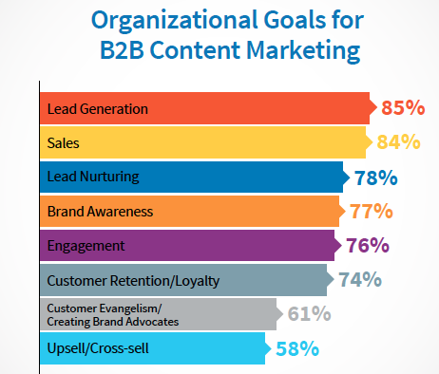
DEFINE YOUR OBJECTIVE
Thought Leadership
Prospecting
Community
Marketing
Sales
Customer Support
Public Relations
SOURCE: www.business2community.com
Notes:
Prospecting . Generate leads for follow-up by sales and marketing teams.
Sales. Help your sales team close sales more quickly.
Marketing. Generate interest in your products.
PR. Build and repair public opinion about your brand and products.
Community. Develop friends and fans who interact with your brand socially.
Customer support. Help customers get the most from your products.
Thought leadership. Develop name recognition and respect, and to influence your industry

Slide 8
SiriusDecisions stated…
“biggest challenge to creating content is a lack of buyer understanding”
Notes:
Here are the three types of queries, with examples from Moz.
Navigational Queries: [alaska airlines]
Informational Queries: [actor who played wash from firefly]
Transactional Queries: [greek restaurant in flemington, nj]
and only 23% of B2B marketers have adopted a persona-centric focus for their content.” In addition, they found “irrelevance is the number one reason why content is not read by buyers, with 29% of respondents mentioning this as their top challenge.”

Slide 9
DEFINING AUDIENCE
Quick questions to frame your audience up…
Who are they?
What are they struggling with or striving towards?
Where do they look to find solutions?
How will you solve their problems or satisfy their aspirations better than anyone or anything else?

Slide 10
PERSONA RESEARCH
SURVEYS (SurveyMonkey or Quiz & Survey Master)
CUSTOMER & LOST DEAL INTERVIEWS
LINKEDIN PROFILE ANALYSIS
FORUM (REDDIT, LINKEDIN GROUPS)
Makemypersona.com [HUBSPOT FREE TOOL]
Personapp.io [REQUIRES A SIGN-UP]
Upcloseandpersona.com [FREE TOOL]
Xtensio.com/user-persona [FREE TOOL]
Talking to your sales and support teams

Slide 11
PERSONA DEVELOPMENT
DEMOGRAPHICS
PSYCHOGRAPHICS
PAINS/GOALS/JOBS
Location
Education
Income
Occupation
Ethnicity
Personality
Attitudes
Values
Hobbies
Lifestyle
Jobs Performed
Functional
Social
Personal/emotional
Supporting
Pains
Undesired outcomes
Obstacles
Risks
Gains
Required
Expected
Desired
Unexpected
SOURCE: Value Proposition Design; Strategyzer
Notes:
LIST THE DEMOGRAPHICS OF YOUR IDEAL READER. A g e L ocation G ender I ncom e l evel E ducation l evel M arital or f am il y status O ccup ation E thnic back g round 2/
LIST THE PSYCHOGRAPHICS (VALUES AND MORAL CODE) OF YOUR IDEAL READER. P ersonal ity A ttitudes V al ues I nterests/ hobbies L if estyl es B ehavior 3/ GIVE HIM OR HER A NAME. 4/ IF YOU CAN, FIND A PICTURE.

Slide 12
DEFINE YOUR STRATEGY
social
blog
subscribe
social
Guest post
download
nurture
Define how your content will flow to achieve your objectives

Slide 13
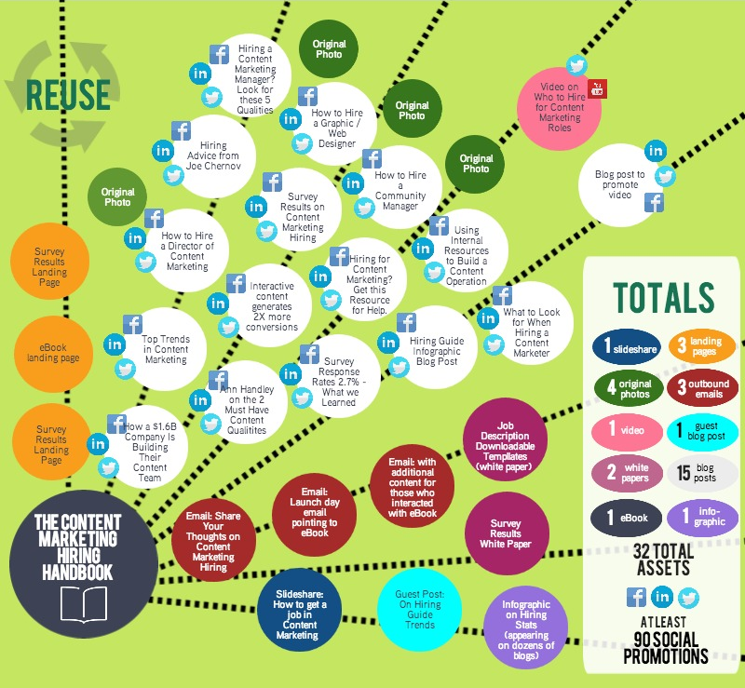
REPURPOSE & REUSE
Develop a major content asset and break it down into multiple content parts to tell an integrated story using varying formats around a key audience theme.
Use tools like: www.draw.io
IMAGE SOURCE: Marketer.Kapost.com

Slide 14
MAP AUDIENCE TO CONTENT
Your BUYER
Your FUNNEL
Your EFFORTS
REALIZES PAIN
Focus on PROBLEMS
Industry-focused content
AWARENESS
SEEKS TO RELIEVE
INTEREST
Focus on SOULTIONS
Help educate & evaluate
INVESTIGATES OPTIONS
CONSIDERATION
Focus on FIT
Illuminate your product
COMMITS TO SOLUTION
PURCHASE
Focus on VALIDATION
Simple and easy to close
VALIDATES DECISION
RE-PURCHASE
Focus on DELIGHT
Support & educate more

Slide 15
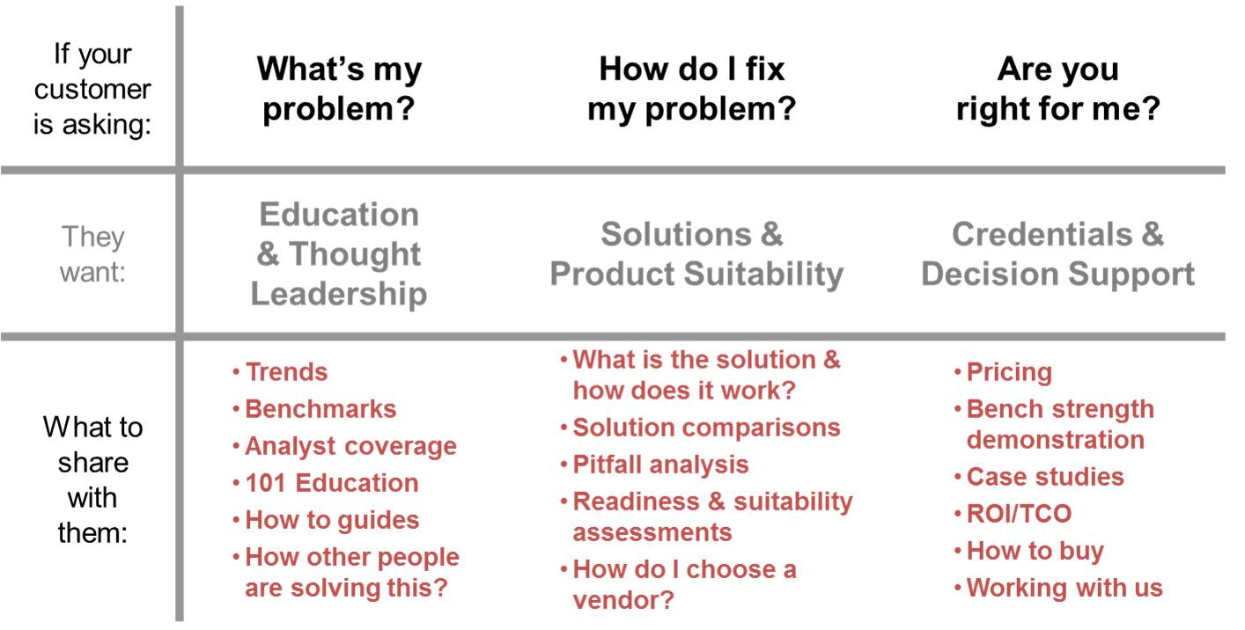
FRAMING CONTENT IDEAS
Source: Google Images

Slide 16
DESIGN INFRASTRUCTURE
Channels
Landing Page
Content download
Nurturing work flow
Landing page
Content download
Website
Landing Pages
Offers
Automation
Email marketing
Phone calls
Tracking

Slide 17
INFRASTRUCTURE TOOLS
LeadPages (leadpages.com)
Thrive (thrivethemes.com)
Unbounce (unbounce.com)
Optimizepress (optimizepress.com
Matic (Open Source: mautic.org)
Landing page builders
MailChimp (mailchimp.com)
DRIP (drip.co)
Ontraport
InfusionSoft
Hubspot
Salesforce
Marketing Automation & CRM

Slide 18
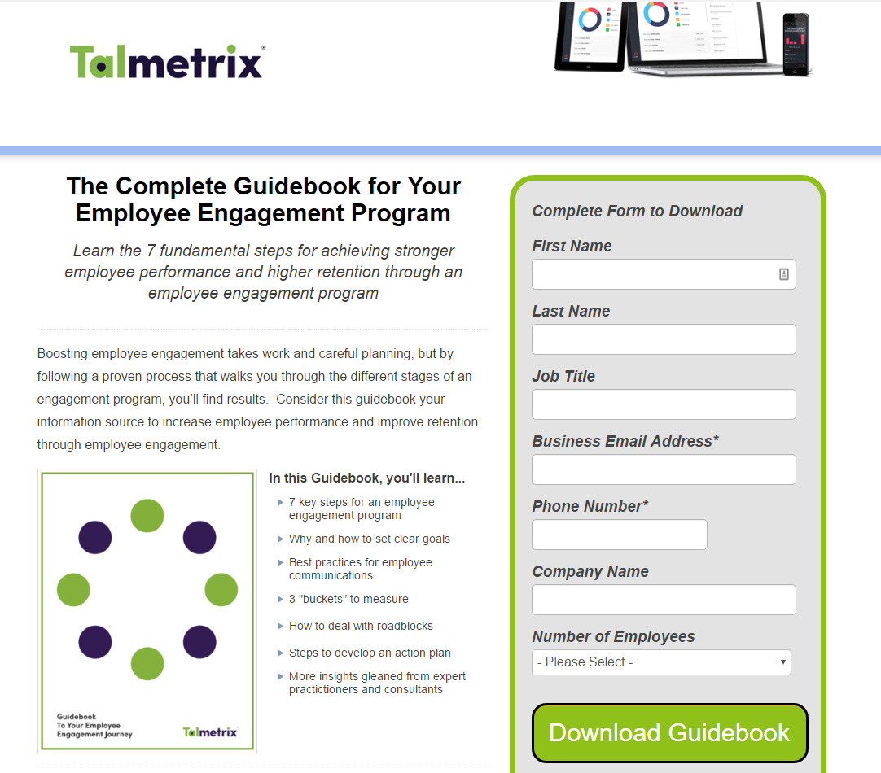
LANDING PAGE EXAMPLE
No Navigation
Strong headline
Benefit-focused copy
Bullet points
Image
Form with CTA

Slide 19
CONTACT FORMS
Form Builder Plugins
WPForms
Ninja forms
Gravity Forms
Contact Form 7

Slide 20
TRACKING
“CANNOT MANAGE WHAT YOU DON’T MEASURE”
METHODS:
Google analytics UTM tracking and conversions
Hubspot tracking
URL shorteners (ow.ly or bit.ly)

Slide 21
DEVELOP EDITORIAL PLAN
WORDPRESS PLUGINS:
Edit Flow (free)
Editorial Calendar (free)
CoSchedule (paid)
OTHER:
Excel or Google Docs

Slide 22
CONTENT CRITERIA
Align with your brand message and values
Enhance your credibility
Build audience trust
Differentiate from your competitors
Deliver against your objective
Be consistent and persistent

Slide 23
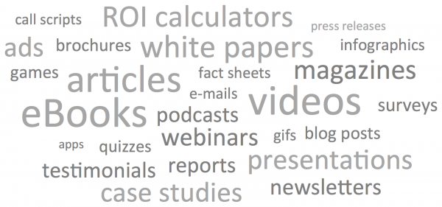
PRODUCING CONTENT
SOURCE: kevinrcain.com

Slide 24
David Ogilvy stated…
“On the average, five times as many people read the headline as read the body copy. When you have written your headline, you have spent eighty cents out of your dollar. ”

Slide 25
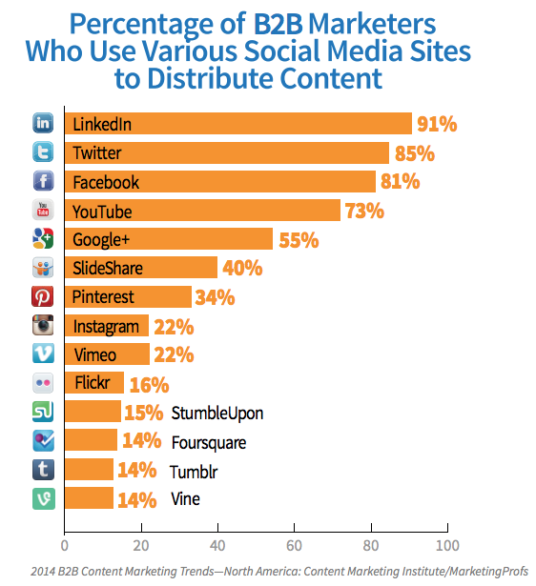
AMPLIFY
Social Media
Outreach & Influencer
Content Platforms: (Outbrain, Taboola)
YouTube, Vimeo
Webinarjam

Slide 26





OPTIMIZE TO OBJECTIVE
Lead Generation Plugins:
Optin Monster
Sumome
Hellobar
Optimizely
Visual Website Optimizer

Slide 27
TAKE-AWAYS
Develop a Business Process (starts with “why”)
Content is an expense until it converts to value
Repurpose and Reuse
Know Your Audience
Consistency (it’s hard work – be persistent)
Test, Measure, Repeat

Slide 28
Thank you!
Interested in learning more?
Check out the Customer Acquisition Accelerator boot camp starting January 2017. Learn more by visiting www.FindYourNextCustomers.com.
Next Leap Strategy – 513.601.8893

