Slide 1
TB
DATA SCIENCE • PREDICTIVE MODELING
Predicting Recipe Site Traffic
for Tasty Bytes
A data-driven approach to maximizing homepage traffic & premium subscriptions
Presented by Muhammad Taha
Tasty Bytes | Recipe Traffic Prediction
1

Slide 2
THE BUSINESS PROBLEM
The Cost of Guesswork
Featuring a popular recipe on the homepage boosts overall traffic by up to 40%.
Higher traffic directly translates into more premium subscriptions.
Currently, recipes are selected based on the Product Manager's personal intuition.
The Issue: Intuition is inconsistent, featuring a “flop” recipe leaves significant revenue on the table.
Popular Recipe
Featured
→
+40%
Traffic Boost
→
More Premium
Subscriptions
Tasty Bytes | Recipe Traffic Prediction
2

Slide 3
OUR OBJECTIVE
Moving to Data-Driven Decisions
Goal
Build a machine learning model to predict which recipes will generate high traffic.
THE REQUIREMENT
80%
Target Metric
Precision: the share of recommended recipes that are true high-traffic winners.
Why Precision?
minimum precision on every recipe
we recommend for the homepage
A false positive (recommending a bad recipe) is costly. Fewer, highly confident recommendations beat many risky ones.
Set by the Product Manager as the
minimum bar for a “win.”
Tasty Bytes | Recipe Traffic Prediction
3

Slide 4
DATA OVERVIEW & PREPARATION
Preparing Data for Success
900
Recipes Analyzed
✓
Categories Consolidated
!
Anomalies Handled
Dataset includes recipe category and detailed nutritional data for each entry.
Merged overlapping categories e.g. combining “Chicken Breast” into “Chicken.”
Capped extreme nutritional outliers (e.g. impossible calorie counts) to keep analysis accurate.
BEFORE → AFTER
Field | Raw Value | Cleaned Value
category | “Chicken Breast” | “Chicken”
calories | 38,000 kcal (outlier) | Capped to realistic max
Tasty Bytes | Recipe Traffic Prediction
4

Slide 5
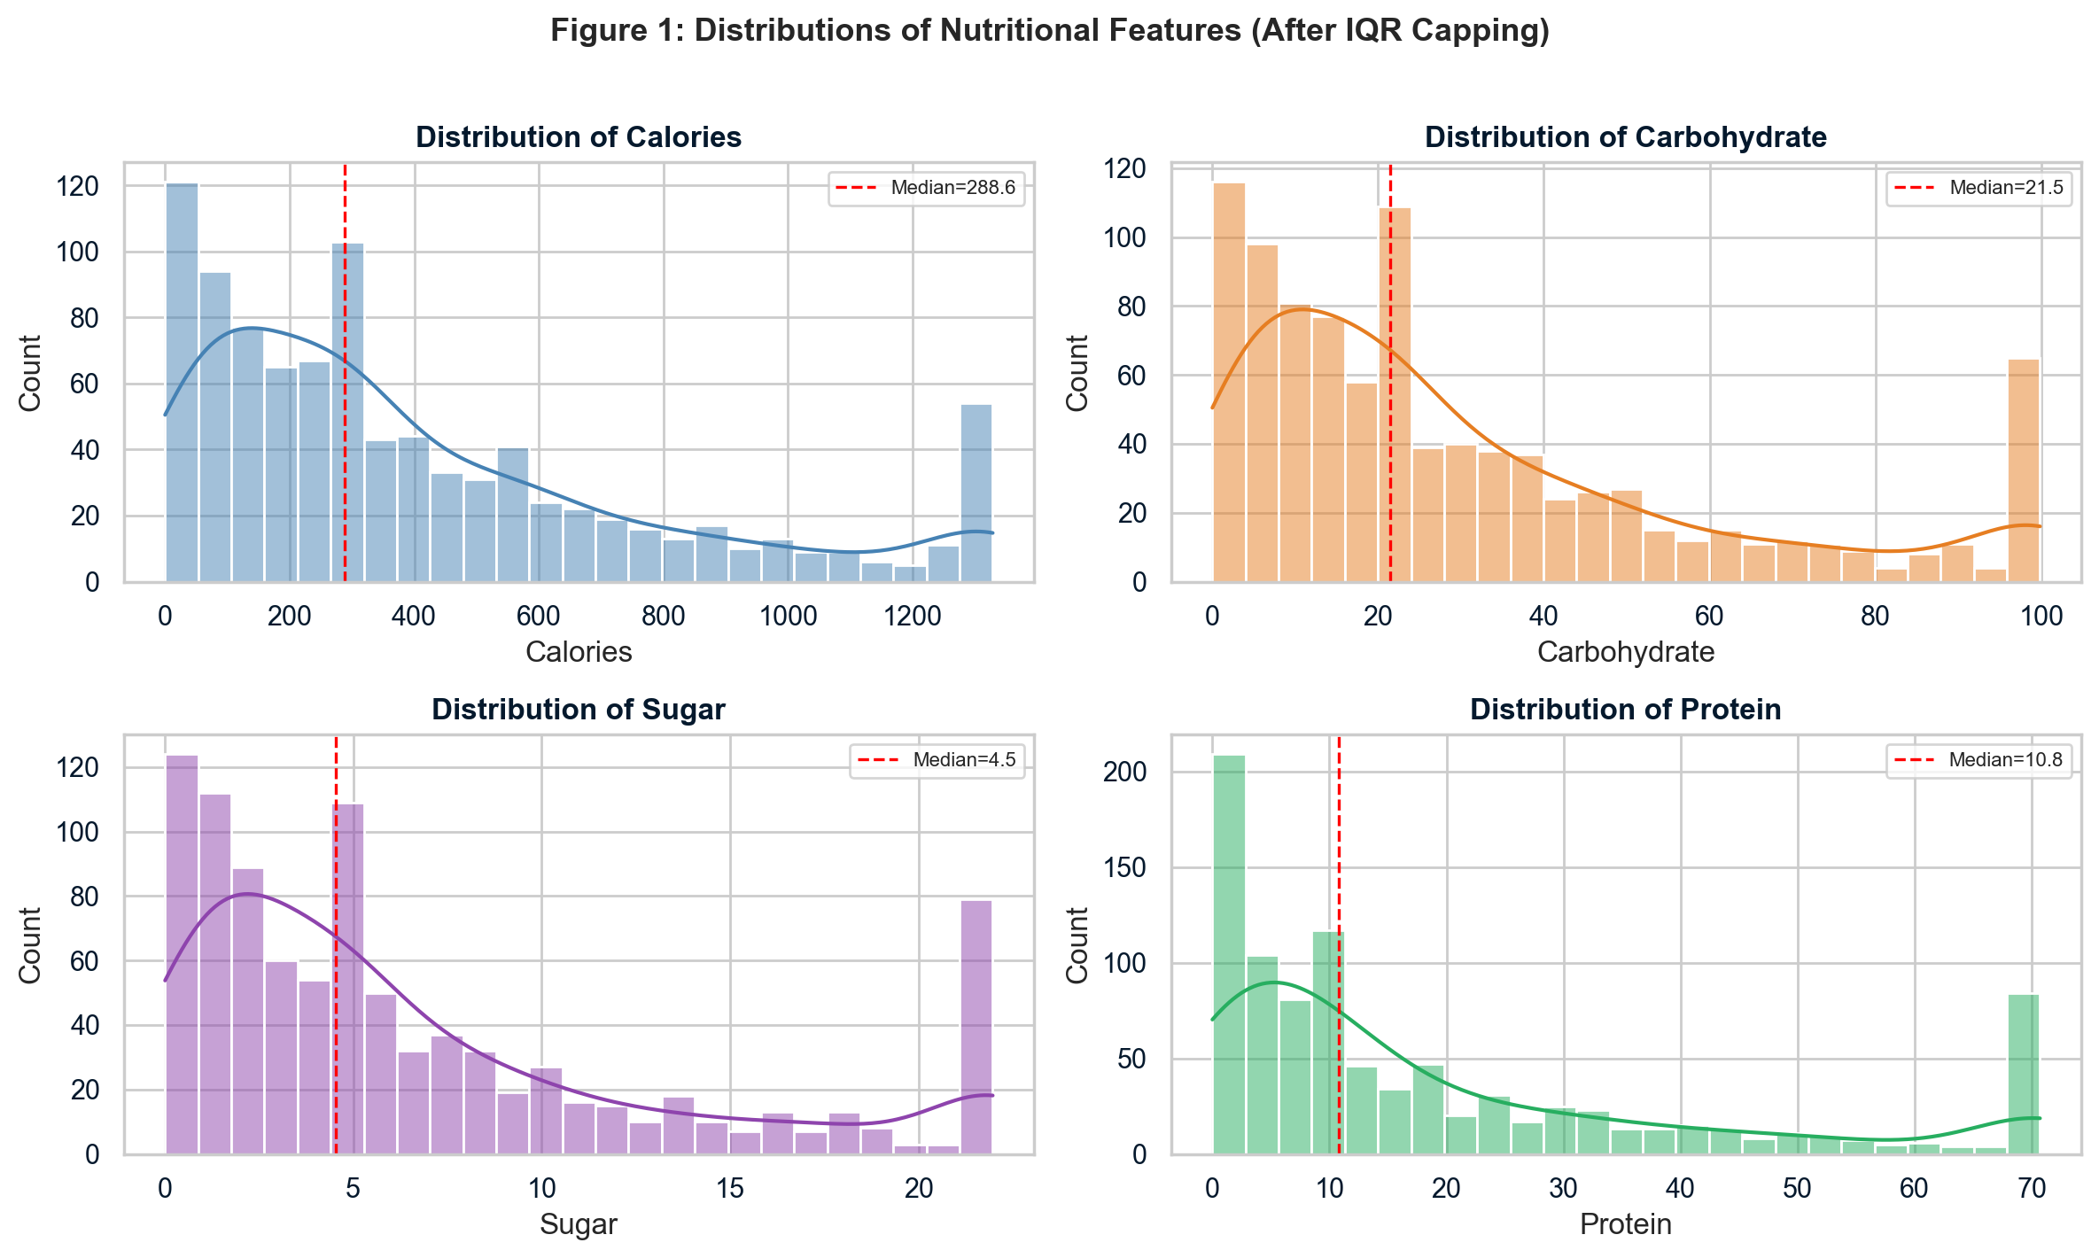
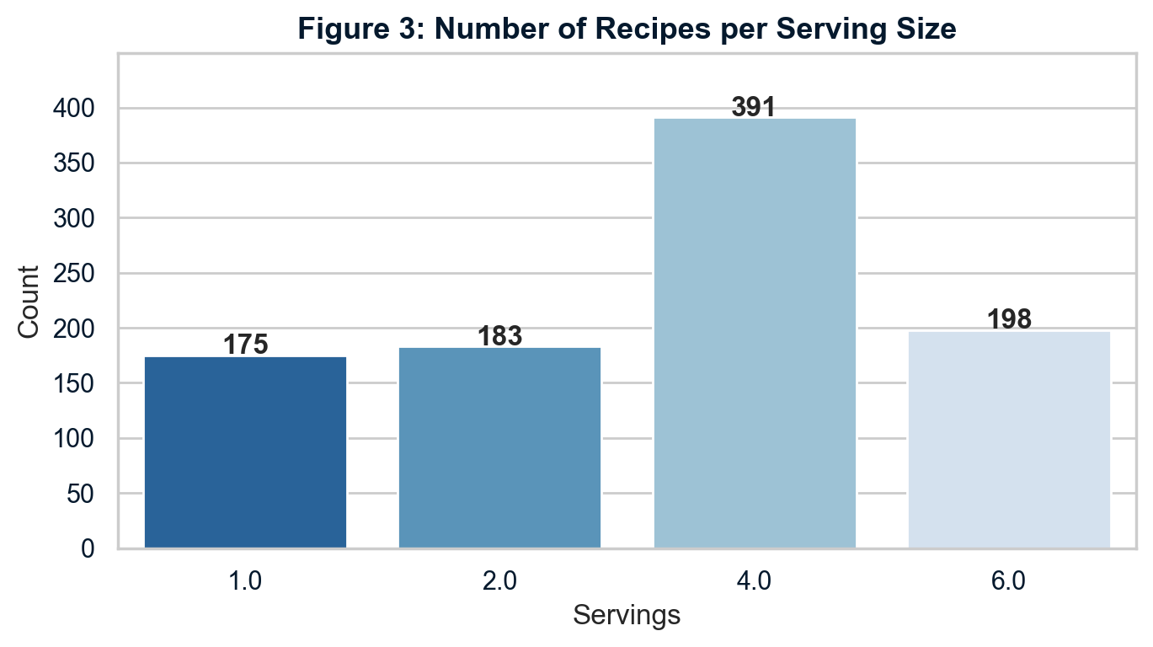
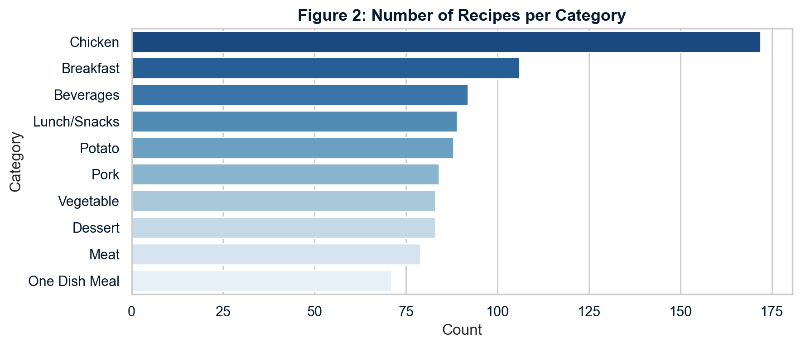
DATA OVERVIEW & PREPARATION
The Dataset at a Glance
Nearly 900 recipes span ten categories and four serving
sizes, giving the model a broad, realistic base to learn from.
Tasty Bytes | Recipe Traffic Prediction
5

Slide 6
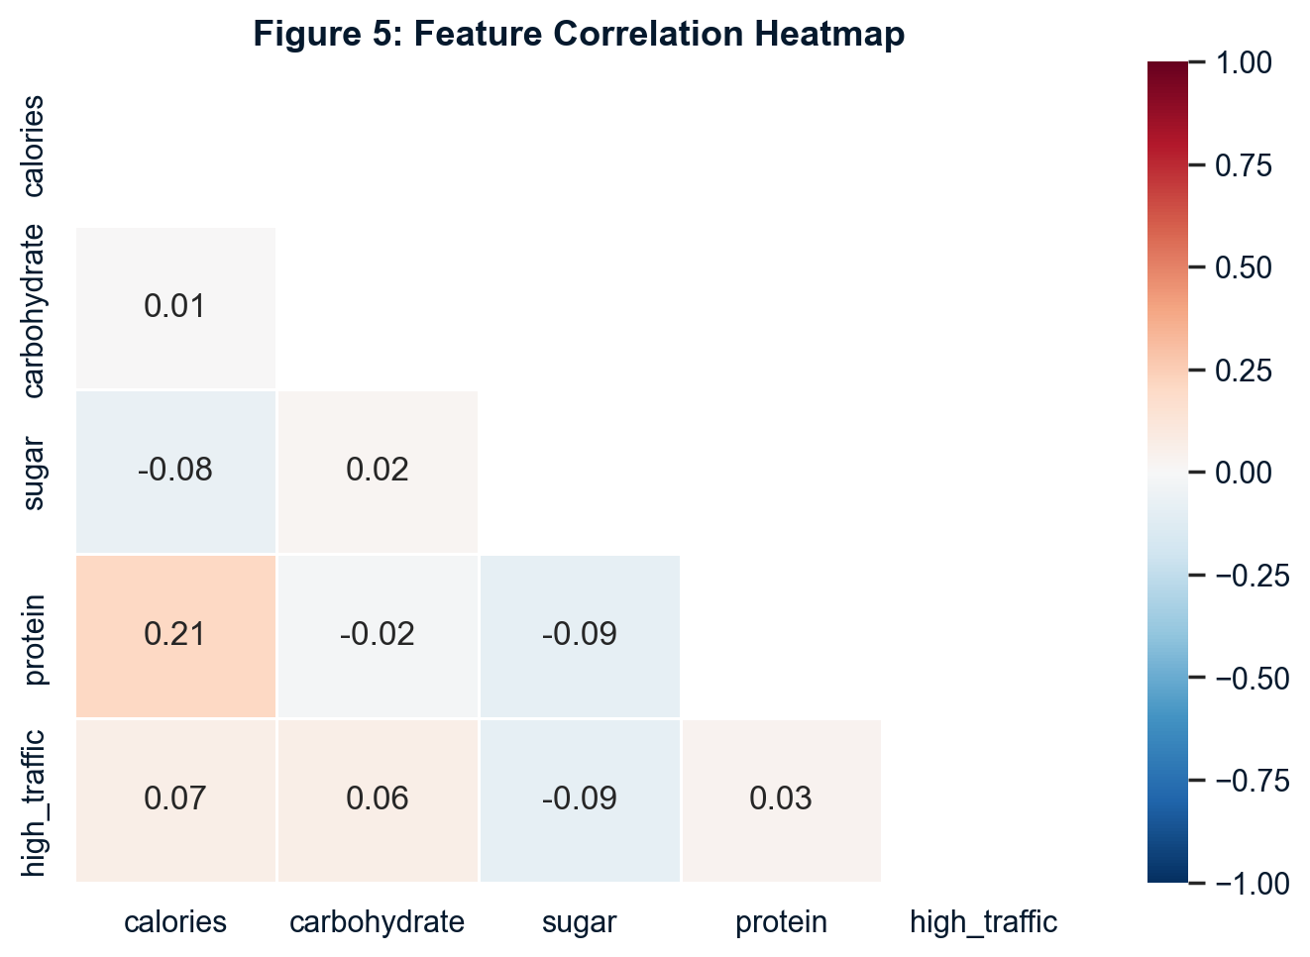
INSIGHT 1
Does Nutrition Drive Traffic?
We hypothesized that healthy (low calorie/sugar) or high-protein meals might drive more traffic.
The Reality: nutritional values show near-zero correlation with high traffic.
Whether a recipe is high or low in calories, protein, or sugar does not predict whether users will click it.
Takeaway: Nutrition data alone won’t tell us which recipes will succeed, we need a stronger signal.
Tasty Bytes | Recipe Traffic Prediction
6

Slide 7
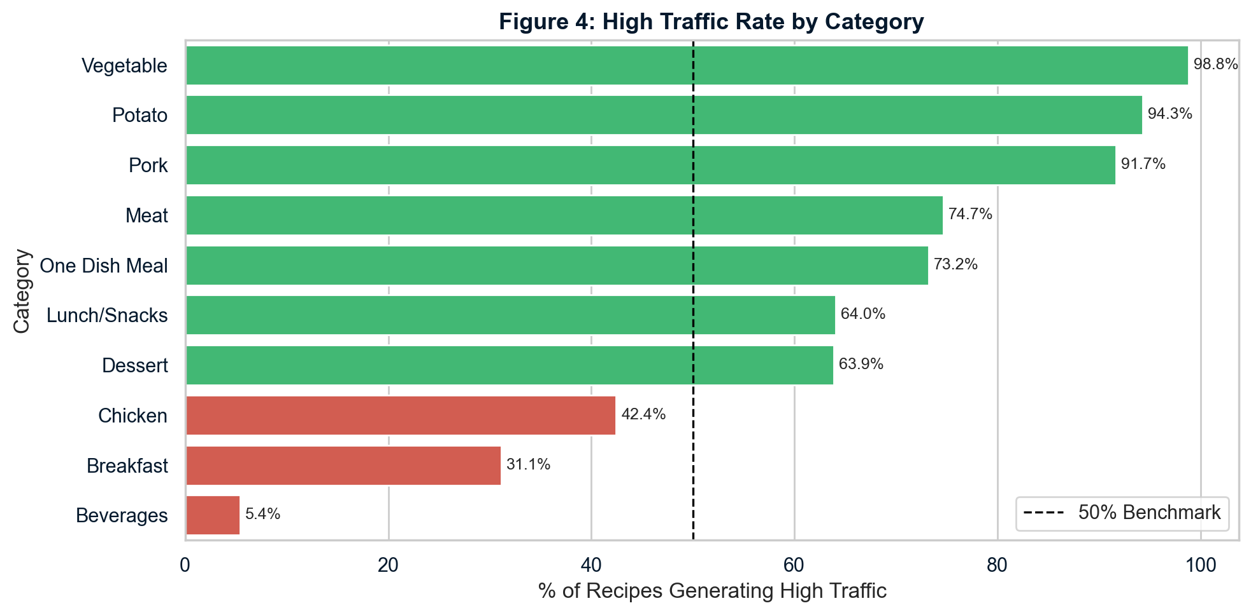
INSIGHT 2
What You Cook Matters Most
Recipe category is the single strongest predictor of traffic.
Vegetable, Potato, and Pork
recipes generate high traffic
over 90% of the time.
WINNERS
90%+
Beverages generate high
traffic less than 10% of
the time.
LOSERS
<10%
Tasty Bytes | Recipe Traffic Prediction
7

Slide 8
MODEL DEVELOPMENT
Building the Predictive Engine
Two models were trained and evaluated using cross-validation to ensure they generalize well to unseen data.
Logistic
Regression
WINNER
Random
Forest
BASELINE COMPARISON
Fast and highly interpretable
More complex, less interpretable
Easy to tune a confidence threshold
Harder to tune for a precision target
Selected as the production model
Evaluated for comparison purposes
Tasty Bytes | Recipe Traffic Prediction
7

Slide 9
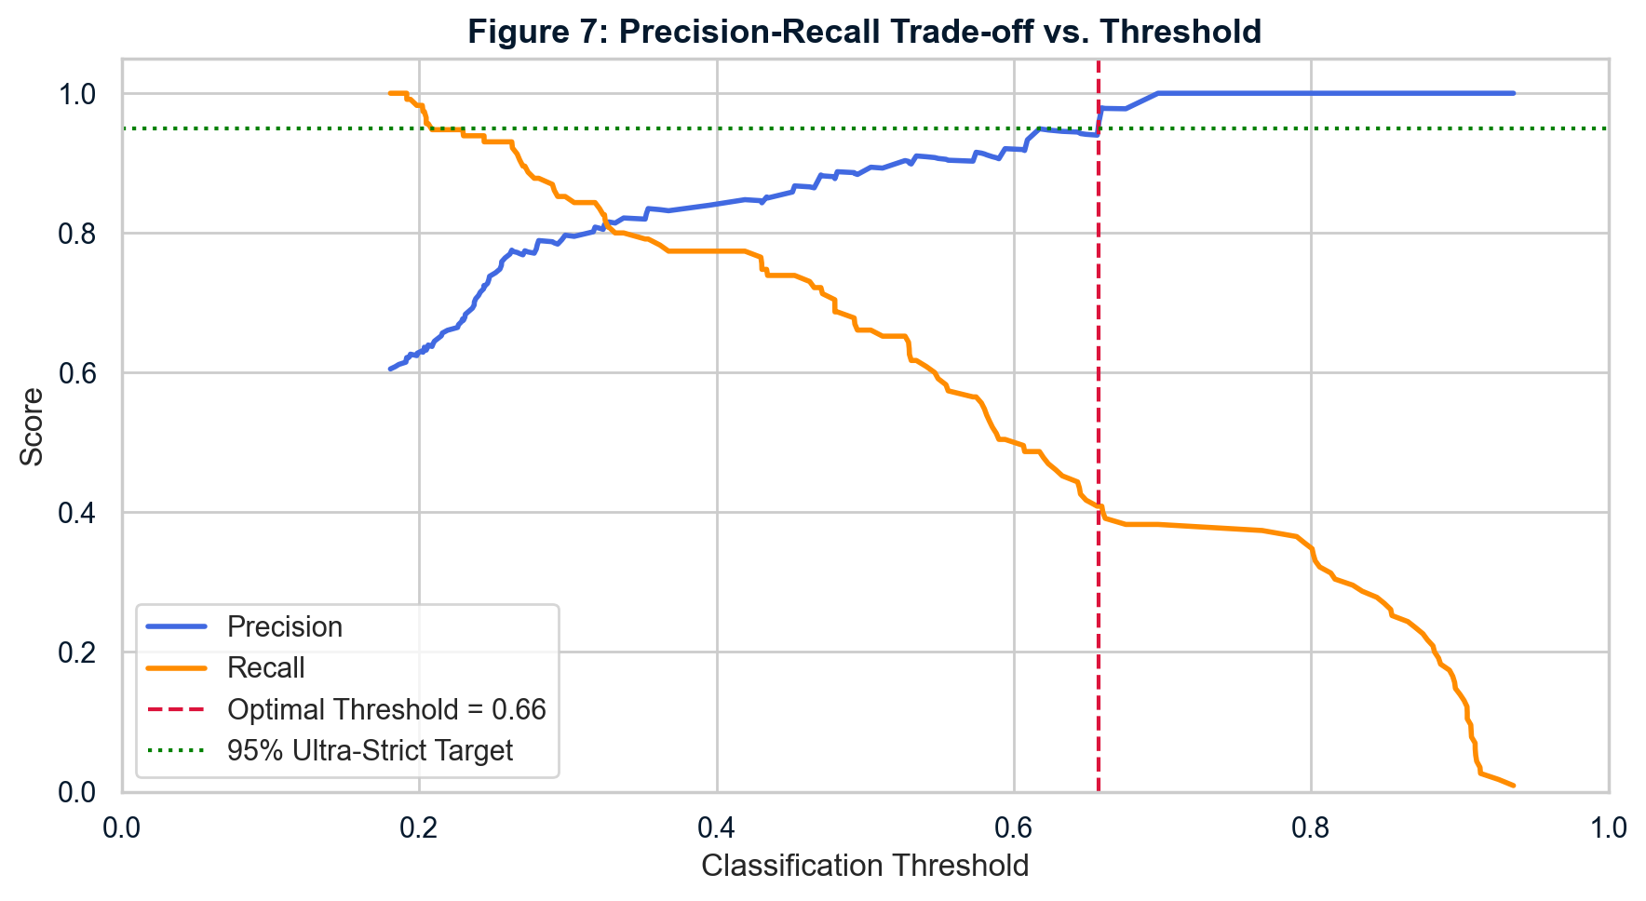
MODEL PERFORMANCE
Beating the 80% Requirement
OUT OF THE BOX
89% precision
Comfortably beating the 80% requirement, right out of the box.
GOING FURTHER
95% ultra-strict
We mapped the precision-recall trade-off and raised
the classification threshold to guarantee an
ultra-strict 95% precision target.
Tasty Bytes | Recipe Traffic Prediction
9

Slide 10
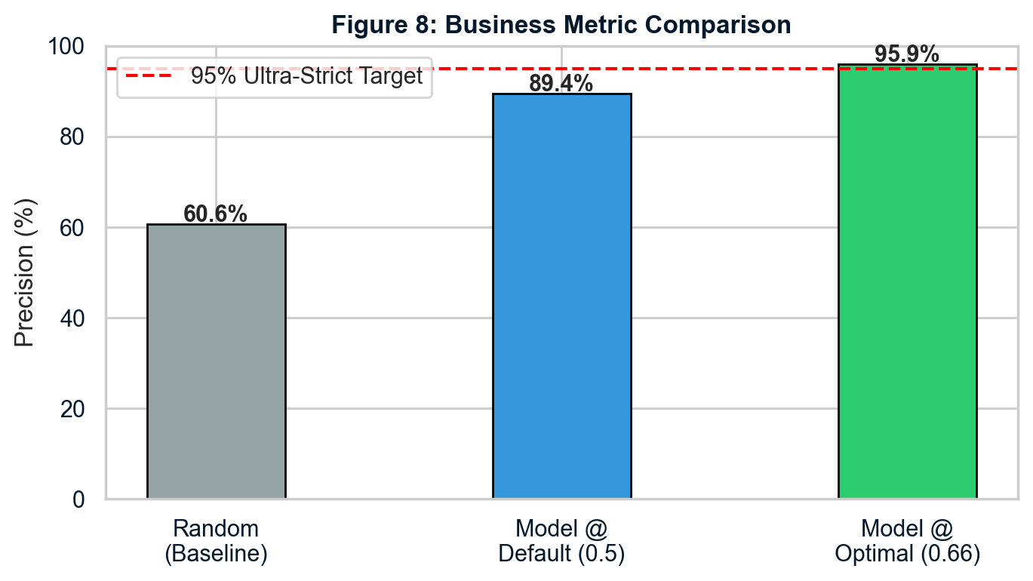
BUSINESS IMPACT
The Value of the Model
This guarantees that almost every recipe placed on the homepage will successfully trigger the 40% traffic boost.
Tasty Bytes | Recipe Traffic Prediction
10

Slide 11
FINAL RECOMMENDATIONS
Actionable Next Steps
NOW
NEXT
LATER
Cease featuring Beverage recipes on the homepage.
Deploy the Logistic Regression model to automate homepage recipe selection.
Collect new features — prep time, image aesthetics, cost — to strengthen the model further.
Prioritize Vegetable, Potato, and Pork recipes for guaranteed wins.
Tasty Bytes | Recipe Traffic Prediction
11

