Slide 1
Smart Gesture & Emotion Detector

Slide 2
Introduction
What are our domains?

Slide 3
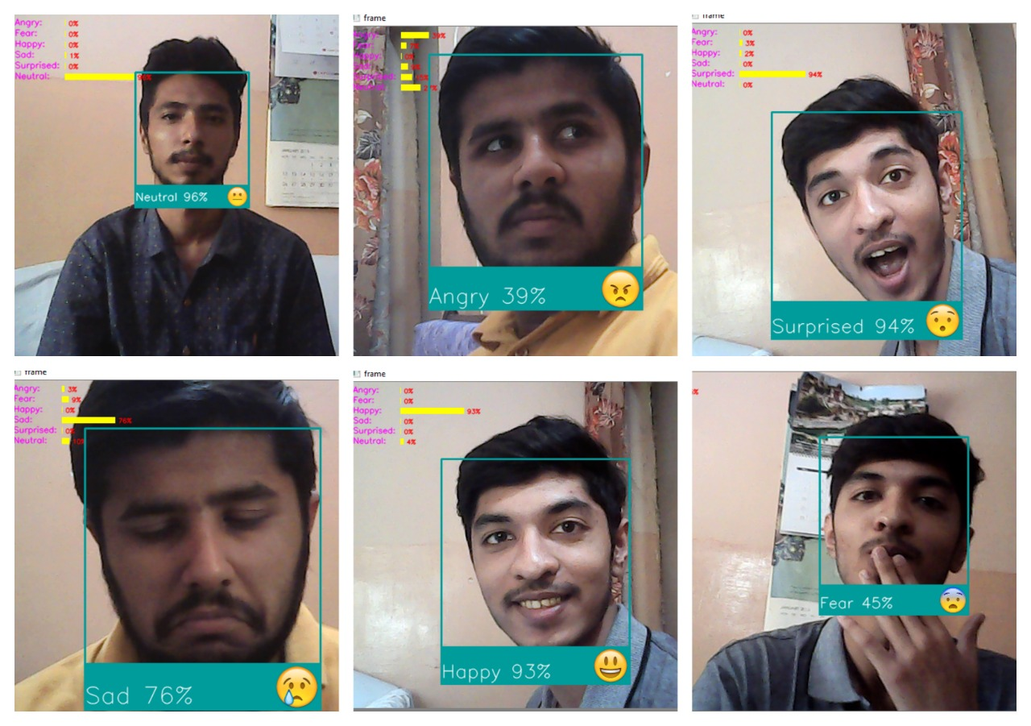
Emotions

Slide 4
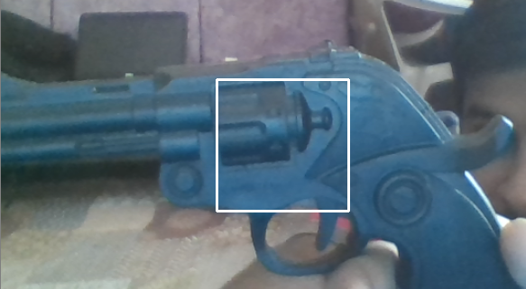
Weapon Detection

Slide 5
MECHANISM
How it works?

Slide 6
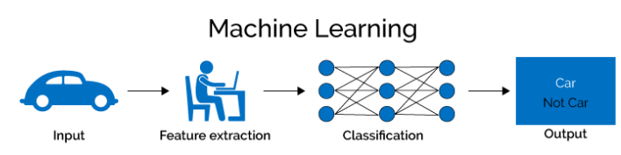

Slide 7
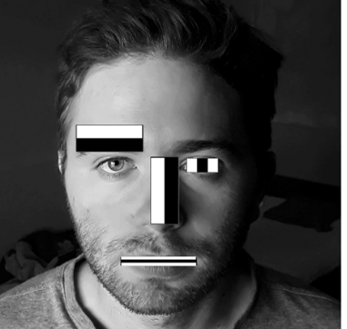
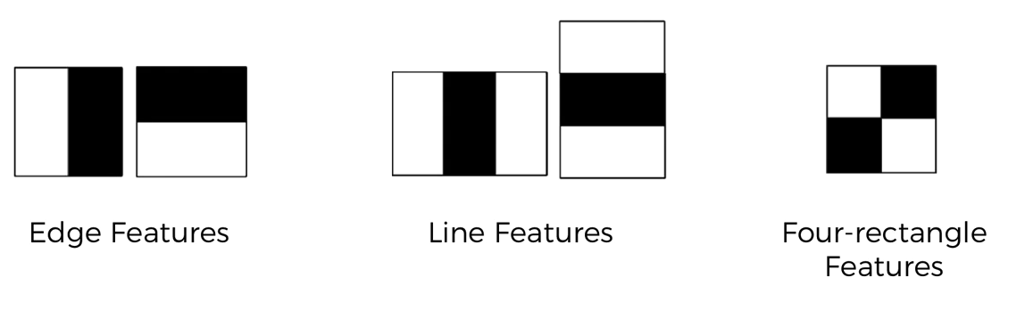
Haar-like Features

Slide 8
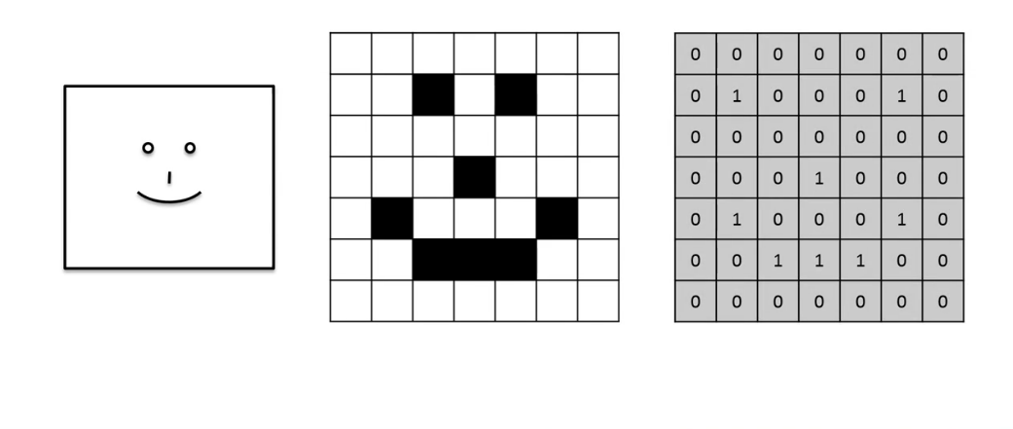
Convolutional Neural Network

Slide 9
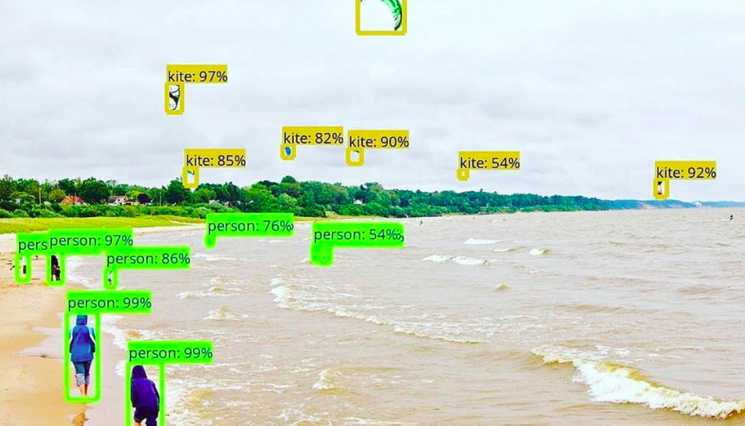
Object Detection

Slide 10




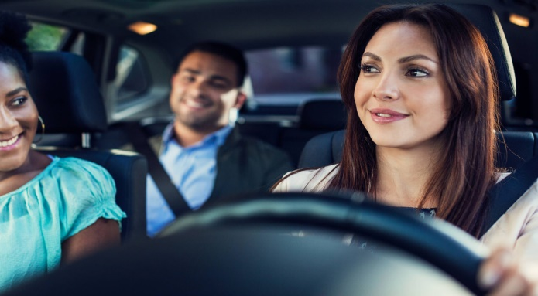
SCOPE

Slide 11
Future Enhancement

Slide 12
Group Members
Jahanzaib Arif (2016-CE-023)
Muhammad Taha Azam (2016-CE-007)
Bilal Ahmed (2016-CE-008)
Muhammad Salman Imran (2016-CE-016)

