Slide 1

CS-313 WEB ENGINEERING · UNDERGRADUATE
Advanced HTML and Forms
Week 2 — From tags that look right to tags that mean something
CLO: CLO1 (primary), CLO2
Bloom: C3 – Apply
Sessions: 2 × 50 min
Instructor: Dr. Muhammad Sohail
Notes:
Welcome slide. Open by asking: 'Show of hands — who built their whole hello.html page out of <div> tags in Lab 1?' Most hands go up. That's today's hook.

Slide 2
TODAY'S SESSION
Learning Objectives
Use semantic HTML5 elements (header, nav, main, article, section, aside, footer) instead of generic <div>s
Build an accessible form with label, fieldset/legend, and the correct input type
Explain how label-for/id and alt text support accessibility
Differentiate GET and POST and justify which one a form should use
Apply HTML5 validation attributes without writing JavaScript
Hand-write a document combining structure, tables, lists, and media
WHY IT MATTERS
Every form you build for the rest of this course — Week 8's fetch(), Week 11's Express routes, Week 13's login — depends on getting the HTML side right first.
CS-313 Web Engineering — UG — Week 2
Notes:
Read through quickly — these map to handout section 1. Flag objective 1 as the big one: today is about breaking the div-soup habit.

Slide 3
QUICK RECAP — LAB 1
What You Already Know
The document skeleton: <!DOCTYPE html>, <html>, <head>, <body>
Opening/closing tags vs. void elements (<img>, <br>)
Common content tags: <h1>–<h6>, <p>, <a href>, <img src alt>, <ul>/<ol>/<li>
IF YOU'RE RUSTY
Rebuild hello.html from memory right now, before we continue. Everything today builds directly on top of that skeleton.
CS-313 Web Engineering — UG — Week 2
Notes:
If a lot of the class looks unsure, spend 3-4 minutes rebuilding hello.html together on the board before moving on.

Slide 4
BIG PICTURE
<div> vs. a Semantic Tag
<div class="top">
<header>
Tells you nothing about what's inside
Only meaningful because of a class name you invented
Invisible to screen readers as a landmark
Search engines give it no special weight
Says exactly what this region is, for free
No naming scheme required — the tag is the meaning
Screen readers announce it as a page landmark
Search engines use it to understand page structure
CS-313 Web Engineering — UG — Week 2
Notes:
Ask: 'if I hide the CSS, which one still tells you something useful?' This is the whole lesson in one slide.

Slide 5
!
COMMON MISCONCEPTION
“More <div>s give me more control, so I should use them for everything.”
Reality: a <div> is a generic container with no built-in meaning — a last resort, not a default.
Semantic tags (header, nav, main, article, section, aside, footer) tell browsers, search engines, and screen readers what a region is for, at zero extra cost.
Before typing <div>, ask: does a semantic tag already describe this region?
CS-313 Web Engineering — UG — Week 2
Notes:
This is the single most important habit to break today. Revisit it explicitly when reviewing the Try It Yourself submissions.

Slide 6
5.1 SEMANTIC HTML5
The Core Semantic Elements
Element | Purpose | Typical Content
<header> | Introductory content for a page/section | Logo, title, search box
<nav> | A block of major navigation links | Menu, breadcrumb trail
<main> | The one dominant content (only one per page) | The central content
<article> | Self-contained content, makes sense alone | Blog post, news story
<section> | A thematic grouping with its own heading | A chapter, a tabbed panel
<aside> | Content indirectly related to main content | Sidebar, related links
<footer> | Closing content for a page/section | Copyright, contact info
CS-313 Web Engineering — UG — Week 2
Notes:
Move at a steady pace — students will reference this table constantly during the Try It exercise that follows.

Slide 7
5.1 SEMANTIC HTML5
One Layout, Built Entirely From Semantic Regions
<header>
Site title, logo, search box
<nav>
Primary site navigation links
<main>
<aside>
Independent content — often several <article> elements
Related links, widgets
<footer>
Legal, contact info, sitemap links
CS-313 Web Engineering — UG — Week 2
Notes:
No <div> was needed anywhere in this layout. Point out that every box here is a native, editable shape — this is the exact skeleton students build in the next Try It step.

Slide 8
WORKED EXAMPLE
Turning “Div-Soup” Into Semantic HTML
BEFORE AFTER
<div class="top">My Site</div> <header>My Site</header>
<div class="links">...</div> <nav>...</nav>
<div class="content">...</div> <main>...</main>
<div class="bottom">© 2026</div> <footer>© 2026</footer>
Same visual result either way — but only the right-hand version tells a screen reader or search engine what each region actually is.
CS-313 Web Engineering — UG — Week 2
Notes:
Walk through each line pair. The visual output can be made pixel-identical with CSS — the difference is entirely in meaning, not appearance.

Slide 9
▶
TRY IT YOURSELF
Step 1 — Build a Semantic Skeleton
In page.html, recreate the wireframe from the previous diagram slide
A <header> with a heading, a <nav> with 3 links, a <main> with one <article>, an <aside>, and a <footer>
Expected result: View Source shows a clean, meaningful tag structure — no <div> soup
CS-313 Web Engineering — UG — Week 2
Notes:
Live-code this together first, then have students repeat it independently. This is the anchor exercise for the whole first half of the lecture.

Slide 10
5.2 TABLES AND LISTS
Tables and Lists, Correctly
<table> exists for one purpose: tabular data — rows and columns of related values
Never used for page layout — an abandoned 1990s–2000s practice
<thead>/<tbody> separate header rows from body rows — not cosmetic, screen readers use it
Lists are unchanged from Lab 1: <ul>/<ol>/<li>, including nesting a full list inside one <li>
CS-313 Web Engineering — UG — Week 2
Notes:
This is a short section — move quickly. The main new idea is thead/tbody.

Slide 11
5.3 FORMS
Forms: Collecting Real Input
A <form> groups input controls and packages their values to send somewhere
action — the URL the data is sent to
method — GET or POST (section 5.4) — how it is sent
Every real feature you build later this semester starts as a form submission
COMING UP
Week 8 intercepts this exact submission with JavaScript. Week 11 builds the server route that finally receives it. The HTML you write today doesn't change.
CS-313 Web Engineering — UG — Week 2
Notes:
Set up the anatomy diagram that follows — this slide is definitions, the next slide is the picture.

Slide 12
5.3 FORMS
The Building Blocks of a Form
<label>
<input>
<select>
<textarea>
<button>
Names the field
Collects the value
Dropdown choice
Multi-line text
Submits the form
CS-313 Web Engineering — UG — Week 2
Notes:
Each block is a real, editable shape — walk left to right, matching the anatomy in the handout's Figure 3.

Slide 13
★
INSTRUCTOR NOTE
Labels Are Not Optional
<label for="email">Email</label>
<input type="email" id="email" name="email">
Clicking the label text focuses the input — a real usability win, not just accessibility.
A screen reader announces “Email, edit text” instead of just “edit text”. Every graded form in this course checks for this.
CS-313 Web Engineering — UG — Week 2
Notes:
Demonstrate the click-to-focus behaviour live — it's the fastest way for students to self-check their own for/id pairs.

Slide 14
5.3 FORMS
Choosing the Right Input Type
Type | Example | Behaviour
text | type="text" | Plain single-line text — the default
email | type="email" | Validates @-shape; mobile shows @ key
password | type="password" | Characters masked as typed
number | type="number" min max | Spinner; numeric keypad on mobile
date | type="date" | Native date picker, no JS calendar needed
checkbox | type="checkbox" | Independent on/off, several at once
radio | type="radio" name="g" | One choice among a group — shared name
file | type="file" accept | Opens the OS file picker
CS-313 Web Engineering — UG — Week 2
Notes:
Full reference table (11 types) is in the handout. Emphasize: the right type gives you validation and UI for free.

Slide 15
▶
TRY IT YOURSELF
Step 2 — Build a Registration Form
In register.html, inside a <fieldset> with <legend>Create Your Account</legend>:
Text input (Full Name), email input, password input
Radio group (Campus, ≥2 options sharing one name), select dropdown (Degree, ≥3 options), submit button
Every field needs a matching <label>
CS-313 Web Engineering — UG — Week 2
Notes:
This is the session's main hands-on activity — budget real time for it. Circulate and check label/for pairing as students work.

Slide 16
5.3 FORMS
Validating Input Without a Single Line of JavaScript
<input type="text" required minlength="3" maxlength="40">
<input type="password" required pattern=".{8,}" title="At least 8 characters">
<input type="number" min="18" max="65">
required blocks empty submission · minlength/maxlength bound length · pattern is a regex the value must match.
CS-313 Web Engineering — UG — Week 2
Notes:
Demo each attribute live by trying to submit an invalid form. This is a usability layer, not security — say that explicitly.

Slide 17
▤
WORKED EXAMPLE
Client-Side Validation Is Not Security
required, pattern, minlength — all enforced by the browser, all bypassable by a determined user (disable JS, use curl/Postman).
Week 13 (Authentication and Security) shows exactly why every one of these checks must be repeated on the server. Never trust the client.
CS-313 Web Engineering — UG — Week 2
Notes:
Short but important — plant this seed now so Week 13 lands as confirmation, not new information.

Slide 18
5.4 GET VS. POST
Same Form, Two Ways to Send It
GET
POST
Data rides in the URL query string
Visible, bookmarkable, cacheable
Limited size (~2000 characters)
Safe to repeat — should only retrieve data
Use for: search boxes, filters, links
Data rides in the hidden request body
Not cached by default
Effectively unlimited size
Often changes server state — don't repeat blindly
Use for: login, registration, uploads
CS-313 Web Engineering — UG — Week 2
Notes:
Matches the GET vs POST table in the handout exactly — keep terminology identical. This distinction resurfaces in Week 11 (Express routes).

Slide 19
?
PAUSE AND CHECK
Think about it for 60 seconds
A search box that filters lecture notes, and a login form that submits a password — which method should each use, and why?
What goes wrong, specifically, if you get this backwards?
CS-313 Web Engineering — UG — Week 2
Notes:
Think-Pair-Share: 60 seconds solo, 60 with a partner, cold-call 2 pairs. Correct answer: search=GET (safe, bookmarkable), login=POST (changes/reveals sensitive state, must not sit in browser history).

Slide 20
5.5 MULTIMEDIA
Embedding Multimedia (Brief)
<figure> + <figcaption> — self-contained media with a caption
<audio controls> and <video controls> — without controls, no visible play/pause UI at all
alt is not optional
  Every meaningful <img> needs alt text; a purely decorative image uses alt="" (empty, not omitted)
TRY IT YOURSELF
Read only the alt text and figcaption in your Step-1 page, ignoring the image. That's exactly what a screen reader user experiences.
CS-313 Web Engineering — UG — Week 2
Notes:
Keep this brief — it's a rounding-out section, not a major new concept.

Slide 21
★
INSTRUCTOR NOTE
Sections 6–7: A Reference Tour, Not a Full Lecture
The next slides cover a wide, industry-common tag vocabulary — more than fits live in the time remaining.
Live-demo 2–3 (suggested: 6.1 strong/em vs b/i, and 7.1 details/summary), assign the rest as guided reading with the rendered-output figures before the lab.
CS-313 Web Engineering — UG — Week 2
Notes:
Matches the handout's Instructor Package scope note. Say this out loud to the class too — it removes the pressure to memorise everything on sight.

Slide 22
6.1 TEXT-LEVEL SEMANTICS
Meaning vs. Appearance: strong/b, em/i
<p><strong>Strong</strong> vs <b>Bold</b>: both look the same, but only
&lt;strong&gt; tells assistive tech "this is important."</p>
<p><em>Emphasis</em> vs <i>Italic</i>: both look the same, but only
&lt;em&gt; carries stressed meaning.</p>
Default to <strong>/<em> — reach for <b>/<i> only when there truly is no semantic weight (e.g. a species name).
CS-313 Web Engineering — UG — Week 2
Notes:
The single highest-value comparison in sections 6-7 — if you demo only one, demo this one.

Slide 23
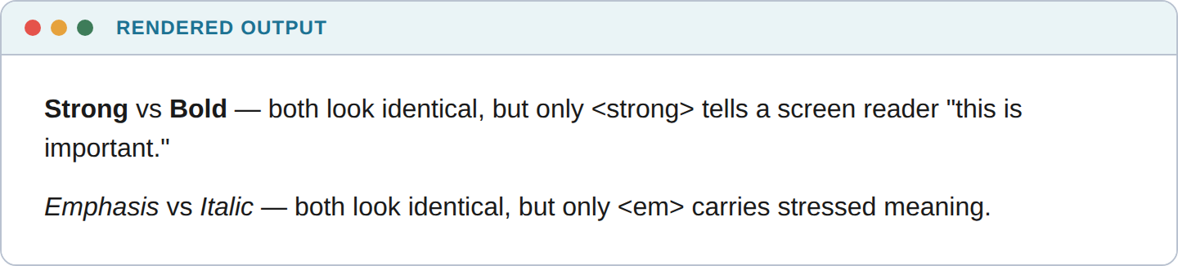
6.1 TEXT-LEVEL SEMANTICS
Rendered Output
Identical rendering, different meaning — a screen reader treats the left word of each pair as more important than the right.
CS-313 Web Engineering — UG — Week 2
Notes:
Ask: 'if both look the same, why does the tag choice matter?' — answer: for anything that isn't looking at pixels.

Slide 24
6.2 HIGHLIGHTING, FINE PRINT, SCRIPTS
<mark>, <small>, <sub>, <sup>
<p>Search results for <mark>web engineering</mark></p>
<p><small>Terms and conditions apply.</small></p>
<p>H<sub>2</sub>O and E = mc<sup>2</sup></p>
Three small, frequently used tags for common everyday text situations.
CS-313 Web Engineering — UG — Week 2
Notes:
Quick pass — these are intuitive once seen rendered.

Slide 25
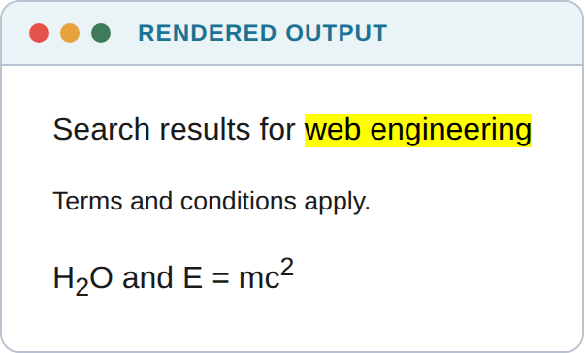
6.2 HIGHLIGHTING, FINE PRINT, SCRIPTS
Rendered Output
<mark> highlights, <small> shrinks fine print, <sub>/<sup> position formulas and exponents correctly.
CS-313 Web Engineering — UG — Week 2
Notes:
Point out the automatic yellow highlight — that's default browser styling, zero CSS written.

Slide 26
6.3 SHOWING EDITS
<del> and <ins>
<p>Registration fee: <del>Rs. 2,500</del> <ins>Rs. 1,800</ins></p>
For content that changed and you want the reader to see both the old and new value.
CS-313 Web Engineering — UG — Week 2
Notes:
One-line example — move quickly.

Slide 27
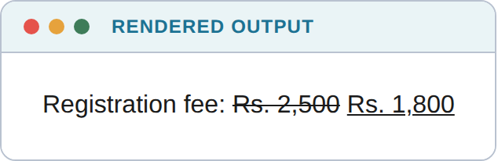
6.3 SHOWING EDITS
Rendered Output
<del> renders as strikethrough, <ins> as underline — the browser's default way of showing a tracked change.
CS-313 Web Engineering — UG — Week 2
Notes:
A quick, satisfying visual — students immediately recognize this from tracked-changes documents.

Slide 28
6.4 QUOTATIONS
<blockquote> vs. <q>
<blockquote cite="https://www.nust.edu.pk">NUST is committed to excellence
in science, engineering, and technology.</blockquote>
<p>As the saying goes, <q>code is read far more often than
it is written.</q></p>
<blockquote> = long, block-level quote. <q> = short, inline quote — the browser adds quotation marks automatically.
CS-313 Web Engineering — UG — Week 2
Notes:
Common confusion point — emphasize that <q> never needs manual quote-mark characters.

Slide 29
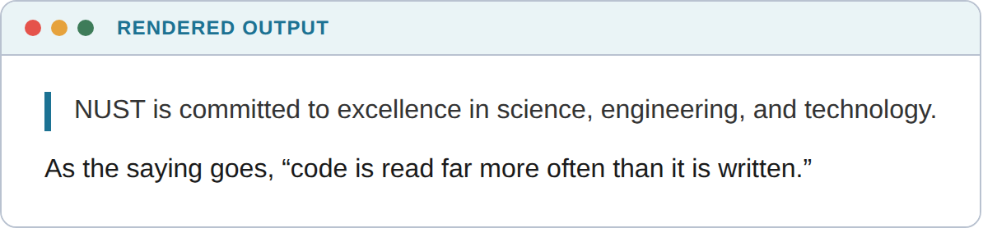
6.4 QUOTATIONS
Rendered Output
<blockquote> breaks onto its own indented block; <q> stays inline with automatic quotation marks.
CS-313 Web Engineering — UG — Week 2
Notes:
Never type " " yourself around a <q> — the browser inserts locale-appropriate quote marks.

Slide 30
6.5 ABBREVIATIONS
<abbr title="...">
<p>The <abbr title="World Wide Web Consortium">W3C</abbr> maintains the
standards that keep every browser speaking the same language.</p>
Gives sighted users a hover tooltip, and gives screen readers the option to read the full expansion.
CS-313 Web Engineering — UG — Week 2
Notes:
Point out the dotted underline convention — students will now recognize it on real sites.

Slide 31
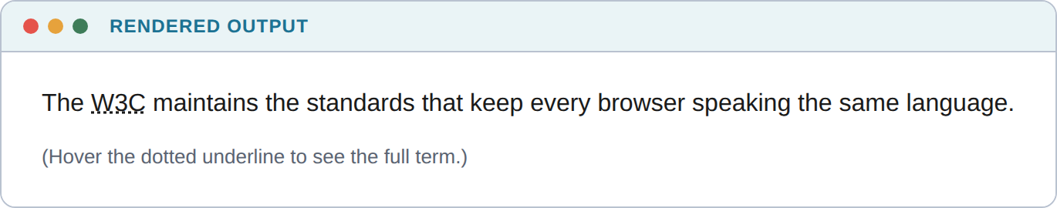
6.5 ABBREVIATIONS
Rendered Output
The dotted underline is the browser's default signal that hovering will reveal a full expansion.
CS-313 Web Engineering — UG — Week 2
Notes:
A live hover demo on the projector lands better than the static screenshot alone, if time allows.

Slide 32
6.6 DESCRIPTION LISTS
<dl>, <dt>, <dd>
<dl>
<dt>HTML</dt><dd>Structures the content of a web page.</dd>
<dt>CSS</dt><dd>Styles how that content looks.</dd>
<dt>JavaScript</dt><dd>Adds behaviour and interactivity.</dd>
</dl>
The third list type — for term/definition pairs, not sequences or unordered items.
CS-313 Web Engineering — UG — Week 2
Notes:
Connect this to the handout's own Key Terminology tables — those are conceptually description lists.

Slide 33
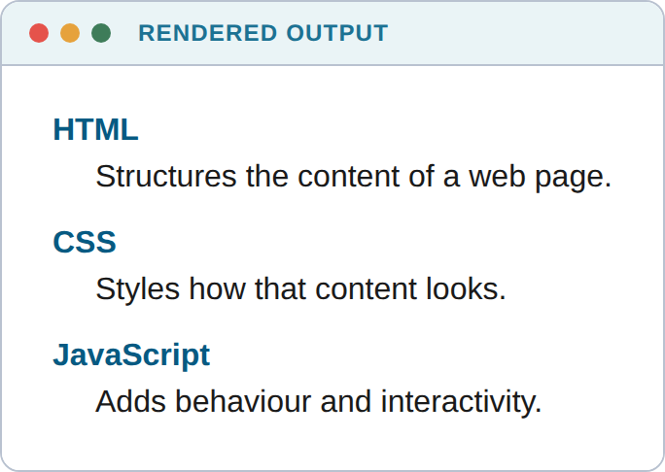
6.6 DESCRIPTION LISTS
Rendered Output
Each <dt> (term) is followed by one or more <dd> (descriptions) — exactly the shape of a glossary.
CS-313 Web Engineering — UG — Week 2
Notes:
The most frequently forgotten list type — worth naming explicitly.

Slide 34
6.7 MORE EVERYDAY TAGS
At a Glance
Tag | Purpose | Example
<hr> | A thematic break between sections | Between unrelated blocks of a long article
<code> / <pre> | Inline code / preformatted multi-line code | Already seen in every code block today
<kbd> / <samp> | Keyboard input / sample program output | Press <kbd>Ctrl</kbd>+<kbd>S</kbd> → <samp>Saved</samp>
<cite> | The title of a creative work being referenced | <cite>HTML & CSS</cite> by Jon Duckett
<address> | Contact info for a page/article's author | Email, physical address, social link in a footer
CS-313 Web Engineering — UG — Week 2
Notes:
Quick pass — note that <code>/<pre> have been visible in every code slide all lecture, so this is confirmation, not new material.

Slide 35
7.1 DISCLOSURE WIDGETS
<details> and <summary>
<details>
<summary>What is semantic HTML?</summary>
<p>HTML that describes the meaning of its content, not just
its appearance.</p>
</details>
A native, zero-JavaScript collapsible section. Add the open attribute to start expanded.
CS-313 Web Engineering — UG — Week 2
Notes:
This is the most immediately useful new tag today — FAQ pages everywhere use exactly this.

Slide 36
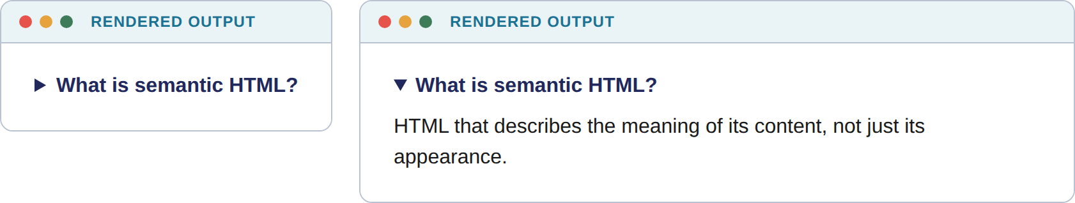
7.1 DISCLOSURE WIDGETS
Rendered Output — Closed and Open
Closed (left) and open (right) — the disclosure triangle and the show/hide behaviour are both built into the browser.
CS-313 Web Engineering — UG — Week 2
Notes:
Live-demo this by actually clicking it in a browser if you have one open — the click interaction is the whole point.

Slide 37
7.2 PROGRESS AND MEASUREMENT
<progress> vs. <meter>
<progress>
<meter>
Completion of a task moving toward 100%
Example: a file upload, a multi-step form
Renders as a blue-filling bar
A measurement within a known range
Not necessarily progress toward completion
Example: disk usage, battery level, a poll result
CS-313 Web Engineering — UG — Week 2
Notes:
Two more visually similar tags with genuinely different meanings — same theme as section 6.1.

Slide 38
7.2 PROGRESS AND MEASUREMENT
Code
<p>Assignment upload: <progress value="70" max="100"></progress> 70%</p>
<p>Disk usage: <meter value="0.6" min="0" max="1"></meter> 60% full</p>
CS-313 Web Engineering — UG — Week 2
Notes:
Point out both are natively styled by the browser — no CSS required for a working progress bar.

Slide 39
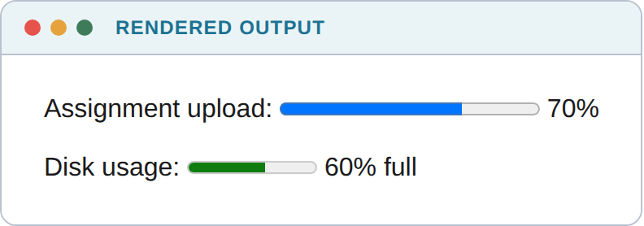
7.2 PROGRESS AND MEASUREMENT
Rendered Output
<progress> (blue) implies motion toward completion; <meter> (green/amber/red by range) implies a static gauge reading.
CS-313 Web Engineering — UG — Week 2
Notes:
The color difference is a real browser default, not something we styled — worth pointing out.

Slide 40
7.3 ADVANCED TABLES
colspan, rowspan, and <caption>
<table>
<caption>Week 2 Grading Breakdown</caption>
<tr><th>Component</th><th colspan="2">Details</th></tr>
<tr><td rowspan="2">Assignments</td><td>Individual</td><td>10%</td></tr>
<tr><td>Group</td><td>5%</td></tr>
</table>
Real tabular data is rarely a simple grid — colspan/rowspan handle merged cells, <caption> is an accessibility landmark.
CS-313 Web Engineering — UG — Week 2
Notes:
Trace colspan and rowspan against the rendered table on the next slide — the merge is easy to see once rendered.

Slide 41
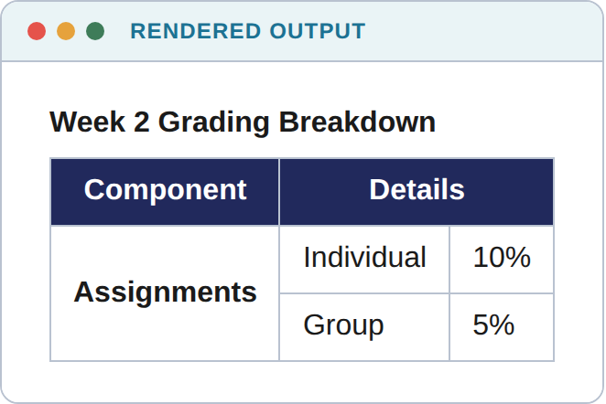
7.3 ADVANCED TABLES
Rendered Output
colspan="2" merges the Details columns; rowspan="2" merges Assignments down across both data rows.
CS-313 Web Engineering — UG — Week 2
Notes:
This is the table style students should aim for in any assignment that needs merged cells.

Slide 42
7.4 ADVANCED LINKS
target, rel, download, URI Schemes
<a href="https://developer.mozilla.org" target="_blank"
rel="noopener noreferrer">Open MDN in a new tab</a>
<a href="notes.pdf" download>Download lecture notes (PDF)</a>
<a href="mailto:cs313@nust.edu.pk">Email the instructor</a>
<a href="tel:+92511234567">Call the department office</a>
target="_blank" always needs rel="noopener noreferrer" — without it, the new tab can redirect your original tab. A real security risk.
CS-313 Web Engineering — UG — Week 2
Notes:
The security note is worth emphasizing explicitly — this is a documented phishing vector, not a style nitpick.

Slide 43
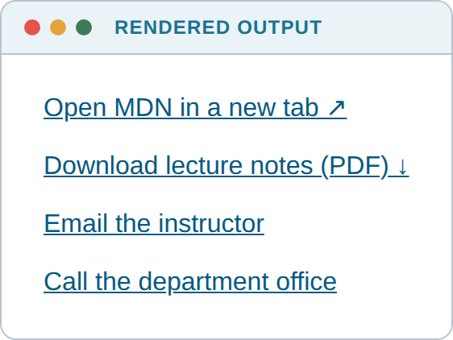
7.4 ADVANCED LINKS
Rendered Output
Four different link behaviours from one tag: new tab, forced download, a pre-filled email, a phone dialer on mobile.
CS-313 Web Engineering — UG — Week 2
Notes:
Ask: which of these four have students already used without knowing the underlying attribute?

Slide 44
7.5 RESPONSIVE IMAGES
Serving the Right Image, Automatically
srcset / sizes — the browser picks the best-fitting file for the visitor's screen, not your code
loading="lazy" — defers downloading an image until the visitor scrolls near it
  <picture> — true art direction (a different crop, not just resolution) for mobile vs. desktop
WHY IT MATTERS HERE
Pakistani mobile users on limited data plans are exactly who these attributes help most — a one-word performance win.
CS-313 Web Engineering — UG — Week 2
Notes:
No screenshot needed — the effect is about which file loads, not what renders. Mention this is a standard Lighthouse audit checkpoint.

Slide 45
7.6 OTHER MODERN TAGS
Reference — You'll Meet These Again
Tag / Attribute | Purpose | Where You'll Meet It Again
<dialog> | A native modal dialog box | Week 6 (DOM Manipulation)
<template> | Inert markup, cloned later by JS | Week 6 (DOM Manipulation)
<iframe> | Embeds another document — always sandbox untrusted content | Week 13 (Security)
<time datetime> | Human-readable date + machine-readable value | Week 6 onward
data-* attributes | Custom data stored directly on an element | Week 6 — read via JS's dataset API
CS-313 Web Engineering — UG — Week 2
Notes:
Recognition only today — these become active tools once JavaScript enters the course in Week 6.

Slide 46
VISUAL SUMMARY
Where Each Piece Sits
Concern | Tool | Covered In
Page structure / meaning | Semantic elements | Section 5.1
Tabular data | <table>, <thead>, <tbody> | Section 5.2
Collecting user input | <form>, <label>, <input> types | Section 5.3
How input is transmitted | GET vs. POST | Section 5.4
Rich media | <figure>, <audio>, <video> | Section 5.5
Meaningful text formatting | strong/em, mark, del/ins, blockquote/q, dl | Section 6
Interactive / modern widgets | details/summary, progress/meter, advanced tables & links | Section 7
CS-313 Web Engineering — UG — Week 2
Notes:
Quick recap slide before moving into industry relevance.

Slide 47
SECTION 9
Where This Shows Up in Industry
W
S
$
V
WCAG Compliance
SEO Agencies
Lead-Gen Forms
Server-Side Validation
Legal requirement for gov't/corporate sites — built on semantic HTML
Audit sites for exactly the structure covered in section 5.1
A broken signup/checkout form directly costs real businesses customers
Client-side checks reduce load at scale, but never replace server checks
P
F
M
★
Password Managers
FAQ Pages
Mobile Performance
You, Next Week
Rely on correct input types + labels to autofill correctly
Almost always built from <details>/<summary> — faster and more accessible than custom JS
srcset/loading="lazy" are standard Lighthouse audit checkpoints
Week 3 CSS styles exactly what you structured today
CS-313 Web Engineering — UG — Week 2
Notes:
Connect each card to something students recognize from their own browsing experience.

Slide 48
▶
TRY IT YOURSELF
Modern Extension — AI Code Generation and Accessibility (optional, not exam material)
AI coding assistants, left unguided, default to div-soup — because it looks correct, and looking correct is often all a quick prompt checks for
Accessibility auditing tools (Lighthouse, axe DevTools, WAVE) exist to catch exactly this gap
Treat AI-generated HTML like a classmate's pull request: check tag choices, label associations, and alt text before accepting it
CS-313 Web Engineering — UG — Week 2
Notes:
Keep brief — 2-3 minutes. The point is connecting today's material to a current, practical habit, not teaching AI tools.

Slide 49
Key Takeaways
Choose tags for what they mean, not just how they look — CSS (next week) handles appearance
Every <input> needs a <label> linked by for/id — accessibility and usability, together
GET exposes data and is safe to repeat; POST hides data and often changes state — don't mix these up
HTML5 validation attributes are a usability layer, never a security layer
Visually-identical tag pairs (strong/b, em/i, blockquote/q, progress/meter) differ in meaning, not appearance
A wide, correct tag vocabulary is what separates HTML that renders from HTML a real team can maintain
CS-313 Web Engineering — UG — Week 2
Notes:
Return to the opening question about div-soup — ask who would build hello.html differently now. Preview Week 3: 'CSS finally styles everything we structured today.'

