Slide 1
Research Trend Analysis and Future Prediction using Deep Learning
Muhammad Talha Tahir (2024MSCS227)
Haseeb Ahmed (2024MSCS221)
Muhammad Usama (2024MSCS222)

Slide 2
Intro
Project Goal: Extract, analyze, and predict research trends across Computer Science domains
Key Components:
Analysis of 4,971 academic papers from 1984-2025
Identification of research topic clusters
Citation impact measurement
Deep learning-based prediction of emerging research areas

Slide 3
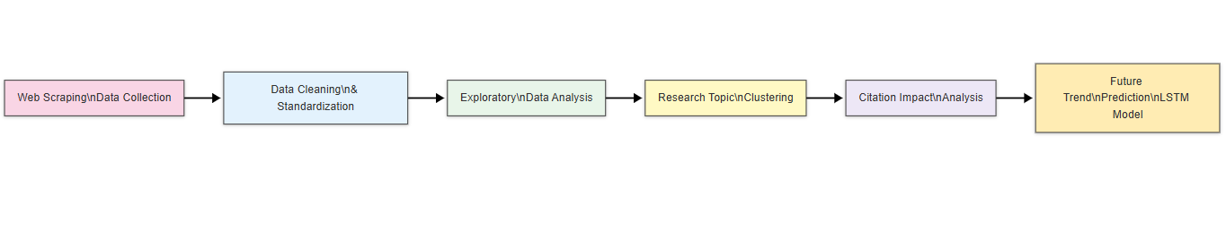
Introduction: Project Workflow

Slide 4
Data Collection
Custom Scrapy spiders developed to extract metadata from research journals
Primary Sources: Elsevier and Springer platforms
Dataset Details:
4,971 papers collected
Coverage years: 1984 – 2025
Fields: Title, Abstract, Year, Citation count, Authors with country, Keywords

Slide 5
Data Collection: Challenges & Solutions
Challenge: Bot detection systems on journal platforms
Frequent CAPTCHAs and IP blocks
Solution: ScraperAPI integration
Rotating proxies
User-agent spoofing
Significantly improved data collection capability

Slide 6
Data Cleaning & Preparation
Cleaning Steps:
Removal of invalid Unicode characters
Dropping papers with missing abstracts/titles
Year format standardization

Slide 7
Methodology: Topic Clustering
Embedding Generation: Sentence-BERT (all-MiniLM-L6-v2)
Clustering Algorithm: KMeans (k=5)
Optimal Cluster Selection: Silhouette Score method
Topic Labeling:
KeyBERT extraction of topic keywords
Manual review for final label assignment

Slide 8
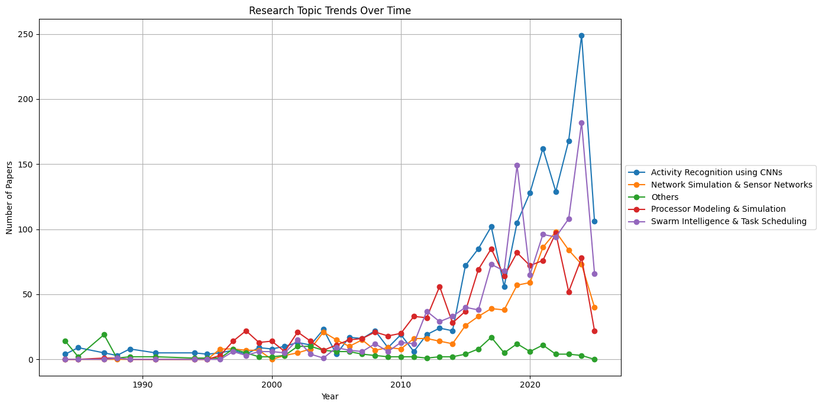
Methodology: Topic Clustering

Slide 9
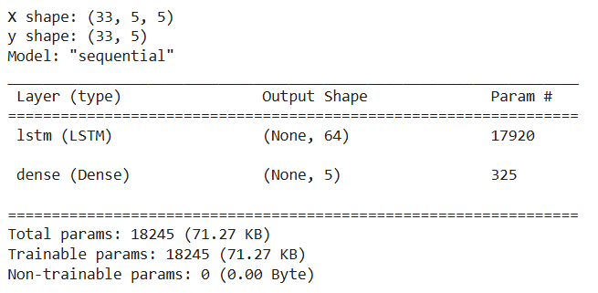
Methodology: Deep Learning Model
Architecture: LSTM-based Recurrent Neural Network
Input: Sequence of past 5 years' topic trends
Output: Predicted paper counts per topic for 2026

Slide 10
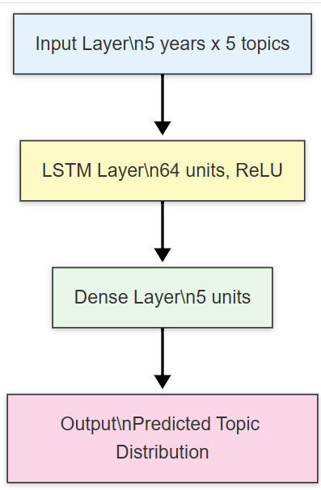
Methodology: Deep Learning Model

Slide 11
Results: Research Volume Trends
Research publication volume has shown consistent growth since 1984
Significant acceleration observed from 2010 onwards
"Activity Recognition using CNNs" emerging as dominant cluster since 2015

Slide 12
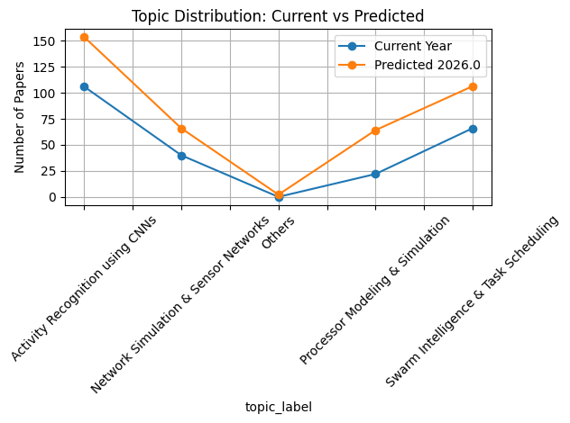
Results: Research Volume Trends

Slide 13
Conclusion
Successfully analyzed nearly 5,000 research papers spanning 41 years
Identified meaningful research clusters using deep learning techniques
Measured real-world impact through citation analysis
Predicted future research trends using LSTM model
Future Work:
Apply Transformer-based time series models
Implement advanced topic modeling with LDA+BERT hybrids

Slide 14
Thanks!
Contact us:
Muhammad Talha Tahir: mtalhatahir2001@gmail.com
Haseeb Ahmed: haaseebahmed319@gmail.com
Muhammad Usama: utari7302@gmail.com

