Slide 1


Complete Guide To React
-Hooks
-React Router
-Redux
Muhammad Talib Waseem
Software Engineer & Instructor

Slide 2
What is React?

Slide 3
A Javascript library for building fast and interactive SPA.

Slide 4
React was created by Facebook in 2011 and currently it is the most powerful library

Slide 5
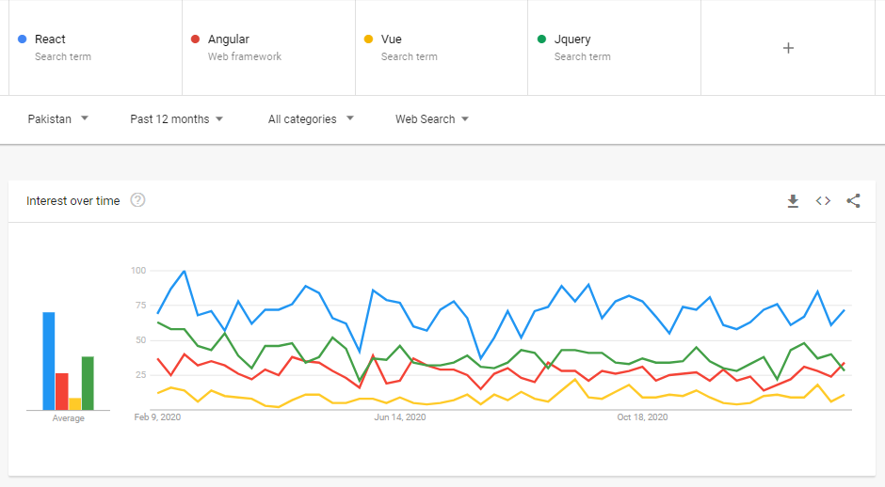

Slide 6


