Slide 1
FYDP Proposal
Defence
Implementing AES Encryption and
Decryption on a RISC-V Processor

Slide 2
Group Members
=
Supervisor
1. Muhammad Tariq Waseem
El - 21056
2. Mirza Musab Baig
El - 21057
3. Rameez Nawaz
El - 21061
4. Anas Uddin
El - 21067
Hafsa Amanullah
Lecturer,
Electronics Department
Dr Muhammad
Faheem-ul-Haq
Assistant Professor,
Telecommunications
Co-Supervisor

Slide 3
01
Problem Statement & Objectives
CONTENTS
02
SDG Relevance
03
Methodology
04
Timeline [Gantt chart]

Slide 4
01
Problem Statement
& Objectives

Slide 5
Objective:
Our goal is to create a Fast, Efficient, and Secure AES algorithm on RISC-V architecture built on FPGA.
Optimize clock cycles, reduce memory usage and power consumption
Enter title
Problem Statement:
This Template Is Designed By Zuo An,It Will Help You Make You Report Easy And Fast.
Sensitive data transmitted over wireless networks is vulnerable to interception and unauthorized access.
Existing encryption algorithms are not optimized for RISC-V processor architecture
Resulting in Higher power consumption, slower performance, and Inefficient data handling

Slide 6
02
SDGs Relevence

Slide 7

This project supports the development of secure communication system contributing to improve digital infrastructure
It promotes secure economic activities like online banking and secure data storage, which are key to economic growth

Slide 8

This project also focuses on innovation in Embedded systems, Network security, and Cryptography by optimizing AES encryption for the RISC-V architecture.
This fosters industrial advancements, builds robust infrastructure, and promotes technological innovation

Slide 9

By providing Secure Encryption solutions, our project enhances the protection of sensitive data, ensuring secure communication.
This aligns with SDG 16, which promotes peace, justice, and strong institutions through measures such as preventing cyber-attacks and ensuring data privacy

Slide 10
03
Proposed Methodology

Slide 11
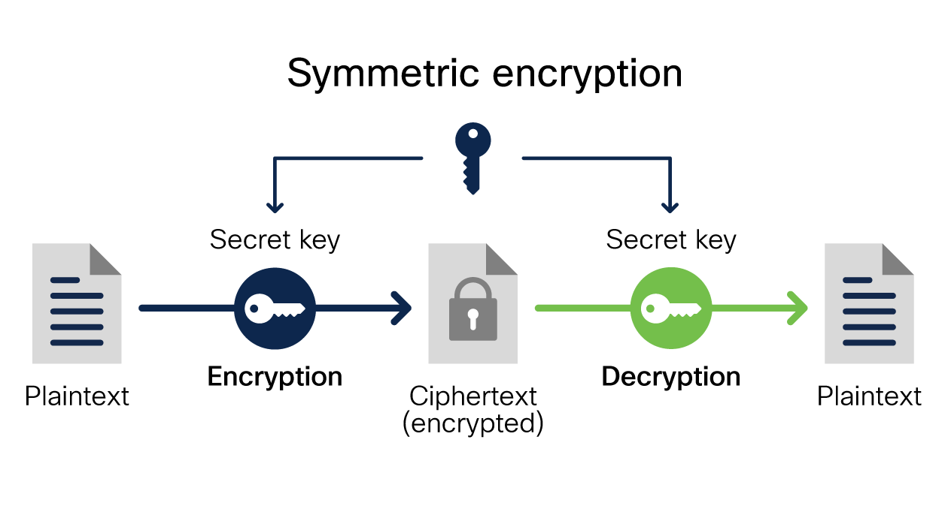
AES Algorithm Implementation:
Implement the AES algorithm tailored to the RISC-V instruction set.
Include key expansion, substitution, permutation, and mixing operations.
Implement the reverse AES process to decrypt cipher text back to plain text, ensuring accuracy with the decryption key.
Secure Channel
STAGES
Substitute bytes: Uses an S-box to perform a byte-by-byte substitution of the block.
Shift Rows: A simple permutation.
Mix-columns: A substitution that makes use of arithmetic over GF(28).
Add Round Key: A simple bit wise XOR of the current block with a portion of the expanded key

Slide 12
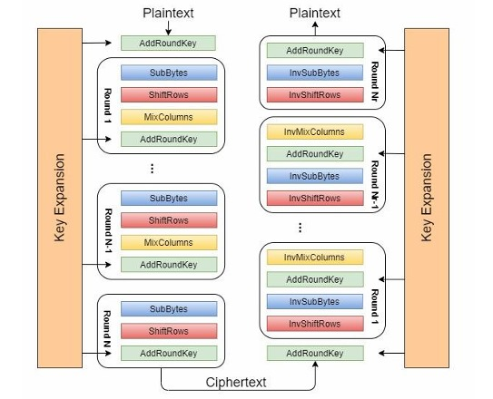
AES Algorithm
Visual Representation:

Slide 13
Development of RISC-V Core:
Designing a RISC-V core on Quartus Prime for implementing the AES algorithm using Verilog or System Verilog.
Connecting a memory design to our processor to store the program data and the data to be encrypted or decrypted
Integration:
Integrate AES Encryption and Decryption Module within the RISC-V core Designed System
Test encryption and decryption using various data sets on the RISC-V processor
Validation & Throughput:
Measuring the throughput by providing different data length input and measuring the time taken by the system to encrypt it. •
Validate the system in real-world scenarios, such as secure data transmission or storage, to ensure robustness.

Slide 14
04
Timeline [Gantt Chart]

Slide 15
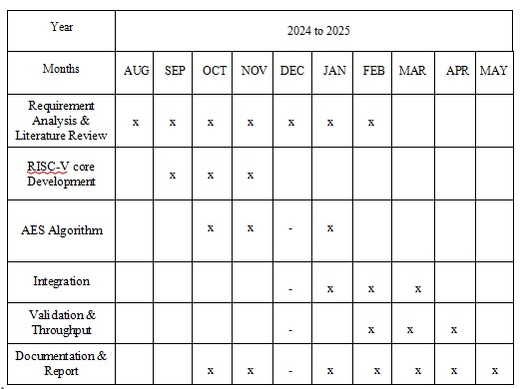

Slide 16
Timeline Overview:
Phase 1: Requirement Analysis & Literature Review
(August-February)
Phase 2: RISC-V Core Development
(September-November)
Phase 3: AES Algorithm
(October-January)
Phase 4: Integration
(January-March)
Phase 5: Testing & Validation
(February-April)
Phase 5: Documentation & Report
(October-May)

Slide 17
END

Slide 18
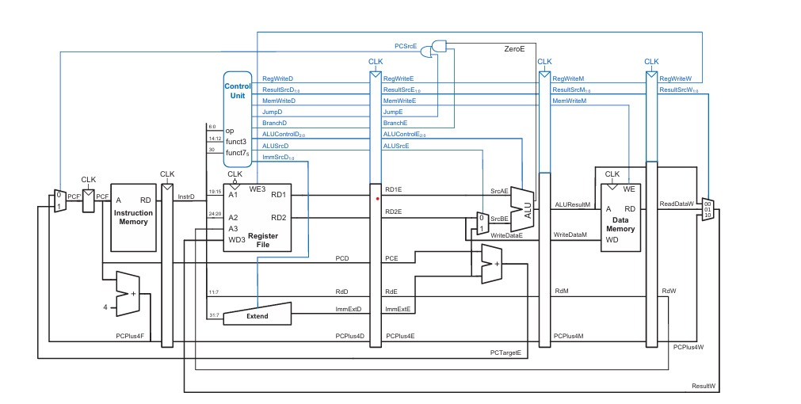
Additional Information
RISC-V Pipelined Processor:

Slide 19
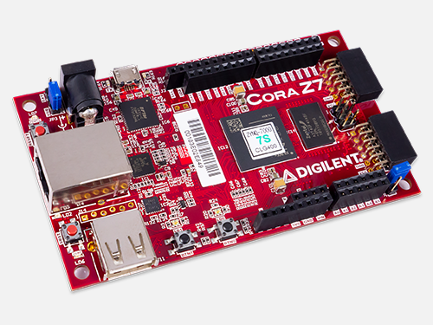
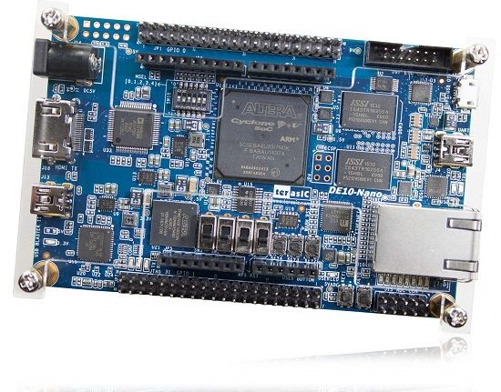
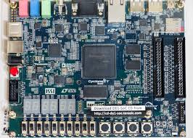
Hardware [FPGA] (cost analysis):
Xilinx Zynq-7000 SoC $350 USD
Intel/Altera DE10-Nano $150 USD
Intel/Altera DE2-115 $400 USD
Intel/Altera DE1-SoC $200 USD
Intel/Altera Cyclone V GX Starter Kit $300 USD

