Slide 1

SOFTWARE BASED SIDE CHANNEL ATTACKS AND DEFENSES: Introduction
Ali Tashfeen
mxalitashfeen@shockers.wichita.edu
Wichita State University
February 16, 2023

Slide 2

What is a Side Channel?

Slide 3

Real-life examples (Cont.)
Source
  https://abc7.com/snow-lack-of-drug-bust-the-netherlands/514461/

Slide 4
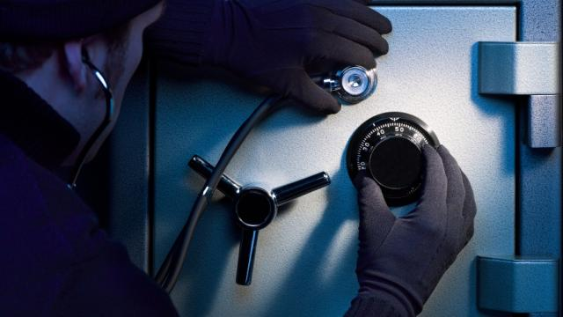
Real-life examples
Safe has two visible states
    Open
    Closed
    But there is more information
    Correct digit lock clicks
    Stethoscope detect it

Slide 5

Humans SCA
Tone
Breathing
Sweating
..
Conditions to pick them???
Notes:
Un concisous side channel attacks

Slide 6
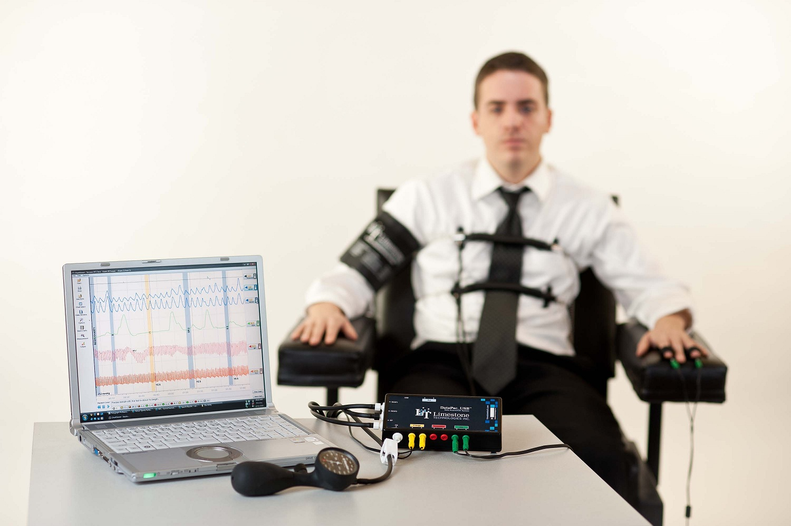
Human Side-Channel Analysis
Heart rate, blood pressure, respiration, and skin conductivity.

Slide 7
Opportunities for SCA
IT systems have a vast attack surface due to their intricate hardware and software components, making them susceptible to various forms of side-channel exploits.
Notes:
In the realm of information technology, the complexity of computers and their extensive functionalities present numerous opportunities for side-channel attacks. These systems have a vast attack surface due to their intricate hardware and software components, making them susceptible to various forms of side-channel exploits. This broad attack surface means that attackers can leverage many different aspects of a computer's operation, from its physical emanations to the minute timing differences in its processes, to extract sensitive information indirectly.

Slide 8
Side-Channel Attacks on IT Infrastructure
Various Sources of Information are utilized that are beyond primary comminication
Secure main data pathways but not consider others??
Notes:
In side-channel attacks on IT systems, attackers leverage various sources of information beyond the primary communication channel between devices or programs. They exploit indirect paths, such as electromagnetic signals, power consumption, sound, or timing information, to gather data that can reveal the system's secrets or operations. This approach highlights the importance of securing not just the main data pathways but also considering other, less obvious sources that could inadvertently leak sensitive information.

Slide 9
The Goal of SCA
Encryption keys
Passwords, or
Personal identifiable Information(PII)
Secret data
User activity (visited websites, running programs, …)
Keystroke Timings
….....!
Notes:
Side-channel attacks aim to retrieve sensitive information without directly breaking into the main communication channel. By exploiting indirect signals and traces left by user interactions, such as electromagnetic emissions, power usage patterns, or even the timing between keystrokes, attackers can infer private data. This can include passwords, PINs, cryptographic keys, details about user activity like visited websites or running programs, and the timing of keystrokes, which might reveal typed information. These attacks require a sophisticated understanding of how systems operate and emit information, demonstrating the need for comprehensive security measures that go beyond protecting direct data channels.

Slide 10
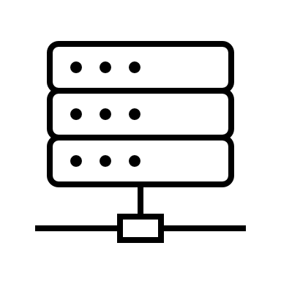

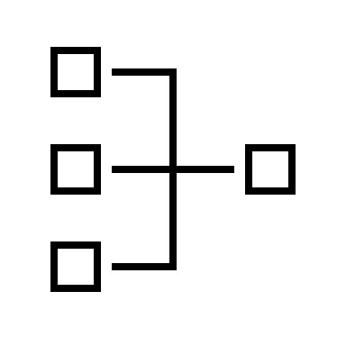
Intended communication channel
Notes:
Systems want to tell us things
▪ for that, they have an intended communication channel
(Data sent over USB, Ethernet, Software API, …)
▪ but often, they inadvertently tell us much more through unintended side channels

Slide 11
Concepts related to side-channel attacks
Term | Explanation
Side Channel Attack | A type of cyber-attack where the attacker gains information from the physical implementation of a system, rather than weaknesses in the software itself.
Side Channel | The unintended communication path that leaks information. This could be anything from power consumption, electromagnetic leaks, sound, or even timing information.

Slide 12
Concepts related to side-channel attacks
Term | Explanation
Information Leakage | The process by which sensitive information is unintentionally exposed through a side channel, allowing attackers to gain insights into the system's operations or secrets.
Side Channel Analysis | The technique of analyzing information gained from side channels to uncover secrets or vulnerabilities in a system, often used in side-channel attacks.

Slide 13

Covert Channel
Term | Explanation | Covert Channel
Side Channel Attack | An attack exploiting physical system implementations to gain information, bypassing software weaknesses. | A method where information is transmitted secretly using a channel not intended for communication, often between processes within a system.
Side Channel | An unintentional path that leaks information through physical means like power, electromagnetic signals, sound, or timing. | A hidden path that allows the transfer of information in a manner violating the system's security policy.
Information Leakage | The accidental exposure of sensitive information through side channels, revealing system operations or secrets. | The unintended and unauthorized transmission of information across the covert channel.
Side Channel Analysis | Analyzing leaked information from side channels to uncover system vulnerabilities or secrets. | The process of detecting and decoding messages passed through covert channels, often to breach security protocols.

Slide 14
Motivation
CIA Triad
Role Based Access Control
Access Control Matrix
2FA
NIST SPs
PCI DSS
Firewalls/IDS/IPS/SIEM
…...
Are these enough to defend against Side channel attacks?
Notes:
The world jumped into the Digital Revolution or the Third Industrial Revolution in the late 20th century [20, 125]. In the pre-digital era, paper files (or mechanical and analog electronic technologies) dominated, with digital-era computers predominated to store and process information. Because of this revolution, overall information is present in cyberspace for now. This revolution triggered intended or unintended disclosure of information and unauthorized access events [1, 99, 113]. Though computer security policies were there to protect the confidentiality of the data, most of the policies emphasized role-based access control, access control matrix, and the chain of trust [78]. Initially, it was enough to provide security to the confidential data, but it could not defend against side-channel attacks because adversaries did not gather the information by exploiting direct access.

Slide 15










Scope that cross Cryptographic Systems
T. George Hornby. “Side-Channel Attacks on Everyday Applications: Distinguishing Inputs with FLUSH+RELOAD”. In: 2016.
Notes:
Initially, researchers focused only on compromising cryptographic algorithms and devices. However, as the topic reached the boom, people started working on side-channel attacks with a scope that crossed the cryptographic-level border. Now many researchers are working on exploiting areas other than the cryptography level. These [2, 59, 85] side-channel attacks are non-cryptographic attacks.

Slide 16
SCA Techniques
Power
Time Electromagnetic Radiations
Acoustic Cryptanalysis
Cache-Based Attacks
Rowhammer Attack
Fault Injection
Hardware Trojon
Photon Emission Analysis
Notes:
Power Analysis: Analyzing power consumption fluctuations to extract sensitive information like cryptographic keys.
Timing Analysis: Exploiting variations in execution time to infer secret information, particularly in cryptographic operations.
Electromagnetic Radiation Analysis: Capturing and analyzing electromagnetic emissions to extract sensitive data, especially from devices performing cryptographic operations.
Acoustic Cryptanalysis: Utilizing sound waves emitted during computation to extract cryptographic keys or sensitive information.
Cache-based Attacks: Exploiting cache access patterns to infer sensitive data or cryptographic keys.
Rowhammer Attack: Inducing bit flips in DRAM cells by rapidly accessing neighboring rows, potentially leading to security compromises.
Fault Injection Attacks: Introducing faults in the execution of a cryptographic algorithm to extract sensitive information.
Hardware Trojan: Introducing malicious circuitry or modifications in hardware designs to leak sensitive information.
Differential Power Analysis (DPA): Analyzing power consumption variations between different operations to extract cryptographic keys.
Photon Emission Analysis: Analyzing light emissions from integrated circuits to infer sensitive information or cryptographic keys.
Photon Emission Analysis: Analyzing light emissions from integrated circuits to infer sensitive information or cryptographic keys.

Slide 17
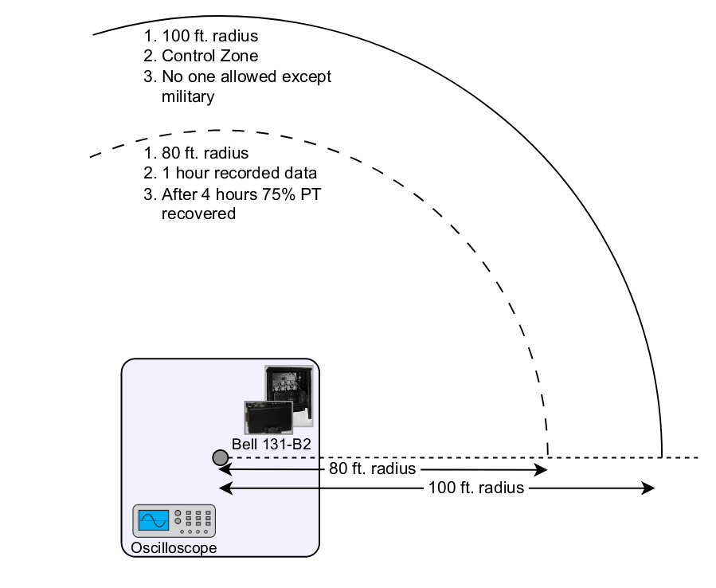
TEMPEST
Telecommunications Electronics Material Protected from Emanating Spurious Transmissions (TEMPEST)
An approved document for release by NSA in 2007 in response to the Freedom of Information Act (FOIA) request to the Department of Defense, USA.
Source:http://arxiv.org/abs/2312.11094
Notes:
The document’s title was “TEMPEST: A Signal Problem” Initially, the document was listed under the secret/classified category but was later released in the public domain by the NSA of the USA. Bell 131-B2 mixing devices were used for secured/encrypted communication during WWII. The researcher(s) of Bell Labs noticed that an electromagnetic spike was seen with the help of an oscilloscope when the mixing machine stepped. It happened because of rotors rotating/shifting. Later, the researchers concluded that plain text

Slide 18
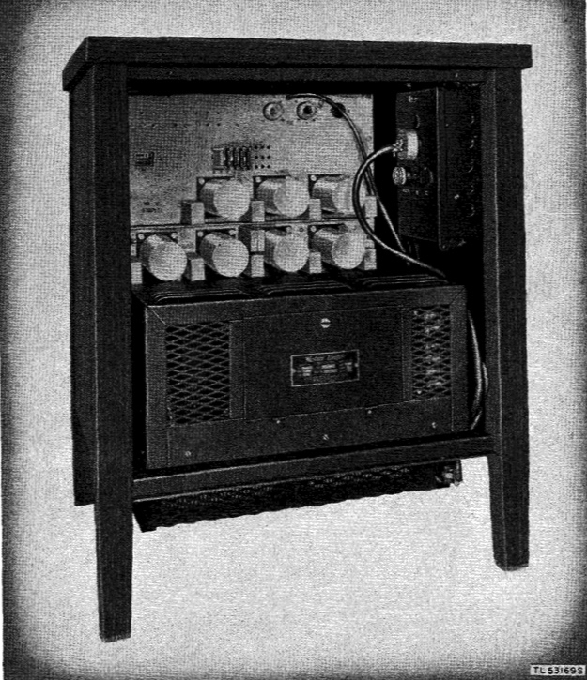
Bell 131-B2 Mixing Devices
Shielding
Filtering
Masking
Notes:
could be recovered from the cipher text. Later this experiment was carried out at a large scale, and Signal Corps found that approximately 3/4 of the original text could be recovered using the mentioned technique, which was 80 feet away. The above mentioned scenario is explained in Fig.The document also states that three methods were used to suppress the attack: • Shielding: They covered the machine with multiple layers of various materials to prevent EM radiation. • Filtering: Filters were installed to stop the electromagnetic radiations. • Masking: They used multiple layers of fake signals to add noise to the original signal of the machine by assuming that it would protect their original signal. Though they used all three mentioned techniques, a modified version could not be placed because shifting all the machines to the Bell Labs was impossible. Moreover, using the mentioned techniques took much work to implement, as it introduced various operational issues like heat generated by the machine, etc.. Hence, the Signal Corps ordered the commanders to secure a radius of 100 feet.

Slide 19
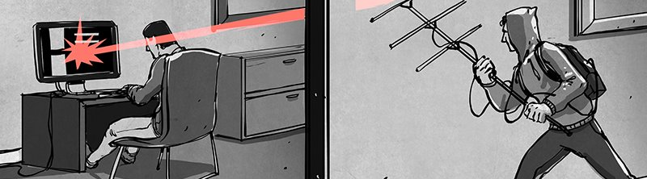
Electromagnetic Radiation from Video Display Units: An Eavesdropping Risk?” by Wim Van Eck
Source: https://hackaday.com/2015/10/19/tempest-a-tin-foil-hat-for-your-electronics-and-their-secrets/​
CRT (Cathode Ray Tube)
Programmable Digital Frequency Divider
Mitigation Strategies
  Minimization of Radation
  Maximization of noise
  Cryptographic displays
Notes:
if we consider the overall side-channel category, then a research paper was published under the unclassified category titled “Electromagnetic Radiation from Video Display Units: An Eavesdropping Risk?” by Wim Van Eck[140]. Eck demonstrated eavesdropping on the CRT (Cathode Ray Tube) video display unit in this paper. Initially, he realized that radiation measurement was not synchronized, so images and pixels moved horizontally and vertically simultaneously. Later, with the help of a programmable digital frequency divider, WV Eck could reconstruct both horizontal and vertical synchronizations. He also proposed some solutions to avoid such Eck successfully eavesdropped on a real system, at a range of hundreds of metres, using just $15 worth of equipment plus a television set.

Slide 20
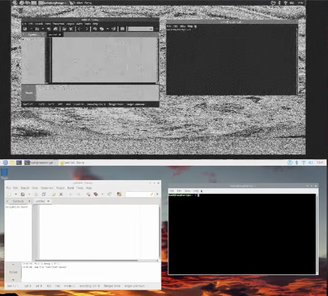
Van Eck phreaking
Software Defined Radio

Slide 21

Unveiling the Pinnacle Achievements of Side Channel Attacks
1996
The Paper: Timing Attacks on Implementations of Diffie-Hellman, RSA, DSS, and Other Systems
Notes:
One of the first papers to bring (theoretical) attention to the idea of using timing attacks to break cryptosystems. Provided the theoretical basis, but wasn’t considered a pertinent concern at the time. Paul C. Kocher [72, 73] introduced timing channels in 1996; he demonstrated how timing measurements of a system performing a cryptographic function could be used to find the secret key of various cryptosystems like Diffie-Hellman, DSS, RSA, and other systems. His work includes the techniques used in timing attacks, statistical analysis, and deriving the correlation between execution time and secret key to deduce the secret key. Later, researchers started thinking in various directions with the concept that a measured quantity can lead to information leakage, and this is how various side-channels [5, 17, 41, 45, 47, 48, 67, 89, 108, 111, 115, 120, 133, 134, 148, 150] were introduced.

Slide 22
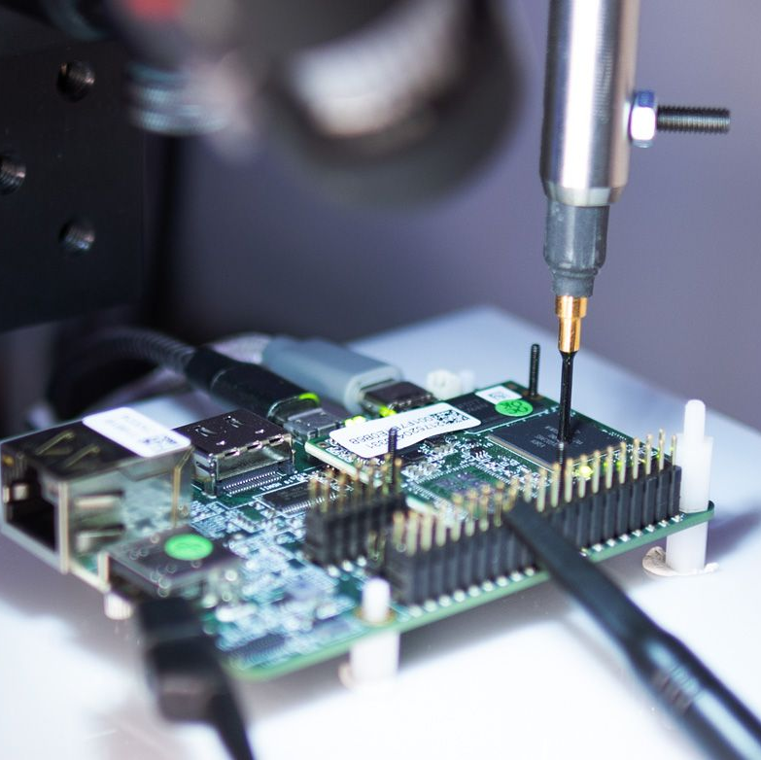
Measured quantity can lead to information leakage, and this is how various side-channels were introduced.
Manfred Josef Aigner and Elisabeth Oswald. “Power Analysis Tutorial”. In: Institute for Applied Information Processing and Communication, University of Technology Graz, 2000.
Notes:
So the basic concept of side-channel attacks is to get the information by observing the process, hardware or any other component through the same device or sometimes external devices. Furthermore, exploit the observed data to deduce the information as seen in Fig. Below slide

Slide 23
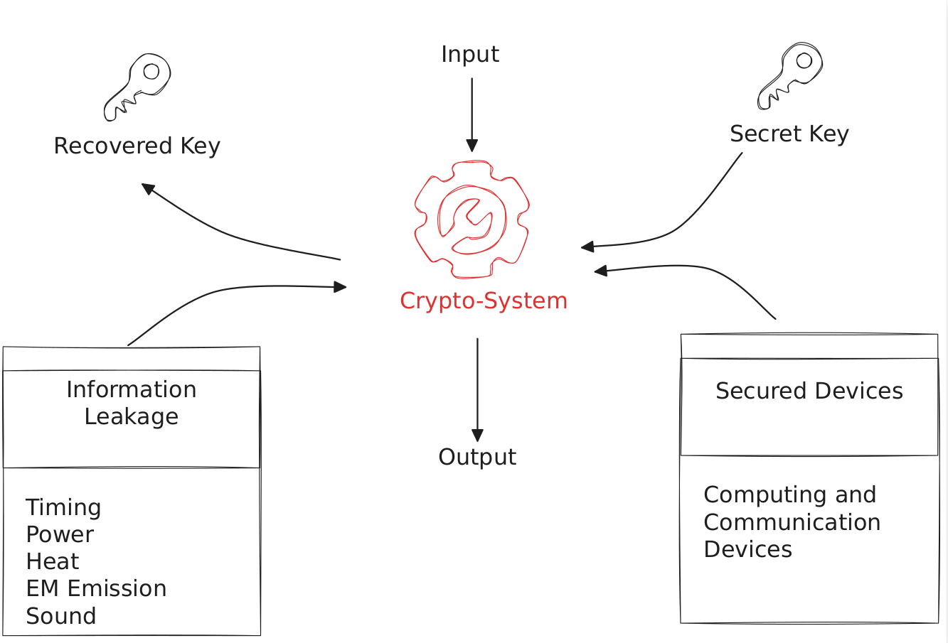
SCA
Notes:
Let us take an example of a vault where diamonds or many valuables are stored. Please assume the vault has a 6-digit pattern to open its mechanical lock. Then, there are 1,00,000 possible patterns to open the vault. If an attacker tries to break the vault’s mechanical lock with the brute force technique, at the side-channel has nothing to do with direct access to the confidential data, which is secure. In a side-channel attack, an attacker observes the leakage of nonfunctional characteristics such as timing, power, heat, EM emission, etc., later by training the model or comparing it with some known data is changed into the data the victim wanted to protect.

Slide 24
SCA Model
Reconnaissance
Profiling
Attack planning
Attack execution
Data analysis
Exploitation
Covering tracks
Notes:
A side-channel attack is completely different from traditional attacks. Some attacks might require the physical access of the system. Due to this being different from other attacks, we must follow the steps below to carry out this attack successfully.
A side-channel attack is completely different from traditional attacks. Some attacks might require the physical access of the system. Due to this being different from other attacks, we must follow the steps below to carry out this attack successfully. 1) Reconnaissance: Initially, the attacker gathers information about the target system or device, including its hardware and software configurations, use cases, and potential vulnerabilities. 2) Profiling: In this stage, the attacker collects baseline data about the target system or device, including its power consumption, timing behavior, electromagnetic emissions, or other side-channel characteristics. 3) Attack planning: In this stage, the attacker selects the appropriate side-channel attack technique based on the characteristics of the target system or device, as well as the level of access and resources available. 4) Attack execution: In this stage, the attacker executes the selected side-channel attack technique to infer information about the victim’s data or secret key. The attacker may use a combination of hardware and software tools to perform the attack, and may need to adapt their approach based on the results of the profiling stage. 5) Data analysis: In this stage, the attacker analyzes the data collected during the attack to extract sensitive information about the victim’s data or secret key. This may involve statistical analysis, machine learning algorithms, or other advanced techniques to extract meaningful patterns or correlations from the data. 6) Exploitation: In this stage, the attacker uses the information obtained from the side-channel attack to achieve their objectives, which may include accessing restricted data, impersonating the victim, or compromising the security of the system or device. 7) Covering tracks: In this stage, the attacker covers their tracks by removing any traces of the side-channel attack, including the data collected, the tools used, and any modifications made to the target system or device.

Slide 25
Side Channel Attack Taxonomy
Exploitation
Attack Method
Access Level
Component
Software
Hardware
Remote
Local
Proximity
Active Attack
Passive Attack
Timing
Sound
Temperature
Power

Slide 26
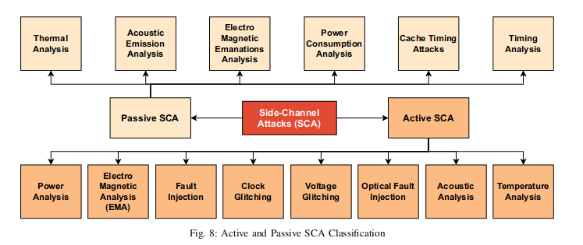
SCA Classification
Source: http://arxiv.org/abs/2312.11094

Slide 27
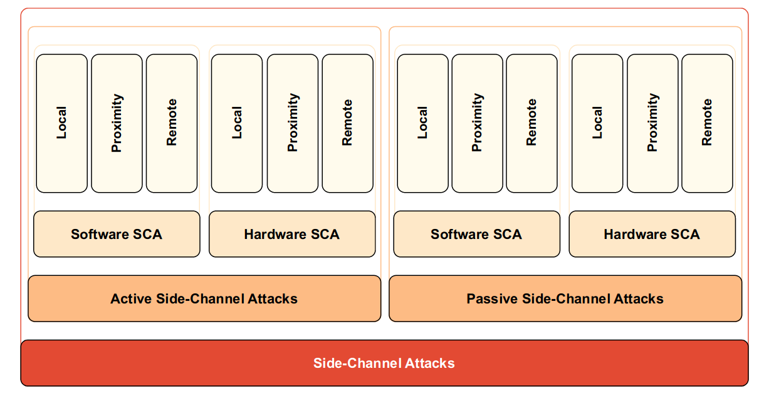
Overall Side-channel Taxonomy

Slide 28
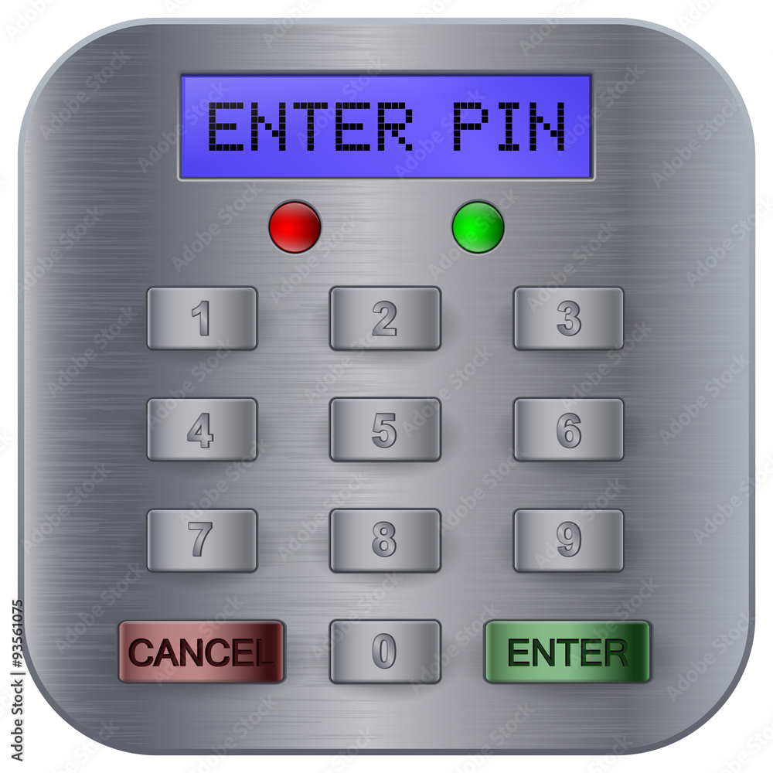
Case Study
ATM PIN
4 Digits
Notes:
In this code, the function check_pin takes an input string input_pin and compares it to a correct_pin string. It first checks if the input PIN has exactly 4 digits. Then it compares each digit of the input PIN to the corresponding digit of the correct PIN. If any digit is incorrect, it returns False immediately; otherwise, it returns True if all digits match.
The vulnerability to a timing attack lies in the fact that the function will return False as soon as it finds a mismatch. An attacker could measure the time it takes for the function to return False and deduce how many digits were correct before the check failed. Each additional correct digit would typically add a small amount of time to the function's execution.

Slide 29
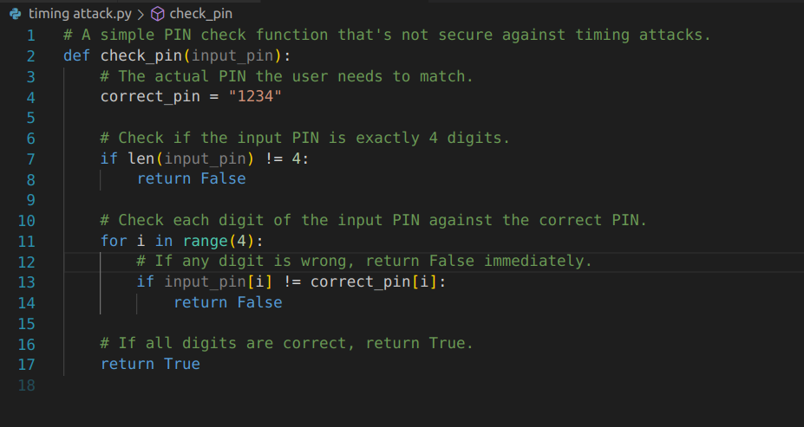
Python function to check a 4-digit PIN

Slide 30

Timing Analysis
Correct PIN ("1234"): Approximately 0.042 seconds
Wrong PINs:
  "1235": Approximately 0.042 seconds
  "1244": Approximately 0.040 seconds
  "1344": Approximately 0.021 seconds
  "2344": Approximately 0.011 seconds

Slide 31

Code Analysis
The code runs fast and exit early!!!
Input Dependent
This Allows the Attacker to guess the password from timing

Slide 32

Mitigation
Don’t exit early
Remove Branches
Try to achieve Contant time code O(1)

Slide 33
Mitigation
Understand Vulnerabilities
Security Training
Physical Isolation
Process and Memory Isolation
Reduce Attack Surface
Randomization ASLR

Slide 34
CVE-2023-32691
gost (GO Simple Tunnel) is a simple tunnel written in golang.
Untrusted input, sourced from a HTTP header, is compared directly with a secret. Since this comparison is not secure, an attacker can mount a side-channel timing attack to guess the password.
Notes:
gost (GO Simple Tunnel) is a simple tunnel written in golang. Sensitive secrets such as passwords, token and API keys should be compared only using a constant-time comparison function. Untrusted input, sourced from a HTTP header, is compared directly with a secret. Since this comparison is not secure, an attacker can mount a side-channel timing attack to guess the password. As a workaround, this can be easily fixed using a constant time comparing function such as `crypto/subtle`'s `ConstantTimeCompare`.

Slide 35

Questions

