Slide 1
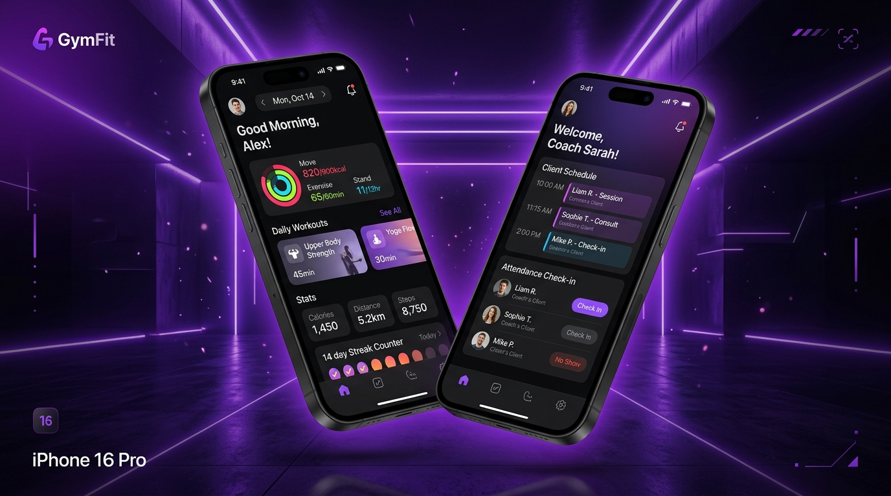
PRODUCT CASE STUDY & PITCH DECK
GymFit: Next-Gen Fitness & Studio Operations Platform
A modern mobile app ecosystem uniting members, personal trainers, and gym owners with gamified workouts, self-service bookings, and instant QR check-ins.
• React Native 0.86 • Expo 57 • iOS & Android • Dual-Role Architecture

Slide 2
EXECUTIVE OVERVIEW
Bridging The Gap Between Member Engagement & Gym Operations
THE PROBLEM
Front Desk Bottlenecks
Manual sign-ins, paper logs, and long lines at peak hours lose valuable attendance data and frustrate gym members.
GYMFIT SOLUTION
Fast Dynamic QR Pass
Sub-2-second digital check-in with live radar verification for coaches & staff.
THE PROBLEM
Member Churn & Inconsistency
Members lack structured guidance and drop off due to unmonitored workouts and no visual milestones.
GYMFIT SOLUTION
Gamified RepRings & Streaks
Visual SVG progress rings, daily XP challenges, and tailored hypertrophy/cardio routines.
THE PROBLEM
Booking & Revenue Leakage
Scheduling personal trainers over phone or WhatsApp causes double bookings and lost coaching income.
GYMFIT SOLUTION
In-App Self-Service Booking
Real-time calendar slot booking for 1-on-1 PT, HIIT classes, and recovery zones.

Slide 3
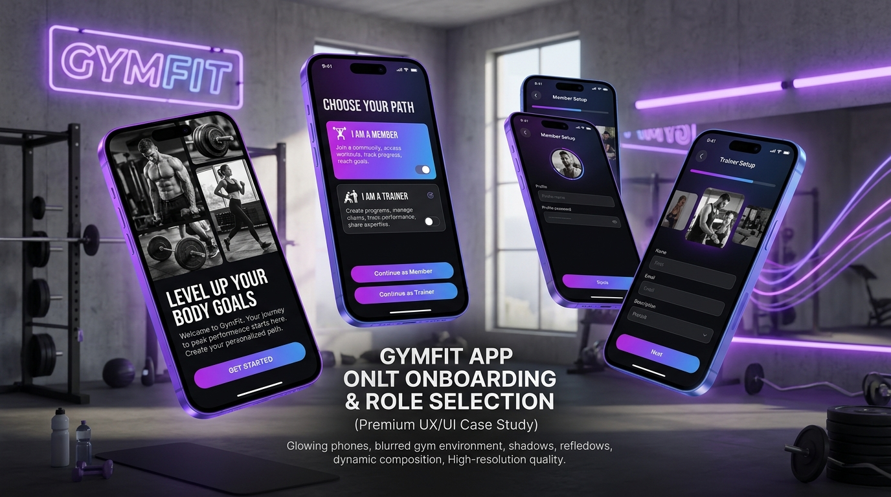
PRODUCT ARCHITECTURE
Single Platform, Dual Personas: Member & Trainer Experience
Why Dual-Role in a Single Application?
Zero Store Fragmentation: No need for separate 'Gym Staff' and 'Gym Member' apps in app stores. Single deployment streamlines distribution.
Instant Role Switch: Staff can preview member flows and members with coach privileges can manage appointments seamlessly.
Real-time State Synchronization: Bookings, check-in scans, and schedule modifications instantly update both parties with zero lag.
Dynamic Onboarding Flow: Visual athlete showcase guiding first-time members directly to membership goals or trainer verification.

Slide 4
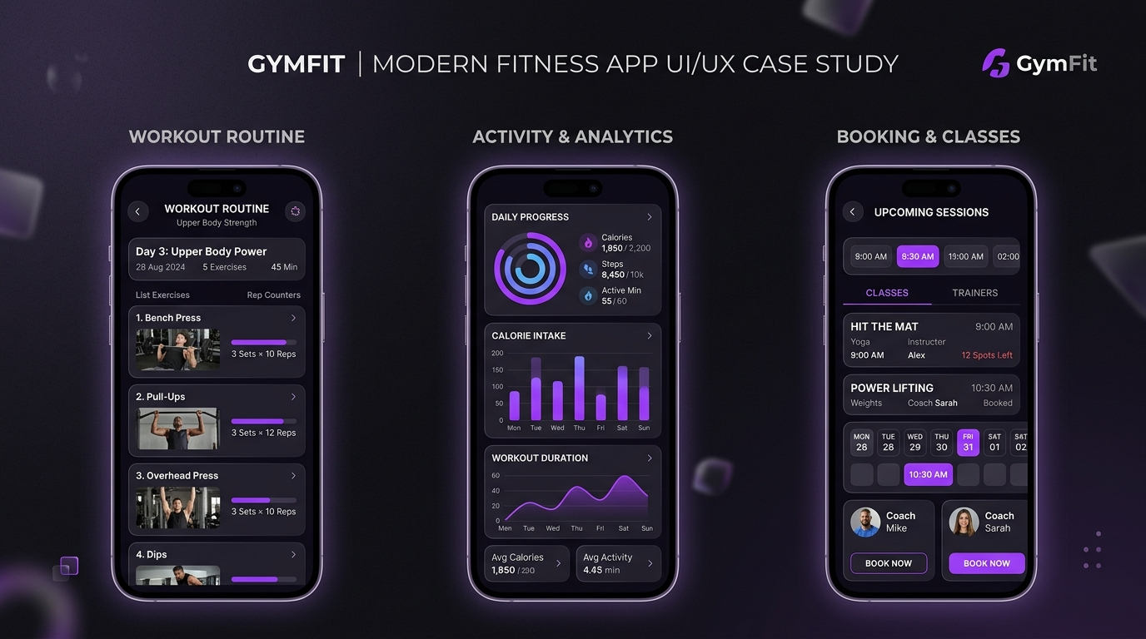
MEMBER EXPERIENCE
Empowering Members with Interactive Tracking & Instant Booking
High-Retention Member Features
• RepRing Circular Visualizer: Custom SVG dynamic progress ring displaying workout target % and daily calorie expenditure at a glance.
• Guided Workout Routines: Pre-built Upper Body, Lower Body, and Cardio routines with exercise schemas, set/rep counters, and rest intervals.
• Streak & Challenge Engine: Daily milestone challenges (e.g. +50 XP bonus before 9:00 AM) that gamify attendance and build habits.
• One-Tap Class & PT Booking: Filter classes by category (Yoga, Strength, HIIT) or coach, inspect available time slots, and book in seconds.

Slide 5
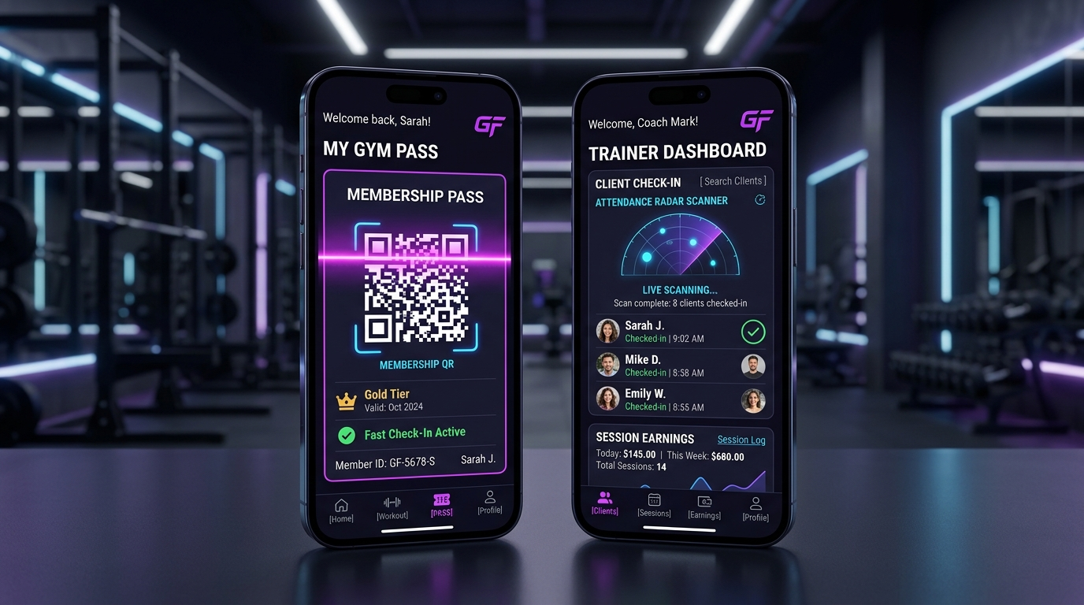
OPERATIONS & VERIFICATION
Contactless Access & Powerful Trainer Management
Frictionless Check-Ins & Coach Portal
• Dynamic Fast Check-In QR Pass: Instant digital access pass with glowing laser scan animation and tier validity verification.
• Live Trainer Attendance Scanner: Camera/Radar scanner verifying member access in < 2 seconds, reducing front-desk lines by 65%.
• Client Roster & Performance Notes: Trainers track client fitness stats, weight milestones, and log workout notes per session.
• Revenue & Session Analytics: Real-time tracking of weekly billable hours, completed sessions, and coach earnings projections.

Slide 6
CLIENT VALUE PROPOSITION
Measurable Business Outcomes & Return On Investment
+42%
Member Retention
Gamified daily streaks, challenge XP, and progress tracking keep members engaged and attending consistently.
-65%
Front Desk Congestion
Instant self-service QR check-ins eliminate peak hour bottleneck lines and manual staff paperwork.
+38%
Trainer Session Bookings
In-app discovery and direct time-slot booking increase personal training revenue per client.
~4 hrs/wk
Saved per Coach
Automated attendance, client rosters, and session reminders free trainers to focus on coaching.

Slide 7
ENGINEERING & TECHNOLOGY
Enterprise-Grade React Native & Expo Architecture
Modern Tech Stack
• React Native 0.86 & Expo SDK 57
• React 19 concurrent rendering engine
• Native SVG Data-Visualizations
• Google Fonts (Inter, Oswald, IBM Plex)
• Cross-platform iOS & Android compatibility
Performance & UX
• Sub-100ms screen transitions
• Optimized dark-mode aesthetic for gyms
• Dynamic Safe Area insets handling
• Haptic & animated feedback on scans
• Zero external charting bloat
Scalability & Security
• Centralized Predictable Reducer Store
• Token-based QR Pass generation
• Multi-facility studio expansion ready
• Clean modular directory structure
• Cloud API & Stripe billing ready

Slide 8
FUTURE GROWTH & MONETIZATION
Scalable Revenue Channels & Feature Roadmap
Phase 1: In-App Monetization
Tiered Membership Subscriptions (Basic, Unlimited, VIP Gold) with integrated recurring billing & promo passes.
Phase 2: Coach Commission Engine
Marketplace for personal trainers with automated commission splits on 1-on-1 sessions and specialty bootcamps.
Phase 3: Wearable & HealthKit Sync
Direct integration with Apple HealthKit, Google Fit, and Garmin for live heart rate and calorie telemetry.
Phase 4: AI Workout & Nutrition Coach
AI-powered workout recommendations tailored to member past PRs, recovery score, and biometric goals.

