Slide 1
CAD- Project
A typical Office Building
Group Members
1. Umer Basit
2. Muhammad Abudllah
3. Muhammad Talha Nadeem

Slide 2
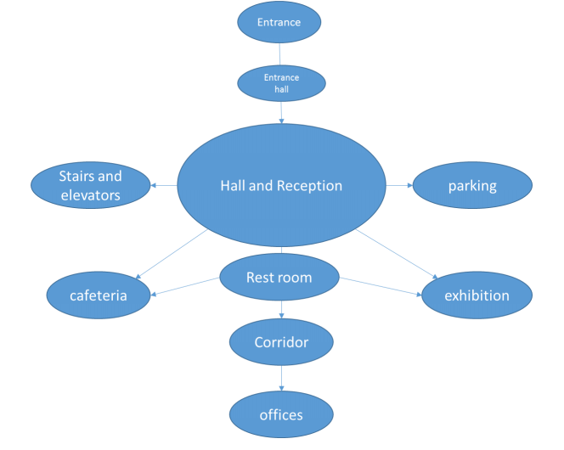
Components of an Office Building:

Slide 3
Entrance:
Entrance of a building is important part of a building and it shows the importance of a building. The proposed drawing consists of entrance with three doors and several windows. Stairs and ramp for disabled people is provided. Different trees and plants are also provided to increase the beauty of the building front.

Slide 4
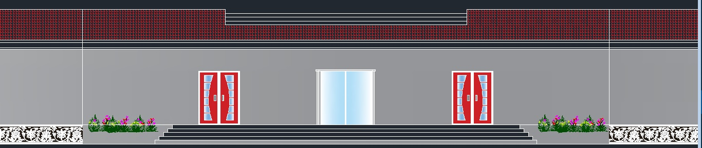

Slide 5
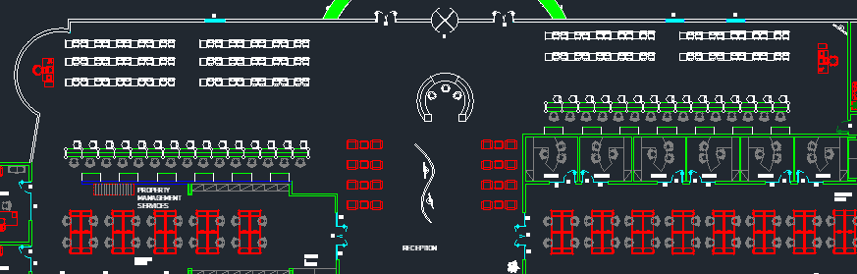
Entrance Hall and Reception:
Entrance Hall consists of a reception desk and several seats in the waiting area. Reception desk is important for people visiting building for first time. Waiting area is large enough for people and a television screen is provided. Different counters are also provided in front to deal with visitors.

Slide 6
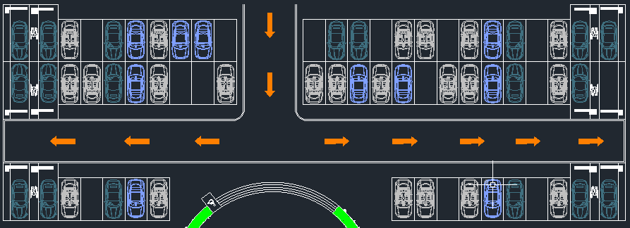
Parking:
The parking place is where the cars stopped and it might be under the ground floor to save areas and for best exploitation when there no enough spaces outside, also it might be outside when there are enough spaces. It is important for a building of such a size to have a proper parking. A proper parking includes parking for everyone and should be wide enough for easy flow of traffic. The size of the standard car is 2.3m width and 5m length and one the parking cars must have enough space for turning and getting out without making any disturbance for other cars.

Slide 7
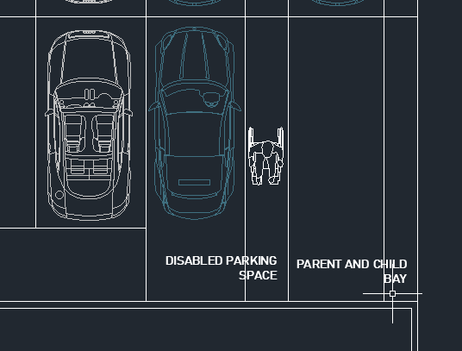
Parking:
Special consideration should be given to the need of disabled people, the special spaces for the disabled persons should be a minimum of 4.8 meters (and up to 6.6 meters) long, with access to the rear of the vehicle where wheelchairs are often stored, the spaces should be 2.4 meters wide plus a minimum of .9 meters (and up to 1.2 meters). Parent and Child Bay is also provided.

Slide 8
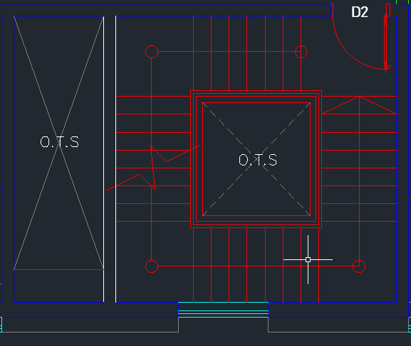
Stairs
The stairs are another solution which supports vertical movement within the office building, stairs have a special use when the electricity cut off, in this case the mechanical equipment such as elevators and escalators cannot work, and thus the stairs are the unique solution. Minimum width of stairs for hotels, offices, educational buildings, theaters, cinema halls should be 1.5 meters while minimum width of stairs for institutional buildings and hospitals etc. should be 2 meters. (Neufert 2012). Stairs are the primary means of vertical travel during fire emergencies and are generally effective and reliable.

Slide 9
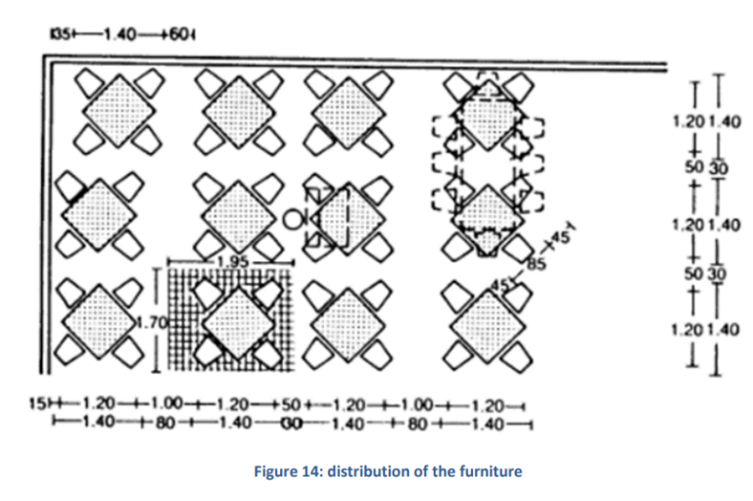
Cafeteria:
The cafeteria in the office building is a small restaurant for the employees and it might be used by the reviewers on there waiting time, so, it will be for small jobs. The cafeteria must have a position on the ground floor closer to the reviewers and employees and it contains an enough space for tables and staff work place. The standard dimensions for the person to be eat comfortably is 60 cm wide and 40 cm deep. Distribution of Furniture is shown below:

Slide 10
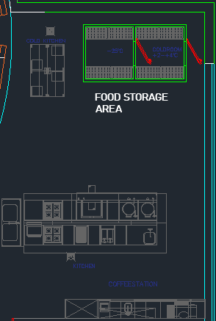
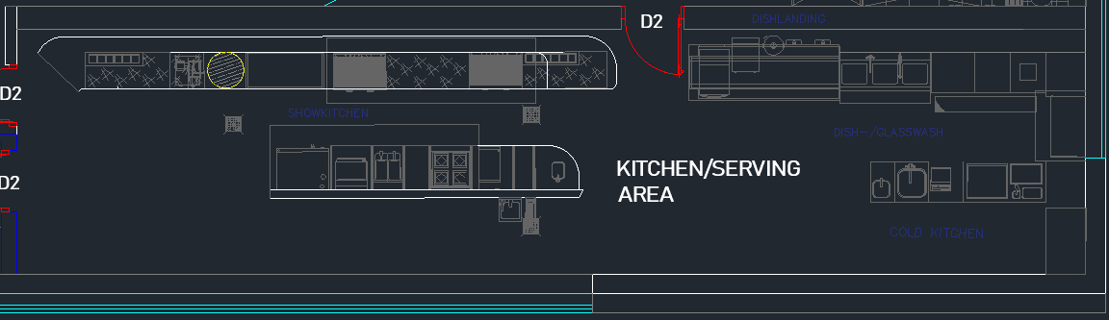
Kitchen:
Kitchen consists of two portions:
Serving Area
Storage Area

Slide 11
Offices:
The office unit must have an enough space for its use, and depend on the furniture and equipment contain. Thus, the furniture, equipment, movement areas, and the people, will control the space areas. We must take into consideration the flexibility of the spaces this principle fewer barriers to change, less distribution when change does occur, and lower costs in money and time can be accomplished by using open spaces and use flexible materials for construct portions. The spaces should be allocated according to functional requirements, so that the location depend on the people position in the company.

Slide 12
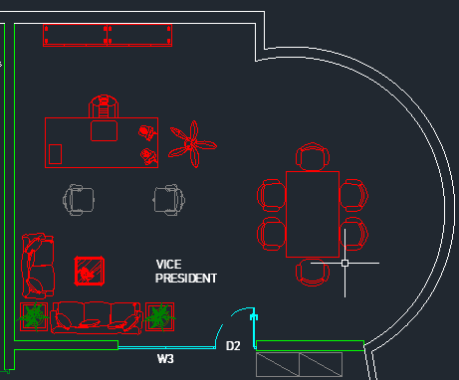
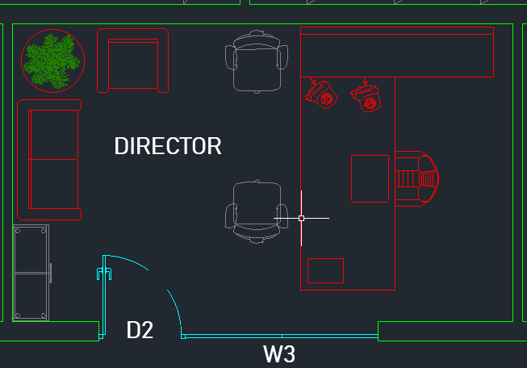
Workstation:
The dimensions of a workstation depends upon various job functions. The work stations most frequently used is a desk and it accessories.

Slide 13
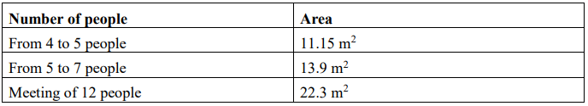
Meeting and conferences rooms:
The meeting rooms as a standers of functionality, the table shows the surface area of such space in function of its capacity – occupants:

Slide 14
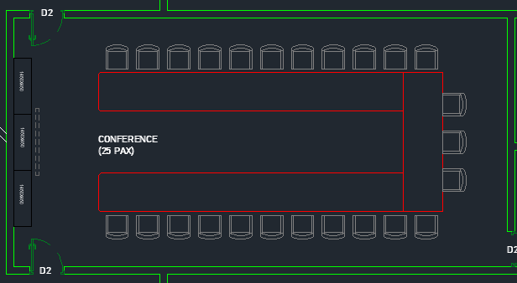
Meeting and conferences rooms:

Slide 15
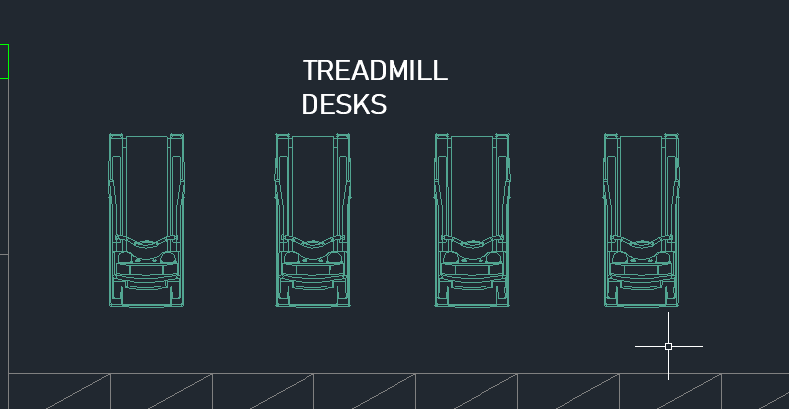
Treadmill Desks:
The concept of treadmill desks is new and being used in western parts of the world. It helps to maintain your health while working. Spaces for these desk are also provided in the plan.

Slide 16
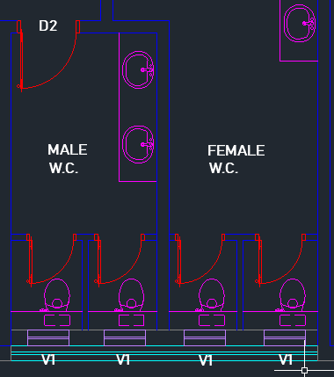
Water Closets:
Water closets should be provided for both men and women in an office building and proper ventilation should also be provided.

Slide 17
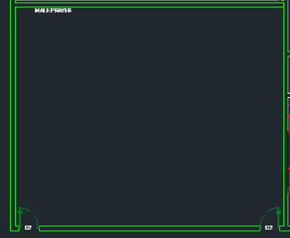
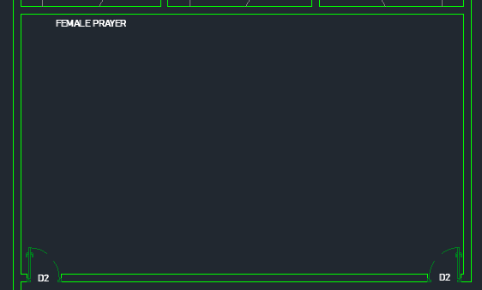
Praying Area:
Praying area for men and women is also provided in the office building.

Slide 18
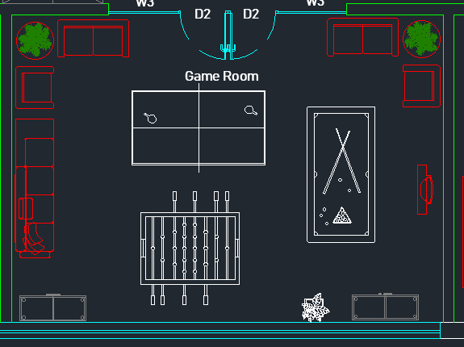
Game Room:
An office building should not be tense. Relaxing atmosphere should be provided and a room is provided for people to relax for a while.

Slide 19
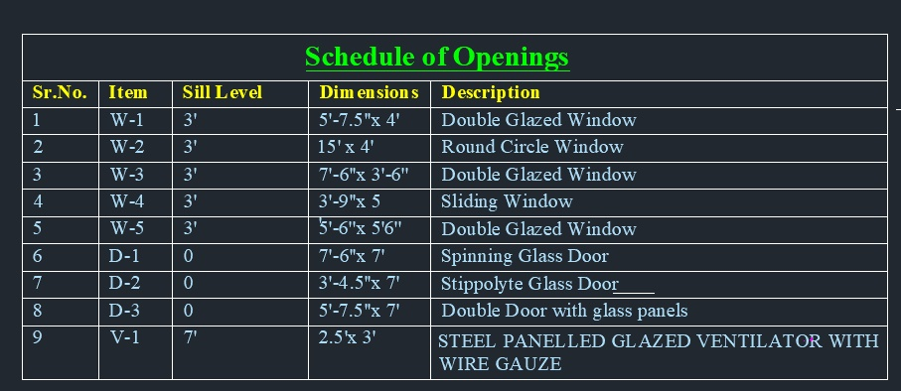
Schedule of Opening:

Slide 20
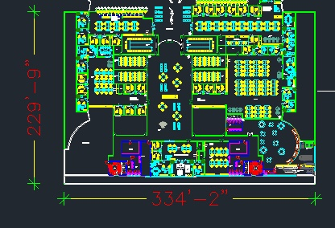
Dimensioning:

Slide 21
14 Kanal
280 Marla
Other inside dimensioning is all according to the standard that is typically followed.

Slide 22
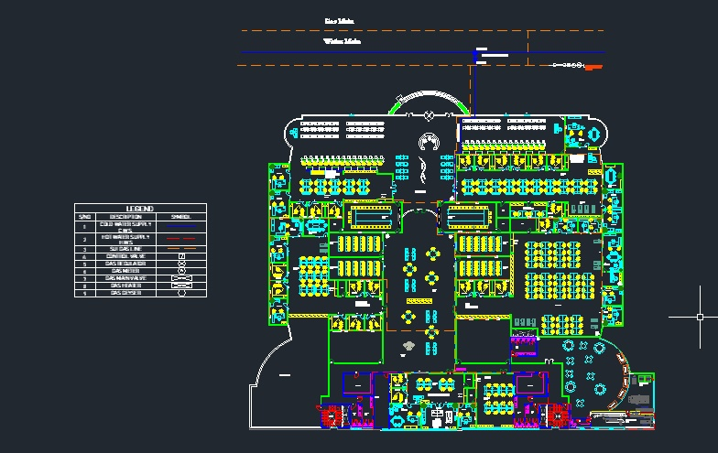
Gas Supply:

Slide 23
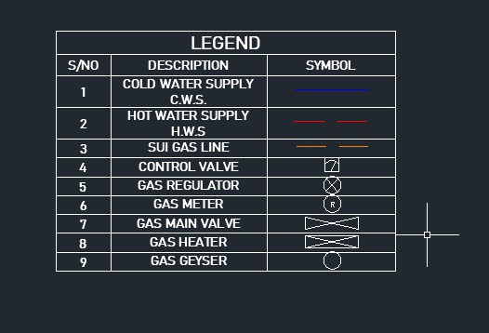

Slide 24
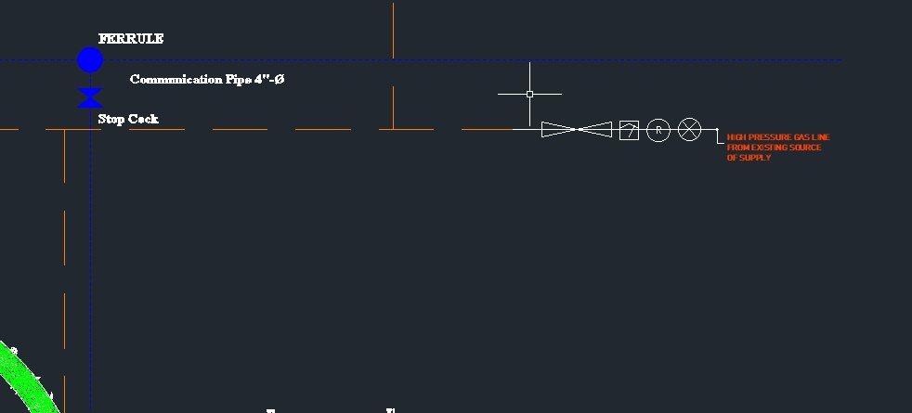

Slide 25
Elevation :

Slide 26
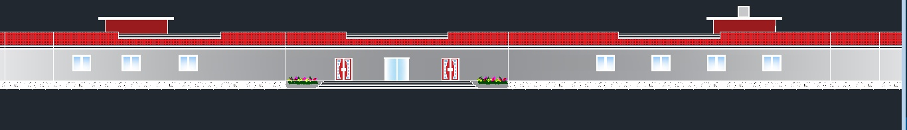
Elevation Cont.

Slide 28
Elevation Features:
Only Ground Floor
Double Glazed Windows
Head Room
Greenery
Rolling Glass Door at Front

Slide 29
Sections:

Slide 30
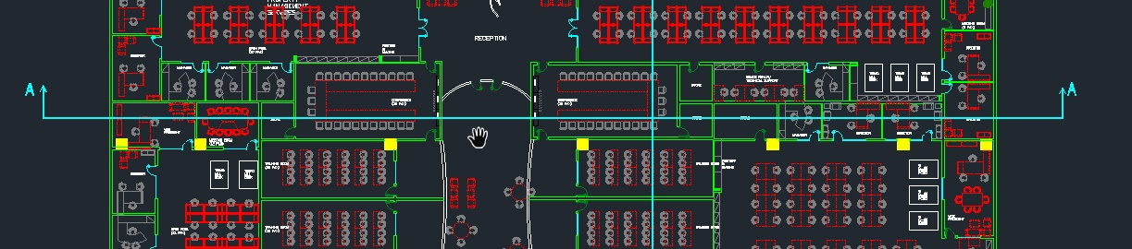
Section A-A’

Slide 31
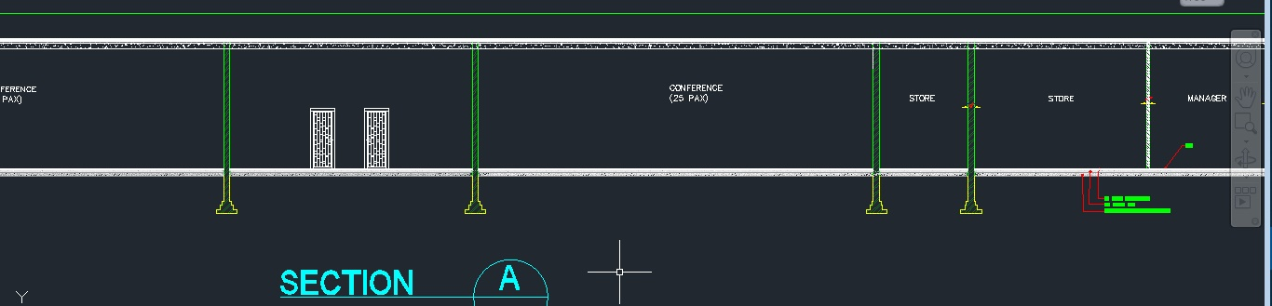

Slide 32
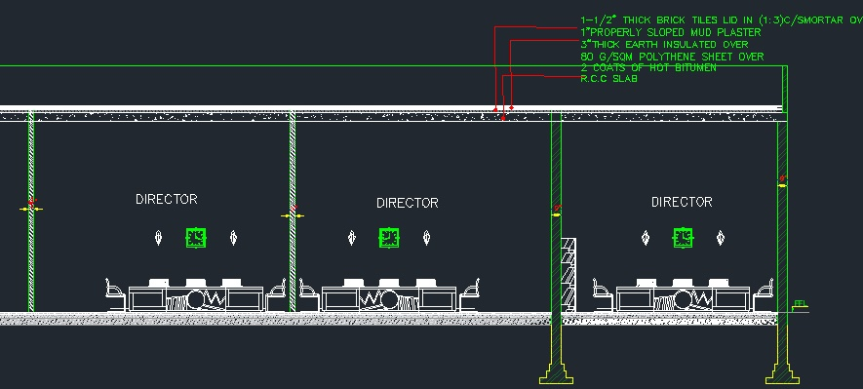

Slide 33
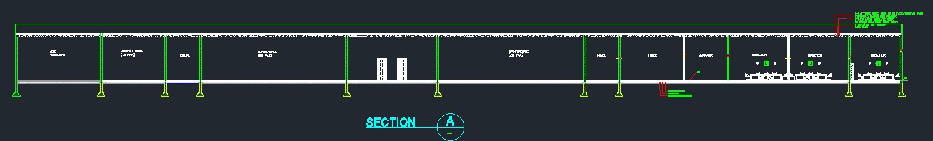

Slide 34
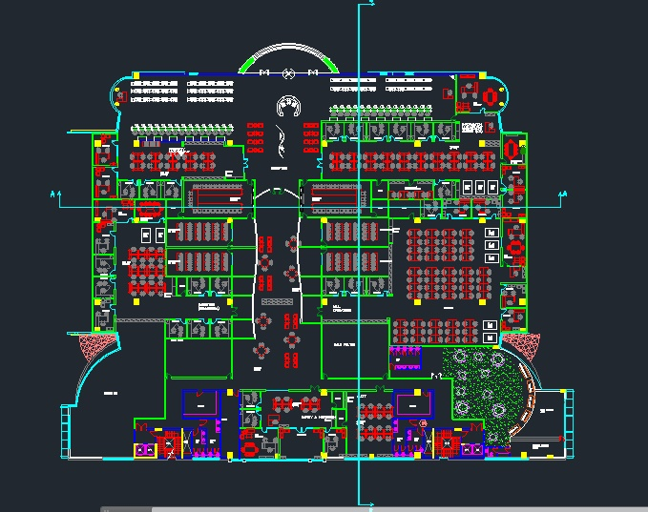
Section B-B’

Slide 35
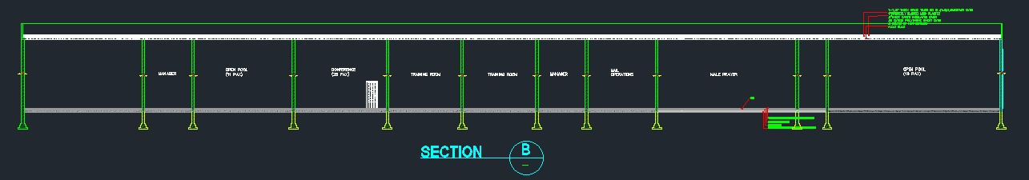

Slide 37
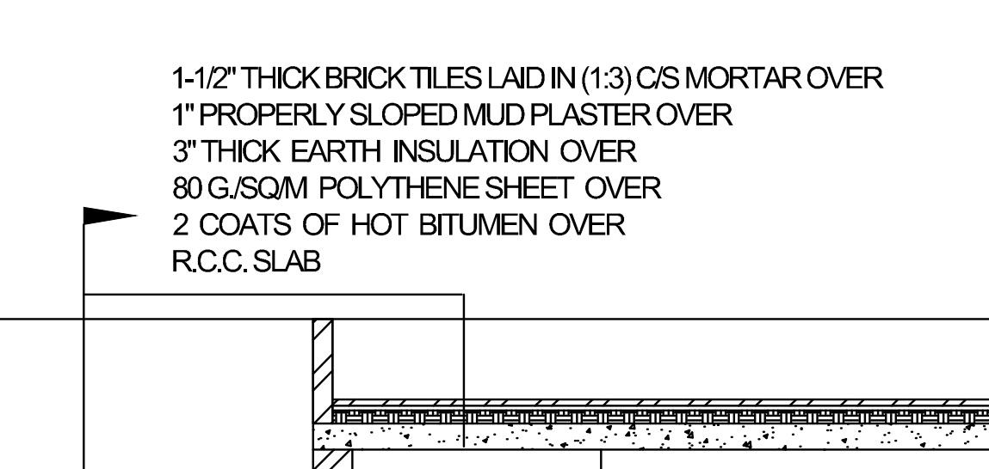

Slide 38
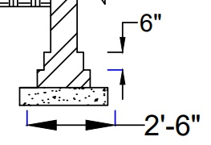

Slide 39
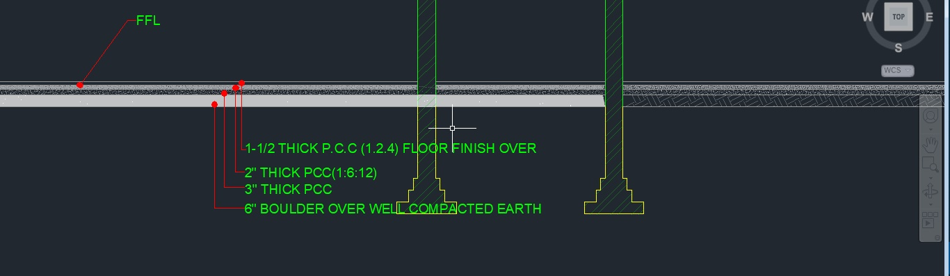

Slide 40
Water Supply Plan

Slide 41
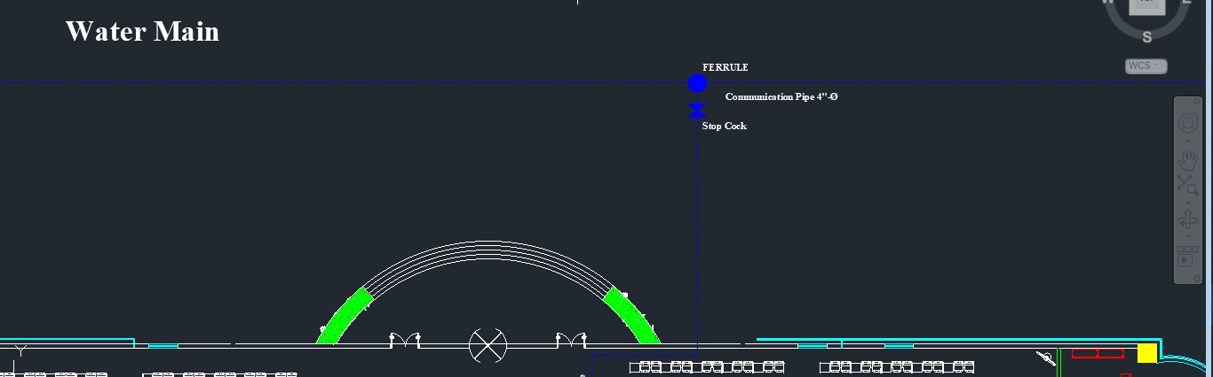

Slide 42
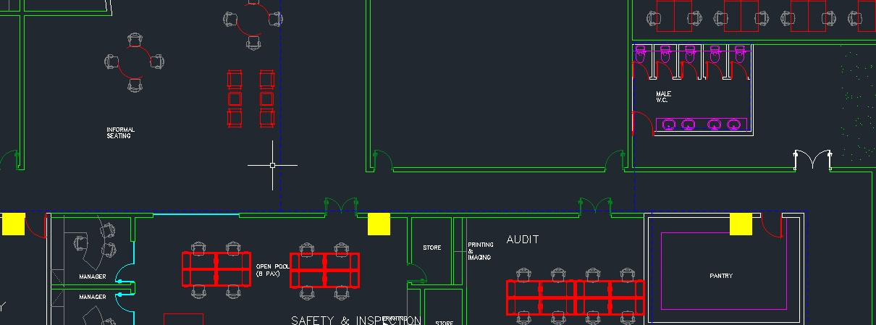

Slide 43
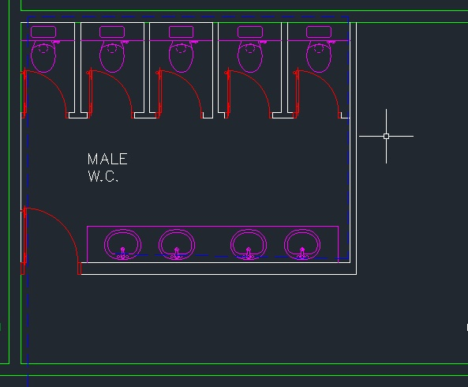

Slide 44
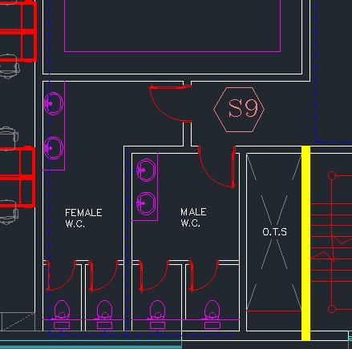

Slide 45
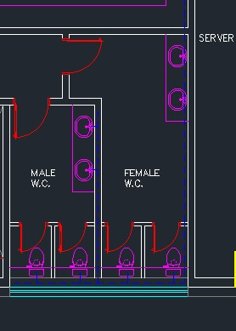

Slide 46
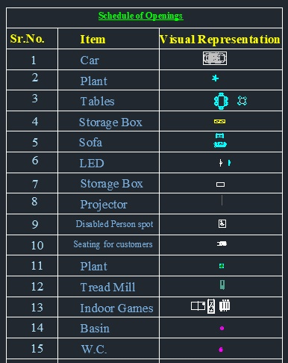
Legend

Slide 47
Sustainable Building
Install double-glazed windows
Double glazed windows help to insulate the house, making it cooler during the summer and warmer during the winter. One can as well use thermal blackout curtains in place of double glazed windows in case they are too costly.
Choose appliances that have more energy-efficiency
Swapping of the regular electrical appliances with energy-saving certified products is highly desirable for a sustainable house.

Slide 48
Installation of solar panels and temperature-regulating walls
It will make the house to be more eco-friendly and also make the house cooler. Solar panels are a sound investment for sustainable home improvement.
Planting of spider plants in the room
Spider plants are known for air purification, they are planted in the chamber,
and they will help to purify the air, especially in the bathroom.

Slide 49
Install a cool roof.
A cool roof is one that reflects the sun’s heat instead of absorbing it into your home. The effect on your cooling bill can be tremendous.

