Slide 1


CS-114
Fundamentals of Programming
Practice Questions – ESE
Course Instructor:
Qurrat-ul-ain Babar
NUST Institute of Civil Engineering (NICE)

Slide 2



Time is of the Essence

Slide 3


Focus!

Slide 4
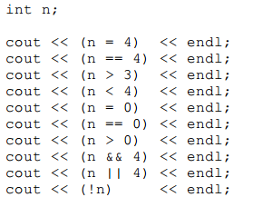
Find the output of the following code snippet

Slide 5
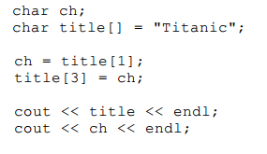
Find the output of the following code snippet

Slide 6
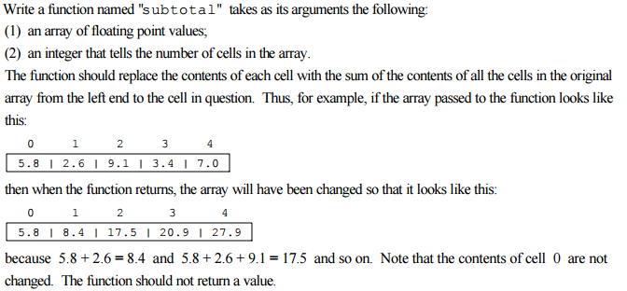
Write a function

Slide 7
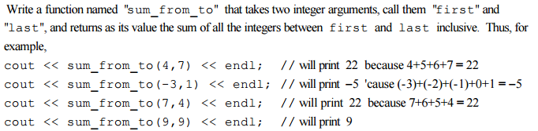
Write a function

Slide 8
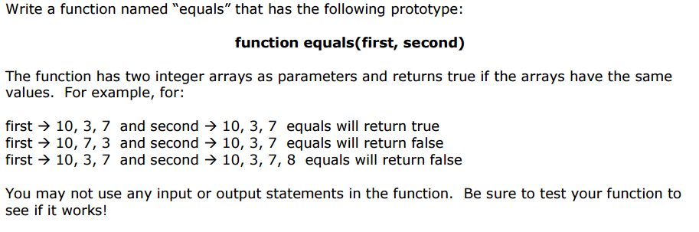
Write a function

Slide 9
Write a Program
Write a program that reverses a string and prints it on the screen.

Slide 10


