Slide 1
Quiz 03 Solution

Slide 2
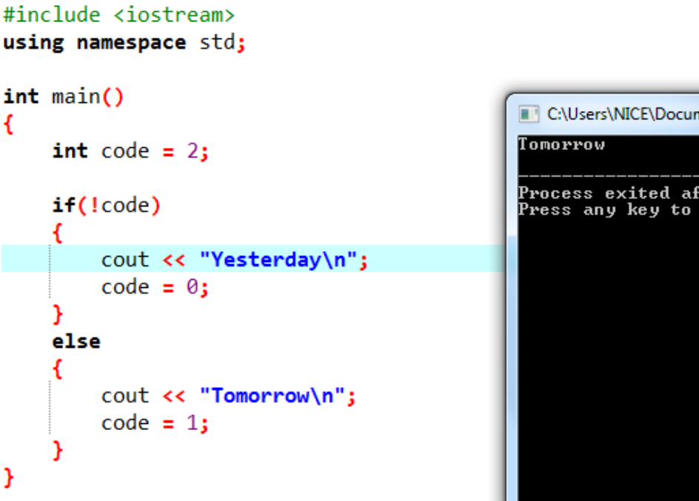
Quiz 03 10 marks
[5 marks] What will be the output of the code given on the right:
In C++, 0 is treated as false in a condition and any other integer is considered as true so !code = !2 = !true = false

Slide 3
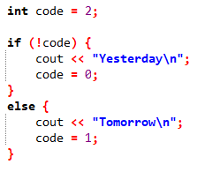
Quiz 03 10 marks
[2.5 marks] Rewrite the piece of code given in Qs 1 using the ternary operator.
(!code)? (cout << "Yesterday\n", code=0)
: (cout << "Tomorrow\n", code=1);

Slide 4
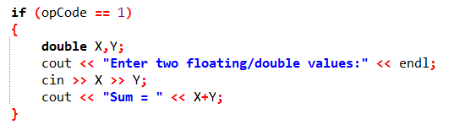
Quiz 03 10 marks
[2.5 marks] Write if statement to do the following:
If integer variable opCode has the value 1, read in double values for X and Y from user and calculate and print their sum

