Slide 1

CS114 – Fundamentals of Programming
Qurrat-ul-ain Babar

Slide 2
Overview
Introduction
Course details
What is this course about?
Aims and Outcomes
Assessment

Slide 3
Introduction
Instructor: Qurrat-ul-ain Babar
  Counseling/Consultation Hours
    During office hours but it will be best if you take an appointment by email first
  Email: qurrat.ain@seecs.edu.pk
  Office: 115, NIT Building
  Contact No: 051 9085 4015
Teaching Assistant – Mr. Shahzeb Khan
  Email: shazktk786@gmail.com
  Contact No: 0300-5574001

Slide 4
Introduction
Brief Introduction of students
  Name
  Qualification
  Day Scholar/ Hostelite
  % in FSc/A-Levels
  Your aim/aspiration in life

Slide 5

Course Details
Credits: 2+1

Slide 6
Course Details
Credits: 2+1
Grade distribution is (67% + 33%)
  Theory – 67%
    Quizzes – 15%
    Assignments – 10%
    OHT‐1 – 15%
    OHT‐2 – 15%
    ESE – 45%
  Practical – 33%
    Lab Work – 70%
    Lab Project/Exam – 30%

Slide 7
Course Description
An introduction to the development of programs using C++.
Emphasis is given to the development of program modules that can function independently.
  Object-oriented design
The theory of data structures and programming language design is continued.

Slide 8
What is this course about?
Problem solving
Designing solutions using flowcharts
Basic computer programming using C/C++
Logic building & algorithms

Slide 9
Text Book
Book
  There are many books on C/C++
  All of them teach almost the same thing
Book only teaches you the syntax.
You must know yourself how to use that syntax.

Slide 10

Text Book

Slide 11
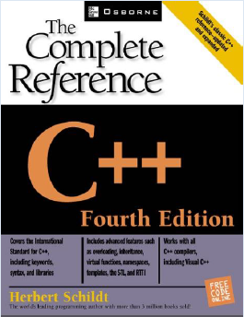
Reference Book

Slide 12
Course Contents
Week | Topics
1 | Introduction to Course, Introduction to Computer: System components, networks and operating systems Lab: Computer Hardware and Operating System
2 | Introduction to Logic, Flow Charts, Pseudo Code, Introduction to Programming Lab: Problem Solving using Flow Charts (Visual Logic), Testing the Programming Environment and Basic Program
3 | Programming Environment, Basic Programming, Statements, Expressions, Comments Lab: First Program, Basic statement, and Output Formats
4 | First Program, Compilation, Variables, Types, Operators, Debugging Lab: Variable processing, Arithmetic operations, Finding Errors
5 | I/O, interactive programming Lab: User Input based programming
6 | OHT – I

Slide 13
Course Contents
Week | Topics
7 | Relational operators, logical operators, conditional statements Lab: Conditional Constructs I
8 | If-Else Statement, Switch-Break-Continue Lab: Conditional Constructs II
9 | Iterations, For loop, Do-While Loop, While Loop Lab: Loops and Iterations
10 | Functions, parameters to functions Lab: Function Definition, Function Parameters and calls
11 | More functions, Recursion Lab: Function reuse and recursion
12 | OHT – II

Slide 14
Course Contents
Week | Topics
13 | Arrays Lab: Arrays and Operations on Arrays
14 | Structures Lab: Structure definition and usage
15 | Pointers Lab: Pointers, Variable Pointer
16 | File I/O Lab: File Handling and Information storage
17 | Project demos, Revision Lab: Project Demos
18 | ESE
19 | ESE

Slide 15
Course Outcomes
By the end of the course, you should be able to:
Comprehend the fundamental concepts of computer systems.
Apply programming skills to implement computer-based solutions of well specified problems.
Analyze where computer programs fit in the provision of computer-based solutions to real world problems.

Slide 16

Ground Rules

Slide 17
Attendance Policy
Will be marked at the beginning of the class (within first 10 mins)
75% required to take ESE
Any missed attendance is your own responsibility
No late attendance marking

Slide 18
Quiz Policy
5-6 quizzes in whole semester
Unannounced
No drop quiz

Slide 19
Assignment Policy
3 Assignments
No drop policy
No late/email submissions will be accepted
Zero tolerance for plagiarism/cheating
  Discussing homework concepts is fine, but you must submit your own work.

Slide 20
Lab Tasks Policy
Each student will submit their own work at the end of each lab
No late/email submissions will be accepted
Zero tolerance for plagiarism/cheating
  Discussing lab task is fine, but you must submit your own work.
Pop Lab Quiz – which can be unannounced, you should expect a lab quiz after every 3/4 lab sessions.

Slide 21
Student Civility
In an effort to make this class enjoyable for everybody…
  Please be on time to class!
  Please do not talk to your friends and neighbors in class! It disturbs everyone, and makes it hard to concentrate. If you have a question, just ask me!
  Please turn your cell-phones off! No usage of mobiles during class – will have a penalty.
Interaction is the key
  Please ask questions
  If you don’t understand, ask
  Let me know if I am going too slow/too fast

Slide 22
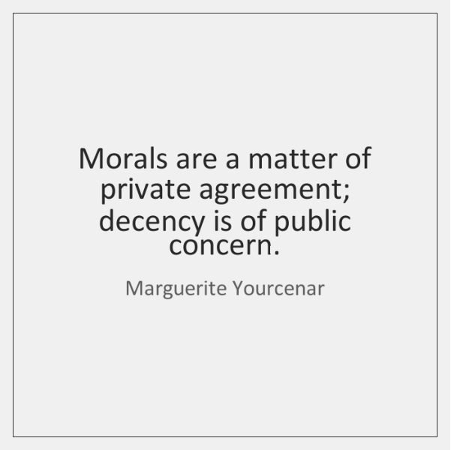
Student Civility
No room for indecency in this class.

Slide 23


Slide 24
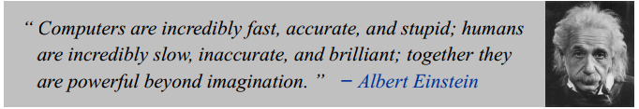
Road Map for Today
Computer Programming in Civil Engineering
History of Computers
Introduction to Computers
Introduction to Programming

Slide 25
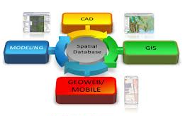

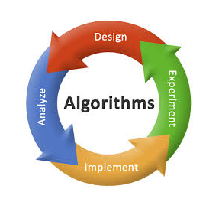

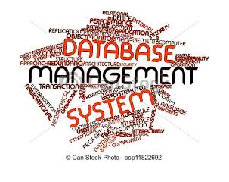
Why study Computer Programming in Civil Engineering?

Slide 26
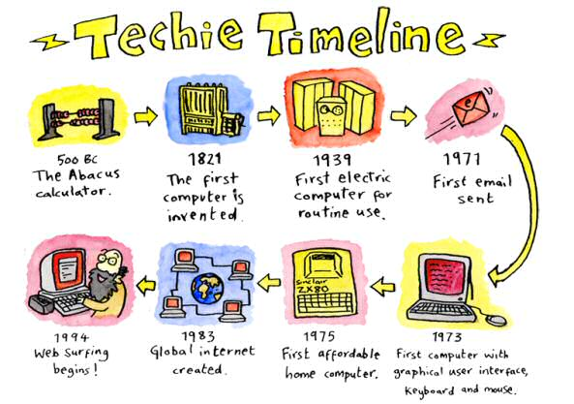
HISTORY OF COMPUTERS

Slide 27
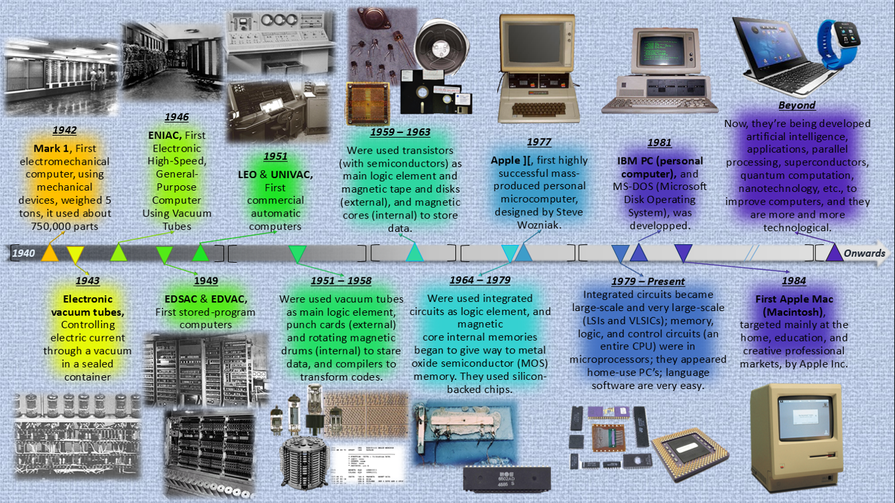
Notes:
Charles Babbage – Creator of the Analytical Engine - the first general-purpose digital computer (1833)
The Analytical Engine was not built until 1943 (in the form of the Harvard Mark I) -
•A programmable, mechanical, digital machine
•Could carryout any calculation
•Could make decisions based upon the results of the previous calculation
•Components: input; memory; processor; output
Ada (1815-52)
•Wrote a program for computing the Bernoulli’s sequence on the Analytical Engine - world’s 1st computer program

Slide 28
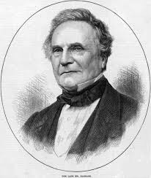
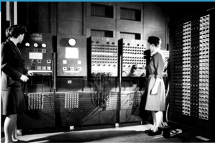
Hardware and Software
Charles Babbage
Creator of the Analytical Engine - the first general-purpose digital computer (1833)
ENIAC - the Analytical Engine was not built until 1945 (Harvard Mark I)
  World’s first programmable computer
  Could carryout any calculation
  CPU was 8 feet tall , 100 feet long and
  weighed 30 tons
(courtesy : Wikipedia.org)
(courtesy of US Army Historic Computer Images)

Slide 29
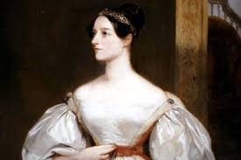
History of Computers
Ada (1815-52)
Wrote a program for computing the Bernoulli’s sequence on the Analytical Engine - world’s 1st computer program

Slide 30
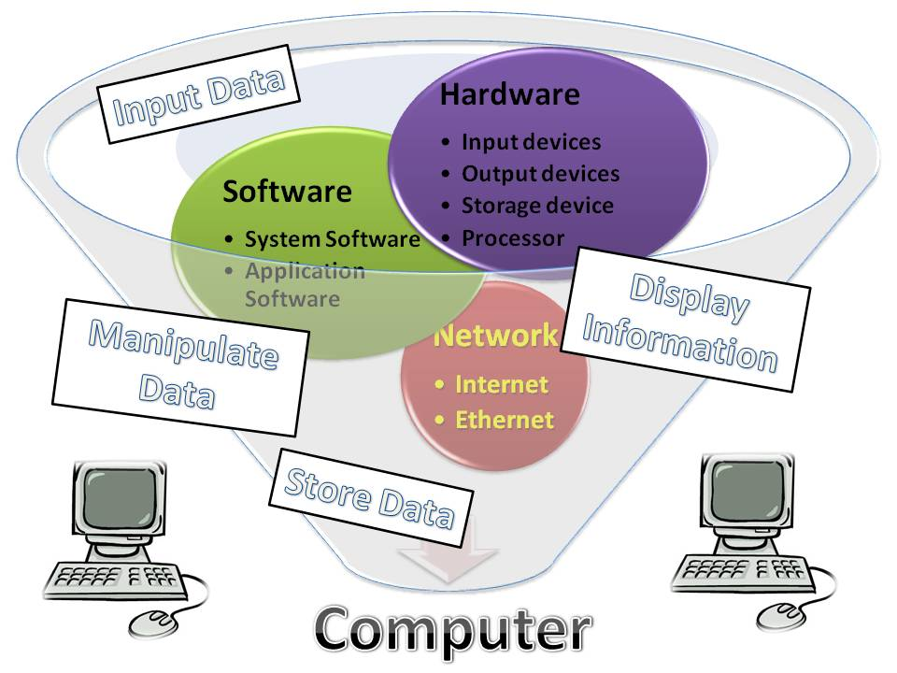
INTRODUCTION TO COMPUTERS
    A device that can perform computations and make logical decisions

Slide 31
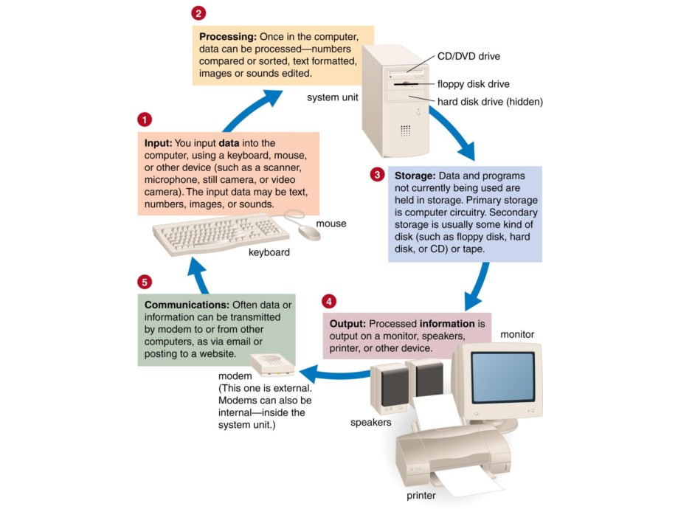
Notes:
Courtesy : Assistant Professor, Dr. Junaid Qadir, SEECS, NUST

Slide 32
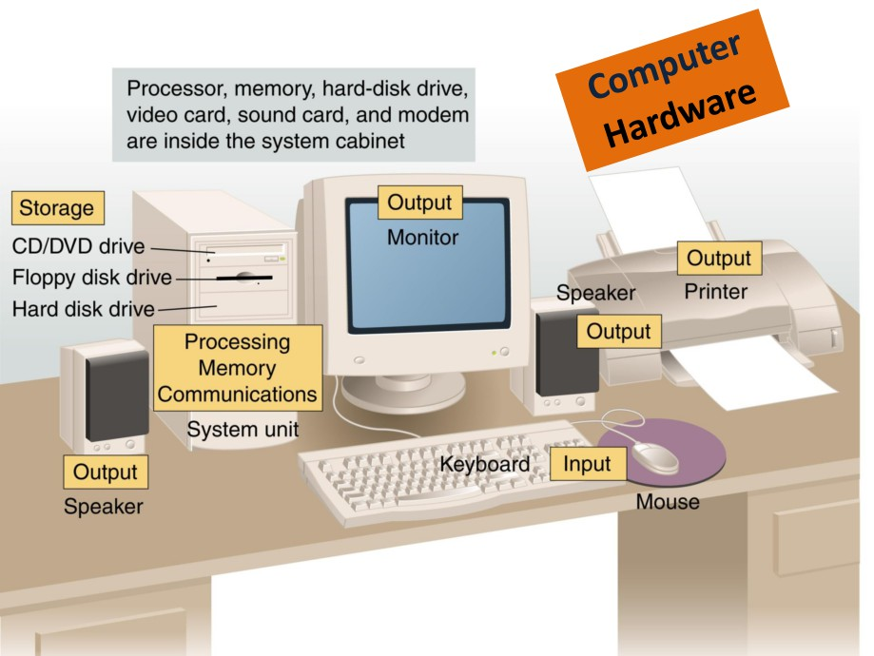
Notes:
Courtesy : Assistant Professor, Dr. Junaid Qadir, SEECS, NUST

Slide 33
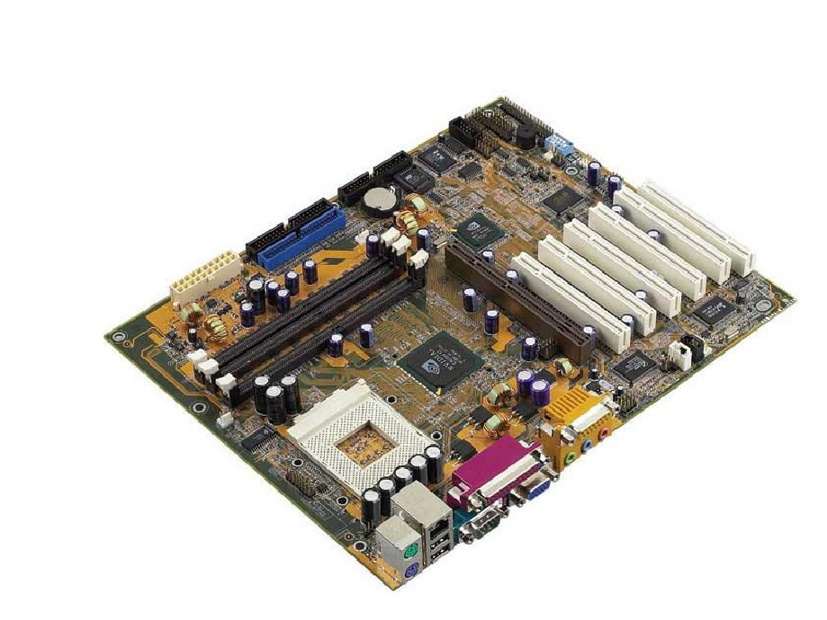
Motherboard
Notes:
Courtesy : Assistant Professor, Dr. Junaid Qadir, SEECS, NUST

Slide 34
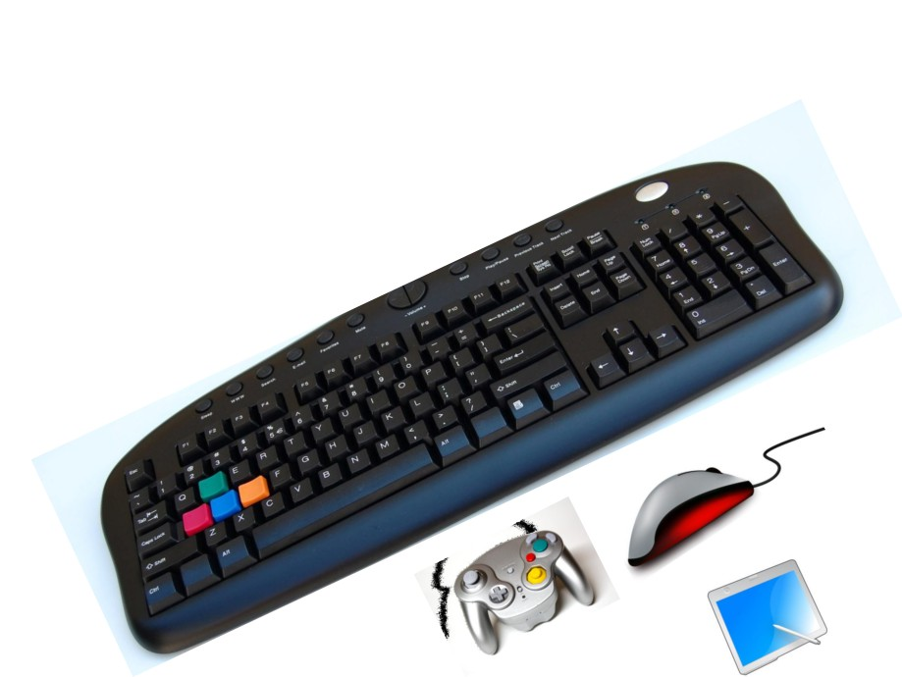
Input
devices
Notes:
Courtesy : Assistant Professor, Dr. Junaid Qadir, SEECS, NUST

Slide 35
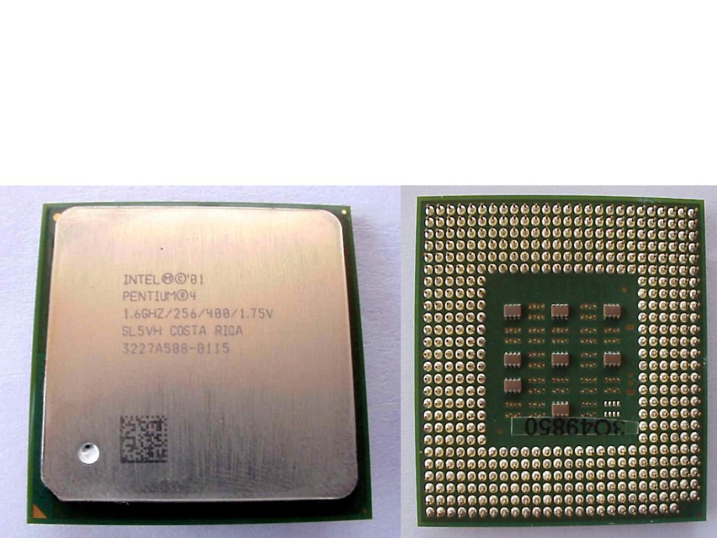
Processing
devices
Quratulain Shafi
Notes:
Courtesy : Assistant Professor, Dr. Junaid Qadir, SEECS, NUST

Slide 36
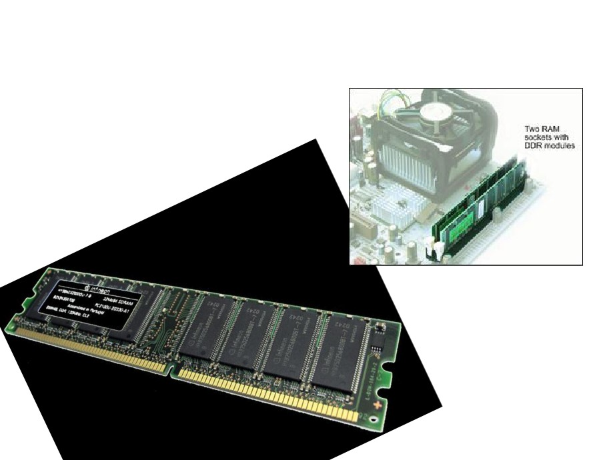
Memory
devices
RAM:
Volatile memory
ROM:
Non-volatile
memory
Notes:
Courtesy : Assistant Professor, Dr. Junaid Qadir, SEECS, NUST

Slide 37
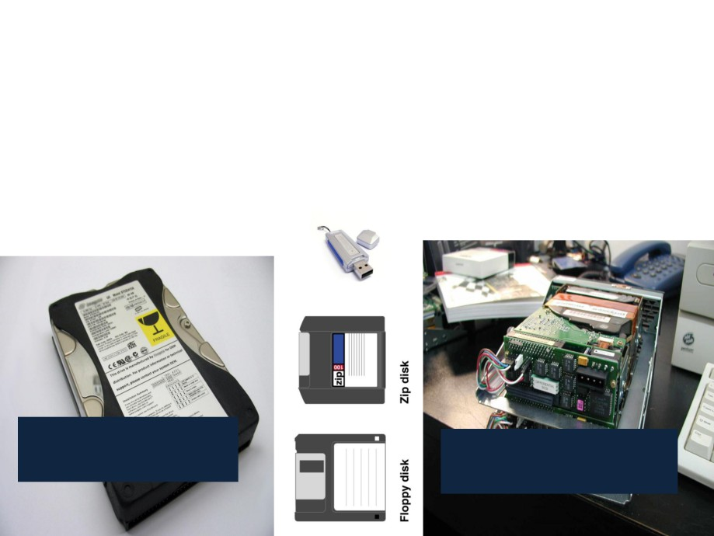
Storage
Magnetic storage:
Hard disks
devices
Non-volatile memory
IDE - Integrated
SCSI - Small Computer
Drive Electronics
Systems Interface
Notes:
Courtesy : Assistant Professor, Dr. Junaid Qadir, SEECS, NUST

Slide 38
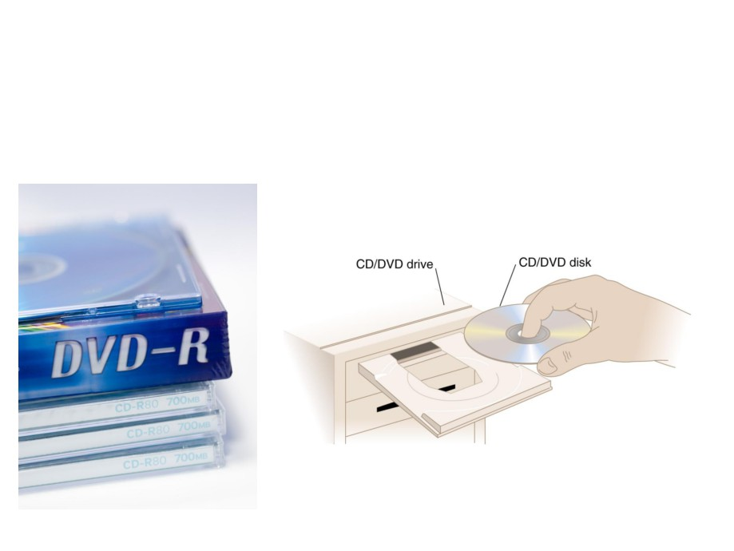
Storage
Optical storage:
CD/ DVD
devices
Non-volatile memory
Notes:
Courtesy : Assistant Professor, Dr. Junaid Qadir, SEECS, NUST

Slide 39
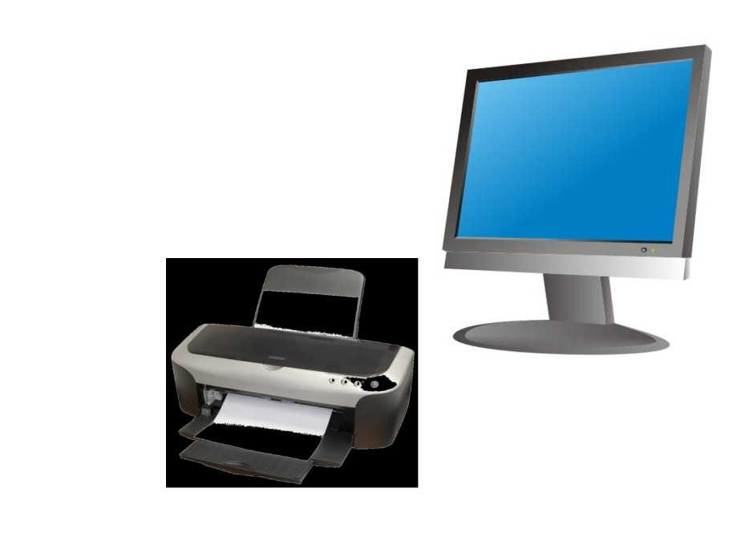
Output
devices

Slide 40
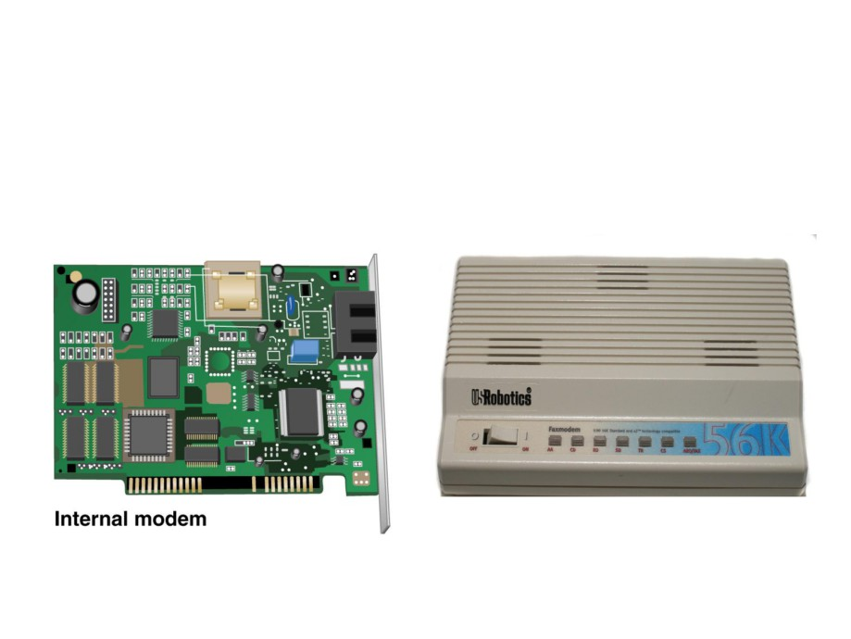
Communication
devices

Slide 41
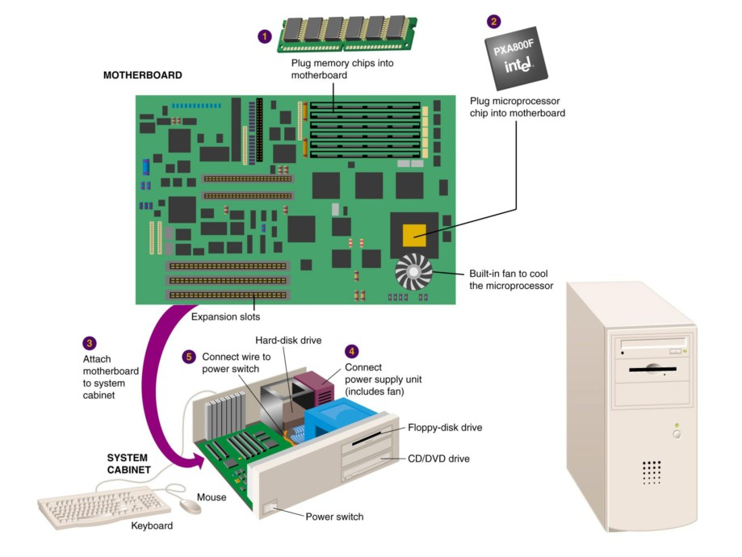

Slide 42
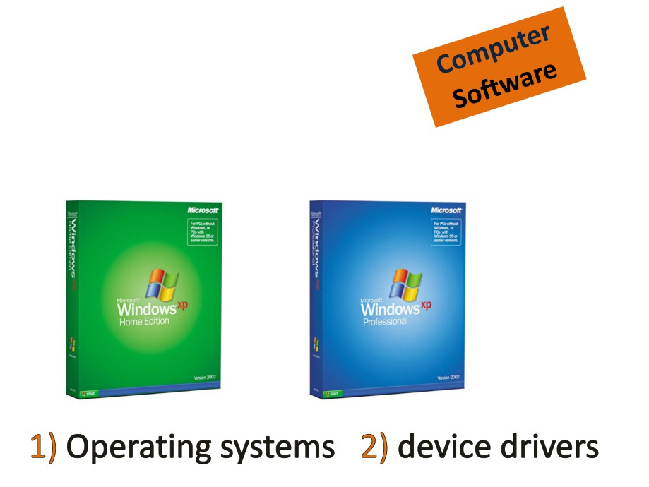



System
Software
Name some other Operating Systems

Slide 43

Application
Software

Slide 44
A Layered View of the Computer
Application Programs
Word-Processors, Spreadsheets,
Database Software, IDEs,
etc…
System Software
Compilers, Interpreters, Preprocessors, etc.
Operating System, Device Drivers
Machine with all its hardware

Slide 45
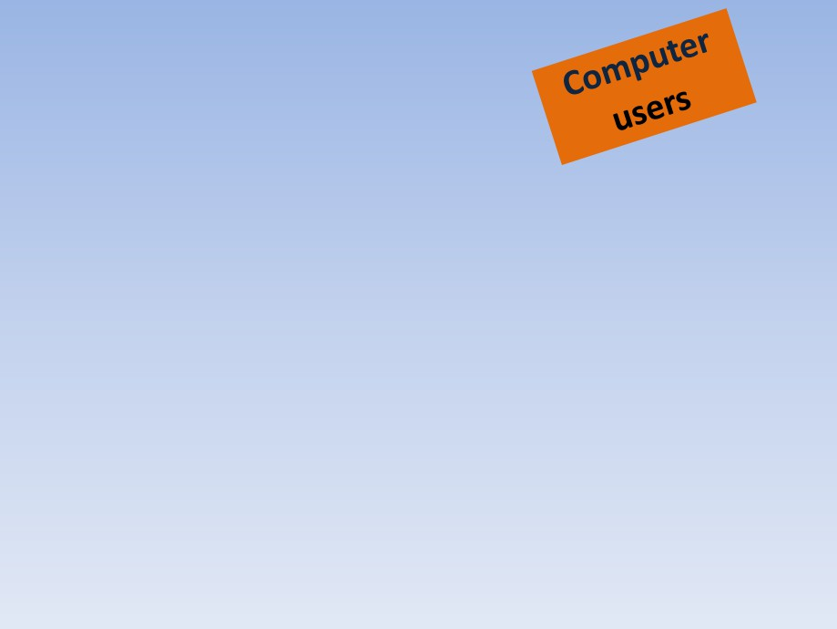
Can computers think?
Even the most powerful
supercomputers require
human interaction!
Why??

Slide 46

1. Setting up the system
2. Installing software
3. Running programs
4. Managing files
5. Maintaining the system

Slide 47

Commonly used
Programming languages
Microsoft .Net
Basic
Perl
Pascal
Cobol
C
C++
Python

Slide 48
We teach C++, Why?
C++ is one of the most popular languages ☺
  C++ (originally C)
C++ is portable (runs on Windows, Macintosh, Unix, Mainframes …)
C++ is widely used in industries ☺
C++ is not easy to learn ☹
C++
C

Slide 49
DevC++
We will be using DevC++ 4.9.9.2
Full-featured Integrated Development Environment (IDE)
Home task:
  Download and install DevC++ on your PCs from:
  http://www.bloodshed.net/dev/devcpp.html

Slide 50
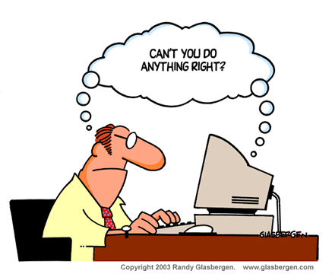
INTRODUCTION TO PROGRAMMING
    Computer has to be precisely told what it needs to do; otherwise

Slide 51
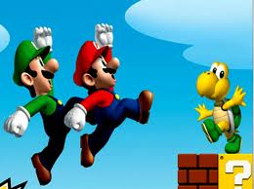
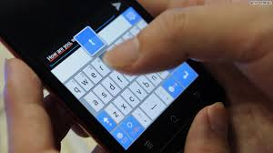


Program
Programs are everywhere on the computer and internet
Even operating systems are programs

Slide 52
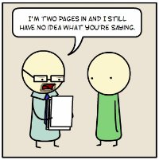
Program
“a precise sequence of steps to solve a particular problem”
Programs are run or executed (like OS runs on Hardware like laptop or cell phone)
Programs can also be run by other programs (like when we play games in a web browser)

Slide 53
Program design
Hierarchy chart
Program Designing
Flow chart
Pseudo Code
Source Code
Machine Code

Slide 54
Program coding
Hierarchy chart
Program Coding
Flow chart
Pseudo Code
Source Code
Machine Code

Slide 55
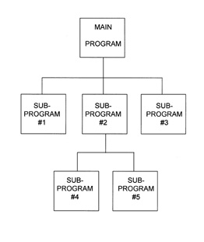
Program design
Hierarchy Chart
Notes:
http://www.shk-dplc.com/cfo/bin/litigate/figure1.jpg
Each module must be of manageable size
Each module should be independent and have a single function
The functions of input and output are clearly defined in separate modules.
Each module has a single entry point and single exit point
If one module refers to or transfers control to another module, the latter module always returns control to the point which it was called by the first module.

Slide 56
Program design
2 ways to show details:
Pseudocode: describes logic and processing flow in human-language statements
Flow chart: graphically represents logic flow.
Most projects use both methods
Notes:
http://www.shk-dplc.com/cfo/bin/litigate/figure1.jpg
Each module must be of manageable size
Each module should be independent and have a single function
The functions of input and output are clearly defined in separate modules.
Each module has a single entry point and single exit point
If one module refers to or transfers control to another module, the latter module always returns control to the point which it was called by the first module.

Slide 57
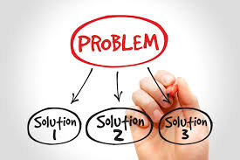
Problem Solving

Slide 58
Problem
A shepherd's son is helping his father build a pen for their sheep. The pen will be 24m long and 20m wide, and have fence posts 4m apart. How many fence post does he need?

Slide 59
Problem
Mr. Qutb‐ud‐din is arranging a dinner party for his friends in a large room. 22 people are invited. He has to borrow square tables, that can seat 1 person on each side. He wants to arrange tables in a rectangular shape so that they look like 1 large table. What is the smallest number of tables that he needs?

Slide 60
Problem Solving
Understand the Problem
  Knowledge of the problem, its domain, & details
Devising the Plan
  Thinking of possible solutions
Carrying out the Plan
  Create retraceable steps
Looking Back
  Compare solution to problem. Improve.

Slide 61
Fence Problem Solution
Understand
  Rectangle
  Length of sides 24x20m
  Posts 4 meters apart
  Number of posts?
Plan
  Drawing a diagram may help
  Start from corner posts perhaps

Slide 62
Fence Problem Solution
Solve
  Draw rectangle
  Show sides to scale
  Place corner posts
  Place posts 4 meters apart
  Count posts
Look Back
  Can you solve it in a better way?

Slide 63
Dinner Party Problem Solution
Understand
  Squares tables, 1 person on each side
  Form a large rectangle
  22 people
  Putting them together will reduce the number of people on each square table
Plan
  Drawing pictures of different arrangements may help
  Few possibilities: 1 single row, 2 rows perhaps

Slide 64
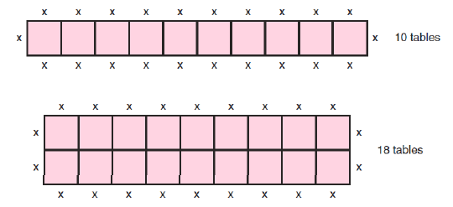
Dinner Party Problem Solution
Carry out the Plan
  Single row: 2 people at each, with 3 people at end tables
  Double Row: 1 person at each, with 2 people at corner tables

Slide 65
Dinner Party Problem Solution
Looking Back
  Single row configuration will be best, given the room is long enough to hold it.
  What if the number of people is increased to 38?

Slide 66
Another Problem
I say a number between 1 and 70.
If the number is less than 30, you say “Too Young”,
otherwise say “Too Old”.

Slide 67
What happened there?!
Understand
  Too simple
Plan
  Too simple
Carry out the Plan
  Too simple
Looking Back
  Why too simple?

Slide 68
Human Intelligence
A very general mental capability that, among other things, involves the ability to reason, plan, solve problems, think abstractly, comprehend complex ideas, learn quickly and learn from experience.
Can you understand this definition?
Why were you able to find answer for 38 people in dinner party?

Slide 69
Machines
Are machines intelligent?
NO. Why?
They need instructions
Accurate
In order

Slide 70
New Problem
Take the problem “ I say a number between 1 and 70. If the number is less than 30, you say “Too Young”, otherwise say “Too Old”. ” and provide a solution so that a machine could do the same what you did.
Understand, Plan, Solve, Look back.

Slide 71
Representing your solution
There are 2 ways to represent
  Pseudo code
    An English‐like representation of logical steps to solve a problem.
  Flowchart
    Pictorial representation of the same thing.

Slide 72
Pseudo Code
BEGIN
  GET number
  IF number less than 30 THEN
  Say “Too Young”
  ELSE
  Say “Too Old”
  ENDIF
END

Slide 73
Corrected Pseudo Code
BEGIN
  GET number
  IF number greater or equals 1 AND number less or equals 70 THEN
    IF number less than 30 THEN
    Say “Too Young”
    ELSE
    Say “Too Old”
    ENDIF
  ELSE
    Say Invalid Input
  ENDIF
END

Slide 74
Pseudo Code
Pseudo Code can be generic or language specific
Works as a planning tool
Clarifies the algorithm flow of information
Makes it easier to generate language syntax

Slide 75
Flow Chart
Same as a pseudo code but graphical
Easier to read and understand
Specific symbols to represent different programming constructs

Slide 76
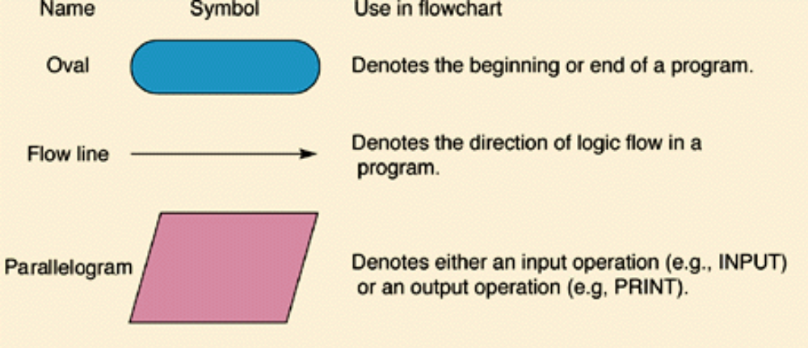
Flow Chart Symbols
Flow charts are used in many domain, hence have numerous symbols
Some basic are:

Slide 77
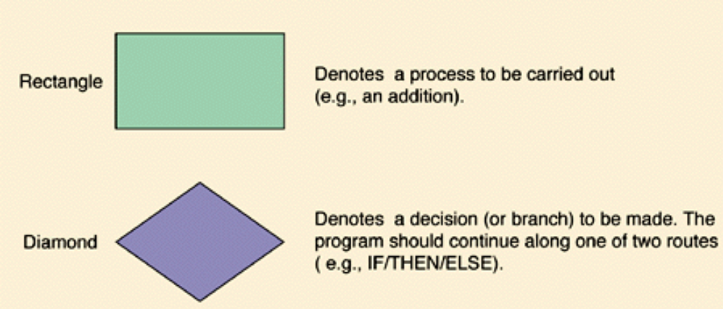
Flow Chart Symbols

Slide 78
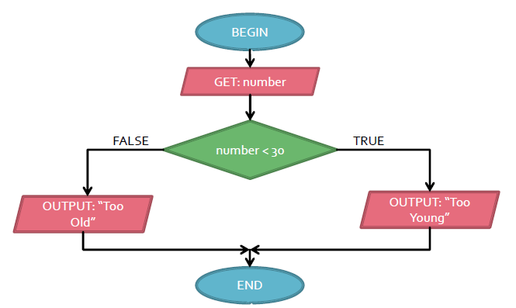
Flow Chart Example

Slide 79
Program design
START
STOP
Convert Centigrade to Fahrenheit
START
PSEUDOCODE:
Display “Enter Centigrade: "
Input centigrade
fahrenheit = 1.8 * centigrade + 32
Display “Centigrade to Fahrenheit = " fahrenheit
PROCESS
inputCent
centigrade
INPUT
OUTPUT
calcFah
fahrenheit = (1.8*centigrade) + 32
CONNECTOR
outputFah
fahrenheit
FLOW LINES
STOP
Notes:
http://www.shk-dplc.com/cfo/bin/litigate/figure1.jpg
Each module must be of manageable size
Each module should be independent and have a single function
The functions of input and output are clearly defined in separate modules.
Each module has a single entry point and single exit point
If one module refers to or transfers control to another module, the latter module always returns control to the point which it was called by the first module.

Slide 80
Write pseudo code and draw a flowchart that will read the two sides of a rectangle (length and width) and display its area on screen after calculation. [Area formula: A = L x W ]

Slide 81


