Slide 1

CS-111
Fundamentals of Computer Programming
Lecture 2 (Part – I)
Program Development
Course Instructor:
Qurrat-ul-ain Babar
NUST Institute of Civil Engineering (NICE)

Slide 2
Road Map for Today
RECAP
Developing a program
Introduction to C++
Typical C++ Environment

Slide 3
Developing a Program

Slide 4
Problem Solving and Implementation
A programming task can be divided into two phases:
1. Problem Solving
  Define: Clearly describe a problem
  Design its solution: Produce an ordered sequence of steps that describes solution to the problem
2. Implementation Phase
  Implement the program in some programming language
  Write code, compile, link, test, debug

Slide 5
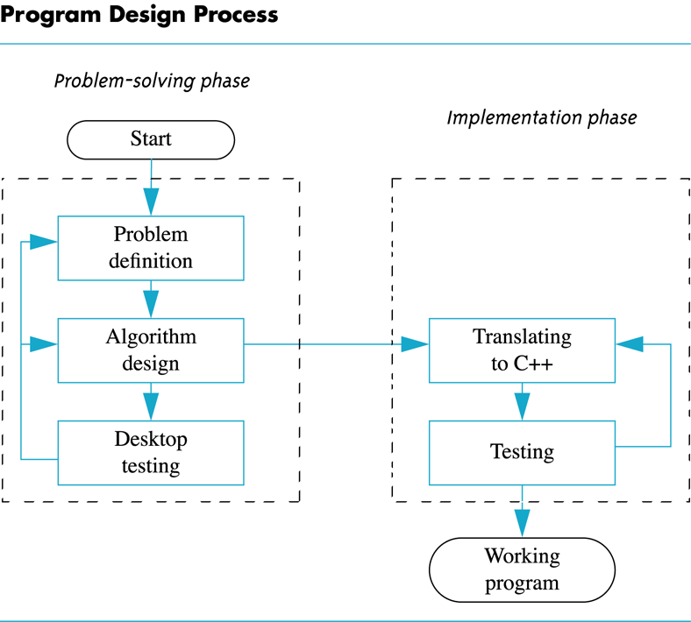
Problem Solving and Implementation

Slide 6
Define a Problem:
Break the definition of the problem down into manageable steps. Example: input, processing, output
Display whether the temperature entered by the user is below or above freezing point?
Input; Read the temperature from keyboard
Processing; Test the temperature – below or above freezing point
Output; Display the result on screen

Slide 7
Design the solution
Algorithm:
A precise rule or set of rules specifying how to solve a problem
A sequence of language independent steps which may be followed to solve a problem. An algorithm can be developed with a:
  Pseudo code
  Flowchart

Slide 8
Algorithm
Pseudo code
Artificial, informal language that helps us develop algorithms
Similar to everyday English
Not actually executed on Computers
Helps us think out a program before writing it
  Easy to convert into a corresponding C++ program
  Consists only of executable statements

Slide 9
Algorithm
Flowchart
Diagrammatic or graphical represenations of steps for solving the given problem.
Use standard symbols developed by ANSI (American National Standard Institute)

Slide 10
Building Blocks of Flowchart
Start and End
Connector
Arrows
Processing Steps
Input/ Output
Decision

Slide 11
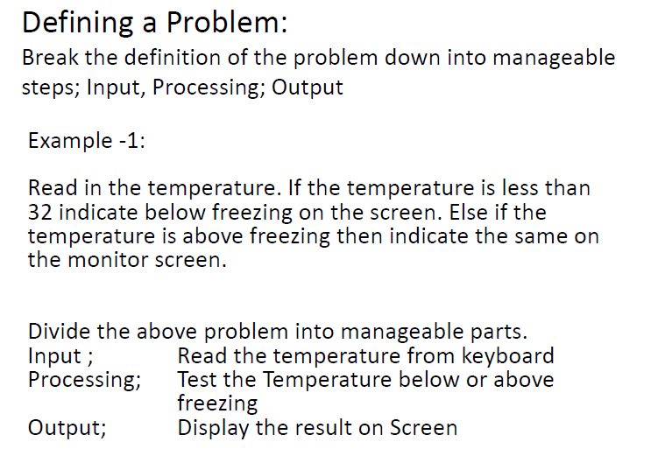
0

Slide 12
Algorithm – Pseudo code
Example -1:
Print “Enter Temperature”
Read the Temp
if (Temp < 0) then
Print “BELOW FREEZING”
else
Print “ABOVE FREEZING”
endif

Slide 13
Algorithm –
Flowchart
Start
Print “Enter Temp”
Read Temp
Temp<0?
Yes
No
Print “Below Freezing”
Print “Above Freezing”
End

Slide 14
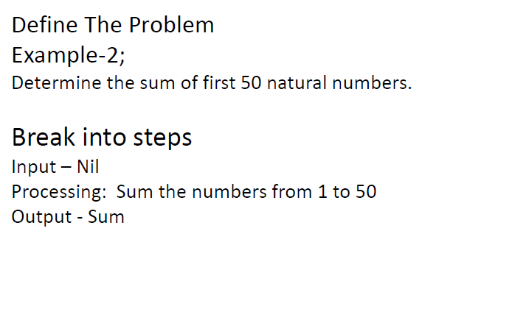

Slide 15
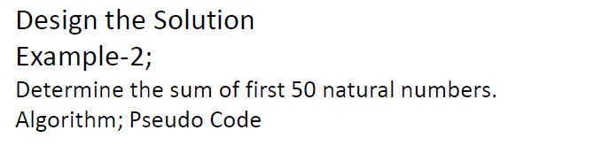
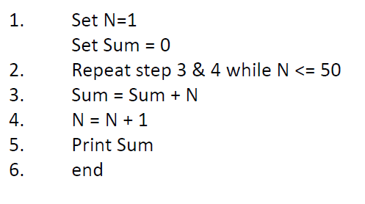

Slide 16
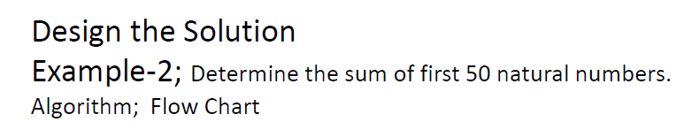
Start
Sum=0
N=1
N=51
Sum=Sum+N
N=N+1
No
Yes
Print Sum
End

Slide 17
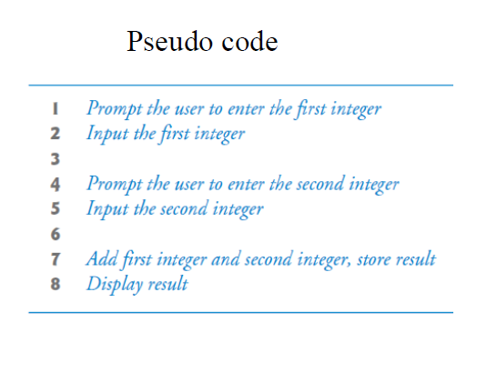
Example 3: Adding two Numbers
Start
Read num1
Read num2
Sum=num1+num2
Print Sum
End

Slide 18
Introduction to C++

Slide 19
Introduction to C++
Where did C++ come from?
  Derived from the C language
  C was derived from the B language
  It was originally called “C with Classes” and
  was renamed C++ in 1983
Why the ‘++’?
  ++ is shorthand for adding 1 to a number in
  programming, so C++ roughly means
  “one better than C.”

Slide 20
C++ History
C developed by Dennis Ritchie at AT&T
Bell Labs in the 1970s.
  Used to maintain UNIX systems
  Many commercial applications written in c
C++ developed by Bjarne Stroustrup at AT&T
Bell Labs in the 1980s.
  Overcame several shortcomings of C
  Incorporated object oriented programming
  C remains a subset of C++

Slide 21
A Sample C++ Program
A simple C++ program begins this way
#include <iostream>
using namespace std;
int main()
{
And ends this way
return 0;
}

Slide 22
Typical C++ Environment

Slide 23
Basics of a Typical C++ Environment
C++ systems
  Program-development environment
  Language
  C++ Standard Library
C++ program names extensions
  .cpp
  .cxx
  .cc
  .C

Slide 24
Basics of a Typical C++ Environment
Phases of C++ Programs:
  Edit
  Preprocess
  Compile
  Link
  Load
  Execute

Slide 25
Basics of a Typical C++ Environment
Editor
Program is created in the editor and stored on disk.
Disk
Preprocessor
Disk
Preprocessor program processes the code.
Compiler creates object code and stores it on disk.
Compiler
Disk
Linker links the object code with the libraries, Creates an executable file and stores it on disk
Linker
Disk
Primary
Memory
Loader
Loader puts program
in memory.
Disk
.
.
.
.
.
.
Primary
Memory
CPU
CPU takes each instruction and executes it, possibly storing new data values as the program executes.
.
.
.
.
.
.

Slide 26
Basics of a Typical C++ Environment
Common Input/output functions
  cin (See-in)
    Standard input stream
    Normally keyboard
  cout (See-out)
    Standard output stream
    Normally computer screen
  cerr (See-err)
    Standard error stream
    Display error messages

Slide 27
A Simple Program: Printing a Line of Text
Before writing the programs
  Comments
    Document programs
    Improve program readability
    Ignored by compiler
    Single-line comment
      Begin with //
    Multiple-line comment
      Begin with /* and end with */
      /* … */
  Preprocessor directives
    Processed by preprocessor before compiling
    Begin with #

Slide 28
fig01_02.cpp
(1 of 1) fig01_02.cpp output (1 of 1)
1 // Fig. 1.2: fig01_02.cpp
2 // A first program in C++.
3 #include <iostream>
4
5 // function main begins program execution
6 int main()
7 {
8 std::cout << "Welcome to C++!\n";
9
10 return 0; // indicate that program ended successfully
11
12 } // end function main
Single-line comments.
Function main returns an integer value.
Left brace { begins function body.
Preprocessor directive to include input/output stream header file <iostream>.
Function main appears exactly once in every C++ program..
Statements end with a semicolon ;.
Corresponding right brace } ends function body.
Stream insertion operator.
Name cout belongs to namespace std.
Keyword return is one of several means to exit function; value 0 indicates program terminated successfully.
Welcome to C++!

